Slide 1
Integrating the Healthcare Enterprise,
IEEE 11073 and
NIST
Medical Device Communication
Test Effort
1 May 2007

Slide 2
Medical Device Test Effort
NIST Team Members
John Garguilo (john.garguilo@nist.gov,
  301-975-5248)
Sandra Martinez (sandra.martinez@nist.gov,
  301-975-3579)
Rick Rivello (richard.rivello@nist.gov,
  301-975-3519)
Maria Cherkaoui (maria.cherkaoui@nist.gov
  Guest Researcher)
Richard Theimer (richard.theimer@nist.gov
  CENTECH Group, Inc., Contractor)

Slide 3
Meeting Goals
NIST Test Tools
  ICSGenerator Update
    Capabilities and Enhancements (since January WG meeting…)
  ValidatePDU
  Next Steps…
    High-level IEEE x73/IHE-PCD test focus areas
NIST 11073 DIM XSchema (PAR)
  Status, Enhancements, Characteristics, Approach
  PAR Project Plan
  Next Steps…
DIM Open Issues and Status
http://www.nist.gov/medicaldevices

Slide 4
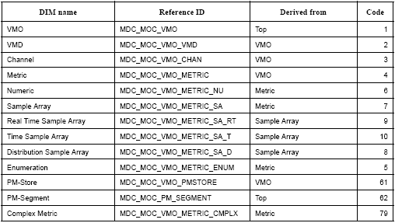
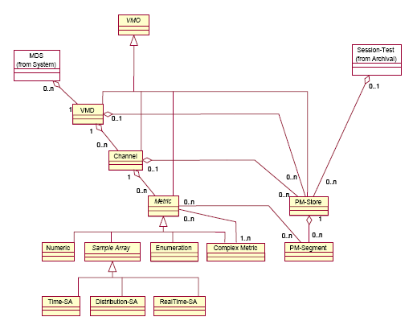

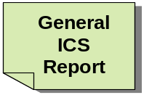

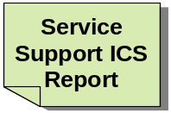


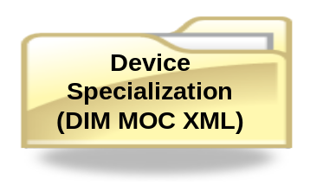
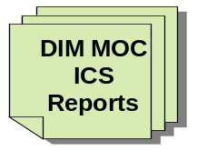
NIST’s ICSGenerator and XSchema
ISO/IEEE 11073
Nomenclature
Part 10101
DIM
Part 20101
DIM
XSchema
ICSGenerator
Compare Devices
HL7/OBX
Mapping
(XML)
Device UML Diagram
Notes:
Primary Capabilities of ICSGenerator
Implementation Conformance Statements
Device Profile (XML)
HL7 OBX Segments
Compare Device ICSs
Device UML Diagram

Slide 5
ICSGenerator Capabilities
Generates Implementation Conformance Statements (ICSs)
  Required in conformance section of DIM x73 document
  Ensures common format for ICS generation
Builds Device Profile (XML)
  Generates an electronic (XML) version of device data model based strictly on the IEEE x73 DIM
  Includes private or manufacturer-specific extensions
Provides validation against DIM Schema
  A device data model generated using this tool can be validated against an updated version of the DIM XSchema
Provides high level semantic interoperability
  Ensures correct containment relationship and terminology at the object class and related attribute, notification, and behavior level
  Compare Device ICSs
    Device ICSs comparison capability aids in identifying potential interoperability issues
Generates HL7 OBX Segments
Generates Device UML Diagram

Slide 6
ICSGenerator Enhancements
(since last WG meetings [San Diego, January 07])
Added “Polling Mode” Application Profiling capability
Added “ICS Project” capability
  Save by project (associated ICSs, XML, and other related files)
  Open (prior saved) projects
Value/Data type association
  Created a DIM data type library
Added value input dialog
  Allows entry of a value(s) of a particular attribute based on the attribute data type
Mapped observation values to HL7 OBX segments
  OBX-2, OBX-3, OBX-4, OBX-5, OBX-6, OBX-7
Updated ICSGenerator code to compile and run under Java 1.5
Updated Users Guide to include latest ICSGenerator changes
  http://www.nist.gov/medicaldevices
Notes:
Added Capability to describe a device in XML based on the polling mode application profile.
Enter a value(s) of a particular attribute based on the attribute data type.

Slide 7
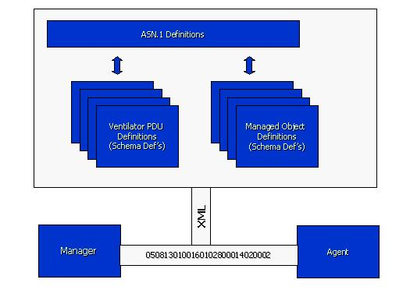
ValidatePDU
(Based on 11073
DIM Schema)
ValidatePDU
  Provides a basic syntax and structure check for a set of captured messages (APDUs).
  Provides low level semantic check (associates Term Code to attribute ID)
Future Enhancements (next several months) w/ ICSGenerator
  Extending ValidatePDU to validate message semantics (content):
    Check attribution (mandatory, supported, attribute information (handle, term code, etc.)
    Value ranges for the appropriate attributes.
    Check if MOC behaviors and notifications are supported as specified in the profile.
    Check MOC information (term code, handle, etc.) and hierarchy.
    Check if services are supported by attributes as specified in the profile.
      (e.g., the validation would fail for “get” attribute (such as numeric observed value) which was not defined by user (ICSGenerator) as part of supported profile)
Notes:
Since the ICSGenerator generates service ICSs the ValidatePDU tool can validate against the supported services
(e.g., get attribute (such as numeric observed value) which was not defined by user as part of supported profile, the validation would fail)

Slide 8
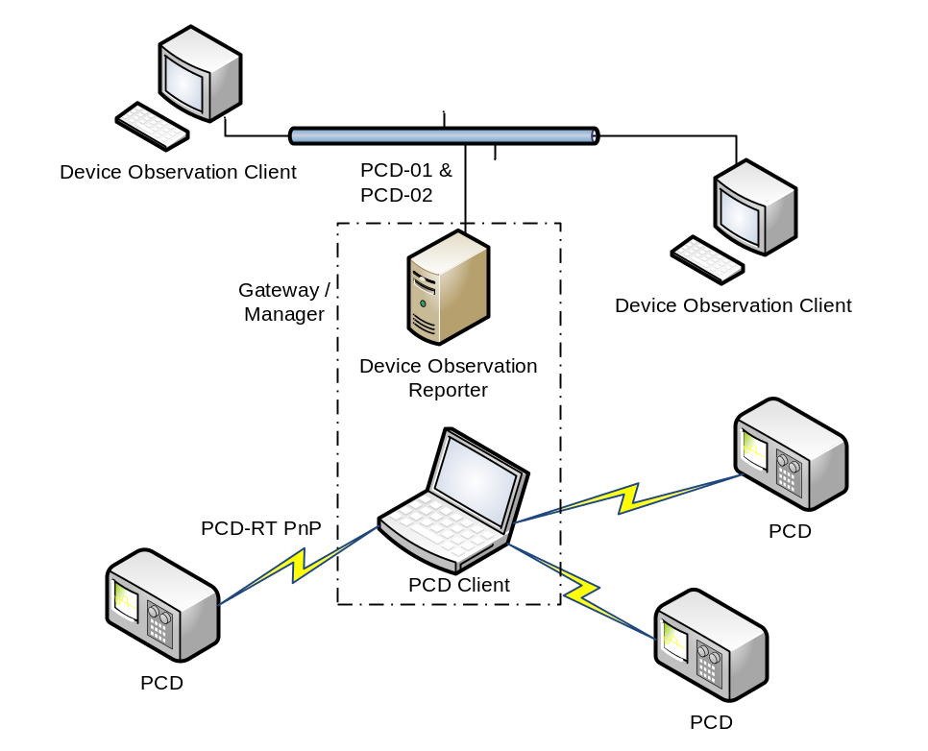
IHE-PCD Year 2 Profile Proposal
PCD-Real Time Plug-n-Play
X73
APDU
Validate APDUs against Standard
Determine if APDUs meets device profile (defined using ICSGenerator)

Slide 9

NIST x73 Medical Device Testing
Year 2 of IHE-PCD Cycle
X73
ASN.1
X73 ASN.1 lib
(Java)
ASN2XSD
XML
Schema
Asn.1Translator
(XML ->Java)
MDER2XER
Decode MDER
Encode XER
X73
APDU
From ??
APDU
(XML)
ICSGenerator
ValidatePDU
(APDU Syntax and
Semantic Validation)
Device Profile
(XML)
Validation
Report
Notes:
Given an X73 APDU, NIST can:
Validate APDUs against Standard
Determine if APDUs meets device profile (defined using ICSGenerator)
APDU message is encoded into XER using NIST MDER2XER tool.
Validate APDU message through ValidatePDU to check for syntax and structure
Data types are well defined and structurally correct
Performs low level semantic validation at the attribute id level
Validating attribute-id (term codes) against attribute values at the data type level
Validation performed in both polling mode and baseline profile type devices
It does NOT check for high level message semantics (content)
ValidatePDU + ICSGenerator
High level message (APDU) semantic validation against the Device profile (generated by ICSGenerator)
(e.g., mandatory attributes, containment relationship, services, etc.)

Slide 10
X73 Medical Device Testing
APDU message is encoded into XER using NIST MDER2XER tool.
Validate APDU message through ValidatePDU to check for syntax and structure
  Data types are well defined and structurally correct
  Performs low level semantic validation at the attribute id level
    Validating attribute-id (term codes) against attribute values at the data type level
  Validation performed in both polling mode and baseline profile type devices
  It does NOT check for high level message semantics
ValidatePDU + ICSGenerator
  High level message (APDU) semantic validation against the Device profile (generated by ICSGenerator)
  (e.g., mandatory attributes, containment relationship, services, etc.)

Slide 11
NIST x73 Medical Device Testing
Potential Future Enhancements (beyond year 2)
ICSGenerator
Device Profile
(XML)
X73 TestGenerator
Tests
X73
APDUs
XML
OBX2- OBX7
Tests
Tests
HL7
Profiles
Message Maker
or MWB
HL7
Messages
Data

Slide 12
ISO/IEEE 11073
Medical Device Communications
DIM XSchema
(Part 10202)
April/May 2007
Sandra Martinez, NIST

Slide 13
Outline
Background
Status/Enhancements
DIM Schema Characteristics
Approach
Project Plan
Next Steps

Slide 14
DIM Schema Background
XML representation of the X73 Data Information Model (DIM) including:
  Common data types
  DIM object definition (MOC, attributes, behaviour and notification)
  Object Inheritance
  Containment Relationship
  ICS Tables
  Service Model

Slide 15
Schema Status and Enhancements
(Since January WG meeting)
Added capability to associate attributes values with data types
Developed Polling Mode schema using MOC definitions from MOC_Defs.xsd
Created components to define Composite_Single_Bed_MDS
Modularized DIM Schema to make it more manageable and accessible
  DIM.xsd
  DIM_Values.xsd
  DIM_Data_Types.xsd
  MOC_Defs.xsd
  MOC_Attr_Behav_Notif.xsd

Slide 16
Schema Status and Enhancements
(Cont.)
Optimized Schematron rules in DIM.xsd
Applied XML Schema best practices for optimization purposes in different areas of the DIM.xsd
  XML Schema best practices: http://www.xfront.com/BestPracticesHomepage.html

Slide 17
DIM XML Schema Architecture
GeneralServices.xsd
DIM.xsd
GeneralICS.xsd
serviceICS.xsd
MOC_Defs.xsd
PollingMode.xsd
MOC_Attr_Behav_Notif.xsd
DIM_Values.xsd
DIM_Data_Types.xsd
Rose.xsd
(http://www.nist.gov/x73DIM)
Transport.xsd
DIM Xschema Document Structure
osxdlib.xsd
include
import
(http://www.obj.sys.com/v1.0/XMLSchema)

Slide 18
DIM XSchema Characteristics
Component Definition General Approach
Namespaces: All DIM Schemas share same targetNamespace
Versioning: Version attribute in schema element
Expressing Constraints: Schematron Rules added to:
  Solve co-occurrence constraints (cardinality) on MOC elements
  Solve the ASN2XSD mapping of ASN.1 “ANY DEFINED BY”
Object Inheritance:
  Existing approach: Re-defines inherited attributes in object definitions
  New approach: use the “group model” grouping elements with the <choice> unbounded compositor and applying Schematron to recover the uniqueness property of the elements (DIM attributes)
Notes:
These are several of the characteristics of the DIM Schema which were not discussed at the January WG HL7 IEEE meeting.

Slide 19
DIM XSchema
General Approach
Venetian Blind Design
  Used to define most of the components
    In this approach we utilize named type definitions (simple or complex) on a global level instead of element declarations
  Advantages:
    Maximize reuse of schema components,
    Maximize namespace hiding (Element declaration nested within types),
    Coupled components (generates a set of components which are interconnected).

Slide 20
DIM XSchema Approach
Namespaces
Separating the schemas into several schema files raised the issue of Namespace approach
DIM XSchemas are conceptually related ➔ they should share same targetNamespace
Alternatives for implementing targetNamespace:
  Homogeneous design approach
  Chameleon design approach
Notes:
Every time we deal with XML Schemas we must address the namespace issue to avoid naming conflicts and maintain the identity of the schema.

Slide 21
DIM XSchema Approach
Namespaces (cont.)
Homogeneous Namespace Design – give all schemas the same targetNamespace:
    When all schemas are conceptually related
    When schemas have no name conflicts (No need to identify in the instance documents the origin or each element/attribute).
Chameleon Namespace Design – give the “main” schema a targetNamespace and give no targetNamespace to the “supporting” schemas
  Included Schemas such as MOCDefs.xsd have no use by themselves unless they are part of another Schema such as DIM.xsd.
Selected Approach: Homogeneous Namespace Design
    Maintains Schema identity
    Avoid name conflicts when imported to another schema

Slide 22
DIM XSchema Approach
Expressing Constraints
XML Schema does not capture all DIM constraints
Alternatives:
  Supplement with another Schema Language.
    Schematron, TREX, RELAX, SOX, XDR …
  Write code to express additional constraints
    Java, Perl, C++, etc.
  Express additional constraints with an XSLT/XPath Stylesheet
Notes:
Because the XML schema can not address possible constraints, supplemental schema languages or traditional languages or stylesheets are used.

Slide 23
DIM XSchema Approach
Expressing Constraints (Cont.)
Selected approach: Schematron
  Schematron rules are embedded within the XML schema
  Easy to learn and use
  Supports the expression of DIM schema constrains; No need for additional schema languages
  Schematron will be supported as long as there are XSL processors. The same can’t not be said about the other schema languages
  Uses XML technologies - no need to go though the compiling, linking, and executing effort.
  Is in the process of becoming an ISO Standard.

Slide 24
DIM XSchema Approach
Expressing Constraints (Cont.)
Schematron Rules added to:
  Solve co-occurrence constraints (cardinality) on MOC elements
    <all> compositor was the choice but it does not allow elements (MOC) with unbounded cardinality.
    <sequence> compositor was not used to avoid adding an order constraint not defined in the standard.
    <choice> unbounded compositor + schematron is the solution that allows unbounded elements in elements with variable cardinality and does not imposed an order.
  Solve the ASN2XSD mapping of ASN.1 “ANY DEFINED BY ”
    An “objsys:OpenType” was defined allowing any component to be defined instead of any component defined by the specified type.
    <sch:report test="attribute-id=2305 and name(*[2]/*)!='LimitSpecList'">The attribute-id is 2305 therefore the first child of attribute-value must be LimitSpecList NOT <name path="*[2]/*"/></sch:report>

Slide 25
DIM XSchema Approach
Versioning
Alternatives:
  Create a schema version attribute on the root element.
  <xsd:element name="DIM">
  … <xsd:attribute name=“version" type="xsd:string"/> …
  Change the Schema's Target Namespace
  Use the version attribute in schema element.
  <xsd:schema targetNamespace="http://www.nist.gov/x73DIM" xmlns:xsd="http://www.w3.org/2001/XMLSchema" xmlns:sch="http://www.ascc.net/xml/schematron" xmlns="http://www.nist.gov/x73DIM" elementFormDefault="qualified“ version=“1.0”>
Selected approach: Version attribute in schema element
  Use change history to record changes.
  Make new and previous versions of the schema available
Advantage: XML Instance documents would not have to change.
  The XML parser ignores the version attribute, therefore it is not an enforceable constraint

Slide 26
DIM XSchema Approach
DIM Object inheritance
Current approach:
  Re-defines inherited attributes in object definitions.
  Example :
<xsd:complexType name="VMD_Attribute_InfoType">
<xsd:annotation>
<xsd:documentation>This complex type defines attribute information for VMD</xsd:documentation>
</xsd:annotation>
<xsd:all>
<xsd:element name="VMD-Status" type="VMD-Status_Type"/>
<xsd:element name="VMD-Model" type="VMD-Model_Type" minOccurs="0"/>
<xsd:element name="Instance-Number" type="VMD_Instance-Number_Type" minOccurs="0"/>
<xsd:element name="Production-Specification" type="VMD_Production-Specification_Type" minOccurs="0"/>
<xsd:element name="Compatibility-Id" type="Compatibility-Id_Type" minOccurs="0"/>
<xsd:element name="Parameter-Group" type="VMD_Parameter-Group_Type" minOccurs="0"/>
<xsd:element name="Position" type="Position_Type" minOccurs="0"/>
<xsd:element name="Operating-Hours" type="Operating-Hours_Type" minOccurs="0"/>
<xsd:element name="Operation-Cycles" type="Operation-Cycles_Type" minOccurs="0"/>
<xsd:element name="Measurement-Principle" type="VMD_Measurement-Principle_Type" minOccurs="0"/>
<xsd:element name="Locale" type="Locale_Type" minOccurs="0"/>
<xsd:element name="Type" type="Vmo_Type_Type"/>
<xsd:element name="Handle" type="Vmo_Handle_Type"/>
<xsd:element name="Label-String" type="Vmo_Label-String_Type" minOccurs="0"/>
<xsd:element name="Class" type="Top_Class_Type"/>
<xsd:element name="Name-Binding" type="Top_Name-Binding_Type"/>
<xsd:element ref="Private-Attributes" minOccurs="0"/>
</xsd:all>
</xsd:complexType>

Slide 27
DIM XSchema Approach
DIM Object Inheritance (cont.)
XML Schema alternatives:
  “Derivation by extension” – consists of a complex type extending another complex type using the <xsd:extension> element
    To implement, we must use the <sequence> compositor which imposes an order in the elements
    ➔ not a requirement in the standard
    ➔ difficult to maintain by an application such ICSGenerator
  Using “group models” for grouping elements with:
    “<sequence> compositor” which imposes an order
    OR
    “<choice> unbounded compositor” which disables the uniqueness property of each element.
New Approach:
  “Group Model” used for grouping elements with the <choice> unbounded compositor (from above)
  Apply Schematron to recover the uniqueness property of the elements (DIM attributes)

Slide 28
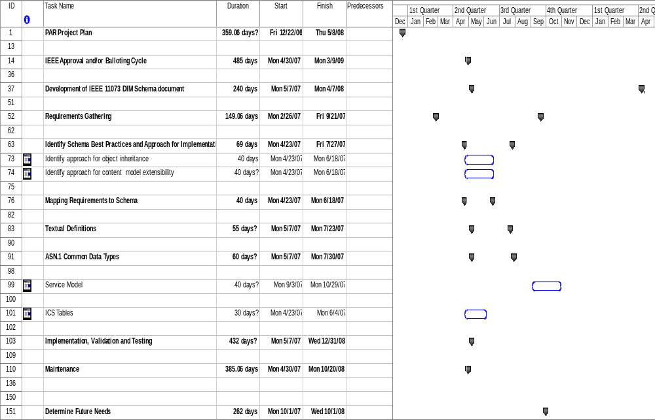
Project Plan

Slide 29
DIM XSchema
Project Plan
PAR Project Plan
  Create PAR
  Create Project Plan (Draft V1.0)
  Submit Project Plan to NESCOM
  NESCOM Acceptance
  "Minor Revision (prior to Cologne, Germany F2F Meeting)"
  Present V0.1 of Plan (Apr/May 07 Meetings)
  Update Plan V0.1
  Review and Accept Plan V1.0
  "Present, Review, Update Plan (Sept 07 Meeting)"
  "Present, Review, Update Plan (Jan 08 Meeting)"
  "Present, Review, Update Plan (May 08 Meeting)"
IEEE Approval and/or Balloting Cycle
  F2F Meetings (~3x per year)
  Recycle Ballot 1 (If Necessary) Each 14 Days
  Recirculation Ballot (As Needed)
Development of IEEE 11073 DIM Schema document
  Develop Initial, Second, and Final Drafts

Slide 30
Requirements Gathering
  Object definitions (textual and UML representation)
  Service Model
  Common data types
  Implementation Conformance Statements (ICS)
  Nomenclature
Identify Schema Best Practices and Approach for Implementation
  Identify approach for object inheritance
  Identify approach for content model extensibility
Mapping Requirements to Schema
  UML Model
    Object containment relationship
    Object Inheritance
    Cardinality
    Encapsulation
Textual Definitions
  Manage Object Class Definitions
  Attribute Definitions
  Attribute Groups
  Behavior Definition
  Notification Definition
  Private Extensions
DIM XSchema
Project Plan (cont.)

Slide 31
DIM XSchema
Project Plan (cont.)
ASN.1 Common Data Types
  Map ASN.1 to Schema using ASN2XSD Tool
  Revise 11073-10201 DIM document to identify invalid ASN.1
    Identify inconsistencies discovered in code development (ValidatePDU Tool)
  Re-map valid ASN.1 to schema
    Proceeding ASN.1 fix
  Include common data types schema to associate attribute values to corresponding data types
Service Model
ICS Tables
Implementation, Validation and Testing
  XML instance file
  Schematron rules
  Schema validation
  Schematron validation
  XML/DIM schema validation through ICSGenerator
Maintenance
Determine Future Needs

Slide 32
DIM XSchema
Next Steps
Review and Agree upon Project Plan
Formalize a Breakout Working Group
  How do you get involved?
    Numbers needed to meet voting and balloting requirements for IEEE balloting
  To Update plan
  To accomplish tasks in project plan
  To Establish review process for DIM XSchema
Document format using IEEE Guidelines
  Document template (style sheet)
  Some clauses/parts should follow the DIM
  Develop first draft
  Establish review process

Slide 33
DIM XSchema
Discussion
Questions?
Break-Out Session?
Thank YOU!

