Slide 1

SPL –
An Overview of the Standard
June 2004
Sandy Boyer
Co-editor, SPL
Co-editor, CDA
Co-chair, HL7 Structured Documents TC slboyer@attglobal.net

Slide 2


Slide 3
Who I Am
Pharmacist
Drug information specialist
HL7 modeler

Slide 4
What Does SPL Mean?
SPL stands for Structured Product Labeling
“Labeling”
  vs Label
  aka Package Insert
  aka Prescribing Information
  aka Product Information
  aka Summary of Product Characteristics

Slide 5
What is SPL?
SPL is an HL7 standard
SPL is a document markup standard that specifies the structure and semantics for the regulatory requirements and content of product labeling
  Not just for drugs
An SPL document can include text, images, sounds, and other multimedia content
SPL is “based on” CDA
SPL is intended to be used as the basis for regulatory guidance documents and tooling applications for exchange of product labeling documents

Slide 6
Purpose of SPL
Facilitate provision of product labeling content both electronically and in human readable format
Improve dissemination of product labeling
  Timeliness is critical re risk management
Facilitate more efficient evaluation of labeling changes, section-by-section
Promote more coordinated data collection throughout regulatory agency
  Improve processing, storage, and archiving capabilities
  Reduce or eliminate redundancies

Slide 7
Purpose of SPL (cont.)
Improve access to information and enhance ability to query and report on content of labeling
  e.g., for sub-population analysis
Improve interoperability of regulatory agency systems with other clinical info systems
Use standards to improve integration of data
Enhance patient safety by improving provider access to information
Support retention of legacy labeling

Slide 8
Scope of SPL
Standardization of the markup of the content of product labeling documents for the purpose of review, editing, storage, dissemination, analysis, decision-support, and other re-use
SPL does not specify the creation of management of documents
Although document management is critically interdependent, the specification of document management is outside the scope

Slide 9
The Problem We’re Trying to Solve
Authoring, updating and storage at manufacturer, regulatory agency
Dissemination
Re-use of labeling content; data analysis

Slide 10
What is Gained By Adding Markup to Labeling Documents
Allows us to get at the rich data that are buried in the narrative for the purpose of:
  Re-use
  Analysis (e.g., sub-population analysis)
  Clinical guidelines
Access/portability/exchange
  query/locate by drug name, manufacturer
Integration
  multiple products or manufacturers
  with decision support

Slide 11
Why XML?
Application independent
Preserves human readability of documents
Semantic markup of documents facilitates machine processability, e.g.:
  Extraction
  Storage in a database
  Re-use (including combination from multiple sources)
  Interchange
  Automation
  Re-ordering

Slide 12
Adding XML markup is easy – why use information standards?
Interoperability

Slide 13
Why HL7 and V3?
Focus on healthcare
Information model
International open standard
  Significant international participation
Widespread support by users, policy makers and suppliers
Proven, consensus-based approach to development

Slide 14
What is HL7?
HL7 is a volunteer, ANSI-accredited Standards Developing Organization (SDO) that focuses on clinical and administrative healthcare data.
Mission:
"To provide standards for the exchange, management and integration of data that support clinical patient care and the management, delivery and evaluation of healthcare services. Specifically, to create flexible, cost effective approaches, standards, guidelines, methodologies, and related services for interoperability between healthcare information systems.“
“Health Level Seven develops specifications, the most widely used being a messaging standard that enables disparate healthcare applications to exchange keys sets of clinical and administrative data.”
Website: www.hl7.org
Phone: 734-677-7777

Slide 15
HL7 Organization
Board of Directors – Creates Policy
Technical Steering Committee -- Manages the Technical Committees
Technical Committees (TC)
Responsible for Standards
Domain TC – Creates/Sponsors Domain-Specific Standards
Examples: Orders/Observations (OO)
Financial Management (FM)
Regulated Clinical Research Information
Management (RCRIM)
Process TC – Provides Standards Development Environment
Examples: Modeling & Methodology
Publishing
Process Improvement
Special Interest Groups (SIG)
Addresses Special Issues within a Domain
Example: Patient Safety SIG within RCRIM

Slide 16
RCRIM (Regulated Clinical Research Information Management)
Mission
“The work of this committee will facilitate the development of common standards for clinical research information management across a variety of organizations -- including government agencies (FDA, CDC, NIH), private research efforts, and sponsored research -- and thus the availability of safe and effective therapies by improving the processes and efficiencies associated with regulated clinical research.”
Goal
Develop standards for interchange of regulated data that are interoperable with general healthcare standards.

Slide 17
HL7 has a number of standards to choose from – why choose CDA?

Slide 18
What is CDA?
HL7 document markup standard for clinical documents
Exchange standard (“one transformation away from exchange”)
Permits migration to more granular markup as needed and as technology and expertise permits
Supports patient care
Ensures both human readability and machine processability
Facilitates integration with other healthcare documents
Extensive international acceptance

Slide 19
Why is SPL Based on CDA?
Facilitates exchange of labeling documents
Preserves human readability while adding semantic markup and coding to facilitate machine processability of content
Flexible structure
Extensible to additional document types

Slide 20
Labeling Requirements
Authoring and storage
Dissemination
Standard format – regulations, sample package insert
  Document sections
  Coded elements
  Standard elements and figures within narrative text
Metadata
Modular updating, version tracking

Slide 21
The Best Things About SPL
SPL markup maintains human readability while providing machine processability
SPL allows scalable implementation of document markup
SPL is flexible – e.g., doesn’t impose naming or nesting of sections
SPL markup facilitates exchange of product labeling documents
  Local tag names can be mapped to SPL
  “One transformation away from exchange”
SPL facilitates modular handling of document sections

Slide 22
Using SPL allows us to bite off what we can chew
Over time, more structured data will be modeled and added (“start simple and build on that”)
There is no need to start over every time the markup gets more granular

Slide 23
The SPL Document
An SPL document is comprised
of a header and a body
Header
Body

Slide 24
The SPL Document
SPL Header identifies and classifies the document and may provide information on the owner of the marketing authority, the author, legal authenticator, and reviewers
CDA Body contains the product labeling content itself

Slide 25
SPL Header – Purpose
The SPL Header is constant across all SPL documents. Its purpose is to:
  Enable product labeling storage and exchange across and within institutions
  Facilitate document management
  Set context for the rest of the document

Slide 26
Structured (XML) Body
Contains one or more sections
Sections contain the human readable content (called the narrative block)
Sections can contain body structures that encode content for computer processing
Sections can contain multimedia

Slide 27
The Basic Structure of SPL
Header
Related docs
Document
- info about doc
Section
- info about section
Section
- info about section
Section
- info about section
Section
Section
Text
Structured Data
(incl. codes, references
Links
The structure is flexible
The human-readable document is preserved
The semantics of markup come from the RIM

Slide 28
Relationship Between SPL Data Elements and Narrative Block
SPL data elements sit outside the narrative
SPL elements can point into the narrative to which they apply

Slide 29
SPL Release One Requirements
Metadata
Sections, e.g.:
  Boxed warning
  Indications and Usage
  Dosage and Administration
  How Supplied
  Contraindications
  Warnings
  Precautions
  Drug Interactions
  Laboratory Tests
  Pregnancy
  Nursing Mothers
  Pediatrics
  Geriatrics
  Adverse Reactions
  Overdosage
  Clinical Pharmacology
  Carcinogenesis, Mutagenesis, Impairment of Fertility
Coded data elements
  Descriptive information about ingredients, dosage form and packaging

Slide 30
There has been unusually broad input into development of SPL and supporting materials:
Content and technical experts within HL7 (U.S. and international)
Industry
Vendors
FDA

Slide 31
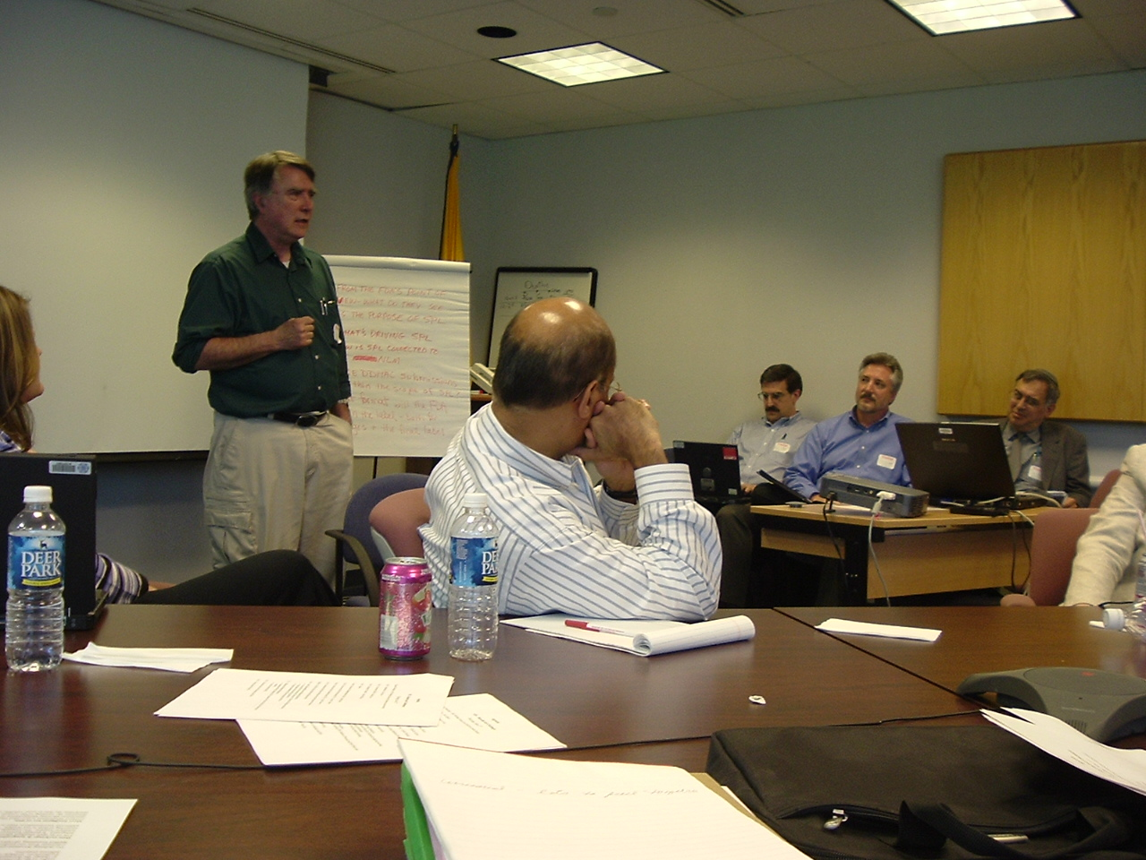

Slide 32
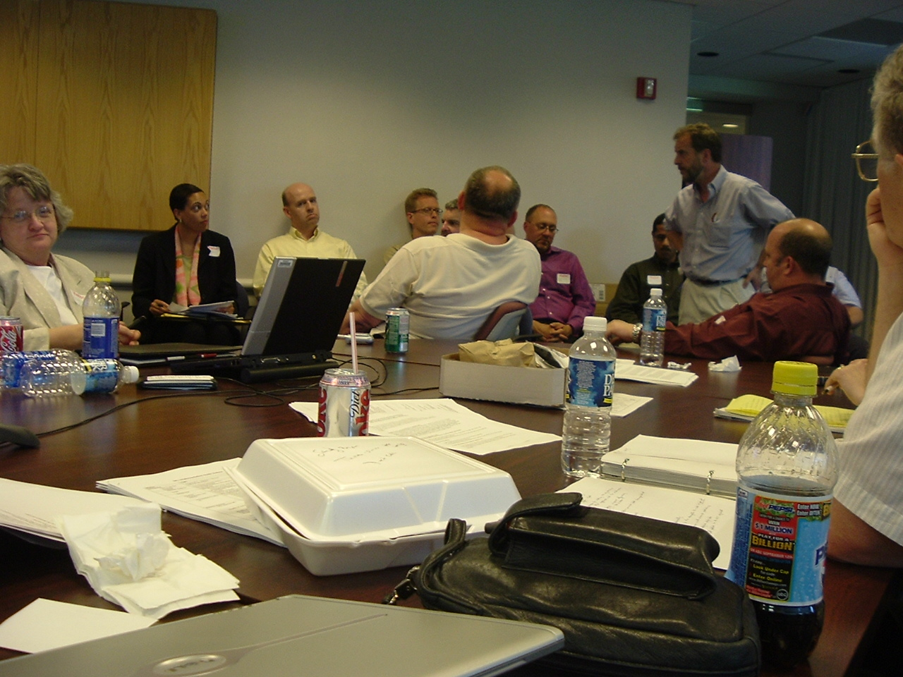

Slide 33
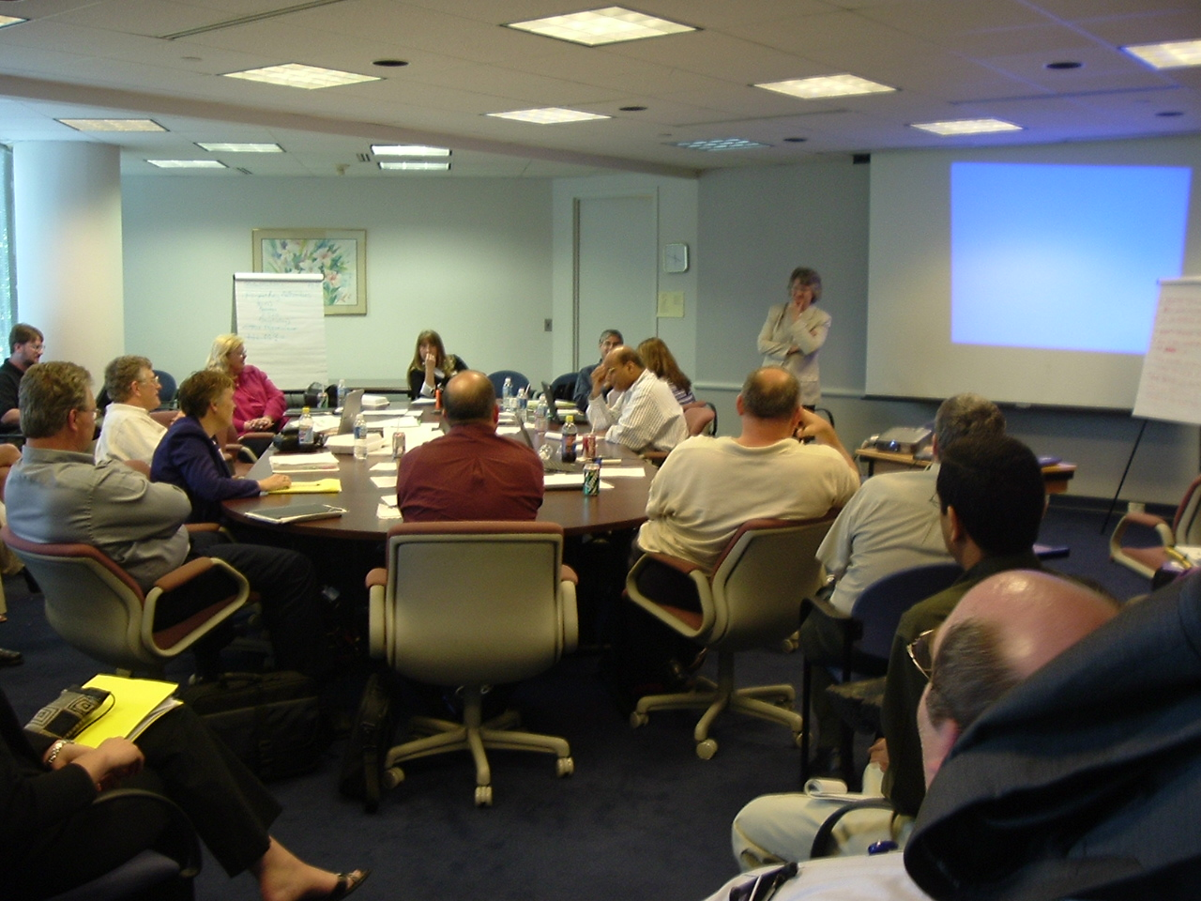

Slide 34
Development of SPL
Involved content and technical experts
Document analysis
  e.g., Sample PIs, Proposed Rule
Requirements analysis
  e.g., Modular updating
Model construction, starting with HL7 RIM
  The ballot package
    Schemas (including data types, vocabulary, narrative block, sample)
    Specification
Balloting
Harmonization

Slide 35
HL7 Ballot Process
BALLOT (VOTING) PERIODS 3 TIMES PER YEAR
BALLOT RECONCILIATION
All negatives addressed
NORMAL BALLOT PROGRESSION
Each Standard is first balloted at “Committee Level”
    Reballoted at committee level until passed with no substantive changes
Each Standard then balloted at “Membership Level”
Higher hurdle for passage
    Reballoted at membership level until passed with no substantive changes
Standard submitted to ANSI as an HL7 Standard

Slide 36
Status
HL7
  SPL has completed HL7 membership level ballot
  Stylesheet development
  Implementation Guide development
Regulatory
  Final rule re submission of labeling in electronic format – Federal Register, December 11, 2003
  Draft guidance re use of SPL for content of labeling – Federal Register, February 5, 2004

Slide 37
What’s Next?
Header
Related docs
Document
- info about doc
Section
- info about section
Section
- info about section
Section
- info about section
Related Documents
Section
Section
Text
Structured Data
(incl. codes, references
Links
Highlights Section and . .

Slide 38
Over time, more structured data will be modeled and added (“start simple and build on that”)
There is no need to start over every time the markup gets more granular

Slide 39
For More Details
Latest working draft of CDA; minutes of meetings; other documents
  Structured Documents Technical Committee page on HL7 web site (www.hl7.org)
SPL and CDA ballots and other HL7 V3 ballots
  www.hl7.org

Slide 40
An Invitation
How to get involved:
  SPL:
    PhRMA working group (Kris Spahr)
    Contact editor (Sandy Boyer)
    HL7 RCRIM Technical Committee listserv
  CDA teleconferences
  HL7 listservs and meetings (see www.hl7.org)

Slide 41
<?Q &amp; A?>
...thank you
for your
time
(and your interest)

