Slide 1
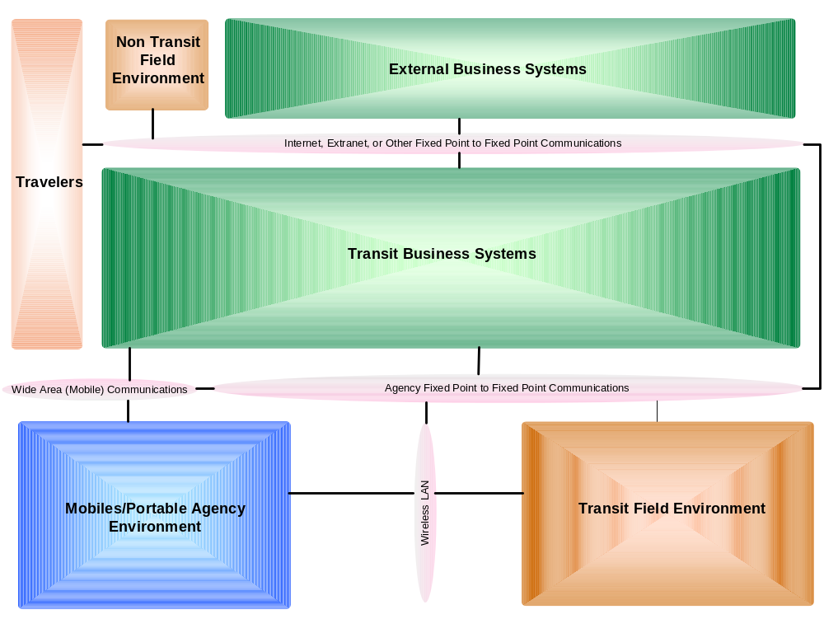


TCIP Fare Collection
Rob Ayers
Prepared for
Talking Technology and Transportation (T3)
State-of-the-State Update on U.S. Fare Collection Standards
December 8, 2005

Slide 2
Topics
TCIP Overview
TCIP Content
TCIP 2.X Releases
TCIP 2.7
TCIP Model Architecture
TCIP Fare Collection Business Area
TCIP FC Business Area Proposal
Summary

Slide 3
TCIP Overview
TCIP is the primary Transit Component of the ITS Standards effort.
TCIP 1 was developed by NTCIP as the NTCIP 1400 Series.
TCIP Development was later transferred to APTA which developed the TCIP 2.X Releases of TCIP.

Slide 4
TCIP Overview
TCIP is the primary Transit Component of the ITS Standards effort.
TCIP provides data exchange standards intended to promote ‘Plug & Play’ interoperability between transit business systems and components provided by different developers.
  Among Business Systems
  Between Business Systems & Onboard Components
  Among Onboard Components
  Between Business Systems & Station/Field Equipment
TCIP provides many opportunities to tailor the standard for use in different agencies and products.

Slide 5
TCIP Contents
Data Definitions for file-based and/or dialog-based information transfers
Dialog Pattern Definitions
Conformance Criteria
Concept of Operations (Non-normative)
Model Architecture (Non-normative)
Polling Protocol (Non-normative)
Agency Implementation Steps (Non-normative)

Slide 6
TCIP Contents-Business Areas
Scheduling
Passenger Information
Incident Management
Onboard
Control Center
Fare Collection
Spatial Data
Common Public Transport
Signal Priority

Slide 7
TCIP 2.0-2.6
Added Model Architecture
Refined Conformance Definitions (A-La Carte)
Added XML Schema
Added ‘Example’ Polling Protocol
Added & Expanded Concept Of Operations
Added Local Extensions
Received & Processed over 1075 Industry Comments

Slide 8
TCIP 2.7
Hyperlinked Volume 2-
  Links Dialogs to Messages,
  Links among Messages, Data Frames & Data Elements
Separated PRL & PICS into 2 Documents
  Agency Produces Profile Requirements List (PRL)
  Supplier Produces Profile Implementation Conformance Statement (PICS)
Improved Support for Inter-Agency Operations

Slide 9
TCIP 2.8
Expected Release in Dec 2005 or Jan 2006
Ballot Version
Fare Collection is expected to be Non-Normative & therefore will not be balloted.

Slide 10
TCIP Model Architecture
Non-normative
Similar to National ITS Architecture
Expands “Transit Management” reflect the types of business systems used in agencies
Expands transit vehicle architecture to reflect real-world arrangements

Slide 11
Concept Of Operations
Illustrates use of TCIP Dialogs & File Transfers in Agency Operations
Uses the Model Architecture as the Example Agency ITS Architecture
Describes 10 Major Business Processes

Slide 12
Concept Of Operations
Business Processes
Security & Incident Management
Vehicle Operations
Transit Signal Priority
Asset Management
Revenue & Fare Collection
Personnel & Work Assignment Management
Scheduling & Runcutting
Data Repository
Spatial Data Management
Customer Information

Slide 13
TCIP Fare Collection
Intent is to focus on areas not covered by UTFS
FC Dialogs:
  Command Disable Fare Equipment
  Command Enable Fare Equipment
  Load Fare Collection Data
  Unload Fare Collection Data
  Report Cashbox Event
  Report Farebox Validation Error
  Subscribe Fare Collection Health
  Push Fare Data
  Push Fare Zones
  Report Cashbox Reconciliation
  Report Vault Event
  Subscribe Fare Collection Health
  Subscribe Fare Passenger Data
  Subscribe Daily Revenue Data
  Subscribe Fare Equipment Subset Definitions
  Subscribe Fare Zones
Dialogs With Station/Onboard Equipment
Dialogs Among Business Systems

Slide 14
TCIP Fare Collection
FC Relevant CC Dialogs
  Command Set Time
  Load Component Configuration Data
  Load Component Software
FC Relevant OB Dialogs
  Notify Start of Trip
  Report Menu Selection
  Subscribe Onboard Location
  Report Onboard Component Health
  Subscribe Onboard Passenger Count
  Subscribe Operator Sign On
  Subscribe Wireless LAN Status
FC Relevant PI Dialogs
  Subscribe Itinerary Fare
Dialogs With Station/Onboard Equipment
Dialogs Among Onboard Equipment
Dialogs Among Business Systems

Slide 15
UTFS
In parallel with the TCIP effort, APTA is developing the “Universal Transit Farecard Standard (UTFS)”
UTFS Focus is on items related to the farecard, farecard real-time transactions & reconciliation
UTFS provides for developer-defined interfaces between the garage and vehicle, and between the Fare System and the field/station.

Slide 16
TCIP FC Balloting Status
Due to the differences in interoperability approaches between TCIP and UTFS, and the desire to limit the resources dedicated to ongoing fare standardization activities, the fare collection vendor community has asked that the TCIP FC dialogs not be balloted at this time.
The TCIP Community is planning to make the FC business area non-normative, rather than balloting the FC business area at this time.
The FC business area may be reconsidered and/or balloted at a later time (after the current UTFS work is completed).

Slide 17
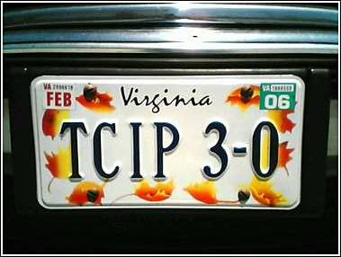
Summary
Currently in the Comment Incorporation Process for TCIP Version 2.8
Approved TCIP Version 3.0 planned for 2006
Plan is to make FC a non-normative business area, with possible reconsideration at a later date.

Slide 18
Contact Information
Rob Ayers
Arinc
ayers62@verizon.net

