Slide 1
What is QCD?
Quantum ChromoDynamics is the theory of the strong force
  the strong force describes the binding of quarks by gluons to make particles such as neutrons and protons
The strong force is one of the four fundamental forces in the Standard Model of Physics– the others are:
  Gravity
  Electromagnetism
  The Weak force
The 2004 Physics Nobel prize was awarded to David J. Gross, H. David Politzer, and Frank Wilczek for their work leading to QCD

Slide 2
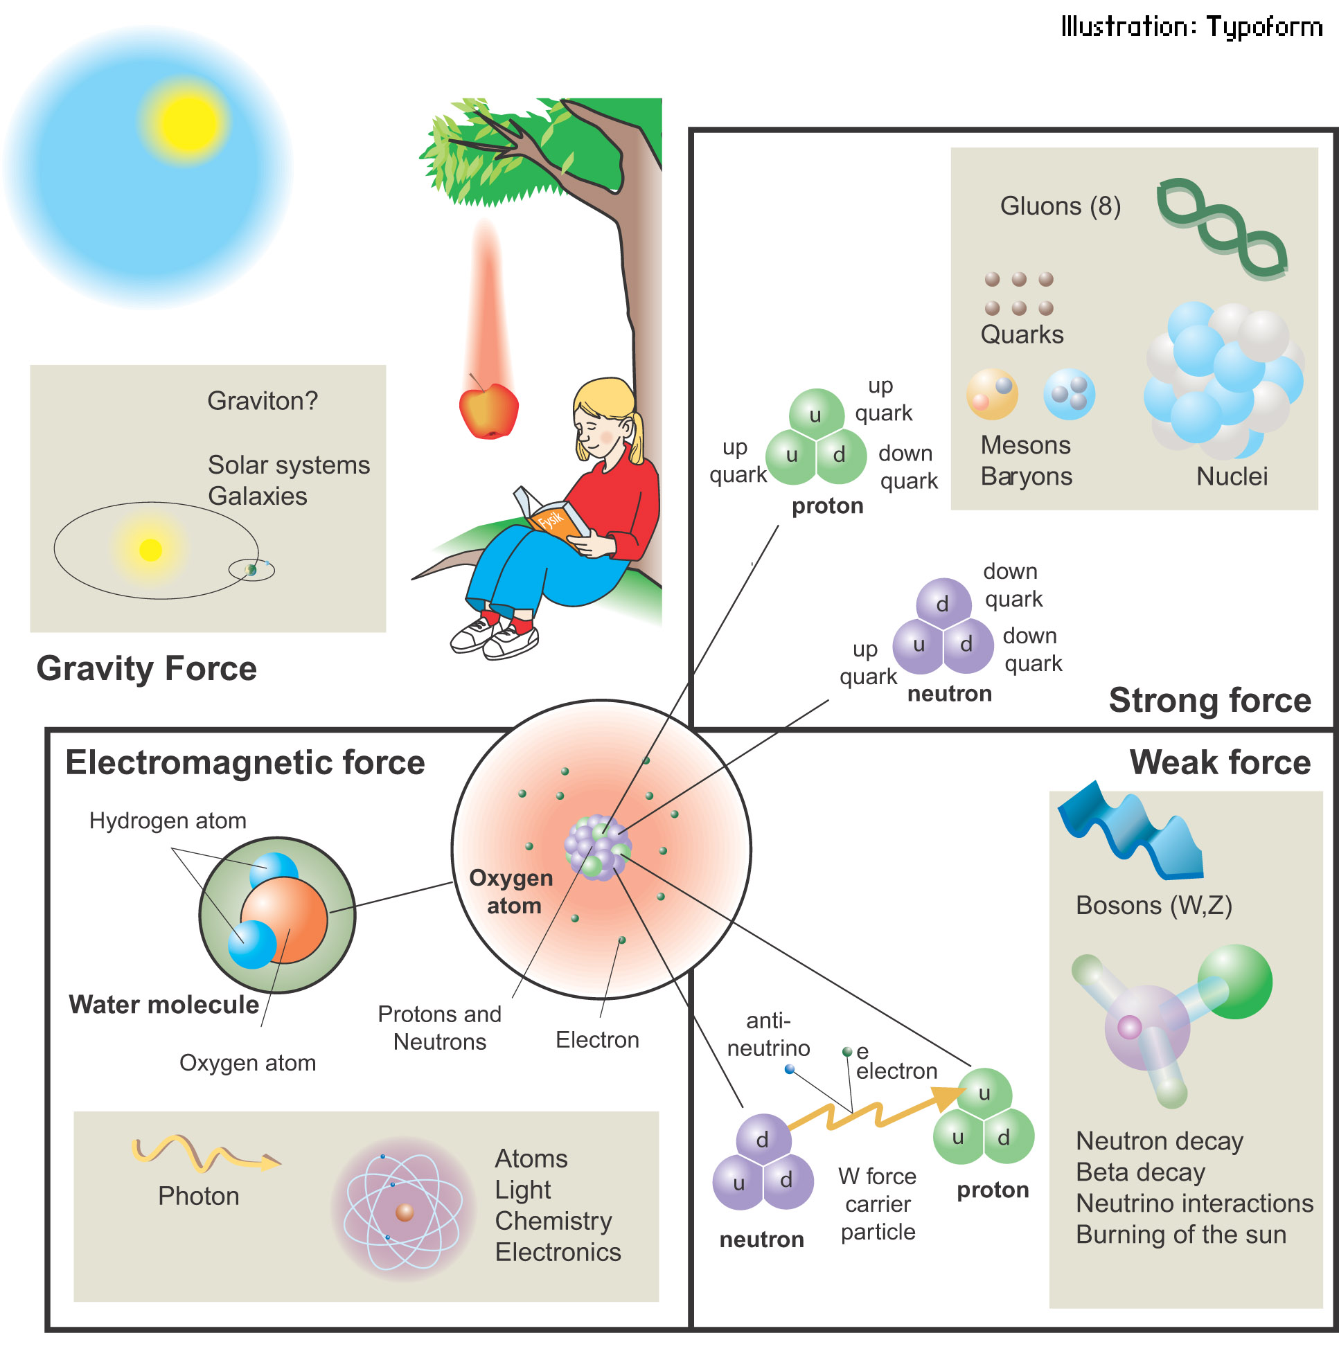
The Four Fundamental Forces

Slide 3
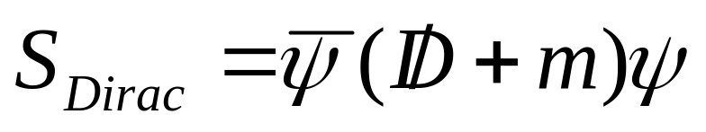
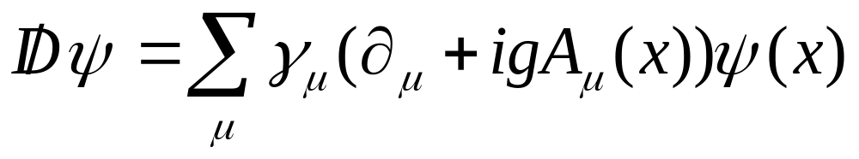
Quarks and Gluons in QCD
The QCD quark action expresses the strong interaction between quarks and gluons:
where the Dirac “dslash” operator,
depends on the gluons, A_{μ}(x) as well as the quarks ψ(x).

Slide 4
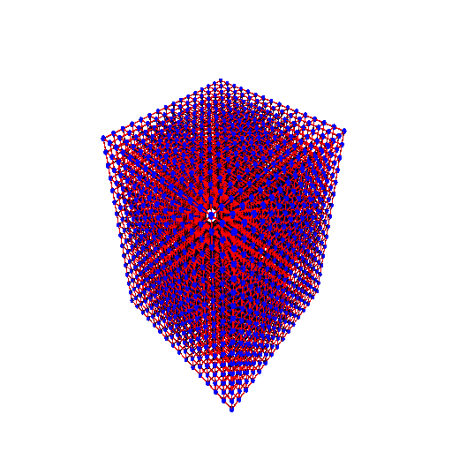
Lattice QCD – Numerical Simulation of QCD
Space and time are discretized on a four dimensional lattice.
On a parallel computer, the lattice is divided among all the nodes.
An illustration of how a 16³ space lattice is partitioned into 8 sub-lattices.

Slide 5
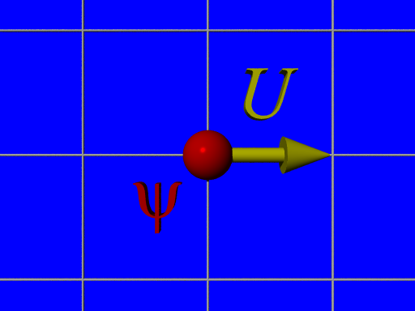
Quarks and Gluons in lattice QCD
Complex 3x1 quarks vectors, ψ(x), are defined at lattice sites.
Complex 3x3 gluon matrices, U_{μ}(x), are defined on each lattice link.

Slide 6
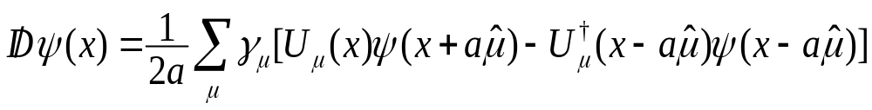
Quark and Gluon Interactions
  A simple discretized form of the Dirac operator is
Quark and gluon interactions are represented by the algebra of complex 3x3 (gluon) matrices and 3x1 (quark) vectors at adjacent sites.
The dominant computation is repeated inversion of the (sparse matrix) Dirac operator via the Conjugate Gradient method.

Slide 7
Why do Lattice QCD?
Many QCD problems can only be simulated numerically, using Lattice QCD
To test the Standard Model, physicists take experimental data and compare to the theoretical predictions of QCD
  Differences may indicate new physics, for example, explaining why the universe is dominated by matter and has so little anti-matter

Slide 8
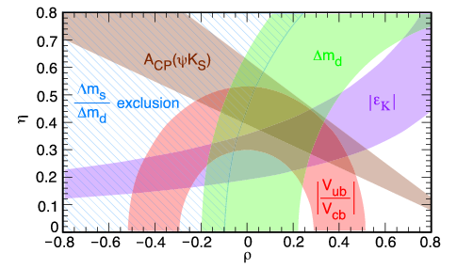
Testing the Standard Model
Regions of different colors correspond to different constraints from theory and experiment
The intersection of the colored regions is allowed by the Standard Model

Slide 9
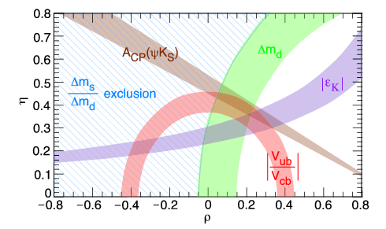
Testing the Standard Model
New B-factory experiments, such as BaBar at SLAC and Belle at KEK, will reduce the experimental errors, shrinking the areas of each region

Slide 10
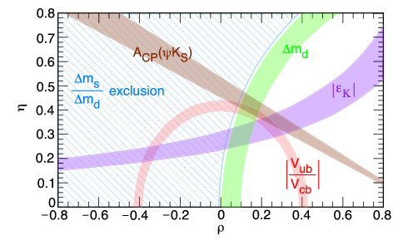
Testing the Standard Model
Even tighter constraints will result from better theoretical calculations from Lattice QCD
If the regions don’t overlap, there must be new physics!

Slide 11
Machines for Lattice QCD
Lattice QCD codes require:
  excellent single and double precision floating point performance
    majority of Flops are consumed by small complex matrix-vector multiplies (SU3 algebra)
  high memory bandwidth (principal bottleneck)
  low latency, high bandwidth communications
    typically implemented with MPI or similar message passing APIs

Slide 12
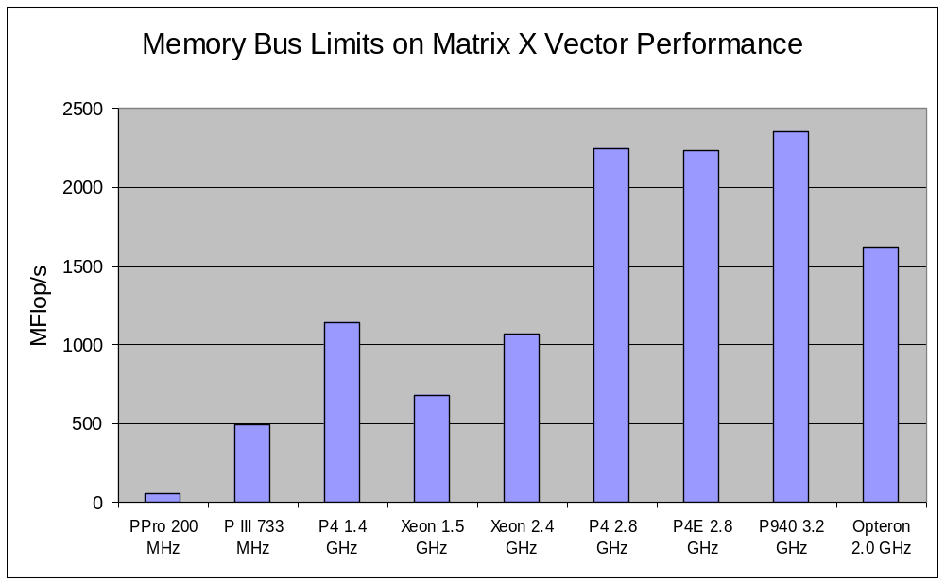
Memory Bandwidth Limits Performance

Slide 13
Lattice QCD Clusters at Fermilab
Cluster | QCD | Pion | Kaon
Nodes | 128 | 520 | 600
Processor | 2.8 GHz Pentium 4E | 3.2 GHz Pentium 940 | 2.0 GHz Dual Opteron 270
Network | Myrinet 2000 | Infiniband 4X (SDR) | Infiniband 4X (DDR)
Performance | 0.14 Tflop/s | 0.86 Tflop/s | 2.6 Tflop/s

Slide 14
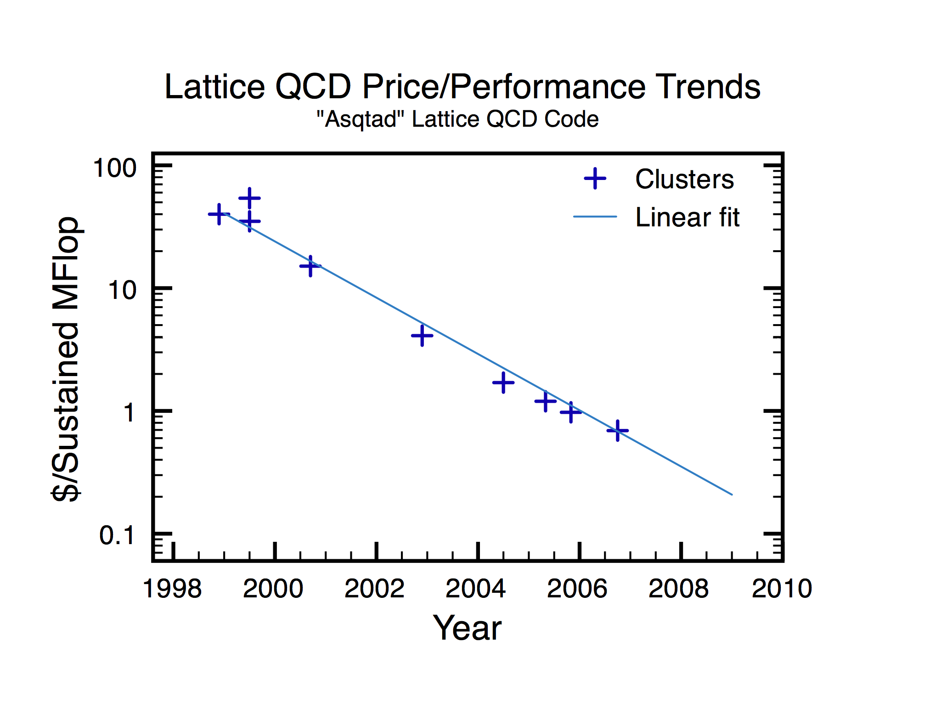
Performance Trends – Clusters

Slide 15
For More Information
Fermilab lattice QCD portal:
http://lqcd.fnal.gov/
US lattice QCD portal:
http://www.lqcd.org/

