Slide 1

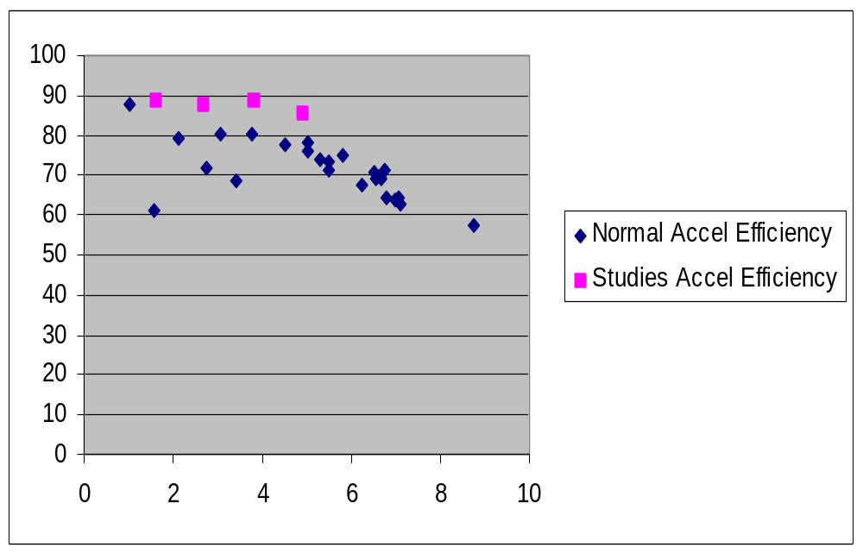
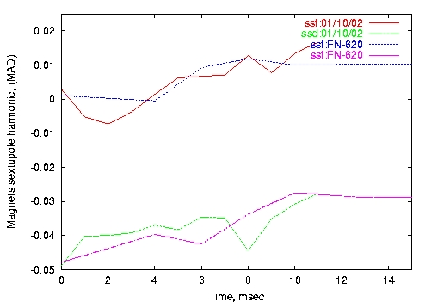
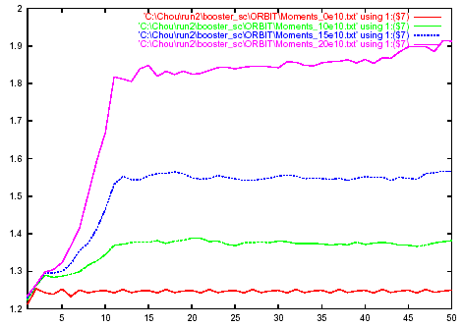
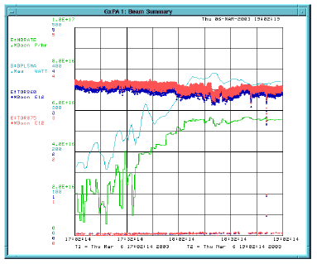
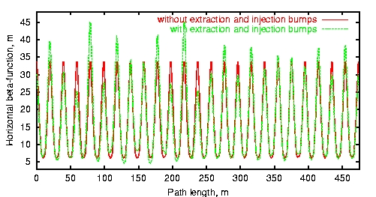
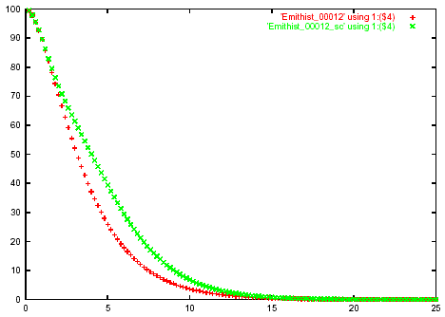
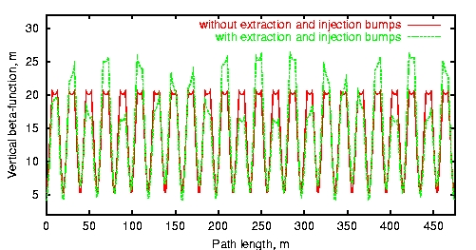
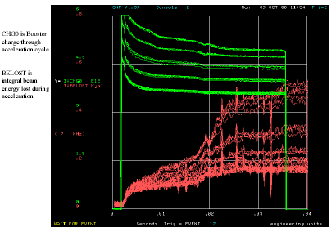
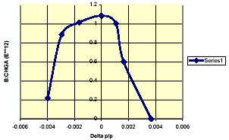
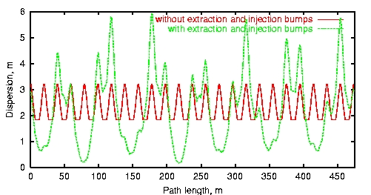
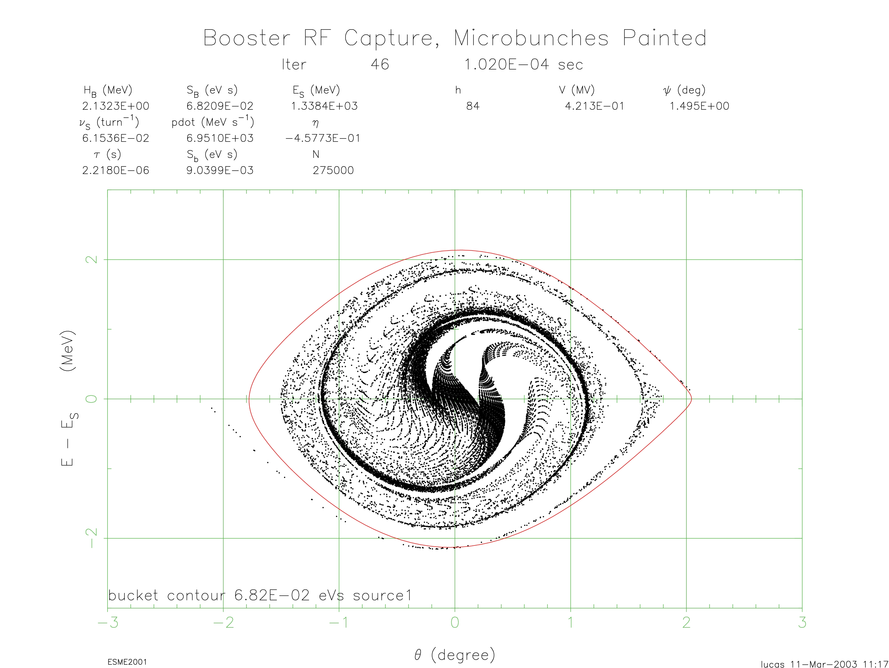
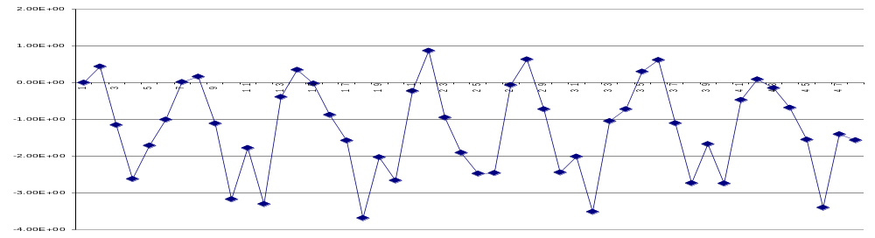
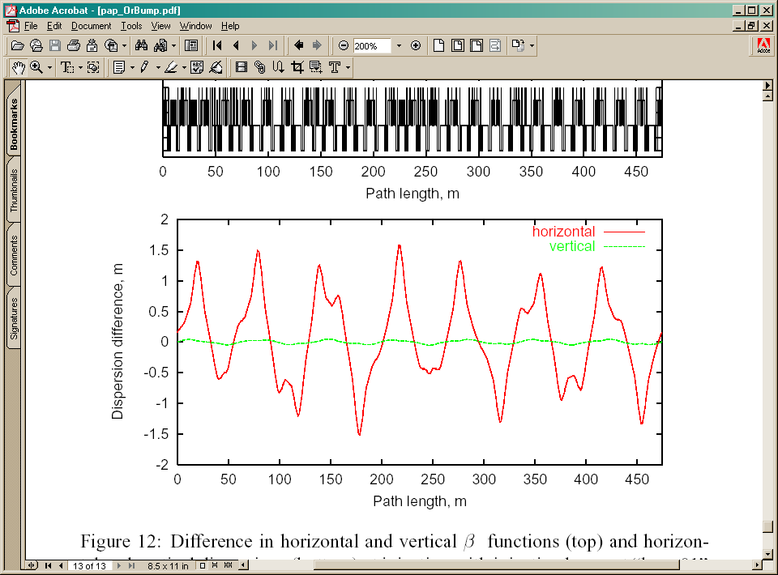
Toward an Improved Model of the Fermilab Booster Synchrotron
A. Drozhdin, J.-F. Ostiguy and W. Chou
Beam Physics Department
Introduction
Space Charge
Chromaticity
Performance Improvements
The Booster is the only machine in the FNAL complex that has not been extensively modified.
Delivering protons to two important neutrino experiments, MiniBooNe (now on-line) and NUMI,
represents a major operational challenge. In the NUMI era, the Booster will have to deliver more
protons than it has delivered in its 30 yrs lifetime ! One area of concern is beam losses, whose cumulative
effects lead to damage and/or activation of tunnel components. A well-designed collimation
system can be used to mitigate losses by helping to control and confine them to specific areas.
However, a detailed and validated model of the machine, including space-charge effects, is invaluable
to understand loss mechanisms, their relative importance and possible cures. To this end, a systematic
Effort,involving the Beam Physics Department working in close collaboration with the Proton Source
Department and the Computing Division has been organized. We describe some of the tools employed
and present some experimental results. Better understanding of the machine optics has already
resulted in sizable improvements.
Space charge has long been known to be associated with loss mechanisms. It causes beam size growth and induces energy dependent tune shift and tune spread which can trigger various
types of nonlinear resonant behavior. Simulation of space-charge effects is computationally intensive. A reasonable approximation in a synchrotron is to separately compute the transverse and longitudinal self-forces. To that effect, we have been using the code ORBIT. The code ESME is also used to study longitudinal dynamics. ORBIT predicts rapid emittance and beam size growth during multi-turn injection. These results are not completely consistent with the predictions obtained with the 3D SYNERGIA/IMPACT which points to slower growth on a longer time scale. The source of this disagreement is under study.
The chromaticity settings of the Booster are determined by head-tail instability considerations. Typically, negative/positive chromaticity is required below/above transition to ensure stability. Although the Booster has no beam pipe, the chromaticities vary significantly through the cycle, due to effects such as remanent magnetization and lattice pertubations induced by the chicanes. Recently, two spare Booster magnets have been carefully re-measured. The sextupole contributions from the main magnets inferred from measured chromaticities and the lattice model are in excellent with magnetic measurements.
An experiment was recently performed by the Proton Source Department. The extraction chicane located at L13 was temporarily eliminated. Beam losses were reduced by 50%, leading to a new milestone for MiniBooNE (5E16 protons per hour).
Performance after a one day study !
Performance after years of tuning !
Optics
Value from magnet measurement
at injection current (t=0)
0.007
A detailed lattice model of the Booster including the injection and extraction chicanes was constructed. The horizontal chicane is used for injection. The vertical extraction chicanes are used to steer the low energy beam away from septum magnets which are encroaching into the vertical aperture. Because of additive edge focusing effects, the chicane bump magnets make the lattice functions deviate considerably from their design values. The most important perturbation is caused by the vertical extraction chicanes (a.k.a doglegs) which induce a subtantial horizontal focusing perturbation. Interestingly, since the chicanes are DC, the perturbations rapidly disappear as the energy is ramped.
Value from magnet measurement
at injection current (t=0)
-0.04
Protons/hr when chicane at L13 is
turned OFF.
Main Magnet sextupole inferred from various chromaticity measurements.
RMS beam size for different beam intensities (no of injected turns).
A Coherent Picture for Losses during the first 3ms
The net pertubation caused by a chicane DC magnets scale approximately like
1/f = θ² / L
Where f is the focal length due to edge focusing, θ is the total bend angle and L is the magnet length.
Short Term – Possible Ways to Mitigate the Chicane Magnet Perturbations
Increase septum magnet height and reduce dogleg magnet strength
Use three-leg instead of four-leg chicanes
Build new, longer chicane magnets possibly using permanent magnets
Remote mechanical septum magnet height to accommodate different operation modes
Long Term – Eliminate both DC chicanes
Use pulsed magnets to move the beam out before extraction
Use special large aperture main bending magnet upstream of the septum magnets
Other Proposals Studied but Deemed not Feasible and/or Practical
Increase the spacing between magnets in the chicane to reduce the angle θ (expensive, no available space)
Relocate the chicane from L13 to L5 or L11 (expensive, marginal improvement)
Use correction wedge magnets or tilt chicane magnets (transfer perturbation to other plane)
Use correction quads (cannot be used to correct geometric focusing)
Particle emittance distribution w/wo space charge.
Booster beam loss during the cycle (Courtesy R. Webber).
Measured Momentum Acceptance of the Booster.
At high intensities, approximately 30% of the beam is lost in the first 3 ms. Our current
model provides a plausible and coherent explanation.
Longitudinal Loss
The measured Booster momentum acceptance is small, about ±0.15-0.20% (see above)
The injected linac beam momentum spread is comparable, about ±0.13%
When the RF is on, the beam is bunched and the momentum spread increases to ±0.3%,
exceeding the acceptance and resulting in a loss.
Transverse Loss
The measured Booster aperture is small, ± 1.2in, corresponding to an acceptance
of 16π mm-mrad
The perturbation caused by the bump magnets reduces the acceptance by 50%
to 8π mm-mrad
The injected linac emittance is 7π mm-mrad
During multi-turn injection, the space charge blows up the emittance and the beam is scraped
transversely, resulting in a loss. The situation is worsened by the injection orbit bumps
which also reduce the acceptance.
Acknowledgements
This work is the result of a close collaboration. We gratefully acknowledge substantial technical discussions and contributions from the Proton Source and Operations Departments.
Data
Phase phase representation of 55 Linac micro-bunches coalesced into one Booster synchrotron bunch. (Courtesy P. Lucas)
Measured dispersion difference caused by changing vertical chicane magnets excitation from 60% to 100%.
(Courtesy R.Tomlin, C. Ankenbrandt and M. Popovic)

