Slide 1
Overview of the IMPACT Parallel Beam Dynamics Code
Ji Qiang and Robert Ryne
SNS Mini-Workshop
Oak Ridge, TN
June 25-26, 2001

Slide 2
Overview of IMPACT
(Integrated Map and Particle Accelerator Tracking)
Started as
  3D parallel PIC code
  Split-operator based with H = H_{external} +H_{space charge}
  3D space charge w/ 2 types of boundary conditions
  Linear maps for drifts, quads, rf gaps
  Maps computed “on the fly” by numerically integrating the equations for the linear transfer map
    based on well-established methods for computing maps
    generalization to high order straightforward
    transformations are symplectic by construction
      No need for Prome-like corrections for rf gap transformations
  Reference trajectory equations also computed “on the fly”

Slide 3
Split-Operator Approach
H=H_{ext}
H=H_{sc}
Magnetic
Optics
H=H_{ext}+H_{sc}
Multi-Particle
Simulation
Split-Operator Methods
M(t)= M_{ext}(t/2) M_{sc}(t) M_{ext}(t/2) + O(t³)
M=M_{ext}
M=M_{sc}
(arbitrary order possible via Yoshida)

Slide 4
Philosopy
Do not take tiny steps to push ~millions of particles
Do take tiny steps to compute maps, then push particles with maps

Slide 5
2 Examples
Early SNS room temperature linac design
  detailed simulation used superfish data from over 400 cavities
  very high resolution – up to 500 million particles
Early CERN/SPL design
  particle arrival time with respect to SC cavity fields (“synchronous phase”) printed at maxima of accelerating gradient

Slide 6
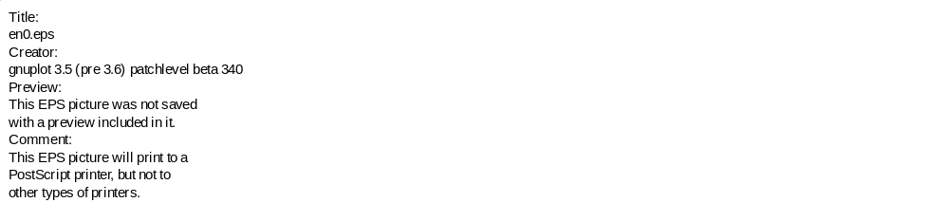
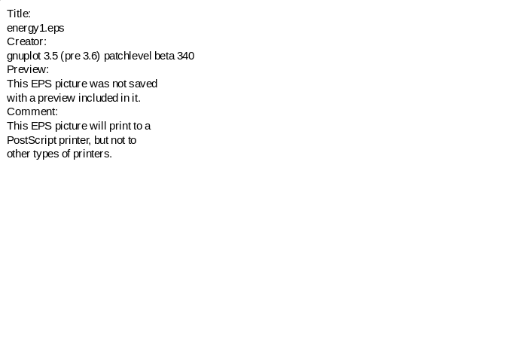





Design Energy and Accelerating Gradient vs. Distance

Slide 7
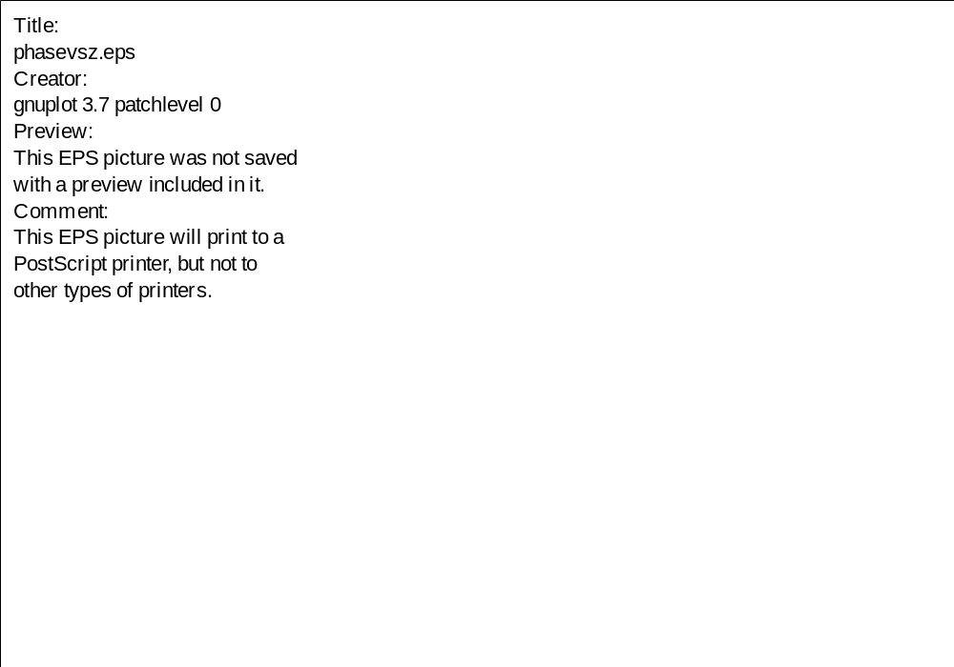
“Synchronous” phase vs. distance

Slide 8
Overview of IMPACT (continued)
Features added in last 3 years
  6 types of boundary conditions
  Field gradient errors, misalignment errors, rotation errors
  More flexibility in rf gap treatment (DTL, CCDTL, CCL, SC, overlapping fields)
  Nonlinear Lorentz force integrator
    Dipoles
  Dynamic load balance, restart function, many new diagnostics

Slide 9
Auxiliary Programs
3D envelope code for matching, finding eigenmodes
“theta” code: design code (sets cavity phases)
Various modified versions of Marylie
  3D space charge, rf gap, acceleration
  3d envelope code

Slide 10
Matching Across Different Section of SC Linac
beta=0.52
beta=0.70
period:
#13
#14
#15
#16
~
~
propagate envelopes to here
compute matched beam in this period
adjust 4 quad strengths + 3 rf cavity parameters to fit 6 envelope functions (2 each for x,y,z) + E_{final}

Slide 11
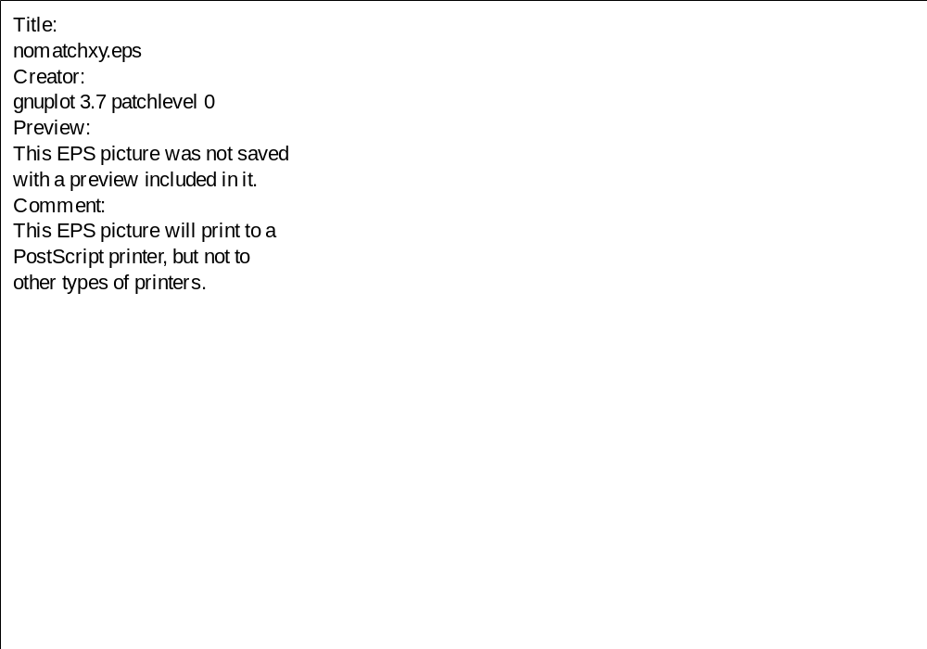
RMS matching: what can go wrong

Slide 12

Successful 7 parameter match

Slide 13
Inputs of IMPACT Code
Global Numerical Parameters
Initial Distribution Parameters:
  6D Gaussian, 6D Waterbag, SemiGaussian, 3D KV,
  6D Uniform, Read-In
Global Beam Parameters
External Beam Line Elements Parameters:
  Geometry parameters and numerical steps
  Field information: Er, Ez, Htheta on grid;
  Discrete Ez on the axis, Fourier coefficients
  of Ez on the axis
Diagnostic Flags

Slide 14
Outputs of IMPACT Code
Position Dependent Quantities:
  Kinetic Energy, Maximum Radius, Particle Losses
  1st, 2nd, 3rd, 4th moments of X, Px, Y, Py, Phase, and
  Energy deviation
  Alpha and Normalized RMS Emittances
  90%, 95% and 99% Radius and Emittances
Snap Shots:
  6D phase space particle output
  3D charge density grid output
  X-Px, X-Y, X-Z, Y-Py, Z-Pz, Y-Z projections
  X, Y, R accumulated density profiles

Slide 15
Object-Oriented Multi-Layer Framework for Accelerator Simulation
AccDriver
InOut
AccSimulator
Lattice
Beam
Field
Computation
Domain
Communication
Numeric Function
Utility
Array
STL
Constants

Slide 16
Control Layer
AccSimulator
Module
Simulator Classes
AccDriver
Module
Driver Classes
InOut
Module
Inputor Class
Outputor Class

Slide 17
Application Layer
Lattice
Module
Beam Line Element Classes
Beam
Module
Particle Bunch
Class
Depositor
Class
…...
Field
Module
Scalar and Vector Fields Classes
Computation
DomainModule
Computation Domain Geometry
Classes

Slide 18
Function Layer
Communication
Module
Particle Manager
Class
Field Manager
Class
…...
Numeric Function
Module
FFT
Class
Matrix Operator
Class
…...
Utility
Module
Auxiliary Function Classes

Slide 19
Data Structure Layer
Array
Module
Array Classes
STL
Module
Standard Template Library
Constants
Module
Numerical and Physical Constants
Classes

Slide 20
Two-Dimensional Domain Decomposition
Boundary Grid
Y
Guard Grid
Physical Boundary
Z
Y
Z

Slide 21
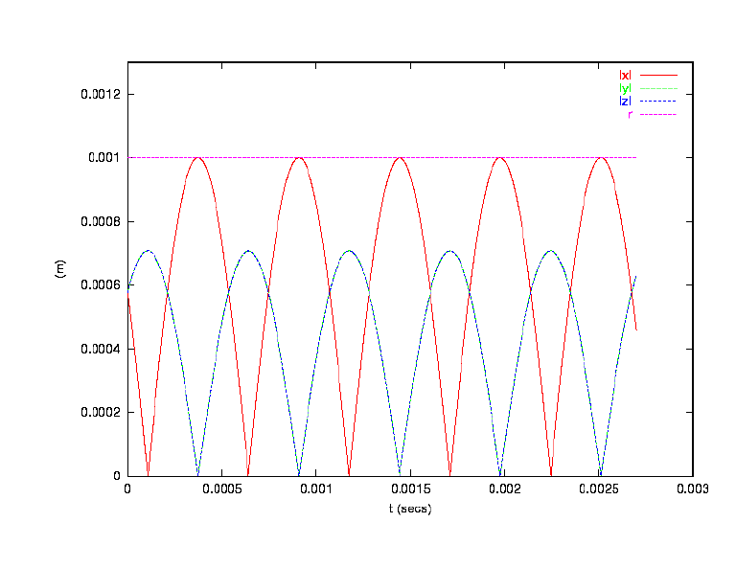
Two Particle Motion In Time Domain Code
With Only Space Charge (64x64x64)

Slide 22
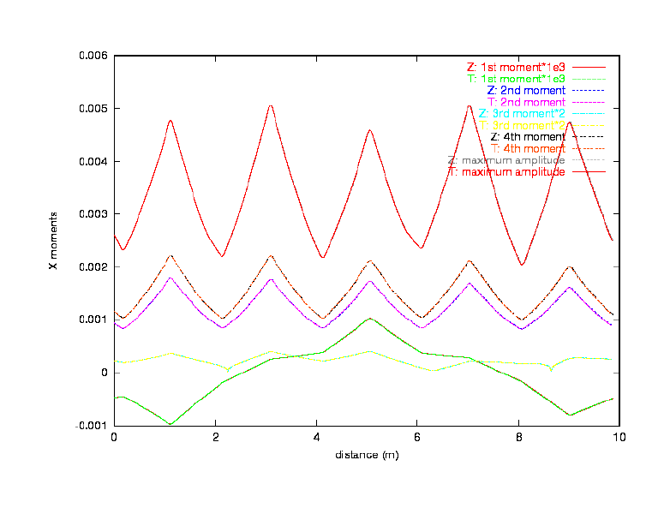
Comparison Between Z Code (Impact) and T Code
For a FODO Channel (1M and 64x64x64)

