Slide 1
Neutral Kaon Interferometry at RHIC
Selemon Bekele
The Ohio State University

Slide 2
1
Introduction
Heavy Ion Collisions
Phase Transitions
Neutral Kaon Correlations
Summary

Slide 3
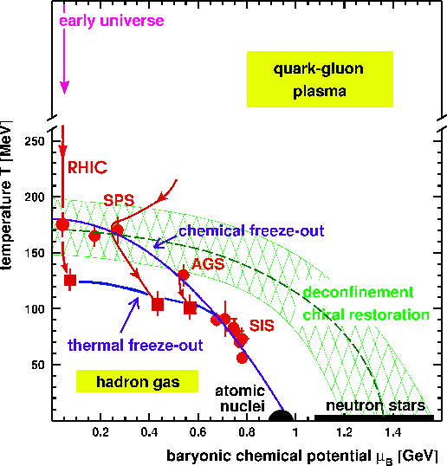
Introduction
2
The Phase diagram of Matter

Slide 4
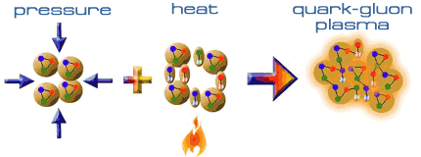

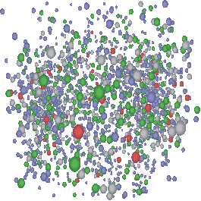
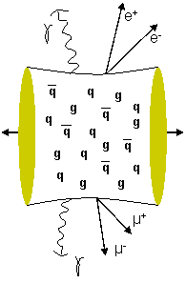
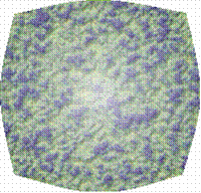
How to create quark matter
3
The Relativistic Heavy Ion Collider (RHIC) will create extremely high
temperatures and pressures by colliding atomic nuclei together
at high speeds.
When they hit, the nuclei may create just the right conditions for quark-gluon plasma to form.
t
K
P
N
Λ
Freeze out
Hadron gas
phase
QGP phase
Evolution of a heavy ion collision
Mixed Phase
z
Partonic re-scattering
phase

Slide 5
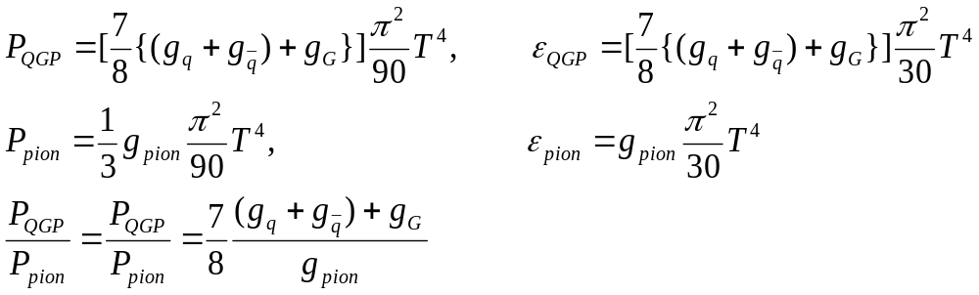
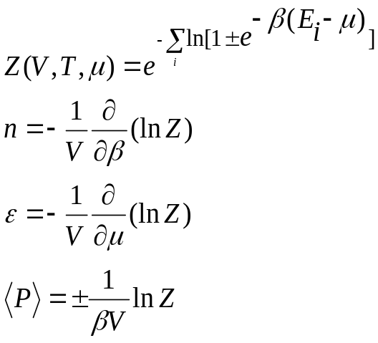
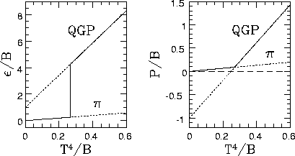
Phase Transitions
4
A thermalised bulk system
is characterized by the equations
Pressure and energy density in a QGP and hadron gas
Schematic diagram showing a phase
transition using bag model calculation
B~200 MeV is the bag constant

Slide 6
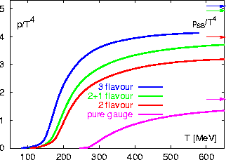
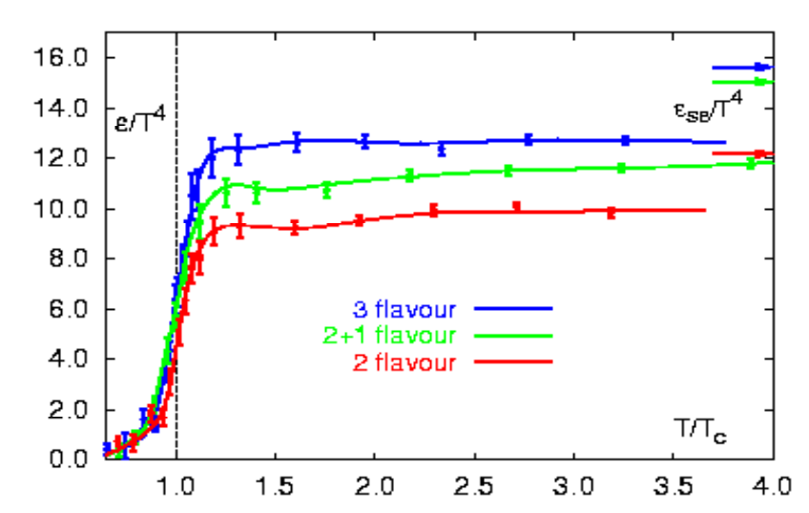
Phase transition from Lattice QCD
5
(F. Karsch, hep-lat/0106019)
T_{c} depends on treatment of quark flavors
The pressure divided by T⁴ changes fast around the critical temperature Tc~170 ± 20 MeV
The energy density divided by T⁴ also changes
very rapidly over a small interval around the
critical temperature
(F. Karsch, hep-lat/0106019)
Deviation from Stefan-Boltzmann (SB) limit
indicates substantial interactions among
quarks and gluons

Slide 7
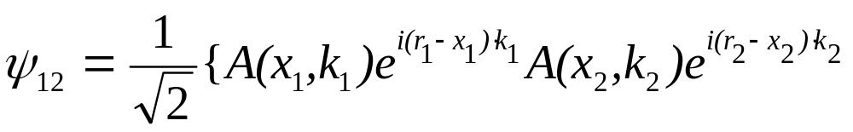
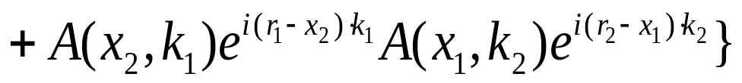
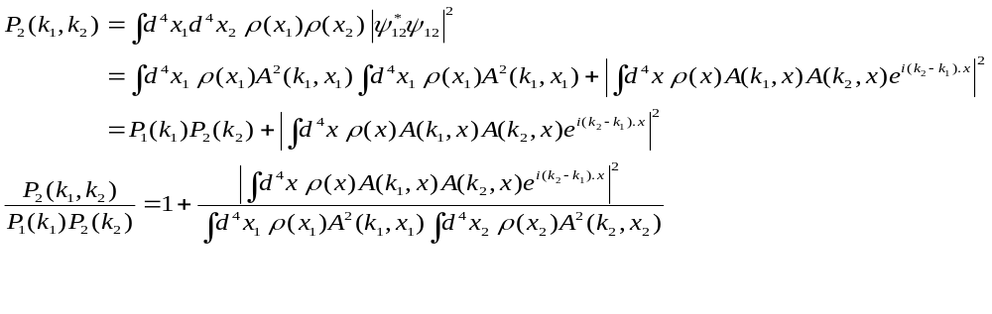
HBT (Hanbury-Brown and Twiss) interferometry
A method developed in the early 1950s
to determine the size of distant stars using
photon intensity correlations
6
For identical bosons one has to symmetrize the two
Particle wave function
x₁
k₁
r₁
π source
ρ(x)
1 m
k₂
r₂
x₂
Where A(x,,k) is the production amplitude for the production
of a particle with momentum k at x. The two particle
momentum distribution is given by
5 fm

Slide 8
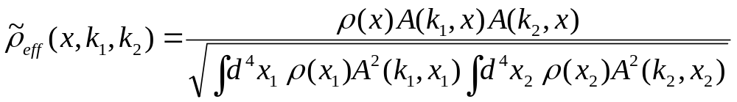
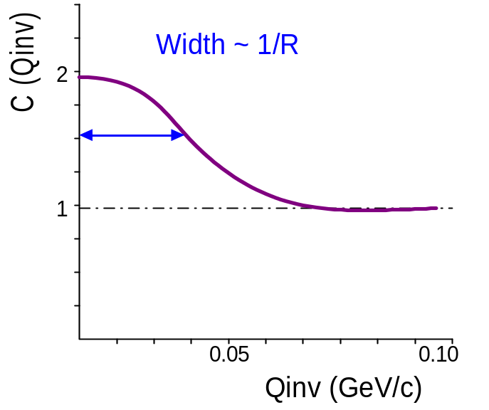
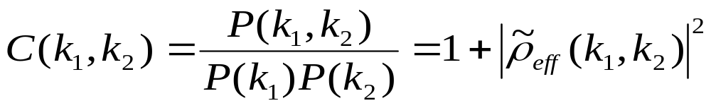
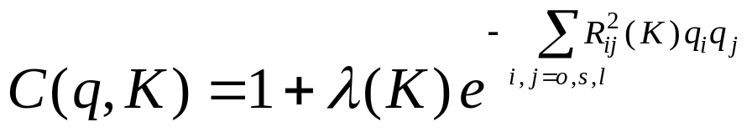
with the effective source distribution is given by
7
the correlation function becomes
Fourier transform of
particle source
Measurable!
For a Gaussian source, the correlation function is usually parametrized as

Slide 9
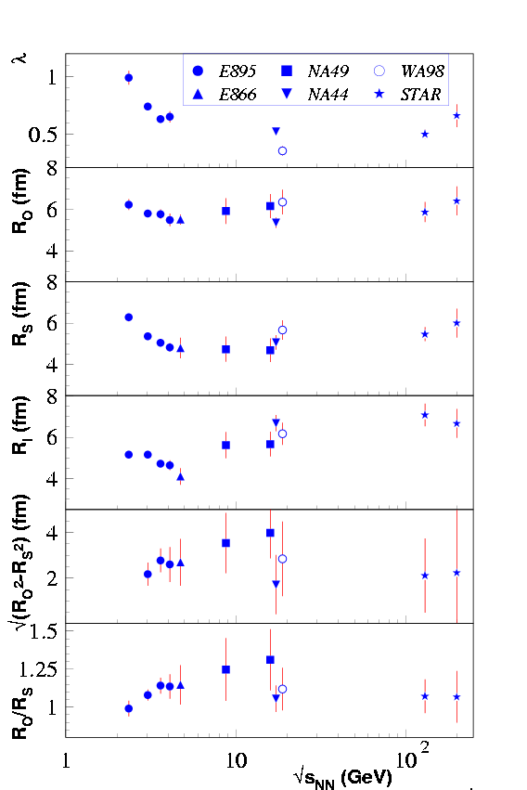
RHIC HBT Puzzle
8
Radius parameters from
pion correlation functions
X
side
2K_{l}
out
long
2K
P₁
2K_{t}
q
P₂
Z
K = (P₁ + P₂)/2
q = P₂ – P₁
Y
Models predict R_{out}/R_{side} > 1
Experiments R_{out}/R_{side} ~ 1

Slide 10
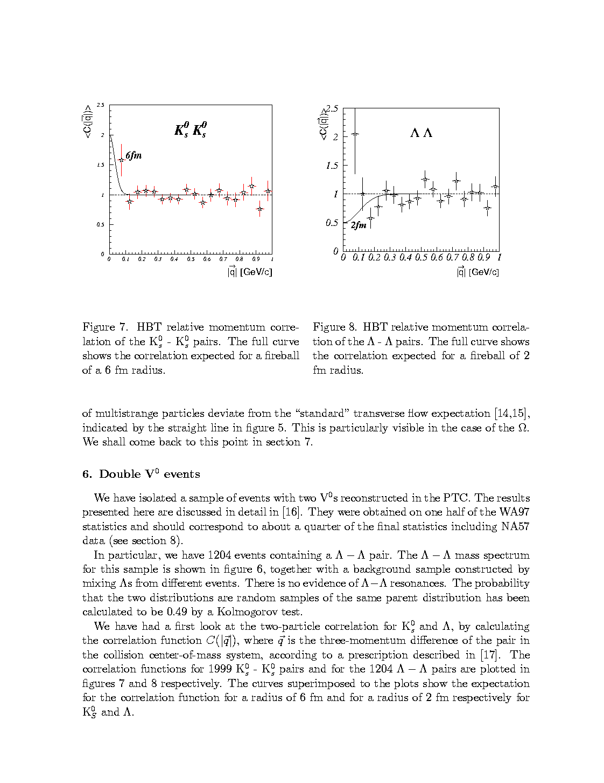
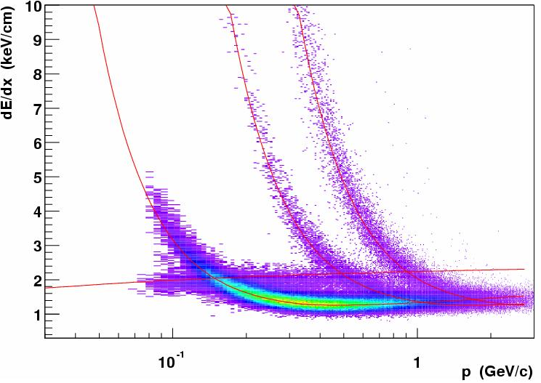
Neutral Kaon Correlations
9
Motivations
Pion correlations are affected by Coulomb interactions, Resonance contributions
Resonance effects are small
No coulomb effects
Less multi-particle effects due to small kaon density
Particle identification possible to higher transverse momentum using decay topology methods
No significant measurements in heavy ion experiments
F. Antinori et al. Nucl. Phys. A661 (1999) 130c
WA97
p
K
π

Slide 11

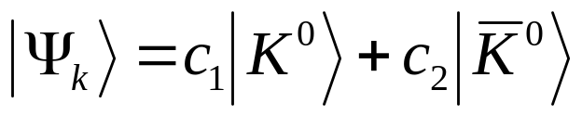


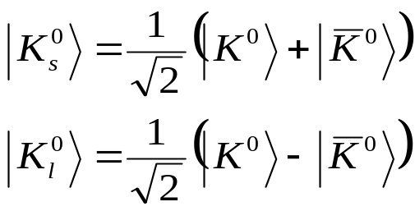

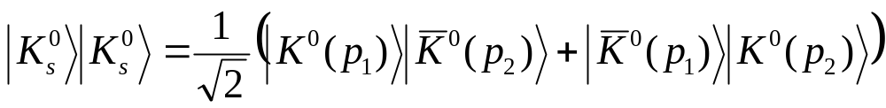
Neutral Kaon ( ) correlations
10
A general neutral kaon wave function may be written as
The
are produced by the strong interaction
The
are what are measured in experiments
Neglecting CP violation, one may write
The
is then a linear combination of
One can form a symmetric combination from

Slide 12
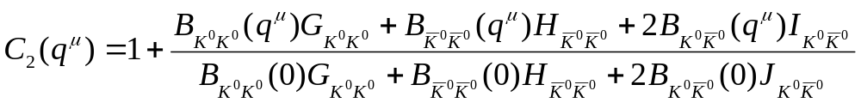
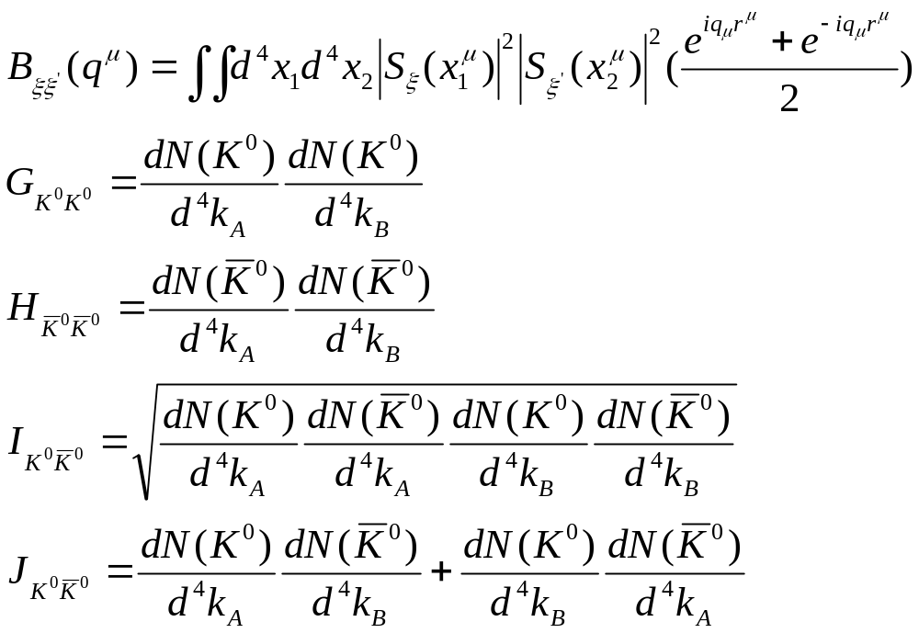
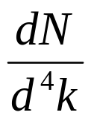
The correlation function is given by
11
where
are production amplitudes

Slide 13
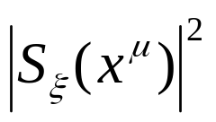
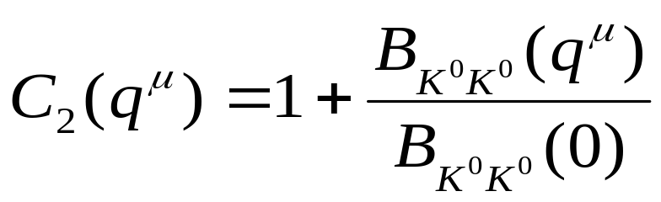

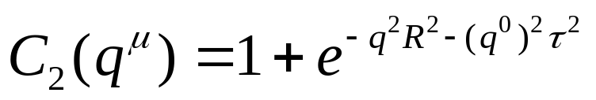
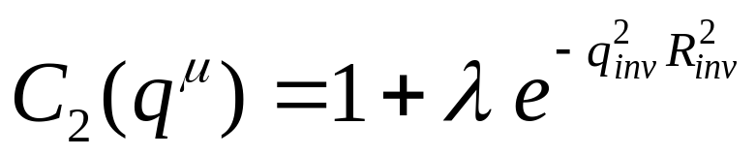
12
If the source function
and the production amplitudes
are identical for both particles, one gets the simple expression
For a Gaussian distribution
, one gets
One can see that the correlation function mixes space and time. In the case of insufficient statistics experimental correlation functions are fit to the form

Slide 14
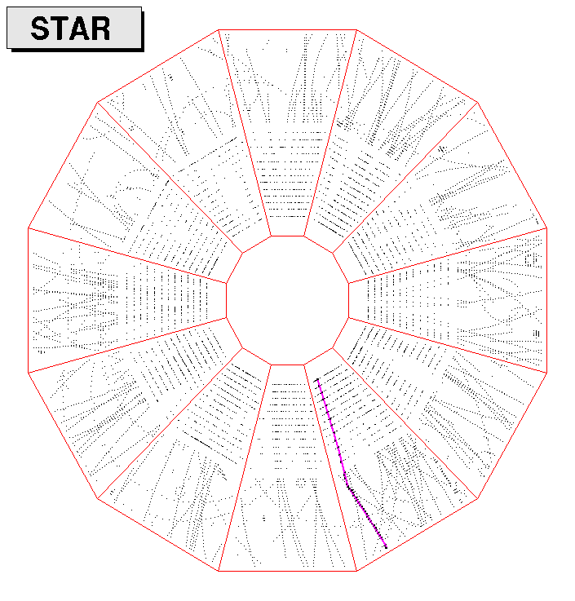
Neutral particle Identification
13
K
p
A schematic diagram of a neutral particle decaying inside the TPC
π
V_{o}
e
decay length
DCA of V⁰ to primary vertex
DCA between daughters
The important geometrical cuts
to identify a neutral particle coming
from the primary interaction vertex
DCA of daughters to primary vertex
DCA – distance of closest approach

Slide 15
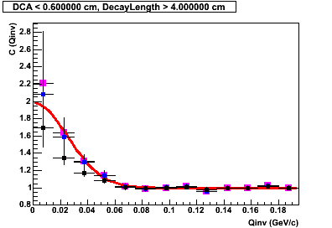

K⁰_{s} K⁰_{s} Correlation Function
X 10²
14
K⁰_{s} invariant mass
Fitting the fully corrected correlation function to a gaussian
Corrected for purity and momentum
resolution
Corrected for purity only
Raw data
Gives the values
λ= 0.99± 0.27
R_{inv} = 5.62 ± 0.69
STAR Preliminary

Slide 16
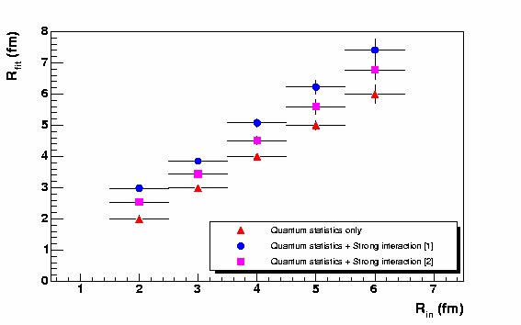
15
The strong interaction makes
the source bigger than the quantum
statistics case

Slide 17
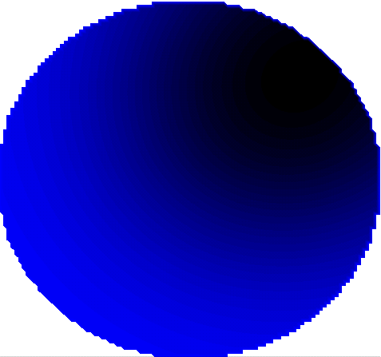

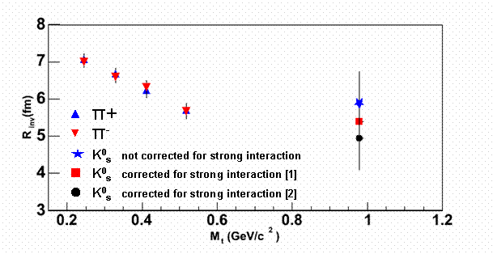
M_{T} Systematics
16
P_{T}=160 MeV/c
P_{T}=380 MeV/c
Rside
Rout
Rside
Rout
The measured HBT radii correspond to the size of the region from which particles with similar momenta are emitted. This means the HBT radii will
Exhibit a dependence on the pair momentum. The plot below shows the invariant radius parameter as a function of

Slide 18
Summary
17
1D K⁰_{s}K⁰_{s} correlations
  Absence of Coulomb final state effects makes it a powerful tool in HBT studies
  The λ parameter is consistent with unity as one expects for a system with small resonance contribution
  Our analysis shows that radius is bigger than what one would expect at M_{t}~1 GeV if the effect of the strong interaction is neglected
With more statistics 3D K⁰_{s}K⁰_{s} correlations will be an important next step

