Slide 1
The Magnetic phase transition in the frustrated antiferromagnet ZnCr₂O₄ using SPINS
Group B
Ilir Zoto
Tao Hong
Yanmei Lan
Nikolaos Daniilidis
Sonoko Kanai
Mitra Yoonesi
Zhaohui Sun

Slide 2
Outline
Principle of triple axis neutron spectrometry
Sample properties: crystal and magnetic structure
Sample behavior: macroscopic (magnetic) properties
Neutron results: structural and dynamic information

Slide 3
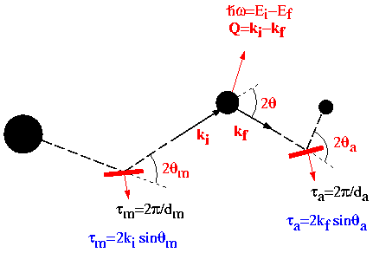
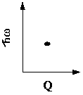
Conventional Triple-Axis Spectroscopy (TAS)
Sample
Single Detector
Neutron Source
Analyzer
Monochromator
A single point at a time

Slide 4
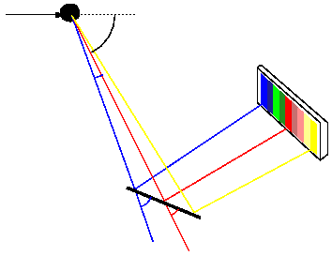
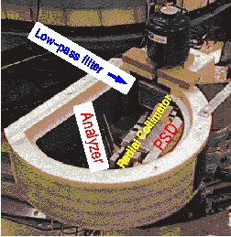
Multiplexing Detection System for TAS
θ_{a}^{i} = θ_{a} + Δ2θ_{i} = θ_{a} - atan(x sinθ_{a}/(L+xcosθ_{a}))
k_{f}^{i} = τ_{a}/2sinθ_{a}^{i}
Q_{i} = k_{i} - k_{f}^{i}
Sample
Position-Sensitive
Detector
Δ2θ_{i}
hω
~1meV
Flat Analyzer
θ_{a}^{i}
θ_{a}
Q
Probes scattering events at different energy
and momentum transfers simultaneously
Survey (hω-Q) space by changing the
incident energy and scattering angle

Slide 5
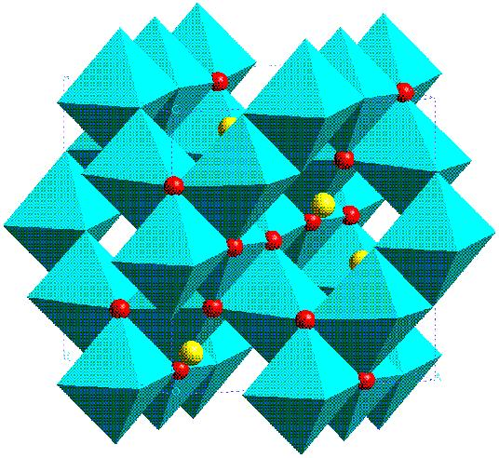
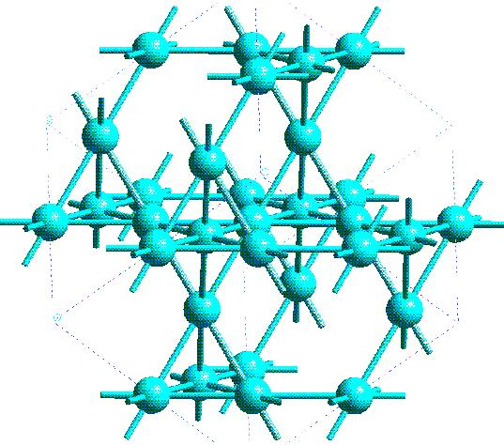
Sample structure (ZnCr₂O₄)
Space group Fd3m
O
Lattice of B sites
: Corner-sharing tetrahedra
A
B
Edge-sharing
octahedra
H = -J Σ S_{i} . S_{j}
nn
? Multiple energetically equivalent configurations:
Geometric frustration

Slide 6
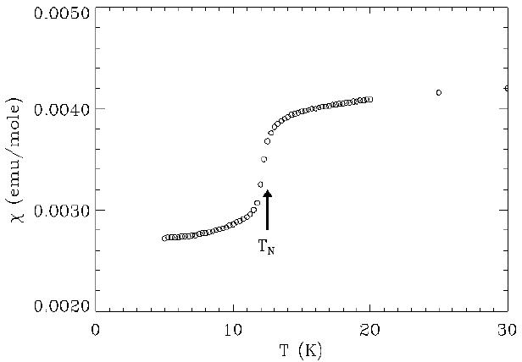
Magnetic Phase Transition in ZnCr₂O₄
Θ_{CW} = 390 K
T_{N} = 12.5 K
Phase transition

Slide 7
What information do we expect to get from neutron scattering?
Static information: crystal structure and magnetic ordering, thus perform elastic scattering.
Dynamic information: what “excitations” do we observe and how they evolve with temperature, thus look for inelastic peaks
Dynamic and static correlations, thus look at peak linewidths.
How are the fluctuating spins in the spin liquid phase correlated with each other?
How do the spin correlations change with the phase transition?

Slide 8
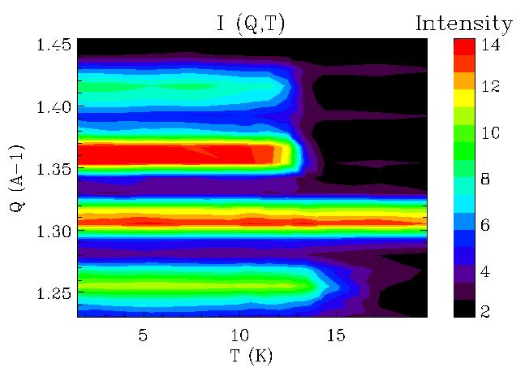
I. Structural data
• Perform Q scan at zero
energy transfer at several
temperatures
• Estimate Q resolution:
ΔQ_{FWHM}≈0.2Å⁻¹
• Estimate energy resolution:
Δ(ћω) _{FWHM} ≈ 0.2meV
• Appearance of several
magnetic peaks below the AF
T_{N}

Slide 9
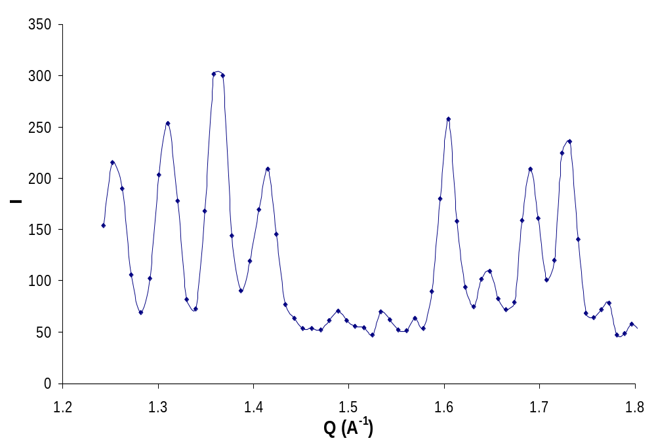
Structural insight gained
• Position of (1,1,1) nuclear peak doesn’t shift
• Several half integer indexed peaks appear
• Comparable peak
linewidths: Long
range structural
order
(3/2,1,1/2)
(1,1,1)
(3/2,1/2,1/2)
(3/2,3/2,0)

Slide 10
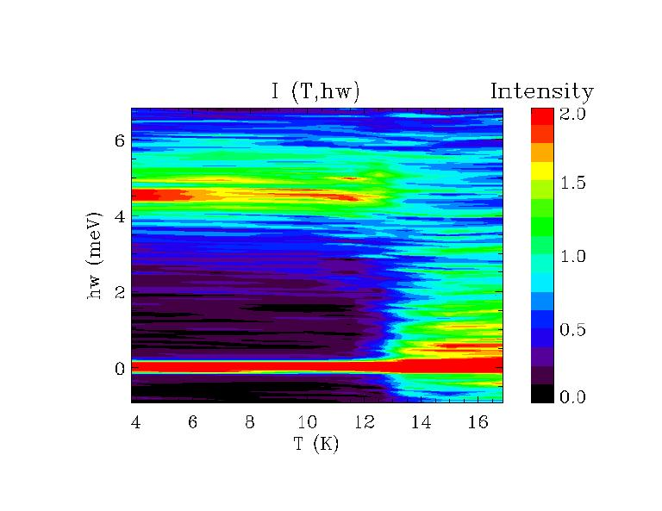
II. Dynamical data
• Scan for energy spectral weight
at Q=1.5Å⁻¹
• Shift in spectral weight from
low (quasielastic)to high (inelastic)
energy at T_{N}.
• T>T_{N}: Thermal energy broadening.
• T<T_{N}: 4.5meV peak
FWHM≈0.5meV (lifetime≈8ps).
• What excitation is it?
• Why the jump in energy?

Slide 11
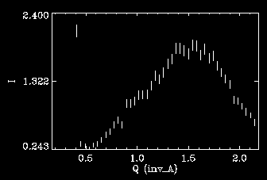
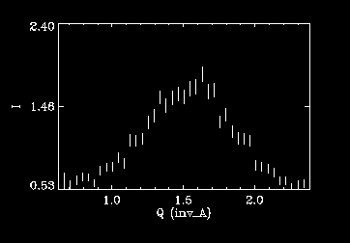
II. More dynamical data
Q scans at low and high T
Correlation length at ħω =1.5meV and T=15K is ~2.5 Å
Correlation length at ħω =4.5meV and T=1.5K is ~3.2 Å
Approximately same range of dynamic spin correlations; comparable to nearest neighbor distance
ħω=1.5meV, T=15K
ħω=4.5meV, T=1.5K

Slide 12
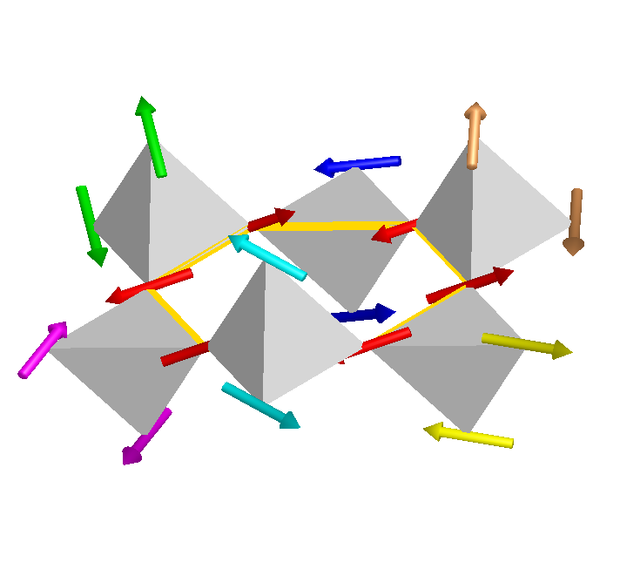
Resolution: The nature of the AF state.
Antiferromagnetic spin hexagons form under T_{CW}.
These can move independently (new degrees of freedom)
Still only spin liquid state can be formed (frustration)
Dynamical correlations of the formed hexagon span its size only
Frustration disappears due to crystal distortion at T_{N} (lifting of degeneracy).
New AF ordered state appears.
Why the jump in energy? What is the Q dependence? To be continued…

Slide 13
Acknowledgements
Seung-Hun Lee
Peter Gehring
Sungil Park

