Slide 1

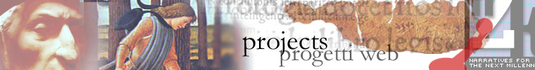
Massimo Riva, Brown University
“The Virtual Humanites Lab
at Brown University:
Toward an Experimental Environment
for Collaborative Scholarship”
“Using New Technologies
to Explore Cultural Heritage”
Presented by the
National Endowment for the Humanities and the Consiglio Nazionale delle Ricerche.
Washington D.C., October 4-5, 2007

Slide 2
Humanism: a New Social Imagination of Technology
“L. B. Alberti implicitly argued for a joint revival of the arts of writing on the one hand, the crafts on the other. His position sounds radical: he placed the abstract, classically grounded pursuits of the well-born and the sweaty, paint-smeared crafts of men who worked with their hands on the same level. But even here he remained within the engineering tradition.”
Anthony Grafton, L. B. Alberti. Master Builder of the Italian Renaissance (Harvard UP, 2000)

Slide 3
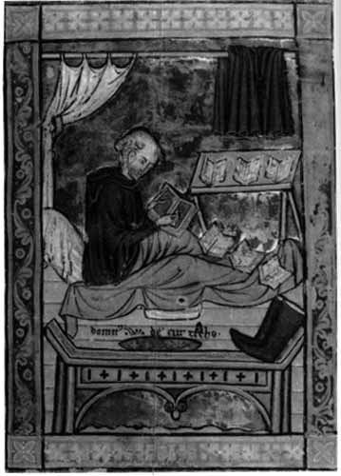
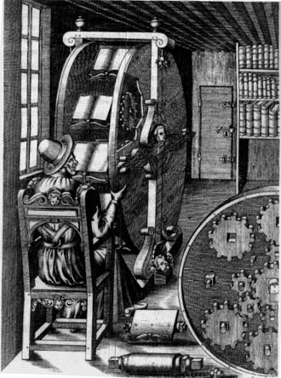
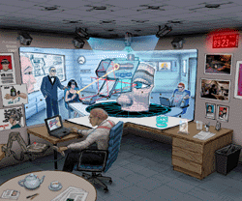
From Manuscript and Print to Digital Editions
In the age of Digital Incunabula, we are the Scribes, transcribing past into present and future media…

Slide 4
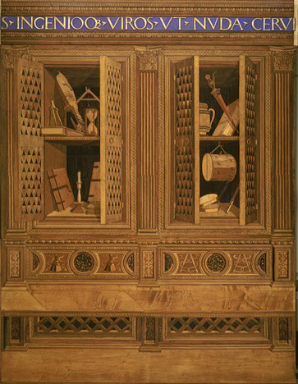
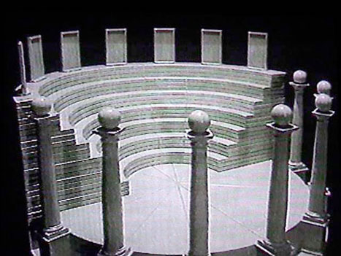
“Sometimes I think and imagine that there is a single art and science and this is painting or design, and everything else derives from it…”
(Michelangelo)
The Theatre of Memory
Giulio Camillo Delminio
1580-1644
The Studiolo of Federico da Montefeltro

Slide 5
“What to do with millions of books?”
“Mass digitization is creating an enormous reservoir of relatively undifferentiated text without the careful mark-up of the previous generation of conversion…”
(Amy Friedlander and Gregory Crane, “Promoting Digital Scholarship,” Council on Library and Information Resources, November 28, 2007)
What is lacking is content material (texts in particular), structured in such a way as to be the result of and promote a variety of research activities as an integral part of the teaching process: research-based teaching and teaching-based research.

Slide 6
Upgrading to Participatory Culture
Henry Jenkins, “Confronting the Challenges of Participatory Culture: Media Education for the 21st C.,” McArthur Foundation, 2007

Slide 7
Proto-hypertexts: Digital Editions
“Of the many kinds of print objects produced over the last centuries, it is difficult to think of any genre that is so well adapted to the computer as the scholarly edition…” (Peter Robinson, “Current issues in making digital editions of medieval texts— or, do electronic scholarly editions have a future?” Digital Medievalist 1.1, Spring 2005).
Scholarly editions of texts from the past are aimed at preserving past systems of knowledge by transcribing and re-presenting them in a new, dynamic medium
New textual models, based on, yet not simple re-presentations of, texts from the past

Slide 8
Digital Editions
  Within the digital cycle, Editor becomes a distributed concept
  Within the digital cycle a document is (still) a social construction
  The Digital Edition (DE) is more a process than an object: the result of distributed and collaborative (knowledge) work
  The DE requires a network of socially accepted and validated (peer reviewed) practices
  These practices involve HCI (Human-Computer interface)
  HCI includes both automatization (machine tasks) and computer-aided editing work (human tasks)
  Collaboration can be greatly enhanced through HCI

Slide 9
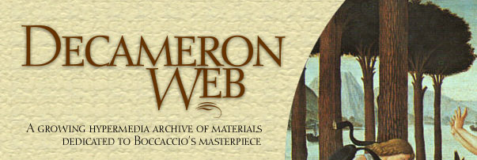
www.brown.edu/decameron
1997-
www.brown.edu/pico
1999-
golf.services.brown.edu/projects/VHL/ 2004-
All generously supported by the National Endowment for the Humanities
Notes:
Metamatrix (dejavu.org)

Slide 10
Toward “Experimental”
Scholarly Modes in the Humanities
An online environment where scholars can train themselves in a set of new practices made possible (and necessary) by digital media and electronic textuality, while at the same time pursuing the traditional goals of their research, in a collaborative fashion.

