Slide 1
Opportunities for U.S. Companies
Sanford Owens, Senior Commercial Officer
US Commercial Service-EBRD Liaison Office
Trade Winds Europe Finance Panel
Istanbul, Turkey: April 14, 2008
Doing Business with the EBRD
Notes:
1
;owiajgoijwaerh

Slide 2

What is the EBRD?
AAA-rated international financial institution founded in 1991, owned by 61 national and two inter-governmental institutions
EBRD, promotes transition to market economies in 29 countries from Baltics to Mongolia
The largest lender and private equity investor with EUR 20 billion capital base
Notes:
4

Slide 3

Committed and Growing
> EUR 36.9 billion in more than 2,500 projects
Private sector > 80%
Debt 77%, equity 23% of portfolio
Cumulative commitments EUR 36.9 billion

Slide 4
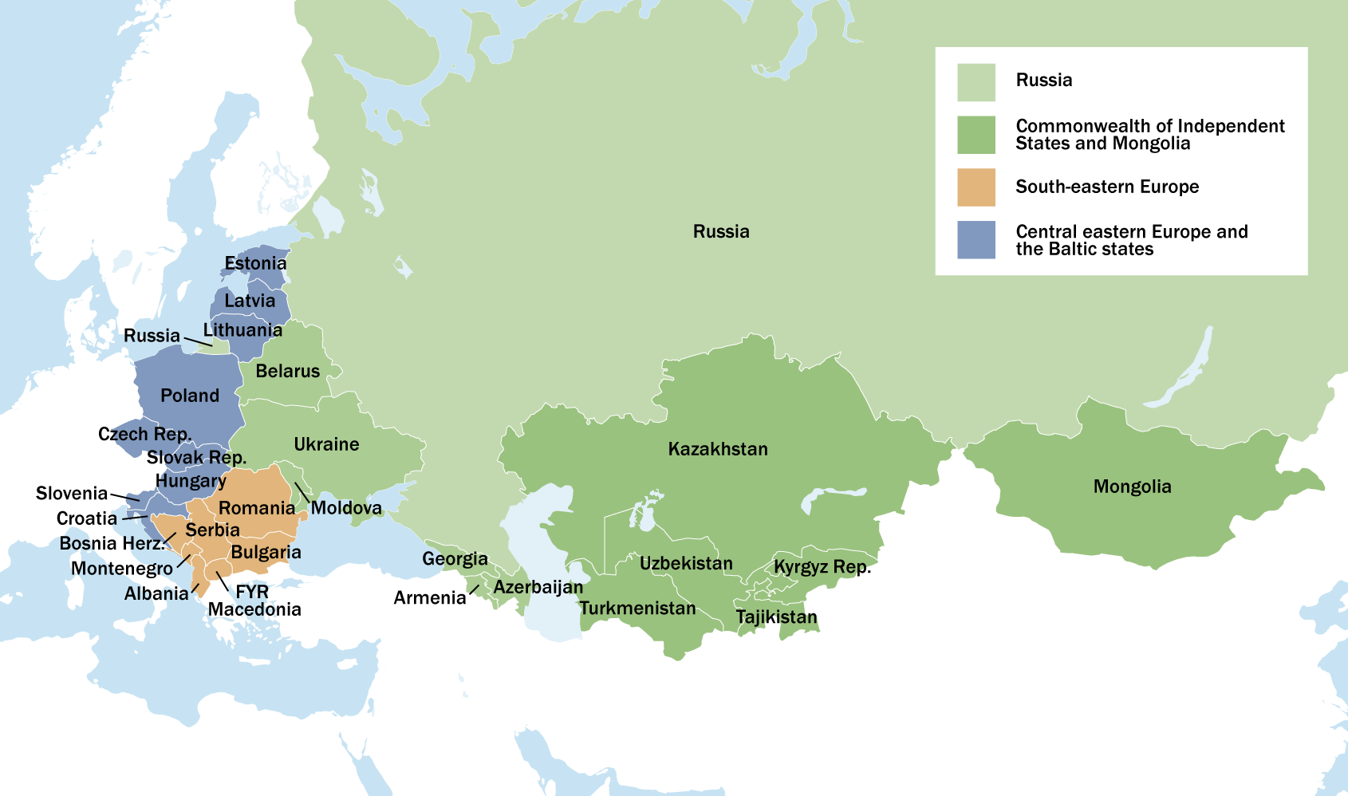
A large field network
29 Countries
33 Offices

Slide 5
EBRD objectives:
Promoting transition~ to market economies by investing mainly in the private sector
Additionality~financing projects which would not be funded by commercial banks
Sound banking principals~ supports privatization, restructuring and municipal services to improve people’s lives
Sustainability~ensuring environmentally sound and sustainable development

Slide 6
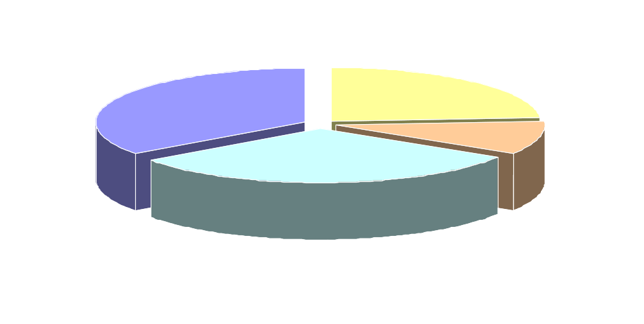
Key Industries

Slide 7
EBRD Financing instruments
Loans
Equity
Guarantees
Senior, subordinated, convertible
LT (up to 10y or more) or ST revolving
Floating/ fixed rates
Choice of currency
Syndication possible for large amounts
Common stock or preferred
Minority position only (up to 35%)
Mezzanine debt
of specific risk (i.e. political)
Commodity-backed instruments
Trade facilitation program (with participation of local banks)
Notes:
EBRD offers a full range of financial products.
Guarantees include: 1) political risk (war, unfair tax, discriminatory treatment) on Bank loans / equity.
2) Credit enhancement (guarantee to purchase commerical paper) and
3) TFP with number of Banks.
Loans - all types of loans, different level of recourse, currency and tenor.
Equity - full range of equity with emphasis on quasi-equity products.

Slide 8
Working with the EBRD
The EBRD works with U.S. companies in three ways:
Borrowers/ investors in private sector projects
2) Suppliers of equipment, works, and services on Bank financed public sector projects
3) Consultants under the Bank's Technical Cooperation program and Bank financed projects

Slide 9
Procurement Opportunities
3 types of opportunities:
  Banks’ own procurement
  Technical Assistance Consultancies
  Bank-funded project procurements
Competitive bidding conducted by borrower and overseen by the MDBs
Visit bank websites for tender notifications and details

Slide 10
Trade Facilitation Program – How does it work?
EBRD supports trade by providing
guarantees that cover risks arising from trade finance transactions
short-term advances/financing to banks in the Countries of Operation for trade finance purposes
TC funded trade finance training and advisory service to local banks
Notes:
3

Slide 11
TFP – Guarantee Transaction
Always involves a local bank (“Issuing Bank”) which issues a trade finance instrument (e.g. a letter of credit) and a foreign bank which confirms it to the exporter (“Confirming Bank”)
The trade finance instrument (e.g. L/C) ensures that the exporter receives payment upon or after delivery
EBRD Guarantee covers payment risks of the Issuing Bank to the Confirming Bank
Notes:
3

Slide 12
Instruction for Exporters & Importers
Check under www.ebrd.com/tfp, for which Issuing Banks and tenors the EBRD guarantees payment;
Ask your buyers/suppliers to check if an Issuing Bank under the TFP would be ready to issue the required trade finance instrument;
Ask a Confirming Bank of your choice to confirm the payment instrument under the guarantee of EBRD
Notes:
7

Slide 13
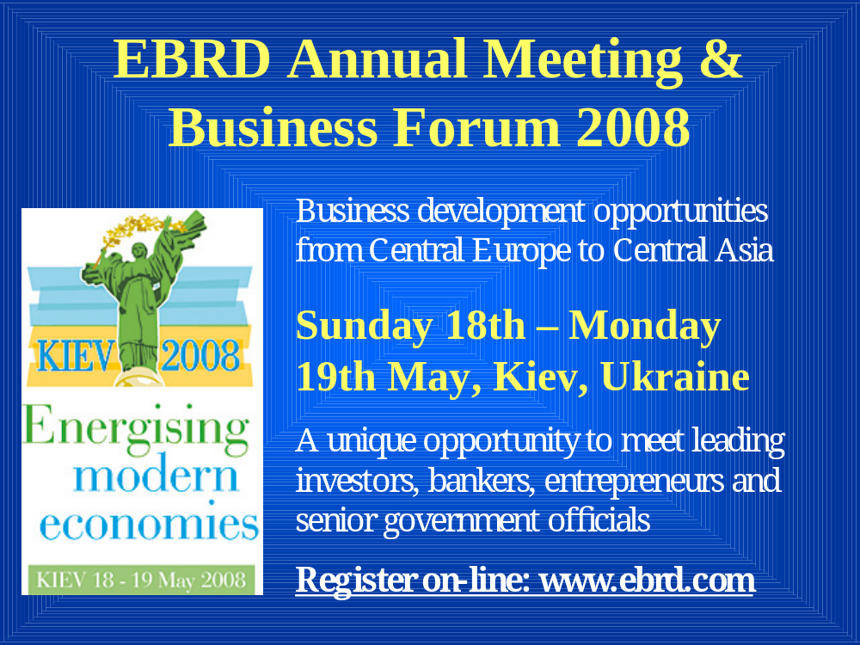

Slide 14
Contact Information:
Sanford Owens, Senior Commercial Officer
U.S. Commercial Liaison/Advocacy Center - EBRD
  One Exchange Square
  London, EC2A 2JN
  Tel: +44 20 7588 8490 Fax: +44 20 7588 8443
  Email: Sanford.Owens@mail.doc.gov
  Websites: www.buyusa.gov/ebrd
  www.ebrd.com

