Slide 1


ISD December 2005
EU-US
Plenary Session: Focus on Wireless Issues
Michael D. Gallagher
Assistant Secretary for Communications and Information
National Telecommunications and Information Administration
U.S. Department of Commerce
December 20, 2005
www.ntia.doc.gov

Slide 2
President’s Spectrum Policy Initiative
“The existing legal and policy framework for spectrum management has not kept pace with the dramatic changes in technology and spectrum use.”
        - President George W. Bush, Presidential Memorandum,
        May 29, 2003
Stated Purposes:
    To foster economic growth,
    Ensure national and homeland security,
    Maintain U.S. global leadership in communications technology development and services,
    Satisfy other vital U.S. needs such as public safety, scientific research, federal transportation infrastructure and law enforcement.
Based on federal agency and private sector input, the Department of Commerce prepared 24 recommendations to improve spectrum management.

Slide 3
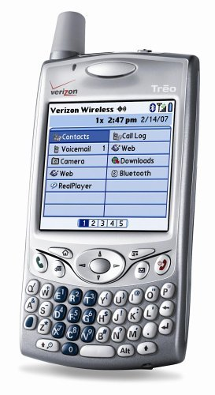

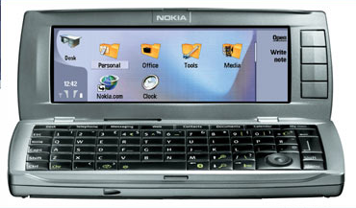
The Vision for Spectrum Policy Reform
Support critical government functions:
Ensure that the spectrum needs of national defense, homeland security and public safety are met
Innovation:
Support the timely deployment of new products and services
Promote market driven competition to the extent feasible
Create an environment fostering
technological innovation and efficient
use of spectrum
Ensure U.S. global lead in spectrum-
based technologies

Slide 4
President’s Spectrum Initiative
Implementation Plan Projects
Project A / Domestic Policies: Improve Stakeholder Participation and Maintain High Qualifications of Spectrum Managers
Project B / International Policies: Reduce International Barriers to United States Technologies and Services
Project C / Information Technology: Modernize Federal Spectrum Management Processes with Advanced Information Technology
Project D / Public Safety: Satisfy Public Safety Communications Needs and Ensure Interoperability
Project E / Engineering Analysis and Technology Assessment: Enhance Spectrum Engineering and Analytical Tools
Project F / System Review and Spectrum Authorization: Promote Efficient and Effective Use of Spectrum
Project G / Spectrum Planning and Reform: Improve Planning and Increase Use of Market-based Economic Mechanisms in Spectrum Management

Slide 5
Commerce Spectrum Management Advisory Committee (CSMAC)
Appointment of this advisory committee implements a recommendation adopted as policy by the Administration in the Nov. 2004 Executive Memorandum.
Committee members will provide advice to the Assistant Secretary on needed reforms to domestic spectrum policy.
It will consist of a cross-section of participants with expertise in spectrum management; including non-federal government users, technology developers, manufacturers and service providers.
For additional information on the President’s Spectrum Policy Initiative, visit www.ntia.doc.gov.

Slide 6
Spectrum Relocation Fund Legislation
President Bush signed the Commercial Spectrum Enhancement Act (CSEA) into law in December, 2004. It governs payment of costs incurred to federal agencies required to relocate from spectrum vacated for non-federal use and licensed by competitive bidding (auctions).
CSEA establishes a spectrum relocation fund from auction proceeds:
  The funds are available to federal agencies required to locate from eligible frequencies.
  Six months prior to an auction subject to CSEA, NTIA must submit, after OMB review, the affected federal agencies’ estimated relocation costs and timeline for relocation to the FCC.
  The law prohibits the FCC from concluding an auction unless total cash proceeds from any auction equals at least 110% of such estimated costs.

Slide 7

Total U.S. Wireless Subscribers
Source: Cellular Telecommunications & Internet Association (1992-2000); FCC (2001-2003); * www.ctia.org as of 12/19/05

Slide 8
Wireless Applications Expanding Competition
Wi-Fi: Airgo Networks announced plans to sell Wi-Fi chips with data rates up to 240 Mbps by 4Q05 – almost 4x the speed of current Wi-Fi chips. Rural Oregon is home to the world’s largest Wi-Fi hotspot → 700 miles².
WiMax: Intel plans to build WiMax into its Centrino chip platforms, which power 80% of all PCs, by 2006. InStat/MDR estimates that a company could reach 97.2% of the U.S. population with a $3.7 billion investment in WiMax.
Unlicensed Mesh Networking: Mesh architecture extends wireless coverage to areas without wire infrastructure, and can link diverse devices or networks.
HSDPA: Faster version of GSM AWS (1.8 Mbps, over time can be boosted to 7.2 Mpbs), expected to reach the mass market in 2006 → launching first in the U.S, followed by Japan, then Europe.
CDMA2000 1xEV-DO Revision A: Increases the efficiency, capacity and data speeds (3.1 Mbps forward link/1.8 Mbps reverse link) of existing EV-DO networks → commercially available in 2006.

Slide 9
Emerging Technologies Will Facilitate More Sharing Between Spectrum Users
Software Defined Radio
  Cognitive radios
Smart Antenna Systems
  Highly directional antennas (fractal antennas)
Use of coding technologies, including coding combined with advanced modulation
Greater utilization of multiple domains
Orthogonal Frequency Division Multiplex (OFDM) such as that used by satellite radio systems
The Goal: Increasing bits transmitted per Hz
per km² at lowest unit cost

Slide 10
5 GHz: Promoting Broadband While Protecting Government Users
Increasing use of wireless local area networks (Wi-Fi) necessitated additional bands for operation to support broadband users.
Extensive cooperation between NTIA, government users (DOD), FCC and private sector developed technical sharing rules to enable co-frequency operation between unlicensed Wi-Fi employing Dynamic Frequency Selection (DFS) and government radar systems.
Ongoing dialogue continues to ensure that, as Wi-Fi expands into upper part of 5 GHz band, technical means of protecting government operations are adequate.
Recent bench testing has been completed by the NTIA Institute for Telecommunication Sciences to provide data needed to finalize conformance test procedures that will provide protection of government operations at 5 GHz.

Slide 11
Conclusion
Spectrum dependent services are essential to the United States’ national security and economic security.
This Administration is committed to spectrum and broadband policies that create a domestic and international environment for economic growth by removing barriers to the implementation of U.S. technologies and services.
Goal: Satisfy the United States’ domestic requirements and provide worldwide spectrum policy leadership.

