Slide 1

Innovative Contracting Techniques that Consider Driver Impacts
Use of A+B Bidding
Presented by: David L. Kent P.E.
New York State Department of Transportation

Slide 2
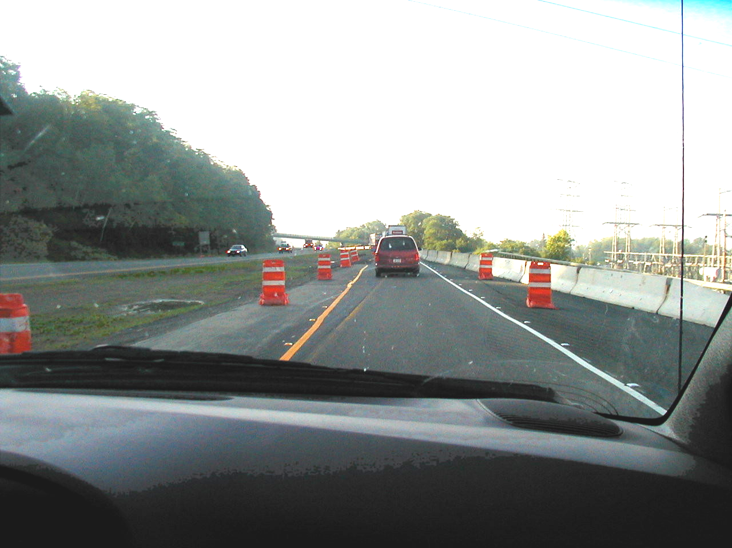

Slide 3
Implementation of A + B Bidding in New York
Initial guidelines / special provisions issued - December 1993.
FHWA Special Experimental Project 14, Innovative Contracting Practices.
Based on FHWA sample provisions.
150 Contracts awarded 4/94 to 2/03.
Total contract value $ 3.1 billion.

Slide 4
What Is A + B Bidding ?
A method of bidding that includes both cost and time in low bid determination.
“A” = $ amount of work to be performed.
“B” = no. of calendar days bid to complete the work X user delay cost.
Lowest A + B is awarded the contract.

Slide 5
I/D for “B” Portion Work
Incentive / disincentive included.
Max. days incentive = 10% of Eng. Est.
Total incentives for each contract limited to 5% of Eng. Est. cost.
No cap on disincentive.

Slide 6
When To Use A+B Bidding
Critical projects or project phases.
User delay and other documented delay costs > $3,000 per day.

Slide 7
A+B Project Characteristics
High traffic volume facilities,
Complete a gap in a highway system,
Major projects that will severely disrupt traffic,
Major bridges out of service,
Lengthy detours of high volumes of traffic.

Slide 8
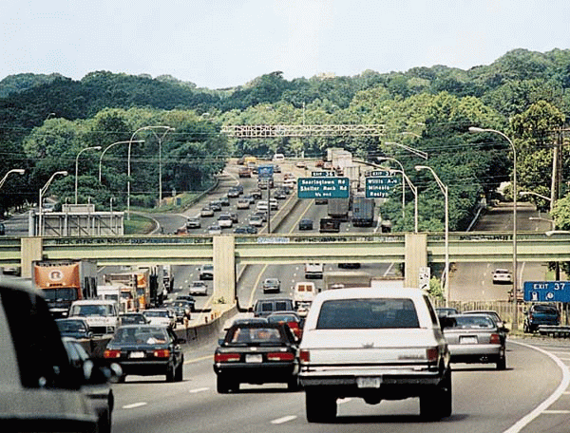

Slide 9
Benefits of A+B Bidding
Encourages contractors to develop detailed well thought out plans in order to bid on the time to complete a project or project phase.
More efficient contractors can generally bid shorter times.

Slide 10
Benefits of A+B Bidding
Encourages contractors to:
Schedule operations to maximize efficiency of crews and equipment.
Work OT, double shifts, at night.
Develop innovative ways to reduce construction duration at the lowest cost during bid preparation and construction.

Slide 11
Applicability of Use in
Other Locations
A+B Bidding is being used in many areas of the US.
State Bidding Laws vary and must be reviewed.

Slide 12
Lessons Learned
Design Phase
Project selection
  Avoid projects where unanticipated conditions are likely to be encountered,i.e., utilities, rock, historical artifacts,etc.
  Protect environmentally sensitive areas from high production construction operations.
  Consider “B” portion work for critical phases instead of the whole project.

Slide 13
A Good Application For A+B
Bridge replacement project / off-site detour.
Contractors bid on bridge closure duration.
Timing of bridge closure coordinated with shop drawing submittals, ordering and delivery of materials, and other preparatory work.

Slide 14
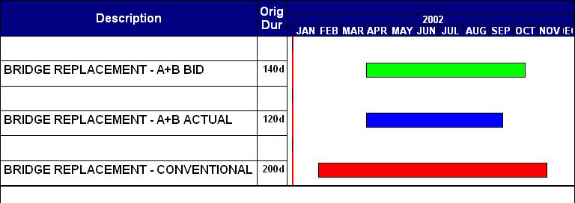
A Good Application For A+B

Slide 15
Lessons Learned
Design Phase
User delay cost calculations
Description of “B” portion work
Constructability reviews
Accuracy of Department estimate of time

Slide 16
Lessons Learned
Construction Phase
Time as a pay item
Critical path method scheduling
Time adjustments due to changed conditions
  Added rehab. work, utilities, subsurface conditions, drainage redesign, piles, lane closure delays / revised restrictions
Overtime pay for inspection, night work, multiple shifts - offset by shorter duration.

Slide 17
Lessons Learned
Construction Phase
Contractors shift experienced staff to A+B projects.
Contractors propose innovative ways to accelerate.
  Revised M&PT schemes
  Use of precast concrete or modular items
  Use of new technology
Change proposals that save time may also save money – Value Engineering provisions.

Slide 18
A+B Bidding Results
NYSDOT has used A+B bidding on more than 150 contracts.
Contractors are bidding 31% below Engineers estimated time and completing work ahead of schedule.

Slide 19
A+B Bidding Results
133 projects completed “B” portion work.
  Original contract value = $ 2.2 billion
  98 contracts awarded to low “A” portion bidder.
  35 contracts awarded to a bidder with a higher “A” cost and shorter “B” duration.
  Added “A” cost of these 35 contracts is less than 1%.

Slide 20
Time & User Cost Savings
133 projects completed “B” portion work.
  114 earned incentives, total $ 57.6 million.(2.5% of orig. contract value)
  10 completed on time, no incentive or disincentive.
  9 assessed disincentive of $ 625,000.

Slide 21
Time & User Cost Savings
133 projects completed “B” portion work.
  42 % of B periods required time adjustments.
  $ 305 million estimated user cost savings.
  23,000 construction days saved.

Slide 22
Additional Information
NYSDOT engineering instruction 99-033.
Guidelines for use of time-related contract provisions.
Http://www.dot.state.ny.us/cmb/consult/eib/files/ei99033.pdf.

