Slide 1
CAISO Transmission Evaluation Assessment Methodology
(TEAM)
SSG-WI Planning Work Group
June 15, 2004
Mingxia Zhang, Ph.D.
Principal Economist
CAISO Market Analysis

Slide 2
Presentation Outline
Briefly explain the five key components of the CAISO methodology
Focus on one key component: market price modeling
Present the results of the Path 26 application

Slide 3
The CAISO Methodology
Objective: Develop a comprehensive methodology to evaluate the economic benefits of transmission expansion in a wholesale market regime
Our June 2 CPUC filing of the methodology with Path 26 Study represents the CAISO’s research and development over two years.
The general methodology developed jointly with London Economics was filed with CPUC in February 2003
The refined general methodology with Path 26 Study was filed with CPUC on June 2, 2004
The methodology and the Path 26 application went through a steering committee and stakeholder process during this two-year period

Slide 4
The Five Key Components of the CAISO Methodology
  Benefits Framework - Standard framework to measure benefits regionally and separately for consumers, producers, and transmission owners
  Market prices – Utilize market prices to evaluate transmission expansion
  Uncertainty - Consider a wide range of future system conditions to compute expected benefit, most likely range of benefit, and insurance value of a proposed upgrade
  Network representation – Demonstrate flow is physically feasible
  Generation/Demand side substitution – Evaluate alternatives to transmission expansion

Slide 5
Flow Chart of the CAISO Methodology
Determine Input Data
Existing transmission topology - Existing generation
Demand forecast - Hydro availability
Natural gas price forecast - Long-term energy contracts
Transmission limits - Near-term new generation/transmission
Sensitivity Case Selection
Demand
Natural gas price
Hydrology
New generation entry
Price-cost markup
Contingency events
PLEXOS Model
WECC detailed transmission network and DC power flow
Security constrained economic dispatch
Generation marginal cost bidding or strategic bidding
Benefit components calculation
Sensitivity Results
Sensitivity Weighting
Expected Benefit
Benefit Range
Insurance Value

Slide 6
What is Market Based Simulation?
Resource planning studies typically rely on production cost simulations to evaluate the economic benefits of new infrastructure.
In a market environment, prices are determined by market bids, which may or may not reflect a unit’s marginal cost of production.
  Assuming marginal cost bidding can lead to inaccurate benefit estimates and may fail to capture the benefits that infrastructure investments can have in improving market competition.
  Assessing the benefits of transmission and generation additions in a market environment should be based on a predictive model of “strategic bidding” rather than an assumption of marginal cost bidding.
  “Strategic bidding” – Suppliers bid differently depending on system conditions and/or expectations of how others are bidding.

Slide 7
Today’s Topic: Market Based Simulation
Issue: How generators’ bidding behavior should be modeled in a wholesale market regime?
Traditionally, cost-based bidding
Historical evidences indicate that generators might bid above their marginal costs
More importantly, transmission expansion can enhance market competitiveness and our methodology should capture this benefit

Slide 8
Today’s Topic: Market Based Simulation
Goal is to perform transmission evaluation based on market prices rather than traditional cost-based analysis.
More specifically, to model suppliers’ strategic bidding behavior and how their bidding behavior changes with the transmission upgrade.

Slide 9
Today’s Topic: Market Based Simulation
Modeling strategic bidding is difficult
  Game theoretical approach
    Cournot-Nash game (physical withholding)
    Supply function equilibrium (economic withholding)
    These methods are difficult to implement in a complex network model
  Empirical approach
    Regression relates price-cost mark-up with Residual Supply Index
    Regression parameters estimated for California
    Parameters for outside control areas could be based on backcast simulation and calibration (or regression analysis)
    Can be applied to zonal configuration of network models
    Can be applied with calibration to nodal network models

Slide 10
An Empirical Approach to Model Strategic Bidding
Develop historical relationship (regression) between price-cost markups and certain system conditions.
Use the regression results to predict bid-cost markups under future system conditions.
Apply the bid-cost markups to the supply bids and run the model to determine dispatch and market clearing prices.
Note:
  Historical Price-Cost Markups are based on the difference between actual zonal market prices and estimated competitive prices.
  Bid-Cost Markups are estimated and used prospectively in the transmission study. Bid-Cost Markups reflect the difference between the variable cost of a generating unit and a market-based bid.

Slide 11
Price-Cost Markup Regression Results
Estimate relationship between price-cost markups (PMU) and system conditions
  Using hourly data covering Nov-99 to Oct-00 and 2003.
  The price-cost markup (PMU) is expressed as the Lerner Index.
  Lerner Index at region i and hour t is:
    PMU_{it}=(P_{it}-C_{it})/P_{it}
    where P_{it} = Actual price in region i and hour t
    C_{it} = Estimated competitive price in region i and hour t
  System conditions are represented by several key variables (e.g., RSI, % of Un-hedged load, etc.)

Slide 12
Residual Supply Index (RSI)
A Residual Supply Index provides a good measure on the extent to which the largest supplier in the market is “pivotal” to meeting demand.
  RSI = (Total Supply – Largest Supplier’s Supply)
Total Demand
An RSI value less than 1 indicates the largest supplier is pivotal in meeting demand.
In the CAISO markets, RSI values less than 1.2 have generally been associated with market prices in excess of estimated competitive levels.
RSI can capture the impact of transmission upgrade on supply/demand balance.

Slide 13
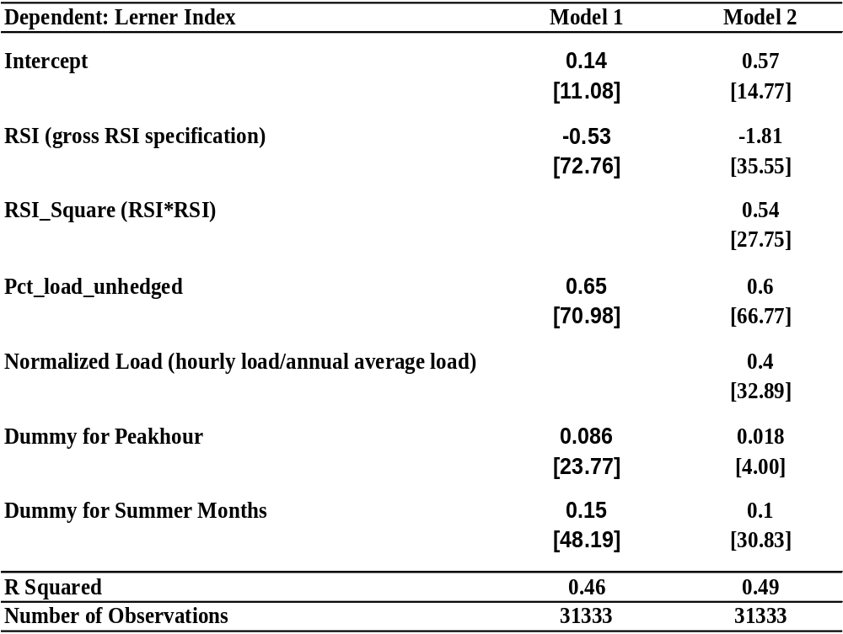
Regression Results

Slide 14
Application of Regression Results to Predict Bid-Cost Markups
Apply regression results prospectively to predict hourly price-cost markups in years 2008 and 2013.
Use predicted price-cost markups as bid-cost markups.
Markups are estimated separately for each hour and each demand region (i.e. PG&E, SCE, SDGE).
3 Levels of Bid-Cost Markups: Base, High, and Low.
Base Markup Case: directly derived using regression coefficient estimates with some calibration.
High and Low Markup Cases: derived based on 90% confidence intervals of predicted markups with some calibration.

Slide 15
High, Low, and Base Markup Cases
Predicted Markup
High Markup Case
Base Markup Case
Low Markup Case
90% Confidence Interval
Future System Conditions

Slide 16
Implementing
Bid-Cost Markup Approach in PLEXOS
Bid-Cost Markup functionality is incorporated directly into PLEXOS
  RSI and other determinants of predicted bid-cost markups can be computed internally in PLEXOS
  The projected bid-cost markups can be automatically incorporated into the market-price run
  The benefit computation can be computed directly in PLEXOS

Slide 17
Potential Future Enhancements to
Market Price Modeling
Further refinements to econometric approach
  Regression based on “bid-cost” markups rather than “price-cost” markups
  Refine the methodology to compute the competitive market clearing price
Explore game theoretical approaches
  Conjectural model (developed by London Economics)
  Cournot model applied in the full network model
  Supply Function Equilibrium approaches

Slide 18
Application of the CAISO Methodology to the Path 26 Upgrade
A complete walk through of the CAISO methodology using this case study
The intension is to demonstrate almost all aspects of the methodology.
It is not a definitive Path 26 upgrade benefit-cost analysis.

Slide 19
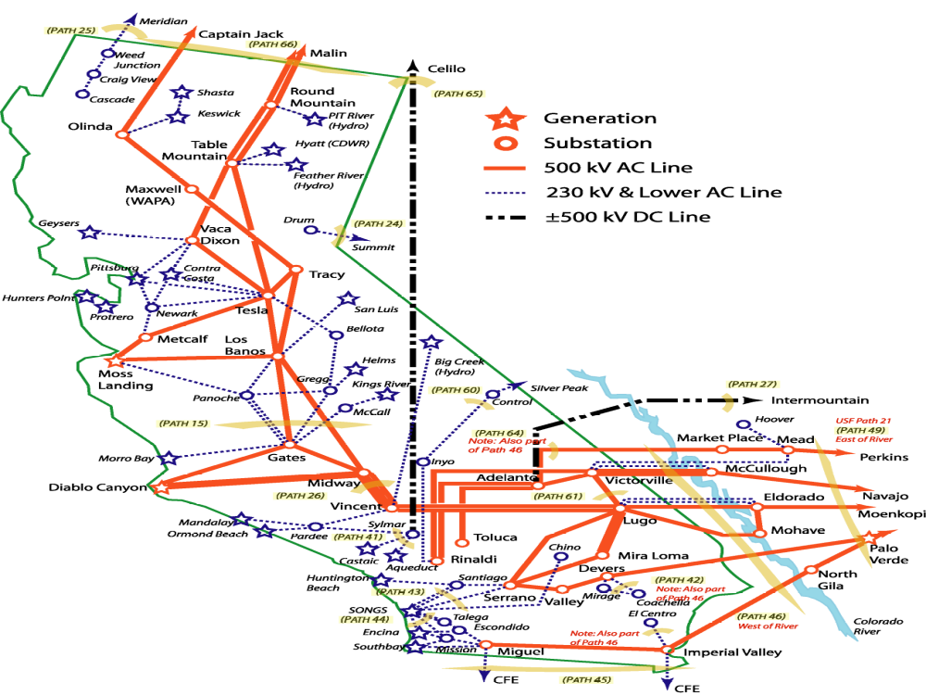
Path 26

Slide 20
Path 26 Latest Rating
Path 26 consists of three 500 kV lines between Midway and Vincent
On 7/17/2003, WECC-PCC approved path rating increase from bidirectional 3000 MW to 3400 MW (N-S) and 3000 MW (S-N)
New rating required implementation of SPS to trip generation north of Midway to mitigate for N-2 overload

Slide 21
Proposed Path 26 Upgrade
Possible short term upgrade to 3700 MW (N-S) by expanding the SPS.
Based on high-level screening analysis, new proposed rating is 4400 MW (N-S) and 4000 MW (S-N)
Model of Midway – Vincent #3 will be the same as Midway – Vincent #1 and #2

Slide 22
Proposed Path 26 Upgrade
New rating will require,
Reconductoring of Midway – Vincent #3 Line
Replacing Midway – Vincent #3 series capacitors
Replace wave traps, breakers and current transformers
Reconductoring Vincent – Antelope #1 230 kV Line

Slide 23
Path 26 Case Study Results
2008, Base System Condition
 | Cost-Based | Market-Based
WECC Total Societal Benefit (Production Cost Saving) | $ 1.00 M | $ 4.28 M
WECC Total Modified Societal Benefit | $ 1.00 M | $ 7.04 M
CAISO Participants Modified Benefit | $ 0.50 M | $ 11.99 M
CAISO Ratepayers Modified Benefit | $ 2.10 M | $ 19.00 M

Slide 24
Path 26 Case Study Results
2013, Base System Condition
 | Cost-Based | Market-Based
WECC Total Societal Benefit (Production Cost Saving) | $ 0.55 M | $ 2.21 M
WECC Total Modified Societal Benefit | $ 0.55 M | $ 12.93 M
CAISO Participants Modified Benefit | $ 0.67 M | $ 18.04 M
CAISO Ratepayers Modified Benefit | $ (0.04) M | $ 8.07 M

Slide 25
Path 26 Case Study Results
2008, Probability-Weighted Expected Benefits
 | Cost-Based | Market-Based
WECC Total Societal Benefit (Production Cost Saving) | $ 0.89 M | $ 3.05 M
WECC Total Modified Societal Benefit | $ 0.89 M | $ 4.46 M
CAISO Participants Modified Benefit | $ 1.46 M | $ 10.29 M
CAISO Ratepayers Modified Benefit | $ 0.24 M | $ 8.65 M

Slide 26
Path 26 Case Study Results
2013, Probability-Weighted Expected Benefits
 | Cost-Based | Market-Based
WECC Total Societal Benefit (Production Cost Saving) | $ 0.67 M | $ 2.11 M
WECC Total Modified Societal Benefit | $ 0.67 M | $ 8.64 M
CAISO Participants Modified Benefit | $ 0.63 M | $ 12.17 M
CAISO Ratepayers Modified Benefit | $ 0.49 M | $ 6.43 M

Slide 27
Path 26 Case Study Results
Insurance Value Under Contingency Situation (PDCI Outage)
Year 2008 | Cost-Based | Market-Based
WECC Total Societal Benefit (Production Cost Saving) | $ 2.28 M | $ 7.60 M
WECC Total Modified Societal Benefit | $ 2.28 M | $ 18.76 M
CAISO Participants Modified Benefit | $ 1.44 M | $ 13.26 M
CAISO Ratepayers Modified Benefit | $ (0.09) M | $ 14.96 M

