Slide 1
Student Advisory Council
Congressman Mike Honda
May 14, 2005
Welcome!

Slide 2
Student Advisory Council
The SAC consists of high school leaders representing various public and private schools throughout the 15th congressional district. The Council was originally designed to aid the Congressmen by providing him with a youth’s perspective on a specific issue in his district, and in turn, the Council has benefited us students as well. The Council not only provided an opportunity to be politically active but also the chance to meet and work with fellow students from all over the South Bay Area.
Cory
Notes:
Hello and welcome to the Student Advisory Council of the 15th Congressional District 2005 Voter Apathy Presentation. The Student Advisory Council, composed of 22 student representatives from high schools throughout the district, was formed to provide advice to Congressman Michael Honda from a student's perspective. At the beginning of the year, the council met at a retreat and we all became better acquainted with one another. Following this introductory phase, the group immediately began working together in an effort to aide both the Congressman and the community. Through our research and community service activities, the council grew closer and formed the relationships that enabled us to compile the required information for the following presentation. Today the council stands before you after several months of avid research ready to present our findings. So thank you all for coming and sharing this experience with us, and without further ado, our presentation:

Slide 3
High School Membership
Archbishop Mitty Kelsey Tyburski
Bellarmine Julian Bruce Jonathan Padilla
Minesh Patel *Jonathan Weed
Cupertino Jenny Lee
Gilroy Daniel Bischoff Amy Kishimura
Harker School Ruchi Jhaveri Salman Kothari
Leigh Jasdeep Bains Arundathi Gururajan
Michelle Mitchell
Leland *Cory Hammon Michelle Man
Los Gatos Hannah Ahmed Nathanial Henry
Milpitas Edward Gardina Amber Manglona
Monta Vista Anya Erokhina Eugene Li
Santa Clara Candace Nisby
Westmont Amy Harmer
* Denotes SAC Co-Chair
Cory

Slide 4
Problem Statement
?
How can we encourage informed civic decision-making among the youth of the 15th Congressional district, thereby empowering them to debunk the political apathy myth by voicing their concerns?
Jonathan

Slide 5
Methodology
Students distributed ~ 1200 surveys to 12 schools in the 15th district
~750 surveys were returned
Students administered and recorded surveys to Junior and Senior peers in their school
Students processed the data on a computerized analysis system and examined the data for biases and potential correlation
Jonathan

Slide 6
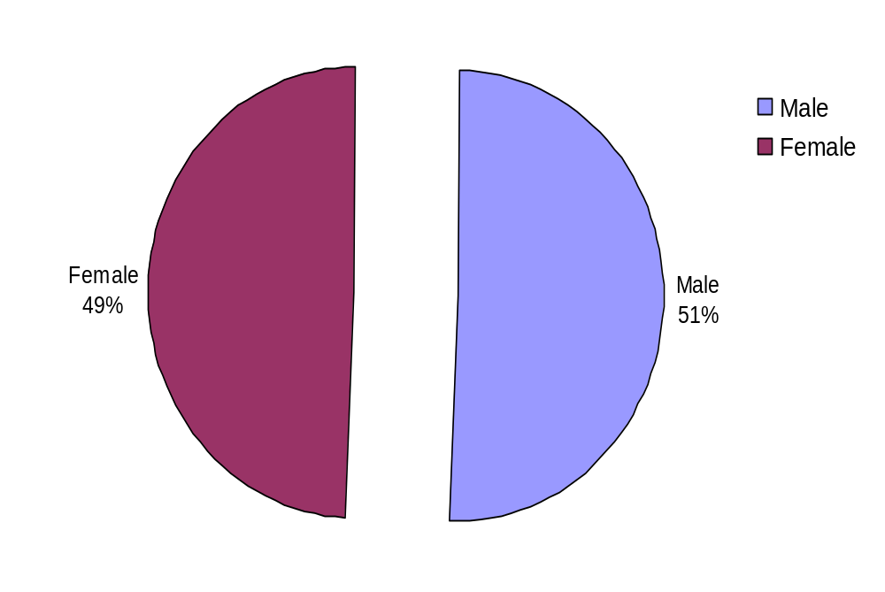
Gender
Minesh
Notes:
Our survey is wide ranging, and it considers slightly more men than women
Men make up 51% of our survey results, whereas women makeup 49% of our survey results.

Slide 7
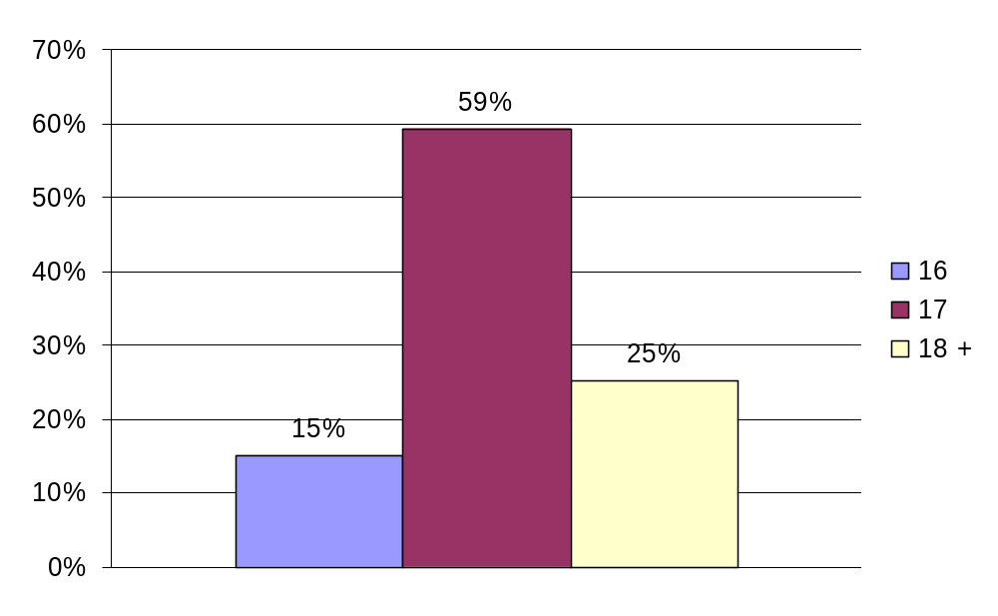
Age
Minesh
Notes:
The goal of our survey was to ascertain the opinions of predominantly high school seniors and juniors. Thus, we have done this with the over whelming majority of our results coming from both seventeen and eighteen year olds.
Sixteen: 15%, Seventeen: 59%, Eighteen: 25%

Slide 8
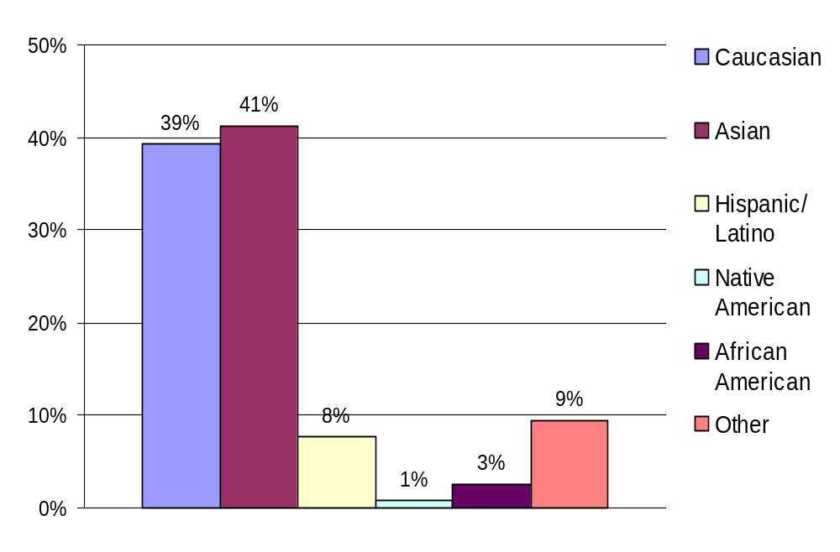
Ethnicity
Minesh
Notes:
Our results indicate the demographics of the 15th Congressional District.
Surveys were given to students in both AP/Honors classes and regular classes at local public and private high schools.
Caucasian: 39%, Asian: 41%, Hispanic/Latino: 8%, Native American: 1%, African American: 3%, Other: 9%.
This reflects the growing Asian and Hispanic population within the Silicon Valley.

Slide 9
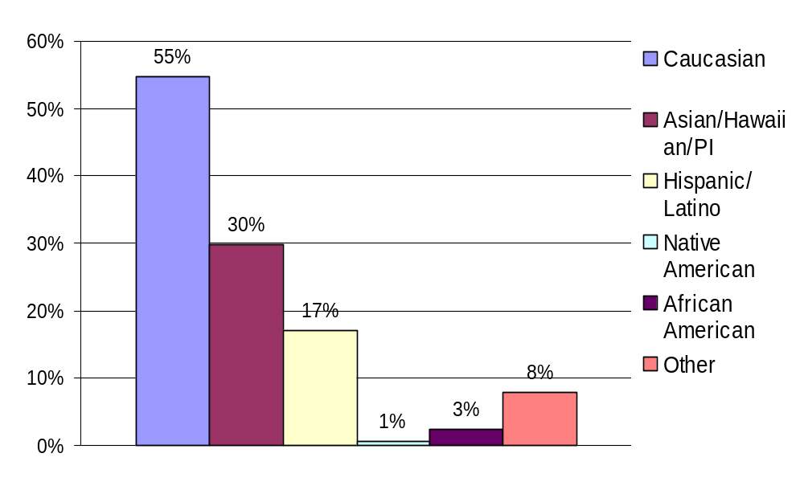
CA 15th Congressional
District Demographics (2000)
Ethnicity

Slide 10
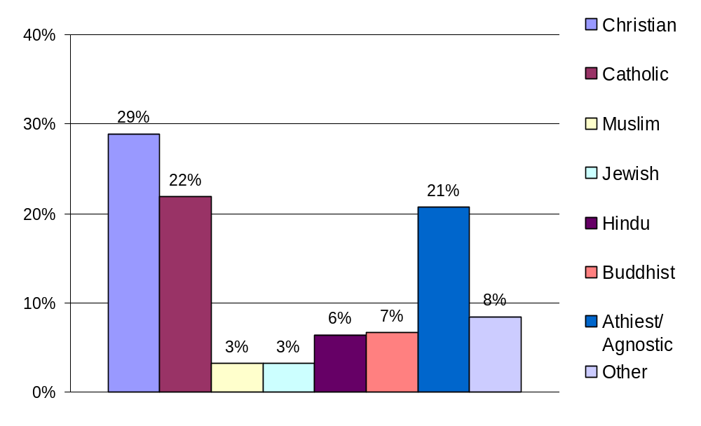
Religion
Minesh
Notes:
Similar to ethnicity, the religions that were taken into account within our survey reflect the diversity of the Silicon Valley.
Aside the various branches of Christianity, the other religions are distributed almost evenly.
Christian: 29%, Catholic: 22%, Muslim: 3%, Jewish: 3%, Hindu: 6%, Buddhist: 7%, Atheist/Agnostic: 21%, Other: 8%.

Slide 11
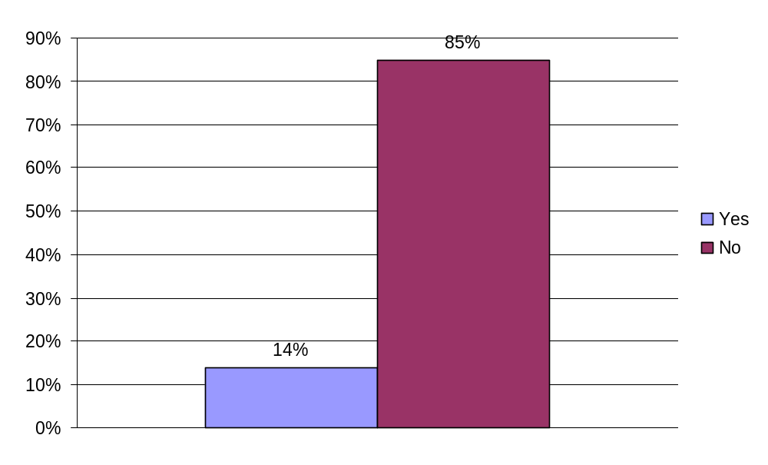
Voting in student government elections is mandatory at my school.
Amy H.
Notes:
Of those who said that voting was mandatory 22% more boys said yes than girls.
Of those who said that voting was mandatory 39% said they were Catholic, versus those who said voting was not mandatory only 19% were Catholic.
Surprisingly of those who said that voting was mandatory only 85% said they voted vs. 65% who voted when they said that voting was not mandatory

Slide 12
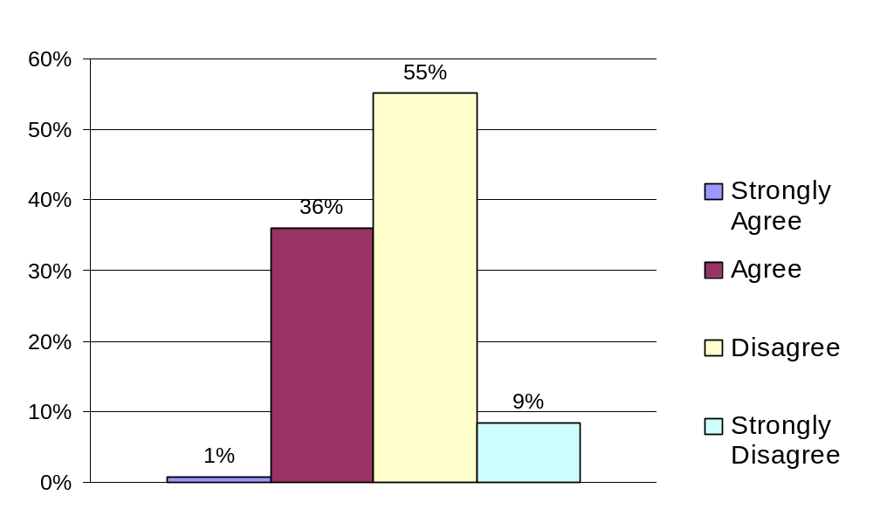
Most students at my school take student government elections seriously.
Amy H.
Notes:
Because only 1% of the population said they strongly agreed with this statement I focused on the other three. Some significant observations:
Among those who said they agreed that most students take elections seriously only 20% said they thought they could express their political views openly in class.
Of those who strongly disagreed with this statement 54% said they never participated in School activities.
77% of the students who strongly disagreed with this statement were male.

Slide 13
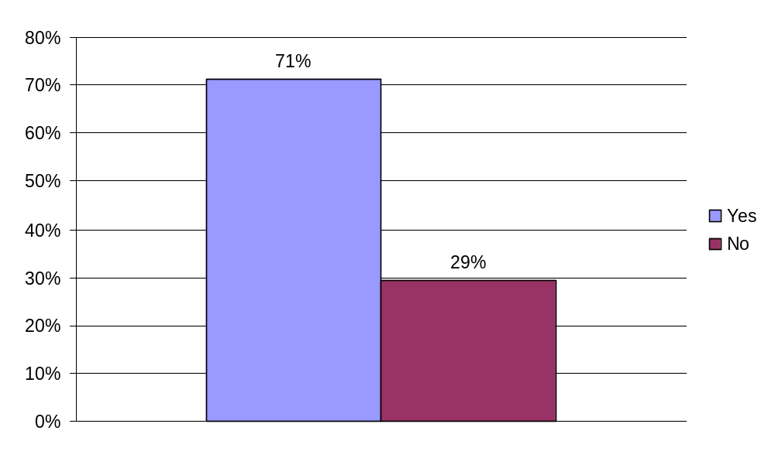
I voted in my last high school election.
Amy H.
Notes:
Things that had a positive influence on whether or not someone voted
Clubs…
Of the people who said that they had voted, 85% said that they belonged to clubs versus 48% of the people who did not vote.
Mock Election…
In response to the question about an on campus mock election, 51% of the people who said that they had voted, had a mock election. In contrast, of those who said they did not vote, only 24% held mock elections.
Things that had a negative influence on whether or not someone voted
Ran/Applied…
Among those who did not vote 92% said they had never run for a student body office. In contrast only 66% of those who said they had voted had run for a student body office.
I participate in school activities…
When asked how often they ever participated in school activities, those students who had not voted were 36% more likely to answer “never” than those who voted.

Slide 14
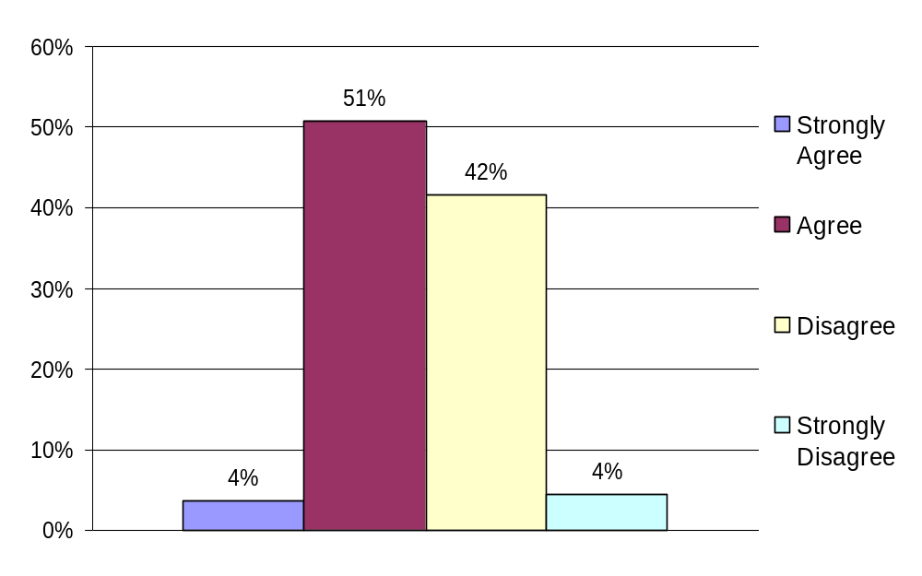
I feel that student government adequately addresses students’ needs.
Jenny

Slide 15
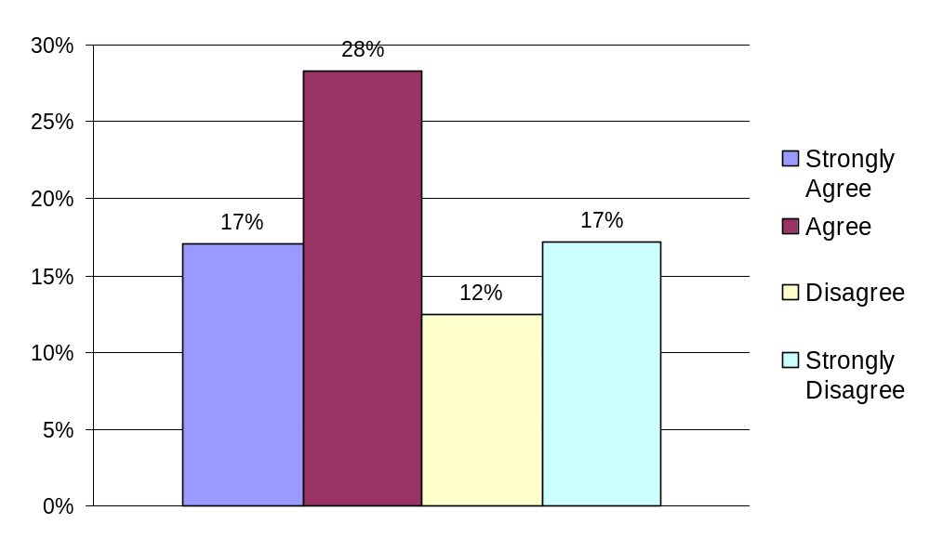
The administration at my school has too much control over student government.
Jenny

Slide 16
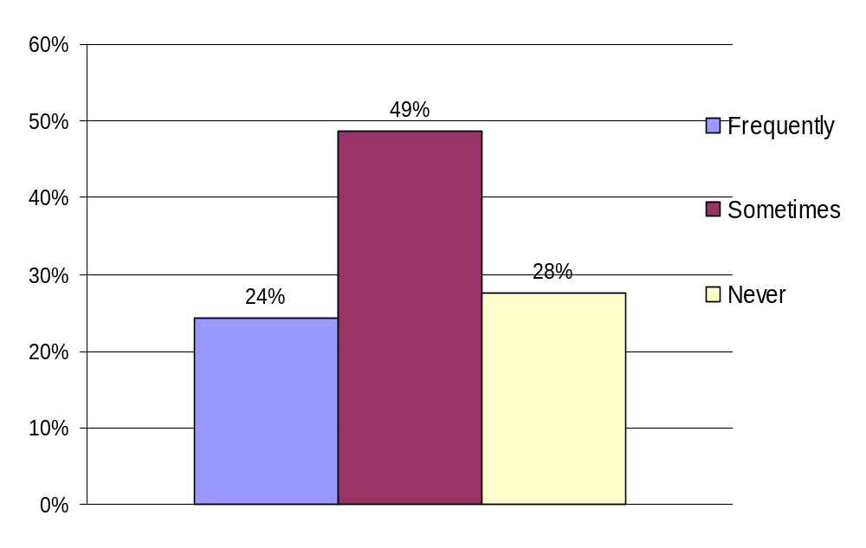
I participate in activities that my student government plans.
Kelsey
Notes:
Of the 24% of respondents who chose “Frequently”, 40% were male and 60% were female. Of the 28% of respondents who chose “Never” 64% were male and 35% were female.

Slide 17
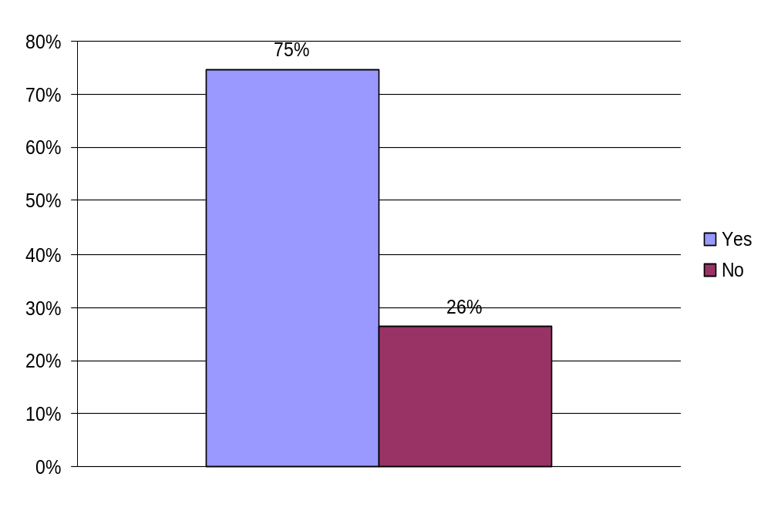
I belong to a club on campus.
Kelsey
Notes:
Q: I belong to a club on campus: Yes or No
Results: 75% yes and 26% no.
Question Analysis:
Being in a club as a teen allows your mind to be sent on something we enjoy doing. We may join the Art club, the chess club, the culinary club, etc. Joining clubs such as these allows our minds to focus on these subject areas, maybe taking the thought away from politics. Most teens don’t join a political club because it does not interest them, or maybe there isn’t even an opportunity to join a club such as this as it does not exist. Joining clubs puts other matters on our minds, if only for some time being. Being involved with clubs or activities of this nature can distract us from what may be going on in our politics today. This may be why so many teens do not know what is actually going on.
Of the 26% of students the responded "No" to this statement, 60% were Male and 39% were Female.

Slide 18
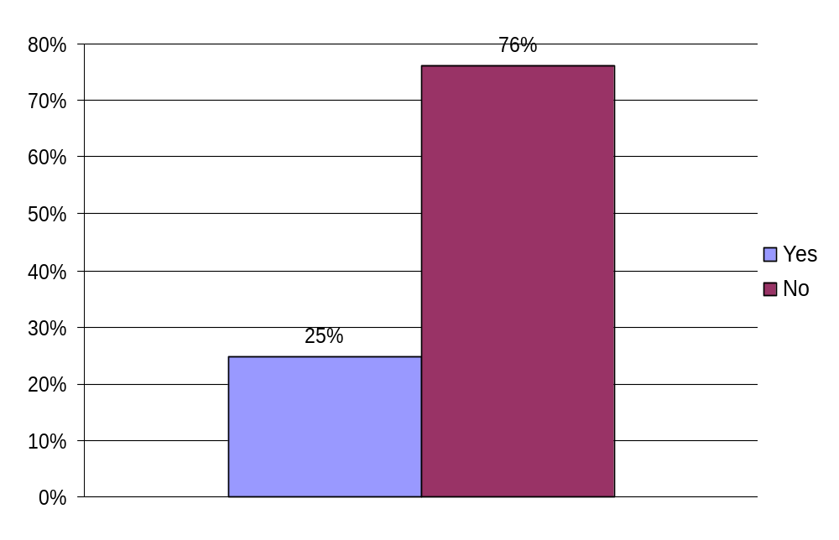
I have been active in a form of student government during high school.
Ruchi
Notes:
Cross tabs:
Of the 25% who responded “Yes” to this statement, 38% were Male and 62% were Female. Of that same 25%, 36% were Caucasian and 48% were Asian.

Slide 19
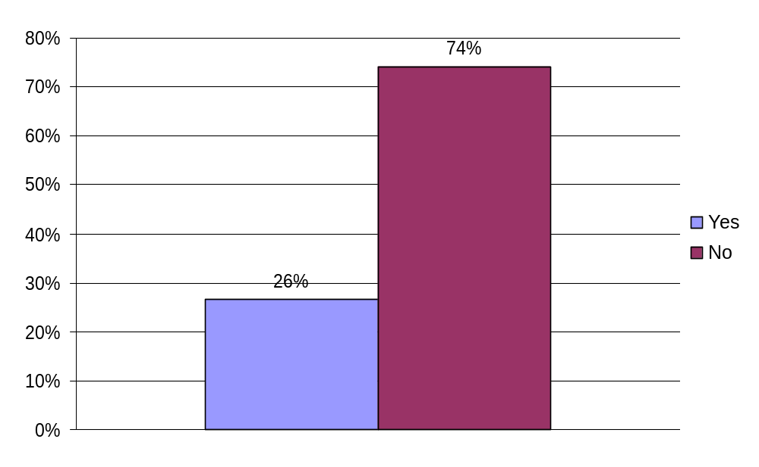
I ran for a position or applied for a non-elected position in student government during high school.
Ruchi
Notes:
Of the 26% of students who responded yes to having ran for a position in their school’s student government, 37% were male and 62% were female. Of the same 26%, 31% were Caucasian, 54% were Asian, and 6% were Latino.
On the other hand, of the 74% of students who answered No to this statement, 55% were male and 44% were female. Of the same 74%, 42% were Caucasian, 36% were Asian and 8% were Latino.
All of these statistics show that females are actually taking a larger role in their school’s student governments than males are. Perhaps because women did not have as much political power as men did many years ago, females are trying to reverse that and gain power through leadership positions. The data also shows that Asians are becoming more involved in their student governments than Caucasians and Latinos are. The cause of this is probably not due to an important correlation, but rather a result of the diverse high schools in District 15 that we surveyed.
Cross Tabs:
Of the 26% those who responded “Yes” to this statement, 37% were Male and 62% were Female.
31% were Caucasian, 54% Asian, 6% Latino, 2% African American and 10% Other.
Of the 74% of those who responded “No” to this statement, 55% were Male and 44% were Female.
42% were Caucasian, 36% were Asian, 8% Latino, 1% Native American, 3% African American and 9% Other.

Slide 20
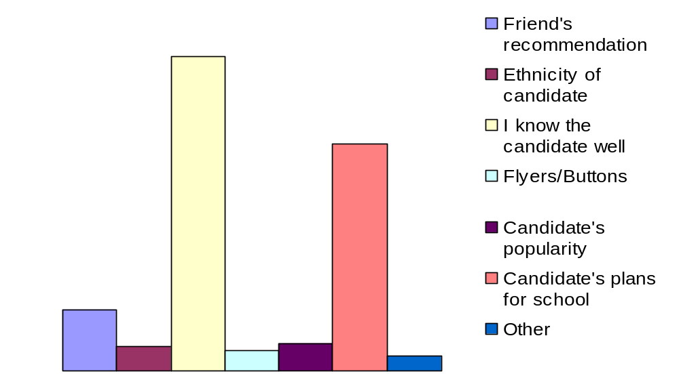
I usually make my choice in high school elections based on: (Please rank the following choices, with 1 being the most influential and 6 being the least influential).
Daniel

Slide 21
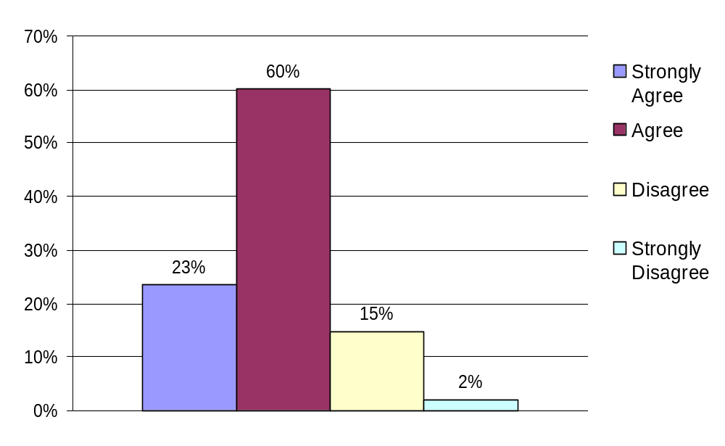
I feel like I can talk openly about my political views in the classroom.
Nathanial
Notes:
"I feel like I can talk openly about my political views in the classroom."
- The students feel that they can speak openly on their political views in the classroom by an overwhelming majority.
- Almost one quarter of those strongly agreed that they could share their views. This is definitely the bolder side of the classroom, the ones who have no problem being challenged and challenging others. They are the classroom discussion leaders primarily.
- Sixty percent of those surveyed felt that they could talk openly about their political views. These are the people who participate in discussion but do not dominate the classroom.
- Seventeen percent have trouble talking about their political views in the classroom. These students are shy, they have been stud down or embarrassed by their political views, possibly by other students or the teacher. These students probably dominate the extreme ends of the political spectrum and do not associate with those in the middle ground.
- The two percent that strongly disagreed with the survey question, they feel like they cannot participate in the classroom because they are either too shy, disagree with every political statement made, or they have zero desire to participate.
Of the 2% of students who strongly disagreed with this statement, 67% were Male and 33% were Female.
Atheist/Agnostic overwhelmingly felt they could share their views.

Slide 22
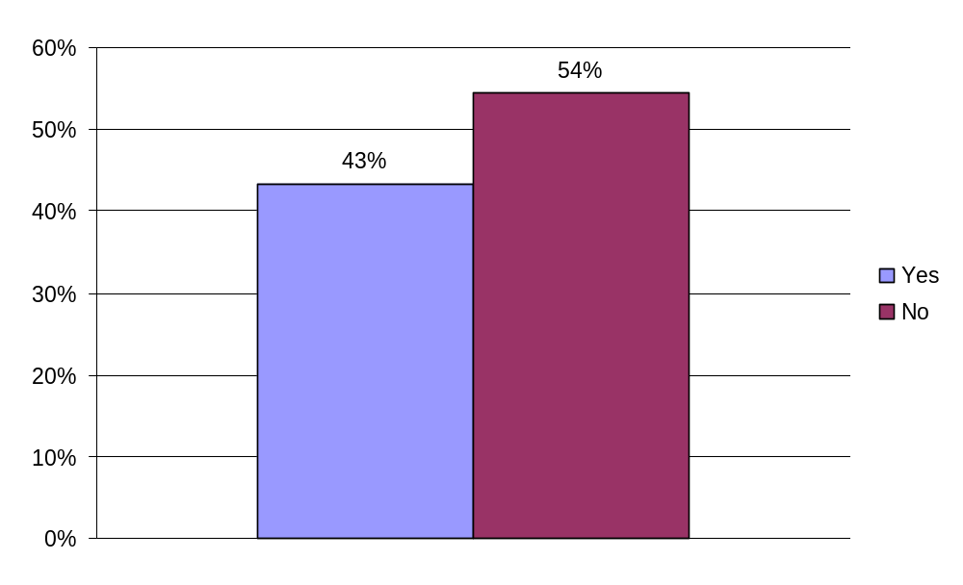
My school hosted a mock election, invited a political speaker or held a voter registration drive in the last year.
Nathanial
Notes:
"My school hosted a mock election, invited a political speaker or held a voter registration drive in the last year."
- Forty-three percent said they had one of the above at their school.
- Fifty-four percent said they did not have one of the above at their school.

Slide 23
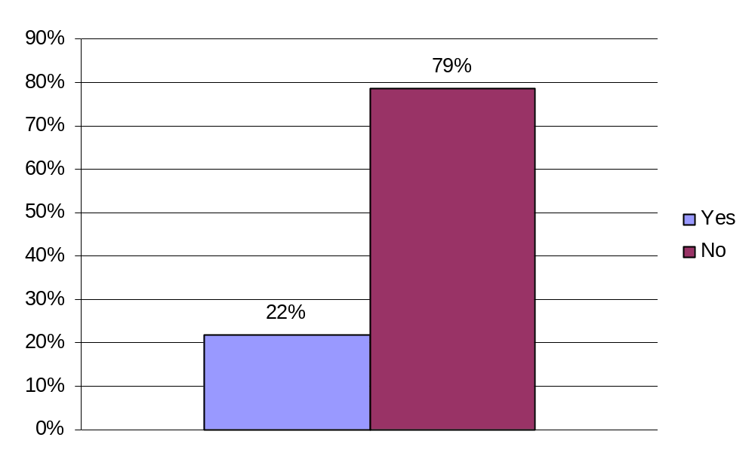
I have attended a council, school board, or other governmental meeting about an issue important to me.
Anya
Notes:
Hello, my name is Anya and I am a senior at Monta Vista High School. To the question "I have attended a council, school board, or other governmental meeting about an issue important to me," an overwhelming 79% responded no.
Perhaps this is because students are not aware of these meetings or the fact that they are open to the public. Or simply students do not care enough about local issues to attend. Of the 22% that answered yes, 41% were male and 58% were female.

Slide 24
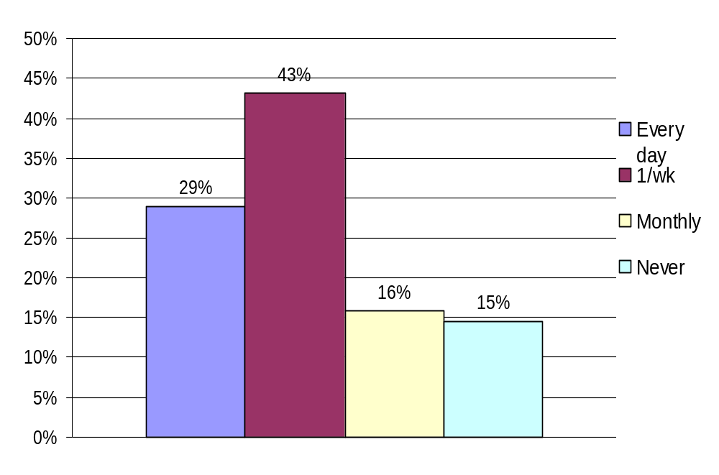
I actively read or watch news about politics.
Anya
Notes:
70% of the students surveyed answered that they actively read or watch news about politics at least once a week or even everyday. These are obviously informed and active individuals, motivated enough to keep up with current events. Unfortunately, there are still those 30% that only watch the news monthly, and even never. These students need a source of motivation so that they too can become informed citizens. Of those that watch the news more frequently, 54% were male and 44% were female.

Slide 25
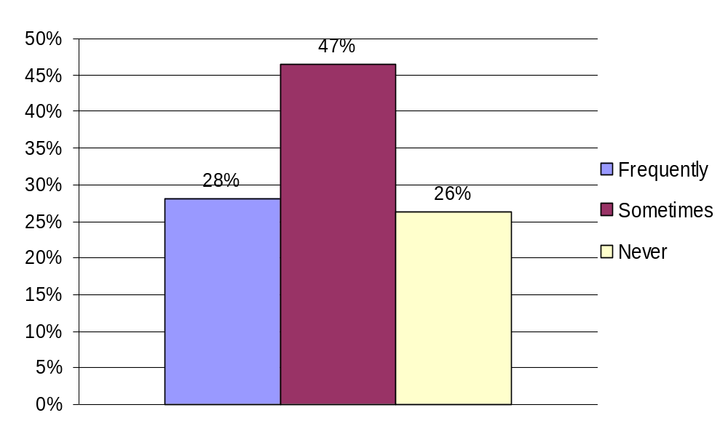
My parent/s speak to me about political issues on a regular basis.
Salman
Notes:
Parents are definitely an influence in their child’s political activity. Parents can introduce children to the realm of politics through multiple arenas, but one of the most important is mere communication. In our survey, we found that the majority of 15th district high school students (75%) have discussions, either frequently or occasionally, with their parents about political issues. Of the 28% of respondents who chose "Frequently", 53% were Caucasian, 26% were Asian, 8% were Latino and 8% were other. Of the 26% of respondents who chose "Never", 24% were Caucasian, 54% were Asian, 6% were Latino and 14% were other. Note how ethnicity is a strong factor in familial communication, implying that discourse is far easier when there are fewer language and cultural barriers to political participation.

Slide 26
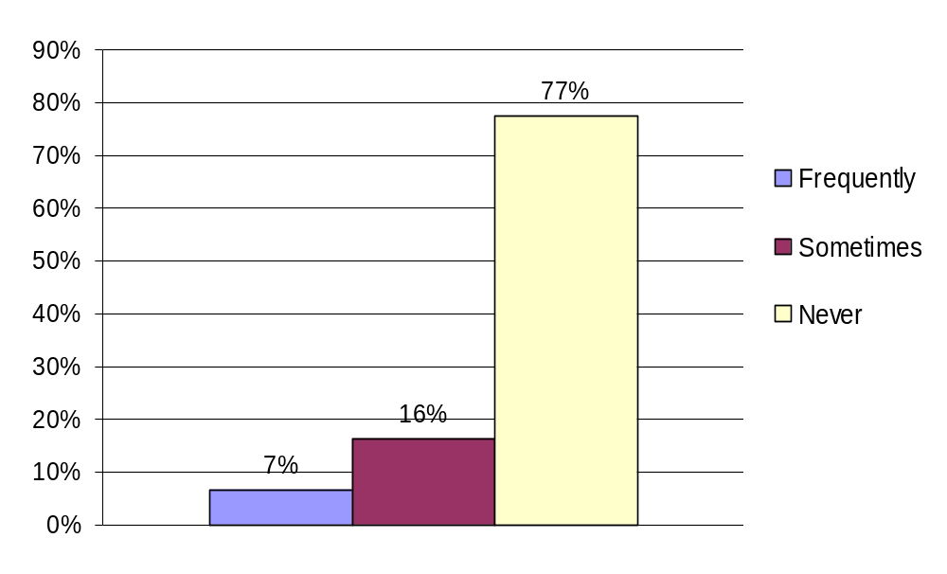
My parent/s have actively campaigned for a candidate for public office at the local, state or federal level (for instance, by putting a sign on our lawn, making phone calls or donating money).
Salman
Notes:
Parents can encourage their children to be politically aware, but also politically active. By campaigning for a candidate for public office, parents can encourage their children to get involved and take action. However, according to our survey, the vast majority (77%) of students reported that their parents never actively campaign by putting a sign on their law or making phone calls or even donating money. Of the 7% of respondents who chose "Frequently", 48% were Caucasian, only 18% were Asian, and 16% were Latino, implying again that cultural barriers may hinder political activity among parents and the youth.. 60% of the respondents also said that their parents frequently discussed politics with them. This reinforces the fact that communication about politics with parents often fosters political activism in the youth.

Slide 27
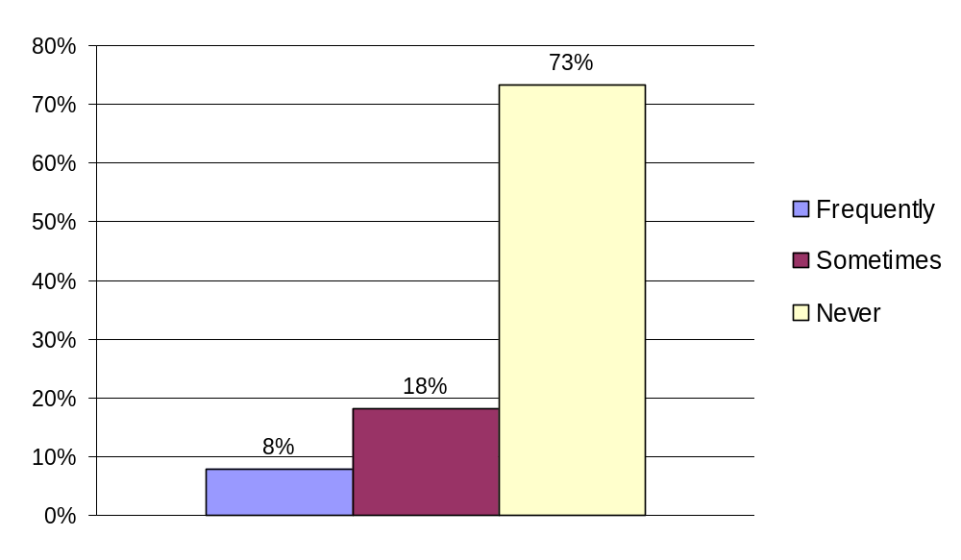
I have campaigned for a candidate/issue before (for instance, by making phone calls, walking in neighborhood or wearing buttons/pins expressing my support).
Hannah
Notes:
From this first slide we can see that the majority of the youth are not politically involved in the presidential election.
Of the 8% of respondents who chose “Frequently”, 30% were male and 67% were female. 58% also responded that their parents frequently discussed politics with them. Thus, individuals exposed to politics by their parents are more likely to develop stronger political views and as a result, campaign more.
Of the 73% of respondents who chose “Never”, 83% also stated that their parents never campaigned.

Slide 28
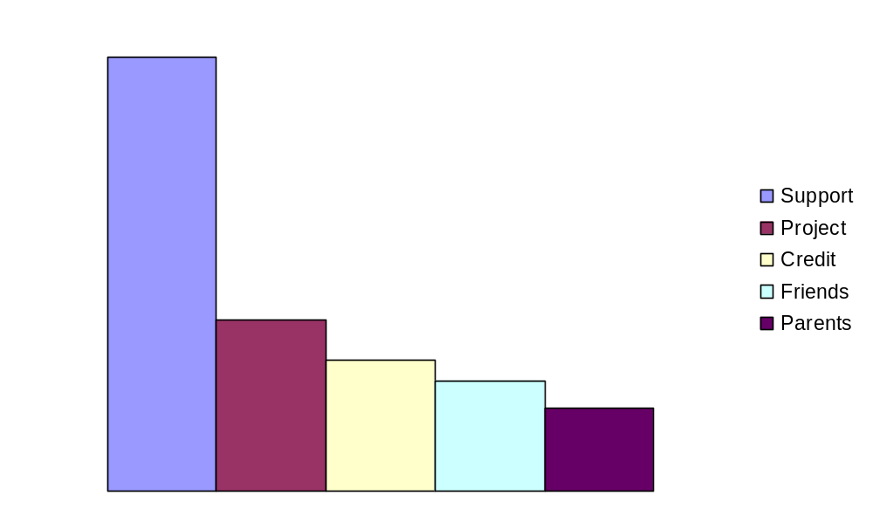
If you answered “Sometime” or “Frequently”, why did you decide to campaign? (Circle all that apply)
Hannah
Notes:
This next slide shows that the youth that are politically aware are active for the right reasons because they support the political views of that particular candidate.

Slide 29
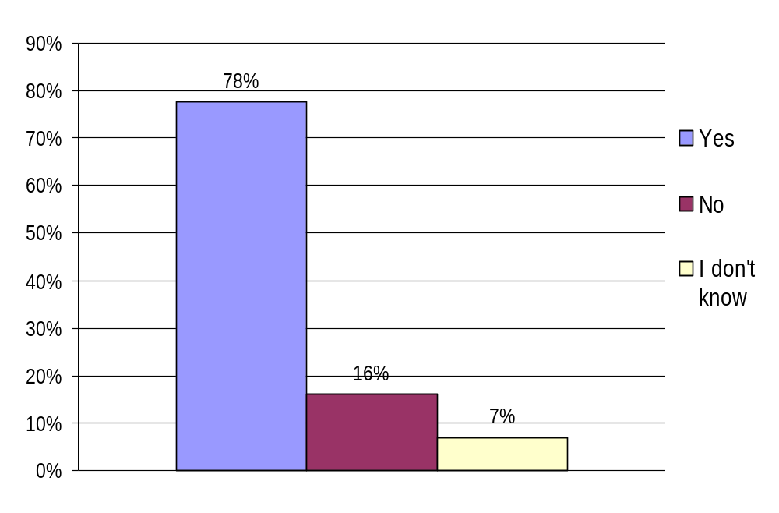
My parents voted in the last Presidential election.
Amber
Notes:
Cross tabs:
Of the 16% of respondents who chose “No”, 27% were Caucasian and 57% were Asian. 69% also responded
“yes” that members of their immediate family had emigrated to the U.S. within the last 20 years.

Slide 30
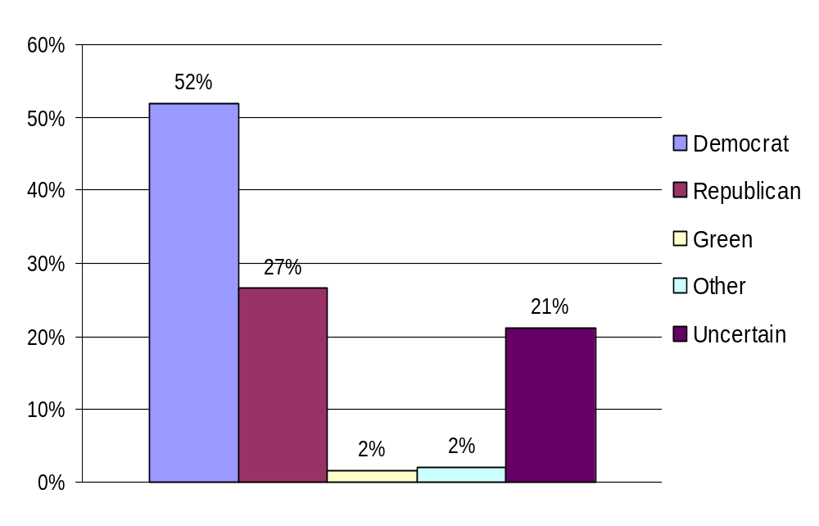
My parent/s usually vote:
Amber
Notes:
Of the 52% who responded that their parent’s usually voted as Democrats, 41% were Caucasian, 36% Asian, 11% Latino, 3% African American and 11% Other. 73% of total Latinos surveyed voted Democrat.
Of the 27% of students who responded that their parents usually voted Republican, 48% were Caucasian, 38% Asian, 5% Latino, 2% Native American, 1% African American and 5% other.
Of the 2% of students who responded that their parents usually voted Green, 42% Asian, 17% Caucasian, 8% African American and 25% other.

Slide 31
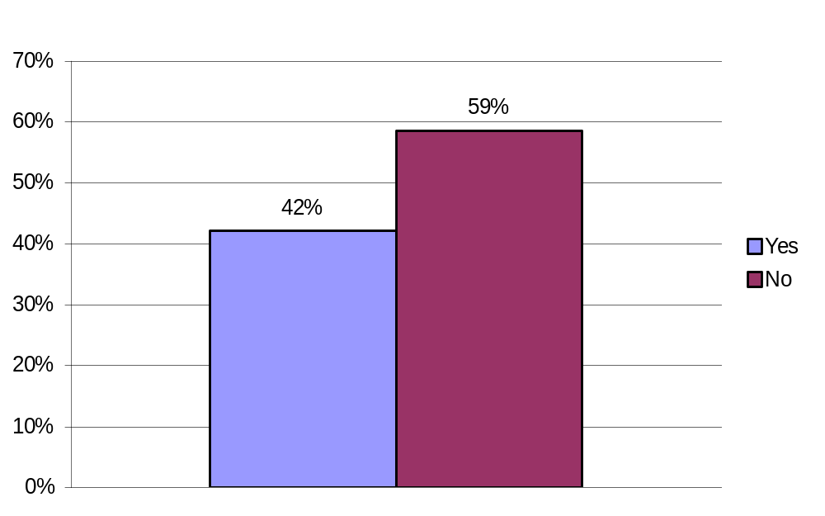
A member of my immediate family has moved to the United States from another country in the last 20 years.
Jasdeep
Notes:
Of the 42% of students who responded yes to this question, 58% were Asian, 17% were Caucasian, 6% were Latino, and 15% were other. 11% also identified themselves as practicing Hinduism.

Slide 32
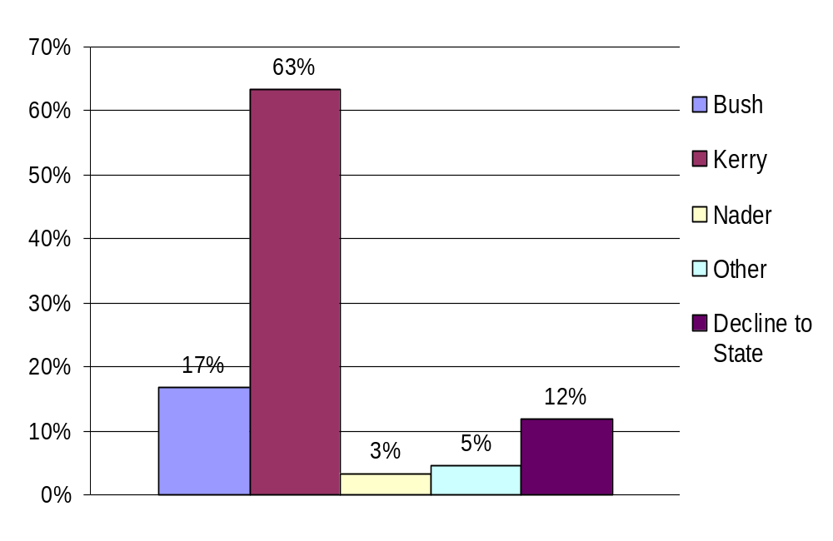
My choice for President was:
M. Mitchell
Notes:
Of the 17% of respondents who chose “Bush”, 50% were Christian and 23% Catholic. Of the 12% of respondents who chose Decline to state, 60% were Asian and 20% were Caucasian.

Slide 33
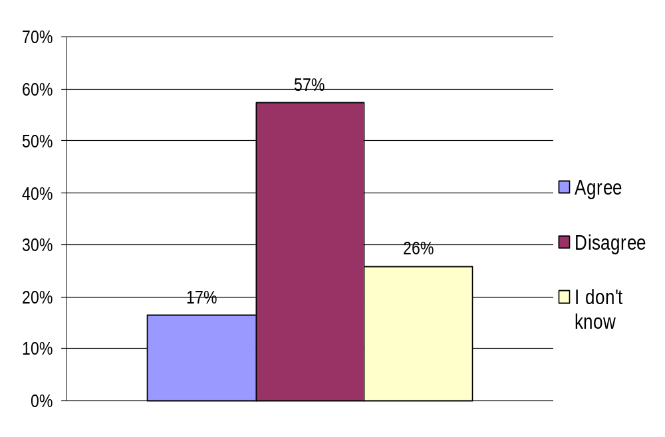
I support a different political party than my parents.
Edward
Notes:
This graph illustrates the number of polled students that represent or support a different political party than their parents. 17 percent, roughly a fifth, of the participants did not support the political party
chosen by their parents. The students within this percentage could quite possibly be a generation gap in political principles, and outlooks. An overwhelming majority of 57 percent (approximately three out of every five students), however, supported the same political party as their parents. The students comprising this majority, are most likely those that converse with their parents about political happenings, or are in some way exposed to their parents political beliefs on a reoccurring basis. 26 percent of the participating students marked that they did not know whether or not they supported the same political party as their parents, and possibly, have little to no exposure to politics within their environment. This data clearly demonstrates the influence of parents' political opinions on their children.
Of the 26% who responded don’t know, 51% were Asian, Asian parents in particular, are not discussing politics with their children.

Slide 34
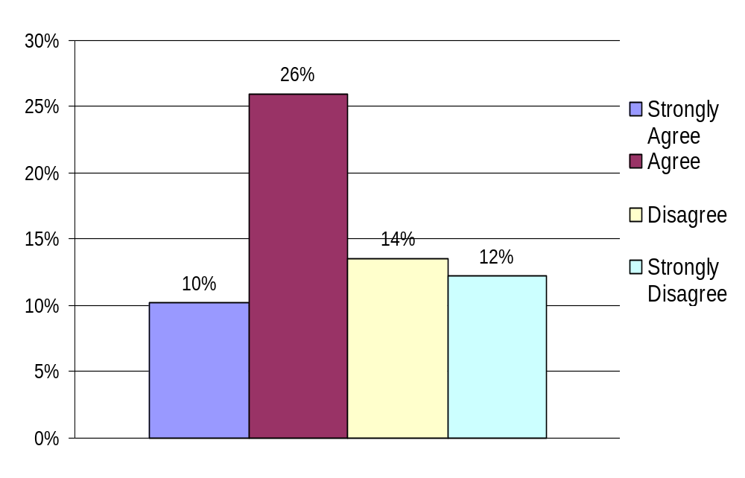
A celebrity I liked actively supported a presidential candidate.
Eugene
Notes:
A solid 26% of the people who responded stated that they agreed that a celebrity they liked supported a presidential candidate. While 26% may not seem too high, it is important to note that this nearly twice as much than the rest of the responses, with 10% at strongly agree, 14% at disagree, and 12% at strongly disagree. The results for this question could imply that the role of celebrities play a role in people’s political decisions, since people are paying attention to which celebrities support whom.

Slide 35
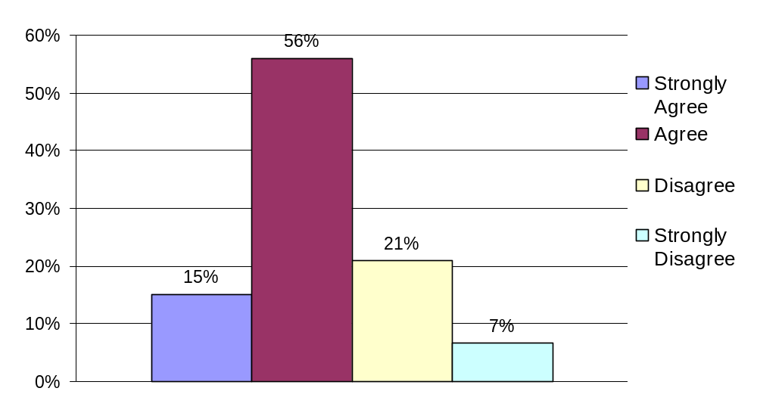
Outreach efforts by the media, like MTV’s “Rock the Vote” are effective in encouraging young adults to vote or become politically active.
Eugene
Notes:
For the question about the effectiveness of MTV’s Rock the Vote, an overwhelming 56% stated that they believed that such outreach efforts were effective in encouraging young adults to become more politically active. This could reflect the potential of using media sources to directly reach to young adults that spend some time watching TV or using the internet.

Slide 36
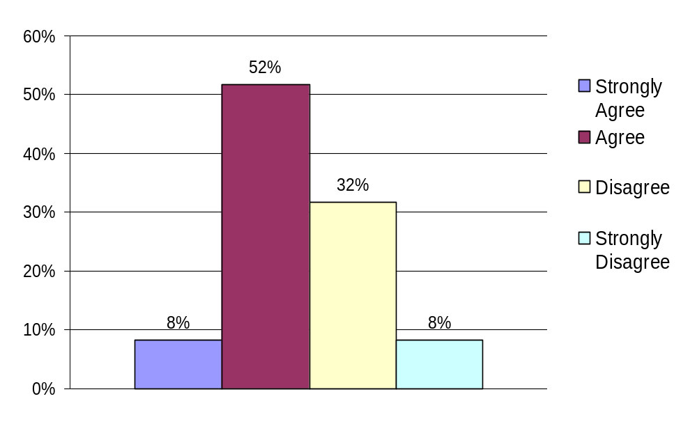
I pay attention when I see TV commercials for political candidates.
Eugene
Notes:
A resounding 52% responded that they agree that they paid attention to the political TV commercials. However, a significant 32% claimed that they disagree, which shows that some changes need to be made if commercials were to appeal more to young adults. One interesting thing to note is that respondents to this question clearly indicated that they supported Rock the Vote – for example, 51% of those who strongly agreed to paying attention to commercials claimed that they strongly agreed to the effectiveness of Rock the Vote.
In conclusion, the response to these three questions imply that the young adults are seeking ways to become more involved and aware in the political arena and also show that efforts such as MTV’s Rock the Vote do hold the attention of emerging voters of America.

Slide 37
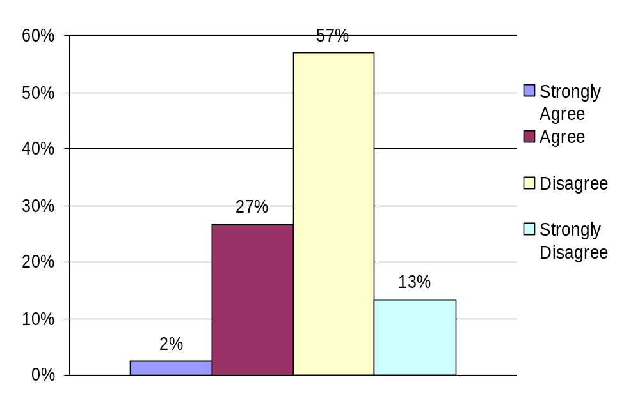
I feel that the current turnout of youth voters is acceptable.
Amy K.
Notes:
I feel that the current turnout of youth voters is acceptable.
57% of survey takers felt the current turnout of youth voters was not acceptable. The majority of these students have actually voted in their school’s student elections and their parents have also voted. Apparently school elections are more attractive or worthwhile to students than presidential elections. Only 30% of these students were involved in student government or had run or applied for a student government position.

Slide 38
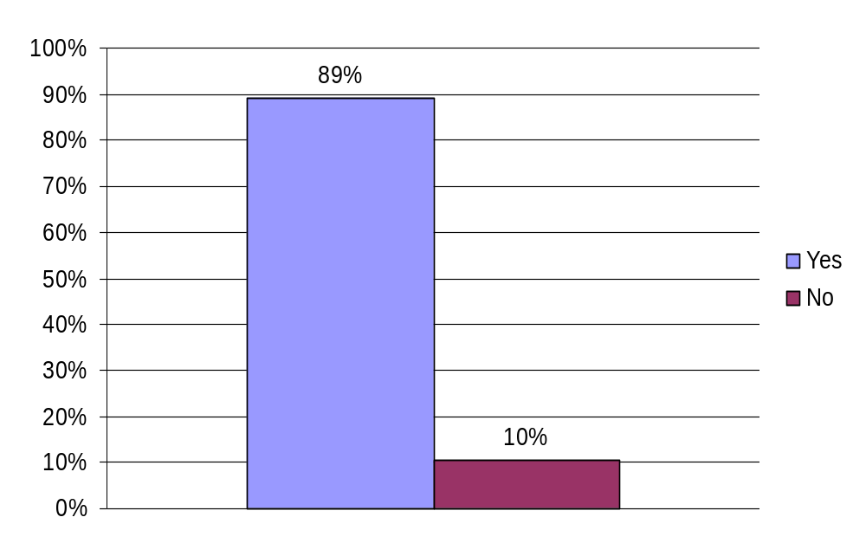
I have registered to vote or intend to do so when I become eligible.
Amy K.
Notes:
I have registered to vote or intend to do so when I become eligible.
Most of the students who took the survey, 89% to be exact, have or intend to register to vote. The parents of 80% of those who claim they have or will register, voted in the last presidential election. 73% of the students who will register have voted in their school elections, so hopefully they will continue to vote in real world political elections. However, only about a quarter of the students who intend to register have participated in school government sponsored activities. Since so few have actually participated in student government activities, it is difficult to believe they will do so in real world politics. 57% agreed that MTV’s outreach efforts labeled, “Rock the Vote”, were effective in encouraging youth to become politically active and their decision to vote may have been influenced by those efforts.

Slide 39
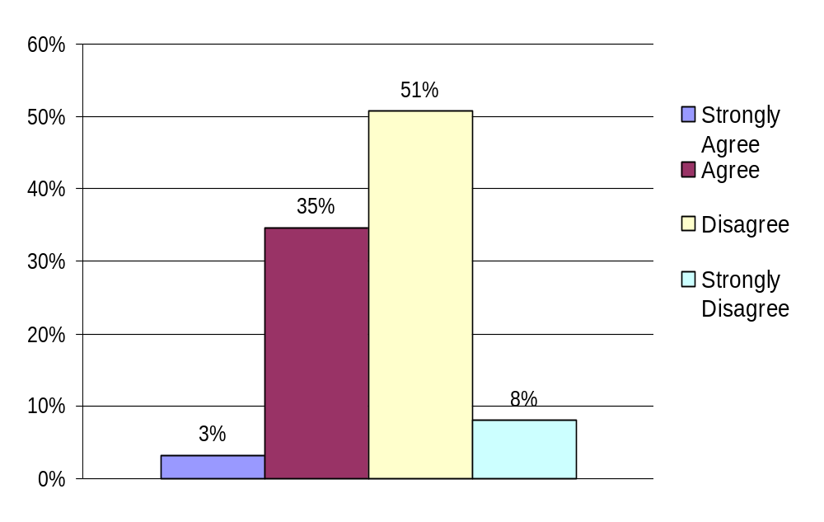
The candidates for President this year adequately encouraged youth to vote.
Amy K.
Notes:
The candidates for President this year adequately encouraged youth to vote.
About half of those students who took the survey felt Presidential candidates did not adequately encouraged youth to vote, but 31% believe they did. Most of the students who answered this question had voted in their school elections, but had not ever run or applied for a position or been involved with their school government. 55% of those who felt Presidential efforts to gain youth votes were inadequate, felt MTV’s “Rock the Vote” campaign was effective. Similar efforts by presidential candidates might be effective in gaining youth to vote for them. About half of the students unsatisfied by Presidential efforts disagreed that decisions made by elected officials affect them in a significant way. This percentage may fall if Presidential candidates paid closer attention to youth, which most students believe isn’t the case.

Slide 40
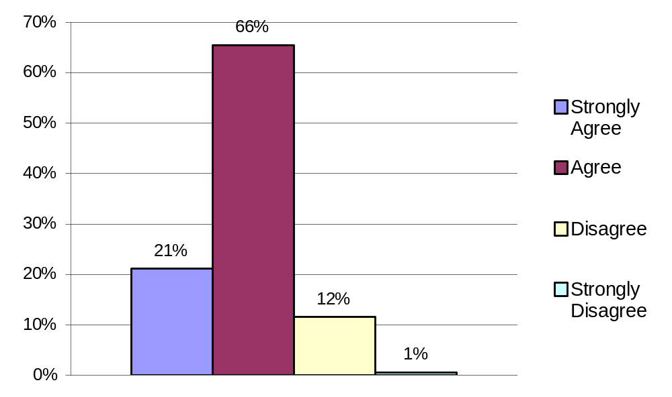
Politics is controlled mostly by money and special interests.
M. Man
Notes:
In this question, an overwhelming 87% of the students answered yes, they believed that politics is controlled mostly by money and special interests. Of those 87%, 21% strongly agreed with this statement.

Slide 41
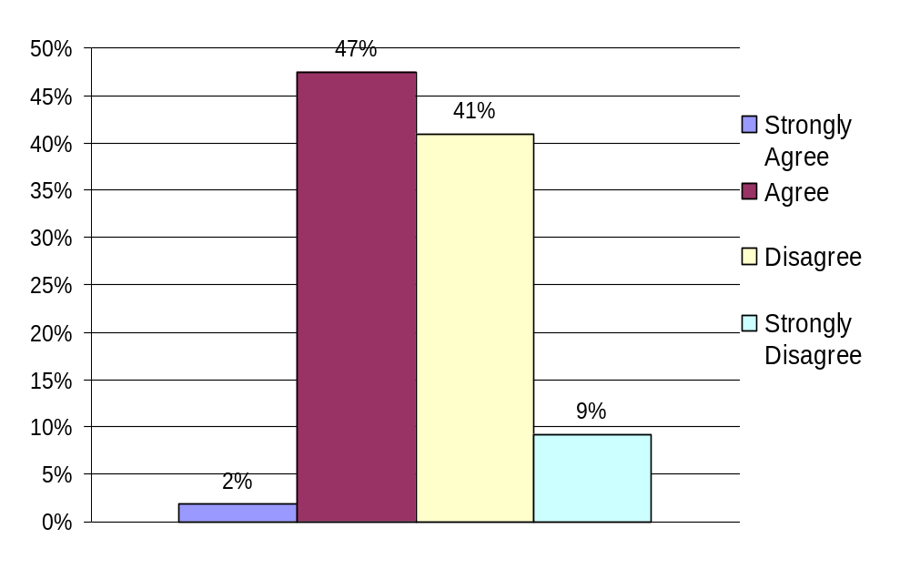
Elected officials are, for the most part, trustworthy and hardworking.
M. Man
Notes:
However, if we look at the next question, elected officials are, for the most part, trustworthy and hardworking, half of the students surveyed answered yes and half answered no. This means that although a majority believes that politics is controlled by money and special interests, there are still those who think that elected officials are trustworthy and hardworking, especially in Santa Clara County, as seen with the next slide.

Slide 42
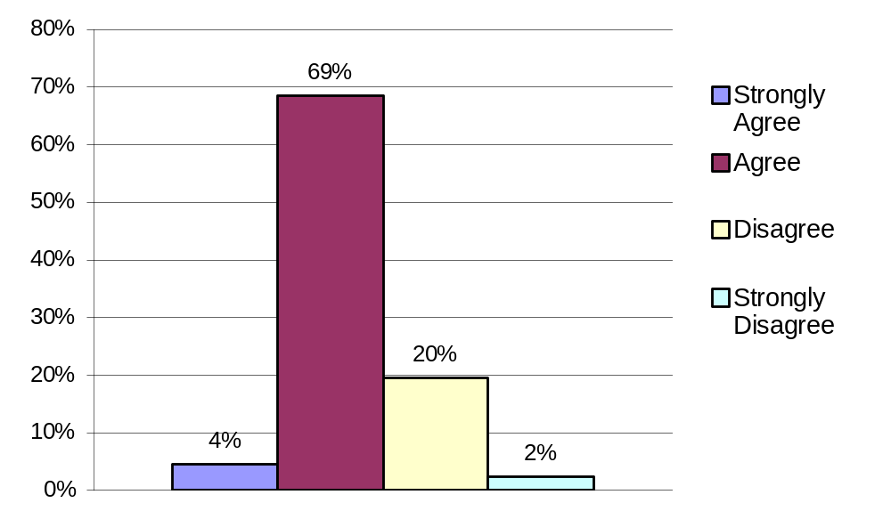
Elected officials in Santa Clara County are, for the most part, trustworthy and hard working.
M. Man
Notes:
In this question, elected officials in Santa Clara County are, for the most part, trustworthy and hard working, a majority of 73% of the students answered yes. This shows that although students are split in the ethics of politics overall, many believe that Santa Clara County officials are trustworthy and hard working. Perhaps this is because they feel closer to the elected officials in their area.

Slide 43
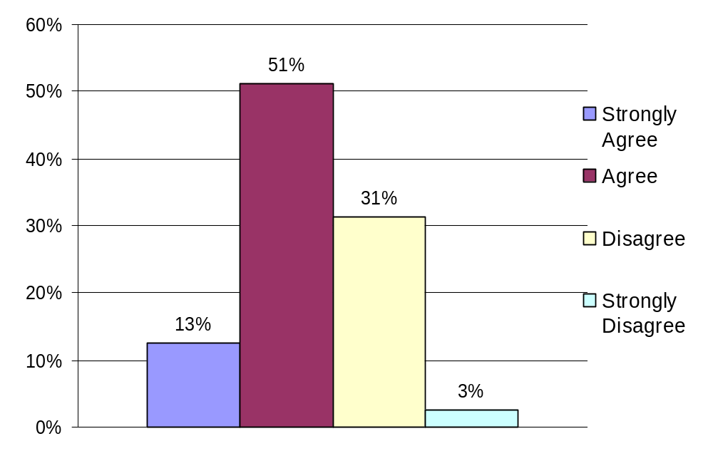
Decisions made by elected officials affect my family or me in a significant way.
Arundathi
Notes:
My name is Arundathi Gururajan and I am a senior at Leigh High School in San Jose
The statement posed on the survey was Decisions made by elected officials affect my family or me in a significant way. Of those who responded, about 64 percent were in accordance with the statement. This statistic demonstrates that teenagers in the fifteenth congressional district are aware of how politics affect their everyday lives. This is a promising result as it suggests that teenagers are paying attention to politics. It also hints that teens do in fact have faith in the political system and feel that elected officials are doing their job. the remaining approximately 35 percent left disagreed that the decisions elected officials make affect themselves or their family. This demographic is most probably representative of teens that are apathetic towards politics.

Slide 44
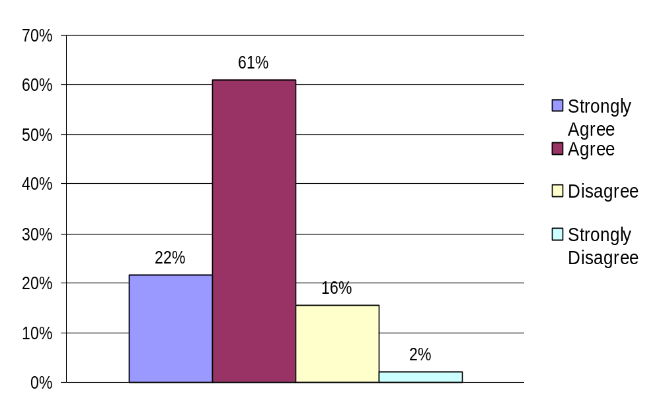
If politicians paid closer attention to issues that affect youth, more youth would vote.
Arundathi
Notes:
The 2004 presidential election was a marked changed due to the fact the candidates were actively pursuing the youth vote. The next statement we proposed was If politicians paid closer attention to issues that affect the youth, more youth would vote. The answer was a resounding yes with a large majority of 83% of those who responded in accordance with the statement. This suggests that the youth are interested in politics and would like to be more engaged in the process. Less than 20 percent dissented. This small minority most likely is aphetic towards politics as a whole and no amount of prodding or stimulus would be sufficient for them to get involved.

Slide 45
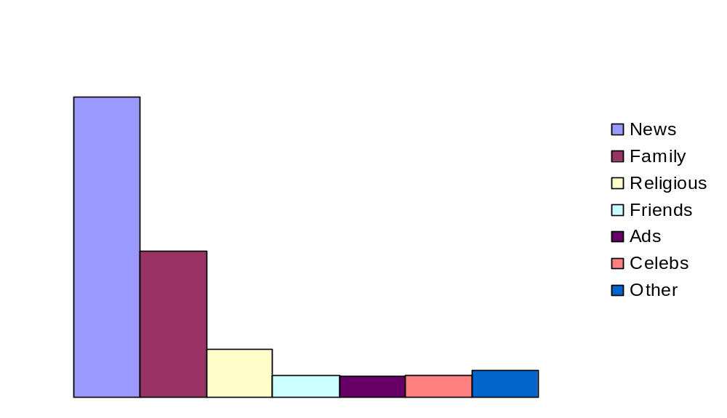
My political opinions are most influenced by (Please rank the following choices, with 1 being the most influential, and 6 being the least influential):
Candace
Notes:
Of the students surveyed 48% feel that they’re political opinions are most influenced by the news while 23% feel their family shape their political opinions. I think the news received almost half of the influence because we live in a media society. We are saturated with news 24 hours a day in various forms such as TV, internet and newspaper. I was surprised that family came in 2nd since most youth form opinions based on their families opinions.

Slide 46
Conclusion
Notes:
SAC CONCLUSION
In our surveys we tested the influence of one’s high school student government experience as an antecedent for political activity; the relationship between a students political interest and their parents involvement in politics; the reasons youth are apathetic to the political system; what youth believe needs to happen for them to get interested;
First the bad news:
1. What we found was that student government in high school may do more harm than good in introducing students to the political process. The majority of students do not take student elections seriously; do not feel that student government adequately addresses students’ needs; and said the administration has too much control over student government, indicating that student governments serve as a puppet for the administrations’ needs; only 25 % of students participated in student government leaving 75% of the student body out of the process.
2. Schools do not do an adequate job of encouraging civic participation. Most of schools did not hold mock elections, candidate debates or voters registration drives. In the comment section of the surveys students were crying out for more information and initiation into the governmental process to happen in their schools.
3. The current political system does little to involve youth. The media scored the highest in terms of influence on youth, not parents, friends, religion, but the media. Kids know that elected officials don’t focus efforts on them and don’t pay attention to their issues. 83% said they would be more involved if politicians addressed issues relevant to youth.
4. Another factor that increases apathy is the negative image youth have of politics. 87% feel that politics is controlled mostly by money and special interest. This was the second highest reaction to any question in the survey. Half of those surveyed feel that politicians are not trustworthy or hardworking.
And now for the good news. There is hope
Most students believe that decisions made by elected officials directly affect their lives. Knowing this gives them incentive to get involved. Most students read or watch the news about politics and do pay attention to candidate ads on TV. Most families do discuss important political issues. Youth are very much aware that the youth vote is unacceptable. And the highest reaction in the survey was that 89% intend to register to vote.
From the comment section it seems that students overwhelmingly have a genuine and strong desire to learn more about the system through the schools. They also want to participate in local elections, particularly if candidates relate to them or address issues important to them.
Although there is plenty to work on to improve the preparation for youth involvement, to teach and outreach to young people, it is a necessity for a vibrant democracy. Look at us, we are the future.

Slide 47
Call to Action
Parents
Talk about current events with your kids
Watch or listen to TV and radio news shows with your children
Encourage your children to become active citizens by learning about issues they think are important
Media
Focus on issues that affect youth like war or the economy
Media is effective at reaching youth voters, youth pay attention to specials like “Rock the Vote”
Politicians
Focus on issues that effect youth
Make appearances at events where youth will be present, i.e. college campuses and high schools, or on media channels that cater to youth.
Create a Student Advisory Council or a scholarship fund for youth
Community/Schools
Make civic education more important and more interesting to youth
Notes:
Parents
Our results strongly indicate that parents are not doing an adequate job of making their children politically aware or opinionated.
In order to help mitigate the problem, parents should begin discussing current events on a regular basis. This can easily be done around the dinner table or on the way to school and would help youth become interested and involved in politics.
There are many easy ways that parents and their children can keep up-to-date on current events, you can listen to the radio or watch the evening news shows.
Media
Unlike parents, our results indicate that the media is doing an adequate job of engaging our nation’s youth.
Youth feel that mediums such as “Rock the Vote” are successful in reaching out to youth and motivating them to vote.
However, the media should focus on issues such as the economy or war because these issues directly affect the youth, instead of just using celebrities or inviting particular candidates to be a part of their broadcasts.
Politicians:
The politicians should address the following issues more thoroughly as to make the youth less apathetic.
- Taking a firmer stance on abortions, birth control, etc.
- Minimum wage adjustments
- Public education
- Environment

