Slide 1


The Flexible Modeling System Runtime Environment (FRE)
October 19, 2007
Amy Langenhorst, RSIS/GFDL
Phone: 609 - 452 - 6572
Fax: 609 - 987 - 5063
Email: Amy.Langenhorst@noaa.gov
National Oceanic and Atmospheric Administration
Geophysical Fluid Dynamics Laboratory
Princeton, NJ 08542
http://www.gfdl.noaa.gov

Slide 2
Overview
Why FRE? What is FRE?
Mechanics of FRE
Command line utilities
Tour of the XML
Database integration
Notes:
our solution is based on XML
XML language, XML tag set

Slide 3
Why FRE?
Get the right source code files, versions
Set the right parameters for compilation
Set up the input, use correct versions of datasets
Manage long production runs, job control
Manage the output, postprocessing, figures
Perform integrity testing on model configurations
Make it simple to organize and share models
Be able to reproduce your actions later
Notes:
cvs
compilation: which libraries, cppdefs
job control:multiople submissions, resubmission to the correct job queue

Slide 4
Key Features of FRE
A standard mechanism for all FMS models
A comprehensive description of model configurations
  records details from code versions through compiling, running, and postprocessing
  records model components, grids, dynamics and physics choices, all input parameters and data
XML is self-documenting
Easy to automate running regression tests

Slide 5
FRE Consists of...
XML Model Description File: contains a complete description of one or more experiments
  cvs: tags and modules needed to obtain code
  compile: compiler flags, mkmf template, etc.
  input: namelists, diag_table, datasets, etc.
  run: simulation length, npes, etc.
  postProcess: time series and averages, figures
Command line utilities read XML file
  fremake, frerun, frepp, etc

Slide 6
FRE Consists Of...
CSH script templates
  compile scripts
  model runscripts
  post-processing scripts
  analysis figure producing scripts
Standards and conventions for file names and locations
  'root' directory tree in /home
  'archive' directory tree in /archive

Slide 7
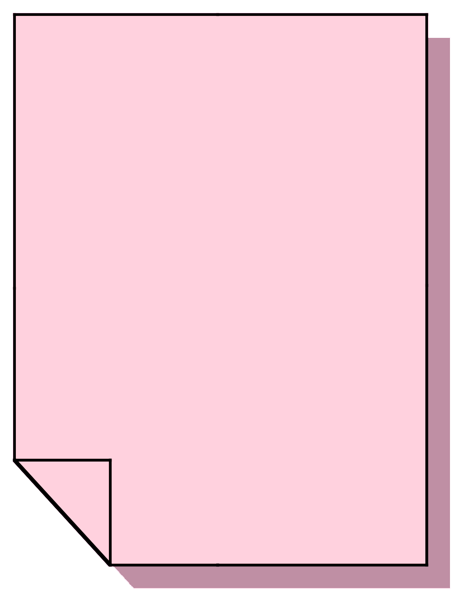
User Edits XML
<experimentSuite>
<setup>
<directory type="root">$HOME/fms</directory>
<directory type="archive">$ARCHIVE/fms</directory>
</setup>
<experiment name="cm2u">
<component name="atmos">
<cvs>
<codeBase>fms_cm2</codeBase>
<modelConfig>jakarta</modelConfig>
</cvs>
<input>
<initCond file="/path/to/file"/>
<gridSpec file="/path/to/file"/>
…

Slide 8
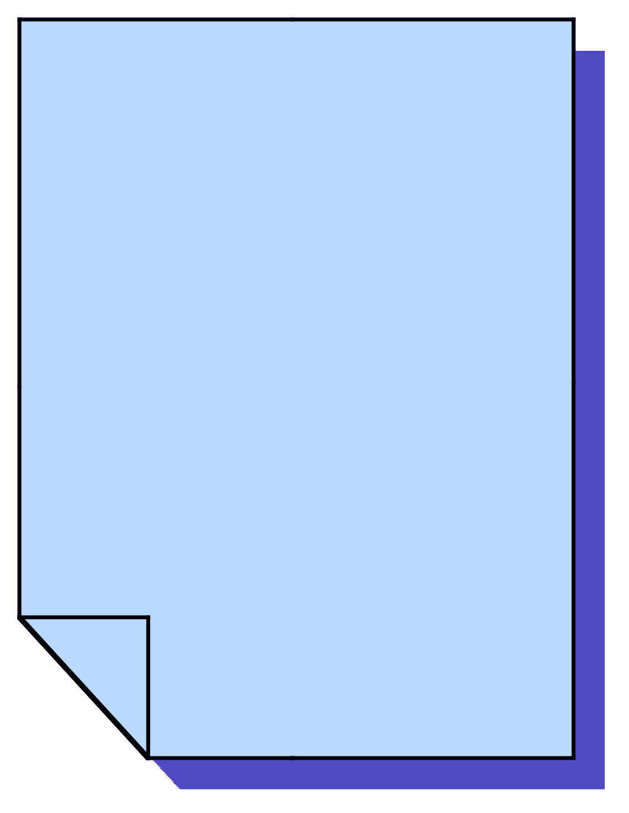
User Calls frerun
> frerun -s cm2u
your job (432243) has been submitted
> frerun cm2u
TO SUBMIT: qsub /home/user/…/scripts/cm2u
>

Slide 9

Model Output in Archive
cm2u
|-- ascii
| |-- ascii_out.cpio
| `-- stdout
|-- history
| |-- 00010101.nc.cpio
| |-- 00020101.nc.cpio
| `-- 00030101.nc.cpio
`-- restart
|-- 00010101.cpio
|-- 00010201.cpio
|-- 00010301.cpio
|-- 00010401.cpio
|-- 00010501.cpio
|-- 00010601.cpio
…

Slide 10
Postprocessing Output
cm2u
|-- ascii
|-- history
|-- restart
|-- analysis
`-- pp
|-- atmos
| |-- ts
| | `-- monthly
| | `-- 5yr
| | |-- atmos.000101-000512.mon.nc.cpio
| | `-- atmos.000601-001012.mon.nc.cpio
| `-- av
| `-- monthly_5yr
| |-- atmos.0001-0005.01.nc
| |-- atmos.0001-0005.02.nc
… …

Slide 11

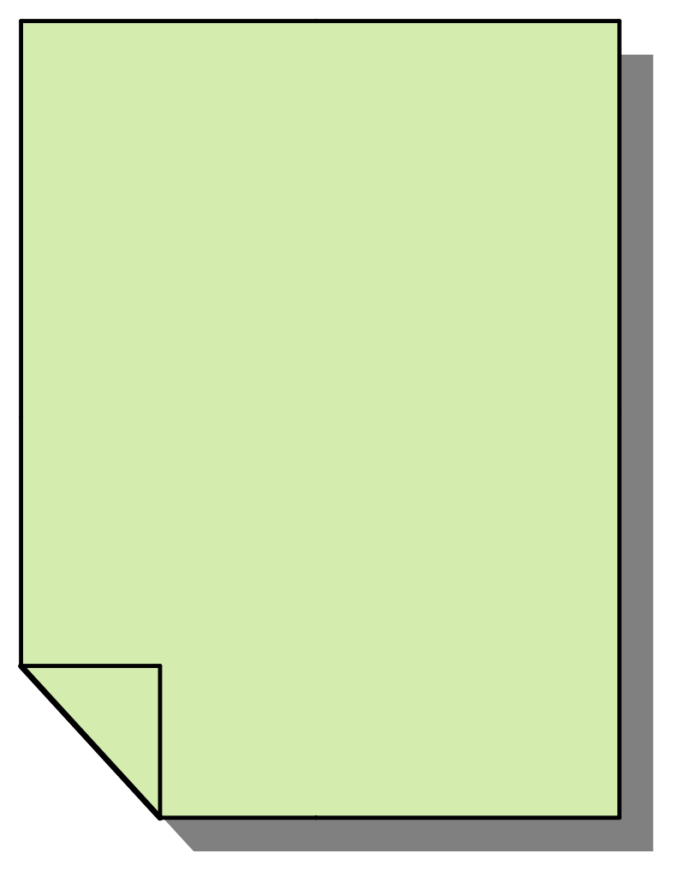
FRE Mechanics
XML
FRERUN
CSH
Model
Output
FREPP
CSH
PostProc
Output
Notes:
user -> xml -> frerun -> csh -> direct output
-> frepp -> csh -> pp output

Slide 12
FRE Mechanics
Curator
Database
FRERUN
CSH
Model
Output
XML
FREPP
CSH
PostProc
Output
Notes:
user -> xml -> frerun -> csh -> direct output
-> frepp -> csh -> pp output

Slide 13
Auto-generated Figures
A subset of the figures automatically generated for one of our publicly-released atmospheric models is available at
http://www.gfdl.noaa.gov/fms/pubrel/analysis/m45_am2p14/
Internally, users can browse experiments and their associated scripts, XML, data, and figures through our Model Development Database
Many additional features coming with the new Curator Database

Slide 14
The FRE Utilities
fremake: check out code, create/submit compile scripts
frerun: create and submit run scripts
frepp: create and submit postprocessing scripts
frestatus: show status of batch compiles and runs
frecheck: compare regression test runs
frepriority: change batch queue information
fredb: interact with Curator Database
frelist: list info about experiments in an xml file
freppcheck: report missing postprocessing files
frescrub: delete duplicate postprocessing files
freversion: use XSLT to change XML format

Slide 15
fremake
fremake -x xmlfile experimentname
  performs cvs checkout if you don't already have code in $rootdir/$experimentname/src
  generates a simple shell script which calls mkmf (the makefile-generator) and make. You can qsub this script or run interactively.
if you already have an executable, you do not need to call fremake

Slide 16
frerun
frerun -x xmlfile experimentname
  generates a cshell runscript which you can submit to the batch system or run interactively
frerun -r basic -x xmlfile experimentname
  -r keyword causes frerun to perform one or more short runs for reproducibility testing
runscript will call frepp, the post-processing tool, as needed during the run

Slide 17
frepp
called at the end of each model simulation year by the model runscript
  creates and submits post-processing scripts to create time series, time averages, and analysis plots
can be called ‘offline’ : outside of runscript
  frepp -t1983 -p4 -x xmlfile experimentname
  -A option: creates figures only, no data
  -d dir specifies non-default history directory
  -c split creates one job per component

Slide 18
frelist
frelist -x xmlfile
  lists all the experiments in an xml file and notes whether they inherit from another experiment
-v option: also prints <description> tag contents for each experiment

Slide 19
frestatus
frestatus -x xmlfile experimentname
  prints the status of batch compiles and runs for the experiment
  useful along with qa -u user -n 45
-c option: status for batch compiles only
-r option: status for batch runs only
-p option: status for production runs only

Slide 20
frecheck
frecheck -x xmlfile experimentname
  verifies reproducibility by comparing the output of regression test runs with resdiff
  prints timing statistics for the regression runs, generates a scaling plot
-l option: just list all the output restart files
-L option: list restart files with migration status (whether files are online or offline)
-n option: perform no dmgets of offline files

Slide 21
freppcheck
freppcheck -x xmlfile experimentname
  checks for missing post-processing files
will prompt you for the startYear and endYear that should be checked
-T option: check all timeSeries variables
  by default only the first variable is checked

Slide 22
frepriority
frepriority -x xmlfile experimentname
  manage job priority: queue allocations and job project
-a queue=num change number of remaining queue allocations
-P proj change job's project
-s option: suspend job
-g option: 'go' -- submit runscript

Slide 23
frescrub
frescrub -x xmlfile experimentname
  prints report of duplicated archive files for an experiment
-A remove netcdf files when a cpio file exists
-B remove redundant, uncombined 'raw' history files
-C clean up $root by deleting excess old scripts
-D all of the above cleanup options
-s option: automatically qsub the script

Slide 24
freversion
freversion -v 3 in.xml out.xml
If there is a change in the XML language, users can use this program to automatically convert their XML files to the new version.
Uses xsltproc

Slide 25
fredb
fredb -x xmlfile experimentname
to add or extract experiments easily to or from the experiment database
in alpha, Sergey will demo

Slide 26
Comparing netCDF Files
ls -1 *.cpio | resdiff
  extracts each cpio file to a temporary directory and uses cmp to compare each restart file
  if cmp fails, it uses a specialized utility nccmp to compare each netcdf file
nccmp file1 file2
  utility for comparing netCDF files
  several options for omitting metadata comparison, excluding certain variables, etc

Slide 27
Work towards a new version
  Explicit support for model development ✔
  Support for generating multiple executables from a single source definition ✔
  Use of libraries to reduce compilation overhead ✔
  Greater flexibility in specifying model run units for both development and production (i.e. steps, seconds, minutes, hours, days, etc) ✔
  Script output tailored to intended use ✔
  Interpretation of dates so that datasets and other input can change with model date ~
  Support for ensembles
  Provide permanent record of production run information through integration with GFDL Data Curator ~
  Enhanced regression testing capabilities ~
  Enhanced post-processing capabilities; more control over time units of post-processing :(
  Support for FRE environment running on remote hosts ~
  Support for model implemented checkpoint / restart ✔
Notes:
add a link

Slide 28
What else is new?
Overhaul of Perl back-end
  Aaron Watters
  Saves user & "canonical" XML
    "canonical" XML has all defaults filled in, is saved with a date stamp, is checked against for user changes
  More object oriented, flexible and robust for implementing new FRE features
Notes:
add a link

Slide 29
Issues we are facing
How to organize the production of standard diagnostic figures
  All scripts under CVS control?
  XML entities with standard figure specs?
  Wrapper scripts maintained by scientific groups?
How can we give the users the shortcuts in the XML they desire without making things too complicated in other ways?
  Inheritance, repeated information, XML variables
Notes:
add a link

Slide 30
XML Tour

Slide 31
Where to go for more info
http://www.gfdl.noaa.gov/fms/fre
  FMS webpage -> FRE Usage
An early beta version of FRE is available for public download at http://fms.gfdl.noaa.gov/
oar.gfdl.fre@noaa.gov mailing list
Amy.Langenhorst@noaa.gov
Notes:
add a link

