Slide 1
The Flexible Modeling System Runtime Environment (FRE)
September 8, 2006
Amy Langenhorst, RSIS/GFDL
Phone: 609 - 452 - 6572
Fax: 609 - 987 - 5063
Email: Amy.Langenhorst@noaa.gov
National Oceanic and Atmospheric Administration
Geophysical Fluid Dynamics Laboratory
Princeton, NJ 08542
http://www.gfdl.noaa.gov

Slide 2
Overview
Why FRE? What is FRE?
Mechanics of FRE
Command line utilities
Optional:
  Tour of the XML
  DEMO: regression testing
Notes:
our solution is based on XML
XML language, XML tag set

Slide 3
Why FRE?
Get the right source code files, versions
Set the right parameters for compilation
Get the right input, correct versions of datasets
Manage long production runs, job control
Manage the output, postprocessing, figures
Perform integrity testing on several model configurations
Be able to reproduce your actions next year
Notes:
cvs
compilation: which libraries, cppdefs
job control:multiople submissions, resubmission to the correct job queue

Slide 4
Previous Environments
Up to the individual, differed from group to group, or person to person
Notes/documentation optional
Secondary users must decipher and translate the runscript without missing any details
Models not reproducible over time
The more general and flexible the runscript, the more complex, and harder to maintain
Extensive regression testing onerous

Slide 5
Key Points About FRE
A standard mechanism for all FMS models
A comprehensive description of model configurations
  records details from code versions through compiling, running, and postprocessing
  records model components, grids, dynamics and physics choices, all input parameters and data
XML is self-documenting
Easy to automate running regression tests

Slide 6
FRE Components
XML Model Description File: contains a complete description of one or more experiments
  cvs: tags and modules needed to obtain code
  compile: compiler flags, mkmf template, etc.
  input: namelists, diag_table, etc
  run: simulation length, npes, etc
  postProcess: time series and averages, figures
Command line utilities read XML file
  fremake, frerun, frepp, etc

Slide 7
FRE Components
CSH script templates
  compile scripts
  model runscripts
  postprocessing scripts
Standards and conventions for file names and locations
  'root' directory tree in /home
  'archive' directory tree in /archive

Slide 8
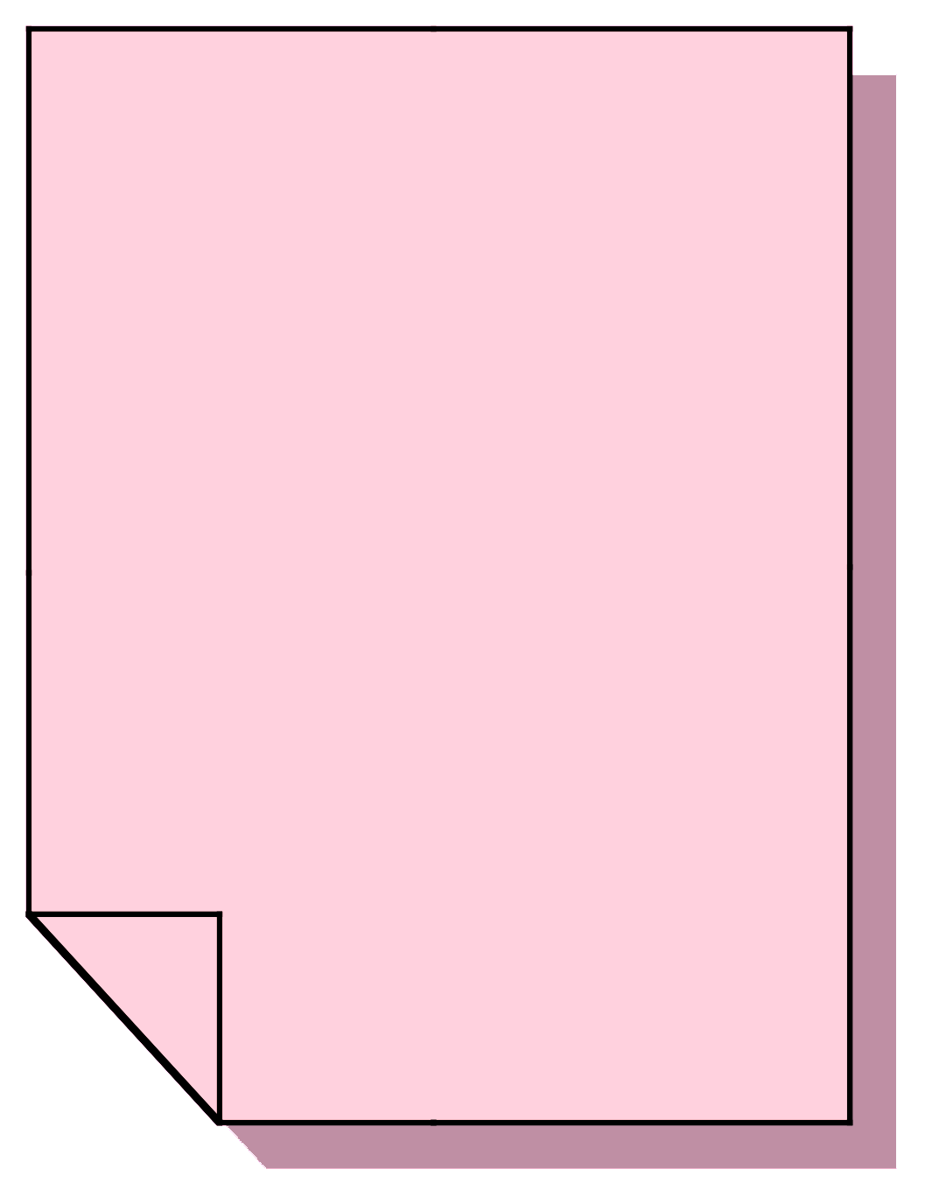
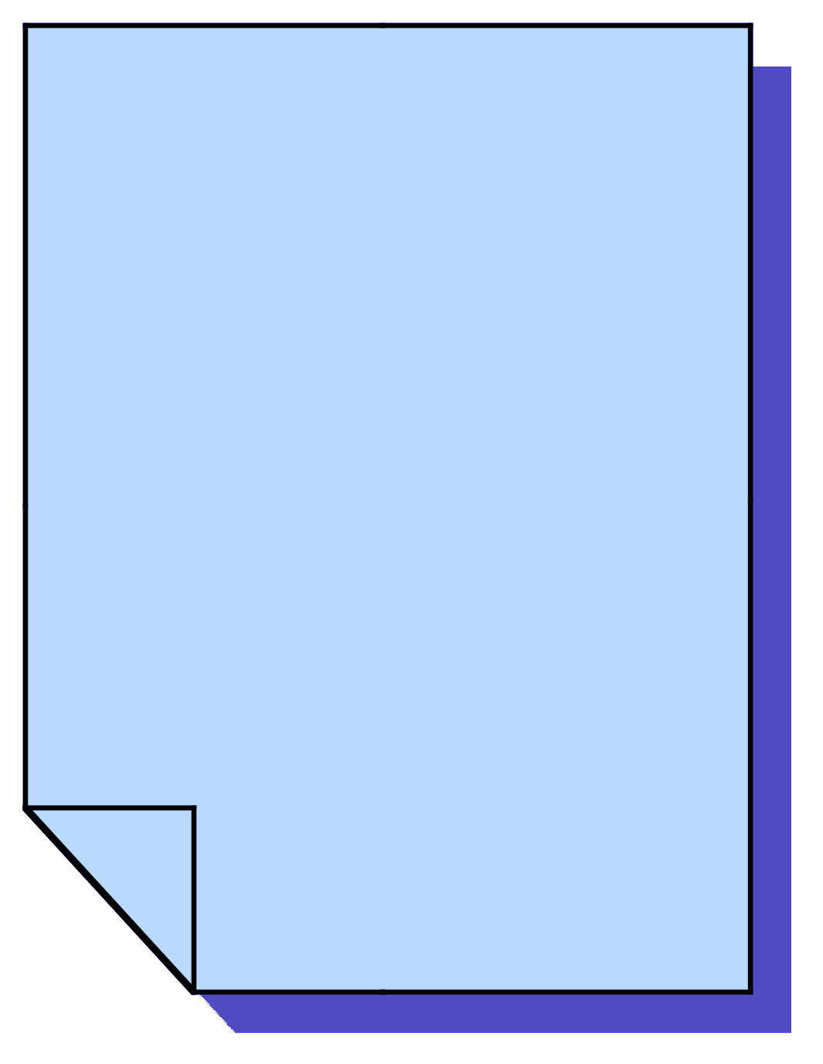
FRE Mechanics
XML
FRERUN
CSH
Model
Output
FREPP
CSH
PostProc
Output
Notes:
user -> xml -> frerun -> csh -> direct output
-> frepp -> csh -> pp output

Slide 9
User Edits XML
<experimentSuite>
<setup>
<directory type="root">$HOME/fms</directory>
<directory type="archive">$ARCHIVE/fms</directory>
</setup>
<experiment name="cm2u">
<cvs>
<codeBase>fms_cm2</codeBase>
<modelConfig>jakarta</modelConfig>
</cvs>
<input>
<initCond file="/path/to/file"/>
<gridSpec file="/path/to/file"/>
<namelist file="/path/to/file"/>
…

Slide 10
User Calls frerun
> frerun -s cm2u
your job (432243) has been submitted
> frerun cm2u
TO SUBMIT: qsub /home/user/…/scripts/cm2u
>

Slide 11
Model Output in Archive
cm2u
|-- ascii
| |-- ascii_out.cpio
| `-- stdout
|-- history
| |-- 00010101.nc.cpio
| |-- 00020101.nc.cpio
| `-- 00030101.nc.cpio
`-- restart
|-- 00010101.cpio
|-- 00010201.cpio
|-- 00010301.cpio
|-- 00010401.cpio
|-- 00010501.cpio
|-- 00010601.cpio
…

Slide 12
Postprocessing Output
cm2u
|-- ascii
|-- history
|-- restart
|-- analysis
`-- pp
|-- atmos
| |-- ts
| | `-- monthly
| | `-- 5yr
| | |-- atmos.000101-000512.mon.nc.cpio
| | `-- atmos.000601-001012.mon.nc.cpio
| `-- av
| `-- monthly_5yr
| |-- atmos.0001-0005.01.nc
| |-- atmos.0001-0005.02.nc
… …

Slide 13
Auto-generated Figures
A subset of the figures automatically generated for one of our publicly-released atmospheric models is available at
http://www.gfdl.noaa.gov/fms/pubrel/analysis/m45_am2p14/
Internally, users can browse experiments and their associated scripts, XML, data, and figures through our Model Development Database
  Perl CGI scripts on a MySQL server

Slide 14
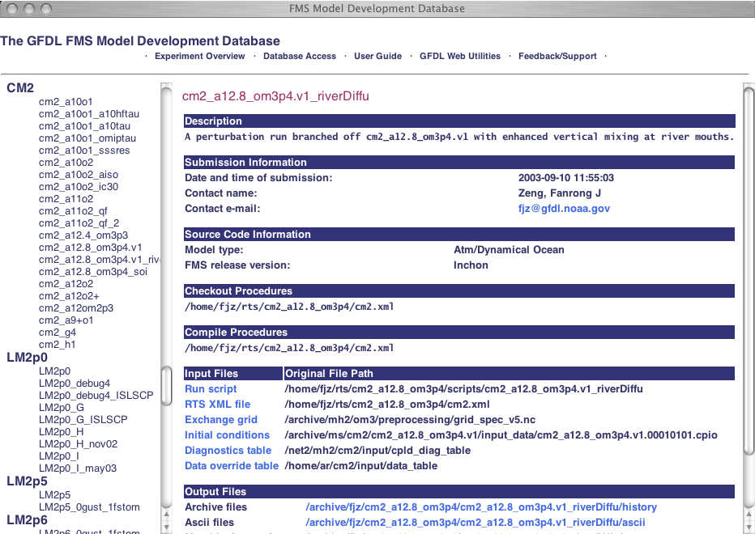
Experiment Database

Slide 15
XML Editors
VIM and Emacs
  Syntax highlighting, tag completion, folding
SciTE: free user-friendly GUI-based editor with folding, can easily add menu options to launch utilities which act on current file
Other editors should syntax highlight
Free Graphical XML Browsers, Editors
  Mozilla-based web browsers
  pollo

Slide 16
The FRE Utilities
fre-utility [options] [experiments]
fremake: check out code, create/submit compile scripts
frerun: create and submit run scripts
frepp: create and submit postprocessing scripts
frelist: list experiments in an xml file
frestatus: show status of batch compiles and runs
frecheck: compare regression test runs
freppcheck: report missing postprocessing files
frepriority: change batch queue information
frescrub: delete duplicate postprocessing files
freversion: use XSLT to change XML format

Slide 17
The FRE Utilities
Written in Perl
Use XML::LibXML
  very good at searching xml with xpath queries

Slide 18
fremake
fremake -x xmlfile experimentname
  performs cvs checkout if you don't already have code in $name/src
  generates a simple shell script which calls mkmf (the makefile-generator) and make. You can qsub this script or run interactively.
-p option: prevent auto-generation of path_names file (list of source code files) for input to mkmf
if you already have an executable, you do not need to call fremake

Slide 19
frerun
frerun -x xmlfile experimentname
  generates a cshell runscript which you can qsub or run interactively
frerun -r basic -x xmlfile experimentname
  -r keyword causes frerun to perform one or more short runs for reproducibility testing
make sure you have ~/.rhosts containing the name of your machine, otherwise frerun will not be able to write to /archive.

Slide 20
frepp
called at the end of each model simulation year by the model runscript
  creates and submits postprocessing scripts to create time series, time averages, and analysis plots
can be called 'offline'
  frepp -t1983 -p4 -x xmlfile experimentname
  -A option: creates figures only, no data
  -d dir specifies non-default history directory
  -c split creates one job per component

Slide 21
frelist
frelist -x xmlfile
  lists all the experiments in an xml file and notes whether they inherit from another experiment
-v option: also prints <description> tag contents for each experiment

Slide 22
frestatus
frestatus -x xmlfile experimentname
  prints the status of batch compiles and runs for the experiment
  useful along with qa -u user -n 45
-c option: status for batch compiles only
-r option: status for batch runs only
-p option: status for production runs only

Slide 23
frecheck
frecheck -x xmlfile experimentname
  verifies reproducibility by comparing the output of regression test runs with resdiff
  prints timing statistics for the regression runs, generates a scaling plot
-l option: just list all the output restart files
-L option: list restart files with migration status (whether files are online or offline)
-n option: perform no dmgets of offline files

Slide 24
freppcheck
freppcheck -x xmlfile experimentname
  checks for missing postprocessing files
will prompt you for the startYear and endYear that should be checked
-T option: check all timeSeries variables
  by default only the first variable is checked

Slide 25
frepriority
frepriority -x xmlfile experimentname
  manage job priority: queue allocations and job project
-a queue=num change number of remaining queue allocations
-P proj change job's project
-s option: suspend job
-g option: 'go' -- submit runscript

Slide 26
frescrub
frescrub -x xmlfile experimentname
  prints report of duplicated archive files for an experiment
-A remove netcdf files when a cpio file exists
-B remove redundant, uncombined 'raw' history files
-C clean up $root by deleting excess old scripts
-D all of the above cleanup options
-s option: automatically qsub the script

Slide 27
freversion
freversion in.xml out.xml
If there is a change in the XML language, users can use this program to automatically convert their XML files to the new version.
Uses xsltproc

Slide 28
Coming Soon: fredb
fredb -x xmlfile experimentname
to add or extract experiments easily to or from the experiment database

Slide 29
RTS Demo
RTS: Regression Test Suite
  RTS was also the original name for FRE, which was originally designed to automate large amounts of regression testing
First, obtain an xml file:
> cvs co -r khartoum rts
cvs checkout: Updating rts
U rts/rts.xml
Notes:
add a link

Slide 30
frelist
> frelist
HSn45
n45shallow
am2p13_ipcc
am2p13
am2p13_bin INHERITS FROM am2p13
am2p13_stable INHERITS FROM am2p13
am2p13_lm3

Slide 31
frelist -v
> frelist -v
HSn45
-------------------------------------------------
A hydrostatic, finite difference primative equation GCM with Held-Suarez physics.
n45shallow
-------------------------------------------------
A B-grid model of shallow incompressible fluid dynamics.
…

Slide 32
fremake
> fremake -s am2p13 am2p13_stable
your job 121030 ("mk_am2p13") has been submitted
your job 121031 ("mk_am2p13_stable") has been submitted
> fremake am2p13
TO SUBMIT: qsub /home/lat/rts/FRE_workshop/rts/scripts/mk_am2p13
> qsub /home/lat/rts/FRE_workshop/rts/scripts/mk_am2p13
your job 121034 ("mk_am2p13") has been submitted

Slide 33
frestatus -c
> frestatus -c am2p13
>>> /home/lat/rts/FRE_workshop/rts/am2p13/exec/stdout
<<< Wed Nov 17 10:57:56 2004
NOTE: make successful for am2p13

Slide 34
frerun -sr
> frerun -sr suite am2p13
your job 121068 ("am2p13_1x0m8d_15pe") has been submitted
your job 121069 ("am2p13_4x0m2d_15pe") has been submitted
your job 121070 ("am2p13_1x0m8d_30pe") has been submitted
your job 121071 ("am2p13_1x0m8d_45pe") has been submitted
your job 121072 ("am2p13_1x0m8d_1pe") has been submitted
your job 121073 ("am2p13_1x0m8d_3pe") has been submitted

Slide 35
frestatus -r
> frestatus -r am2p13
>>> /archive/lat/MS/FRE_workshop/am2p13/1x0m8d_15pe/ ascii/stdout <<< Tue Nov 16 22:37:28 2004
NOTE: Natural end-of-script for /home/lat/rts/FRE_workshop/scripts/am2p13_1x0m8d_15pe.
…

Slide 36
$root directory structure
> ls
am2p13/ CVS/ rts.xml scripts/
> ls am2p13
exec/ include/ src/

Slide 37
$archive directory structure
> cd /archive/lat/MS/FRE_workshop/
> ls
am2p13/
> cd am2p13
> ls
1x0m2d_15pe/ 1x0m8d_1pe/ 1x0m8d_3pe/
1x0m8d_15pe/ 1x0m8d_30pe/ 1x0m8d_45pe/
> cd 1x0m2d_15pe
> ls
ascii/ history/ restart/

Slide 38
$archive directory structure
lsc6> cd ascii/
lsc6> ls
ascii_out.cpio reload_commands stdout
lsc6> cpio -iv<ascii_out.cpio
19820101.diag_integral.out
19820101.dynam_integral.out
19820101.fms.out
19820101.logfile.out
19820101.xgrid.out
256 blocks

Slide 39
$archive directory structure
lsc6> cd history/
lsc6> ls
19820101.nc.cpio
lsc6> cd ../../restart/
lsc6> ls
19820103.cpio

Slide 40
frecheck
lsc6> frecheck -n am2p13 am2p13_stable
/// am2p13
\\\\\\\\\\\\\\\\\\\\\\\\\\\\\\\\\\\\\\\\\\\\\\\\\\\\\\\\\\\\\\\\\\\\\
NPES RUNTIME (sec) for am2p13 (1x* runs)
---------------------------------------------------------------------
1 20311.648 0m8d
3 6916.245 0m8d
15 1266.961 0m8d
30 687.238 0m8d
45 519.492 0m8d
--------------------------------------------------------------
/archive/lat/MS/FRE_workshop/am2p13/1x0m8d_15pe/restart/19820109.cpio
/archive/lat/MS/FRE_workshop/am2p13/1x0m8d_1pe/restart/19820109.cpio
/archive/lat/MS/FRE_workshop/am2p13/1x0m8d_30pe/restart/19820109.cpio
/archive/lat/MS/FRE_workshop/am2p13/1x0m8d_3pe/restart/19820109.cpio
/archive/lat/MS/FRE_workshop/am2p13/1x0m8d_45pe/restart/19820109.cpio
/archive/lat/MS/FRE_workshop/am2p13/4x0m2d_15pe/restart/19820109.cpio
/archive/lat/MS/FRE_workshop/am2p13_stable/1x0m8d_15pe/restart/19820109.cpio
/archive/fms/khartoum/am2p13/1x0m8d_15pe/restart/19820109.cpio
---------------------------------------------------------------------

Slide 41
frecheck (continued)
////archive/lat/MS/FRE_workshop/am2p13_stable/1x0m8d_15pe/restart/19820109.cpio
\\\/archive/lat/MS/FRE_workshop/am2p13_stable/4x0m2d_15pe/restart/19820109.cpio
Comparing atmos_coupled.res.nc...
Comparing atmos_tracers.res.nc...
Comparing bgrid_prog_var.res.nc...
Comparing coupler.res...
Comparing ice_model.res.nc...
Comparing radiative_gases.res.nc...
Comparing soil.res.nc...
Comparing strat_cloud.res.nc...
Comparing vegetation.res.nc...
PASSED: am2p13 am2p13_stable
FAILED:
CRASH DETECTED:
NO RUNS TO TEST:

Slide 42
Other useful in-house utilities
ls -1 *.cpio | resdiff
  extracts each cpio file to a temporary directory and uses cmp to compare each restart file
ls -1 *.cpio | histdiff
  extracts each cpio file and uses Remik's utility nccmp to compare each netcdf file
/home/rsz/util/netcdf/nccmp file1 file2
  utility for comparing netcdf files
  several options for omitting metadata comparison, excluding certain variables, etc

Slide 43
Where to go for more info
http://www.gfdl.noaa.gov/fms/fre
  FMS webpage -> FRE Usage
An (alpha) version of FRE is available for public download at http://fms.gfdl.noaa.gov/
oar.gfdl.fre@noaa.gov mailing list
Amy.Langenhorst@noaa.gov
Notes:
add a link

Slide 44
Work towards a new version
New XML structure (work in progress)
  http://www.gfdl.noaa.gov/fms/fre/dev/fre.xml
New features:
  Explicit support for model development
  Support for generating multiple executables from a single source definition
  Use of libraries to reduce compilation overhead
  Greater flexibility in specifying model run units for both development and production (i.e. steps, seconds, minutes, hours, days, etc)
  Script output tailored to intended use
  Interpretation of dates so that datasets and other input can change with model date
  Support for ensembles
  Provide permanent record of production run information through integration with GFDL Data Curator
  Enhanced regression testing capabilities
  Enhanced post-processing capabilities; more control over time units of post-processing
  Support for FRE environment running on remote hosts
  Support for model implemented checkpoint / restart (this will require major revisions to the FMS infrastructure)
Notes:
add a link

