Slide 1
FCC Numbering Symposium
State of the NANP
Presented by the
North American Numbering Plan Administrator (NANPA)
and the
National Pooling Administrator (PA)
John Manning – Amy Putnam
November 4, 2004
N

Slide 2
Outline
NANP Past and Present
  Review of NPA/CO code assignment history
NANP Resource Administration
  Number assignment policies and practices
  1K block pooling implementation
Looking Forward at NANP Exhaust
  Drivers of NANP exhaust

Slide 3
NANP in 2000
Area Code Exhaust
  25 new NPAs assigned
  14 NPAs placed into service
  68 NPAs in jeopardy of exhaust
  37 new NPA relief projects implemented by NANPA
Central Office Code Assignments
  Total of 15,400 central office code assigned
  Average of 1,280 codes assigned per month
NANP Exhaust
  Projected as soon as 2012 or with the implementation of national number pooling 2015 – 2025

Slide 4
NANP in 2000 (cont)
FCC Number Resource Optimization Efforts Initiated
  Number optimization requirements
    Requirements for resource assignment
      Proof of authority and network readiness for initial resources
      Month-to-Exhaust criteria and utilization thresholds
      NRUF on file
      Individual number administration requirements
    Semi-annual reporting of utilization and forecast data (NRUF)
    Scheduled rollout of mandatory 1K block pooling
    New reclamation process
    State role in assignment process
      Safety valve process, access to CO code application/information

Slide 5
NANP in 2002
Area Code Exhaust
  3 new NPAs assigned
  9 NPAs placed into service
  41 NPAs in jeopardy of exhaust
  2 new NPA relief projects implemented by NANPA
Central Office Code Assignments
  Total of 7,200 central office code assigned
  Average of 600 codes assigned per month
NANP Exhaust
  Projected 2031 - 2035

Slide 6
NANP in 2004
Area Code Exhaust
  4 new NPAs assigned over last two years; one NPA returned
  1 NPA placed into service
  Fewer than 40 NPAs in jeopardy of exhaust
  Only 1 new NPA relief project implemented by NANPA in two years
Central Office Code Assignments
  Yearly assignment rate of 3,000 central office codes
  Average of 250 codes assigned per month
NANP Exhaust
  April 2004 - Projected beyond 2035

Slide 7
NANP Resource Administration
Eligibility for Resource Assignment
  Regulatory directives and industry guidelines identify who is eligible to receive NANP resources
  Most common entities receiving geographic NPA resources include ILECs, CLECs, wireless entities and paging providers
    Applicant must demonstrate it is:
      authorized to provides service in the area for which the numbering resources are requested and
      capable of providing service within 60 days of resource activation
  These requirements pertain to both central office codes (10,000 numbers) and pooled blocks (1,000 numbers) available via the National Pooling Administrator (PA)

Slide 8
NANP Resource Administration
Applying for Number Resources
  All applications for numbering resources (i.e., CO codes or blocks) in mandatory pooling rate centers must be submitted to the PA
  For optional pooling rate centers, participating service providers submit their request for blocks to the PA while non-participating carriers go directly to NANPA for CO codes
  For rate centers excluded from pooling, all requests go directly to NANPA

Slide 9
NANP Resource Administration
Thousands Block Pooling Implementation in U.S.
  State Trials
    First was Illinois 847 implemented June 1, 1998
    Between June 1998 and March 2002, state trial pools were implemented in 27 states and over 100 NPAs
    National Pooling Administration System (PAS) rolled out on March 15, 2002
  There are 20,584 rate centers in U.S. NPAs, of which:
    7,372 have mandatory number pooling
      5,766 inside Top 100 MSAs
      1,606 not in Top 100 MSAs but mandatory as a result of state pooling trials
    903 have mandatory pooling with only a single service provider
    5,861 have optional pooling rate centers
    6,448 are excluded from pooling
  Pools have been opened in all 272 U.S. NPAs
    266 NPAs have assigned blocks
    NPAs without assigned blocks: MA 351, GA 470, PA 878, AK 907, PR 939, MI 947

Slide 10
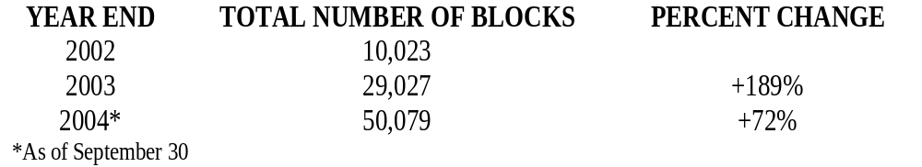
NANP Resource Administration
Number of CO Codes Opened to Replenish Pools
  2,890
Number of CO Codes Saved as a Result of 1K Block Number Pooling
  12,617
Number of Assigned Blocks in PAS

Slide 11
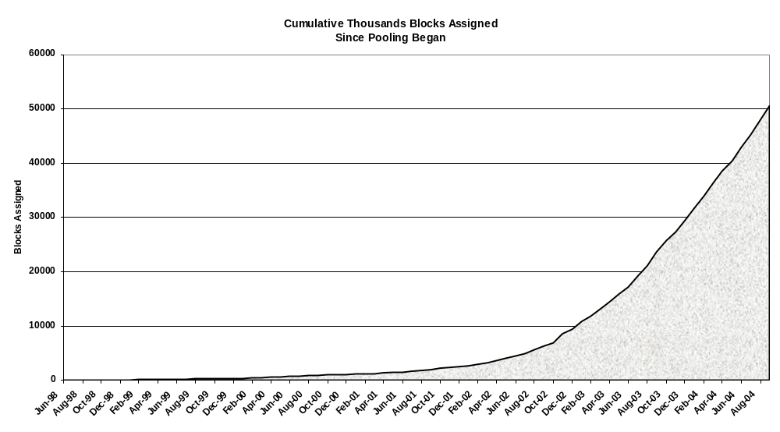
NANP Resource Administration

Slide 12
Current Status of the NANP
Number optimization measures have proved successful
  Delay in both NPA and NANP exhaust
Demand shifted from codes to blocks
  Increasing block assignments
  Better positioned to absorb changes in the marketplace and associated demand impacts
Increased awareness of number usage
  NRUF reporting

Slide 13
Looking Forward at NANP Exhaust
Potential drivers of NANP exhaust:
  Introduction of new technology/services/players
    Changes in eligibility requirements
    Participation in current optimization efforts
    LRN requirements
    Use of numbers
  Number optimization efforts
    Further deployment of existing optimization measures
    Implementation of other optimization measures to increase utilization of existing resources

