Slide 1
Vital Statistics Enhancement Team
Amy Symens Smith
U.S. Census Bureau
Gregg Williams, Alaska
FSCPE, Research & Methodology Subcommittee
FSCPE Meeting
Washington, DC
September 13, 2005

Slide 2
Vital Statistics Enhancement Team
Census Bureau and FSCPE collaboration
1st research project of this type.
Project designed to examine the current processing of vital statistics data used to produce subnational population estimates.

Slide 3
Research Project – Parts 1 & 2
Part 1. Evaluate differences in the birth and
death input data supplied by FSCPE
members and NCHS.
Part 2. Examine how the birth and death data
are used to produce county population
estimates once differences are
reconciled. Of particular interest is the
methodology used to produce estimates
by race.

Slide 4
Research Project – Part 1
Began after Fall 04 FSCPE meeting. Report and Recommendation delivered July 05, currently being reviewed by Steering Committee.
Part 1 Project Goals:
  Review the process to request & receive the vital statistics data from FSCPE members &
  streamline the process, if necessary.
  Review the current method used to combine FSCPE & NCHS vital statistics data & make recommendations to improve the efficiency.
Notes:
Each data source has particular strengths and weaknesses associated with it. Goal of current methodology is to reconcile and combine the data in a way that draws on these strengths.

Slide 5
Research Project - Part 1
Evaluation:
  County-level “final” birth & death data
    Vintage 2005: Census Bureau requested in May 2003
    county birth and death data from FSCPE members.
    Received comparable NCHS micro-data.
  State/county-level “preliminary” birth & death data
    Vintage 2005: Census Bureau will request in
    October 2005 state/county birth & death data for 2004.
Notes:
Last time we had a Steering Committee meeting we shared our research agenda and timeline.
Now we want to share our report and recommendations.
Report and recommendations broken into 2 sections.

Slide 6
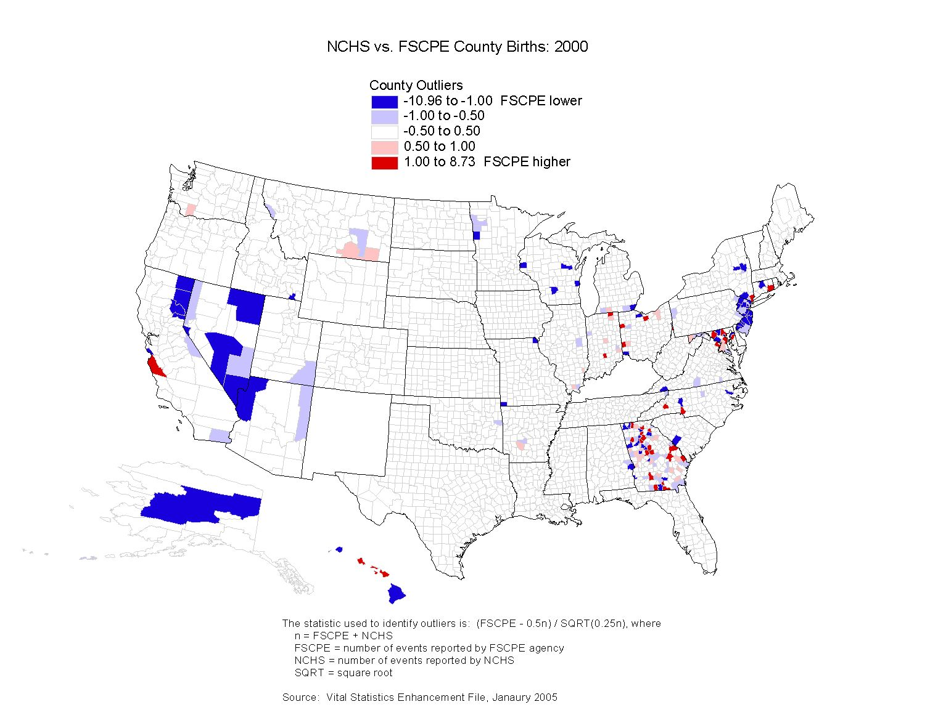
Notes:
This is one of the maps that was used to help with the county evaluation.
County outlier was constructed to look at difference between NCHS and FSCPE data and take into account number of events in the county.
Majority of counties are white, meaning very small differences.
There are 198 red and blue counties, making up 6.34% of all counties. Not included here but the percentage of red and blue counties grows to 8.29% in 2001 and goes down to 5.22% in 2002.
Two general patterns exist:
red and blue counties that are clustered within states and
counties GA
red and blue counties that border one another and cross state lines CA, AZ, NV, UT NJ,NY
Index of dissimilarity compares 2000 birth data from both sources to the Census population under age 1. Data does not show that either NCHS or FSCPE is closer to the census benchmark the majority of the time.
Indexes are consistent with the 2 general explanations given above for certain states. For instance GA, NJ

Slide 7
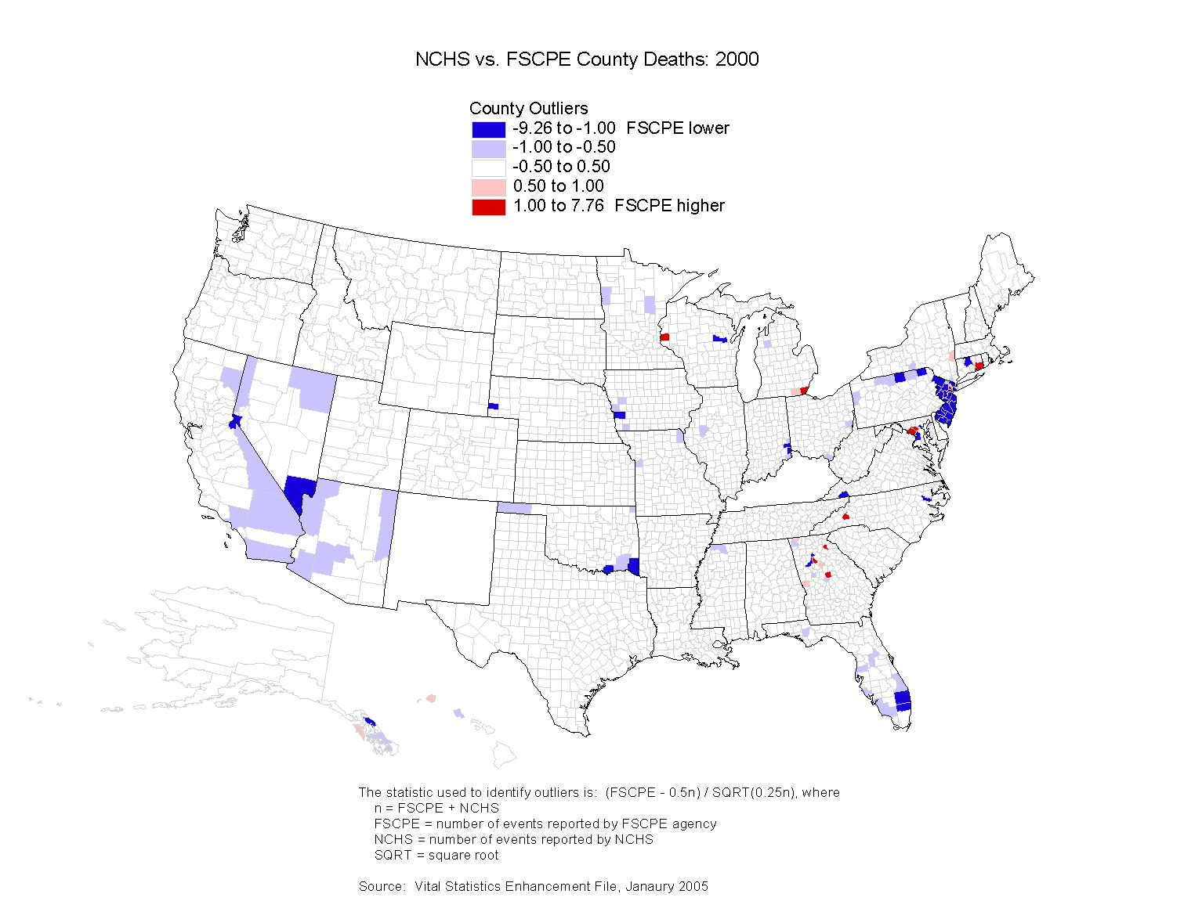
Notes:
Turning to deaths, same type of national evaluation that was then broken into smaller geographic areas:
Again most counties are white.
In 2000, 129 counties or 4.13% of all counties were either red or blue. In 2001 this percent went up to 5.54% and then back down to 4.13%
Again saw clustering in most of the same areas as clustering for births plus, Oklahoma panhandle, FL and OH in later years.
Not able to compare to census benchmark

Slide 8
Recommendation: County-level data
No methodological change, continued research.
  County-level data files with NCHS & FSCPE “final”
  2003 births & deaths shared with each FSCPE member
  Fall/Winter 2005.
  FSCPE members evaluate data and comment on differences in their state/counties. FSCPE members recommend changes to reconcile differences by 1/16/06.
  Outstanding issues: national and state control totals.
  Spring 2006 Census Bureau review FSCPE comments and reconciled birth and deaths.
  FSCPE members provide updates in time-series data.
Notes:
Based on these finding make the following recommendations for births and deaths.

Slide 9
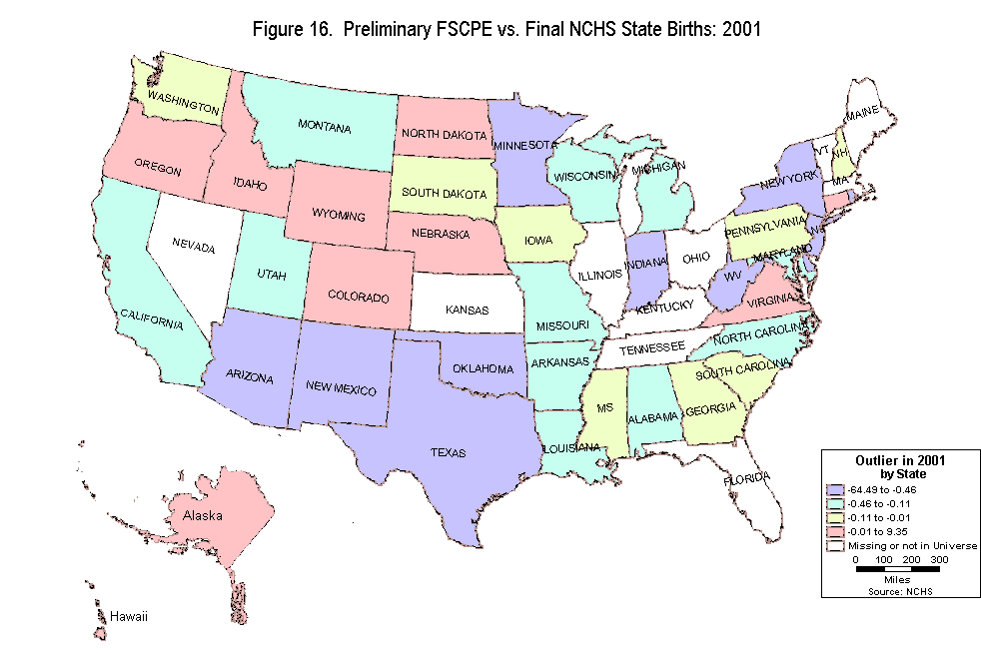
Notes:
We had data to make state-level comparisons. Compared state data for 2001 and 2002 to final NCHS micro-data for the same years. The NCHS micro-data were summed across counties to get state totals
Same outlier statistic as before.
State with largest differences are roughly same as those with differences in the final data: NV, AZ, NM, CO, TX and OK WV, VA, DE, PA, NJ, NY, VT, RI
Two general explanations for differences:
States make distinctions between “preliminary” and “final” data that are unique to their state and fit with their processing schedule and requirements NM final number of deaths 27,128 nearly twice that of the preliminary number of 14,043
Out of state occurrences: explain NY, NJ

Slide 10
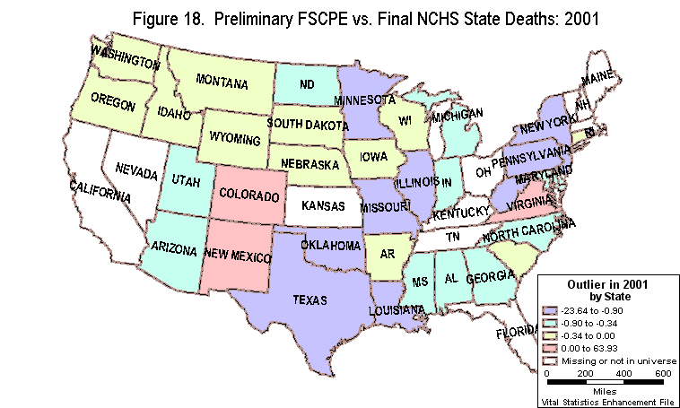
Notes:
Deaths same states
TX the final number of deaths was nearly 13,000 more than the preliminary number
Largest negative difference was for NM with the final number of deaths 12,981 less than the preliminary number.

Slide 11
Recommendation: State-level data
Change in the FSCPE data request leading to possible methodological change.
  Along with May request for “final” t-2 year county-level data, FSCPE members are encouraged to provide t-1 year state/county-level data.
  In October when the Census Bureau requests state-level data for t-1 year, FSCPE members are encouraged to send t-1 year county-level data if they have not already done so or provide updates.
Notes:
21 states reported in the R&M Subcommittee survey that they could provide county-level data for the t-1 year. Much variation across states concerning when these data could be provided.

Slide 12
Recommendation: State-level data
Methodological Enhancement
  Census Bureau staff along with FSCPE participation will compare the state/county-level 2004 data with “final” county-level 2004 data received from NCHS in the Spring/Fall of 2006.
  Possible that can replace state-level data with county-level data. Eliminate processing step that produces county-level data for t-1 year by raking county-level t-2 year data to t-1 year state totals.

Slide 13
Research Project – Part 2
Research agenda currently being prepared. Research update at Spring FSCPE meeting
Part 2 Project Goals:
  Review the population estimates production steps that rely on birth and death component data.
  Examine the methodologies used to make the birth and death component data racial categories consistent with the population estimates.
Notes:
Each data source has particular strengths and weaknesses associated with it. Goal of current methodology is to reconcile and combine the data in a way that draws on these strengths.

Slide 14
Contact Information
Amy Symens Smith
Population Analysis and Evaluation Staff
Population Division, Census Burau
Amy.Symens.Smith@census.gov

