Slide 1
E-COMPETENCIES
GODORT RESOURCES
Amy West and Sherry DeDecker

Slide 2
GODORT Created Resources http://sunsite.berkeley.edu/GODORT/created.html

Slide 3
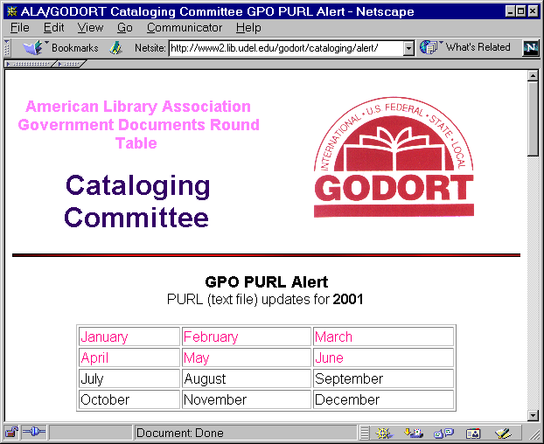

Slide 4
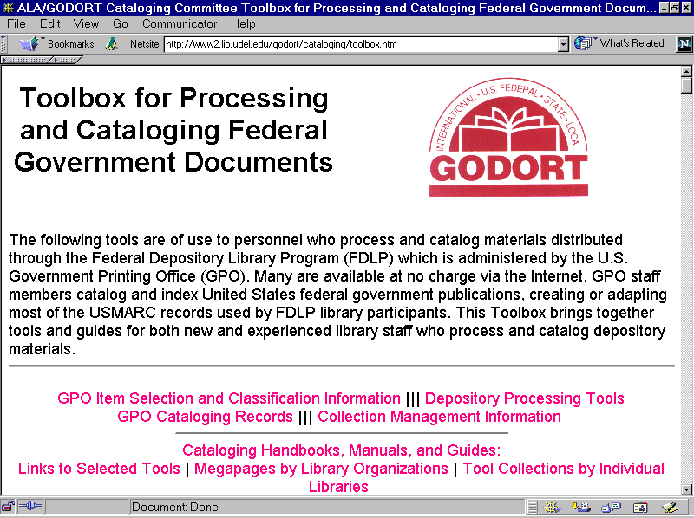

Slide 5
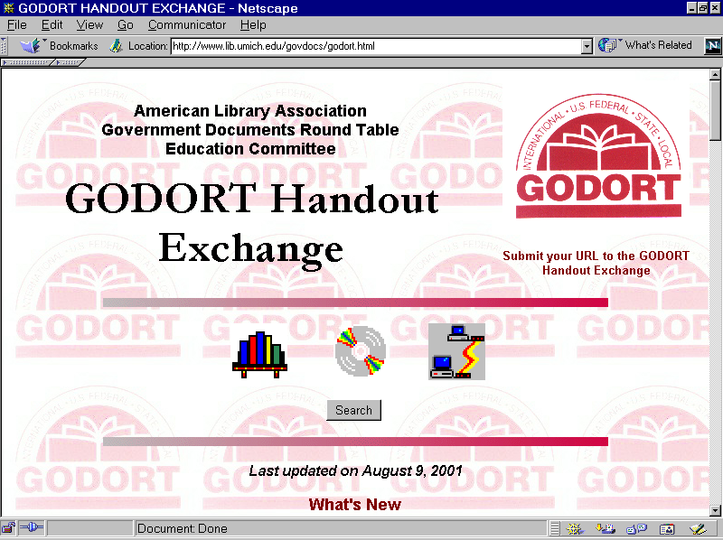

Slide 6
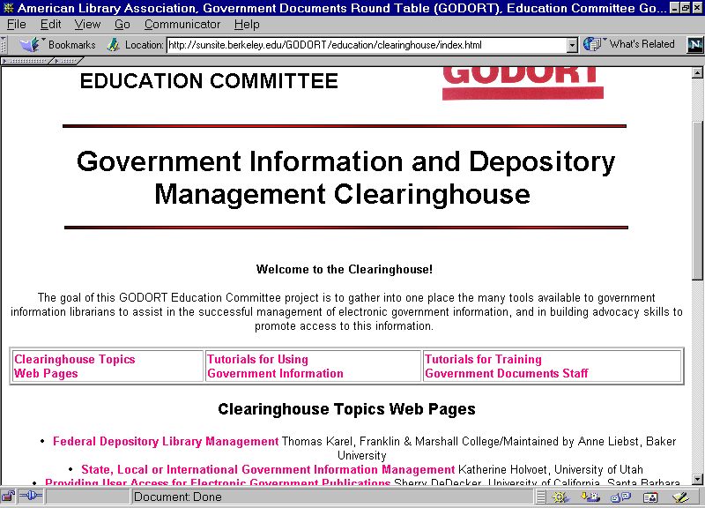

Slide 7
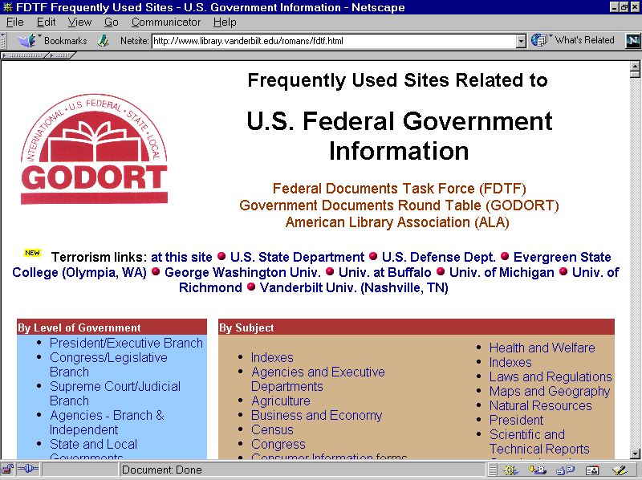

Slide 8
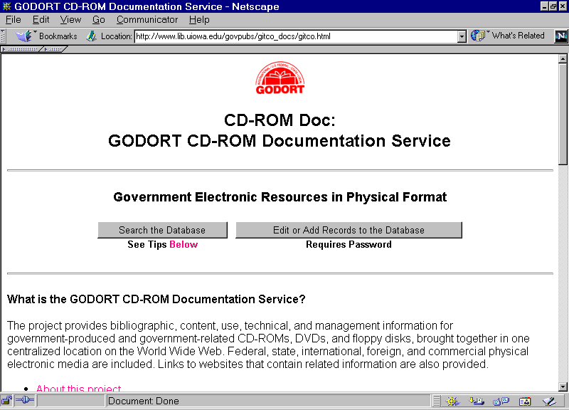

Slide 9
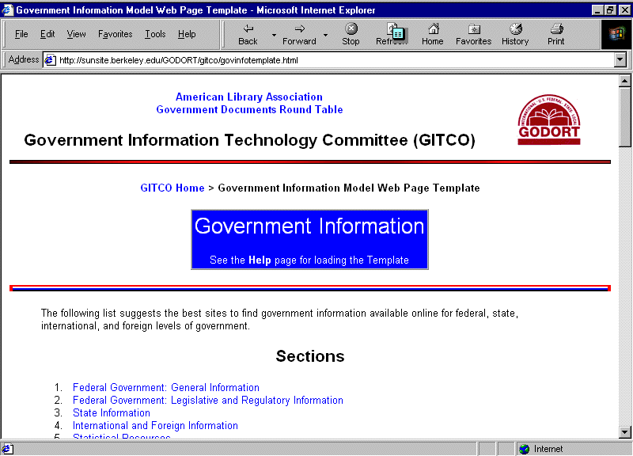

Slide 10
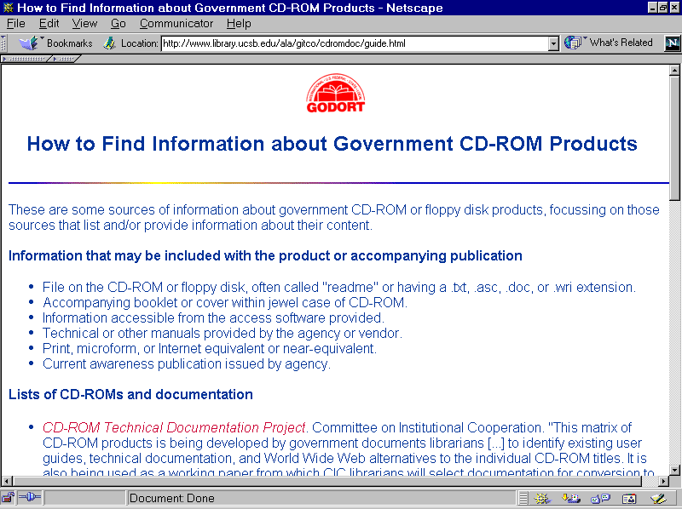

Slide 11
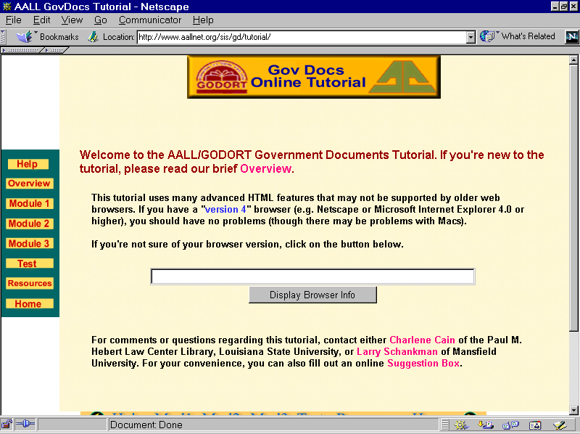

Slide 12
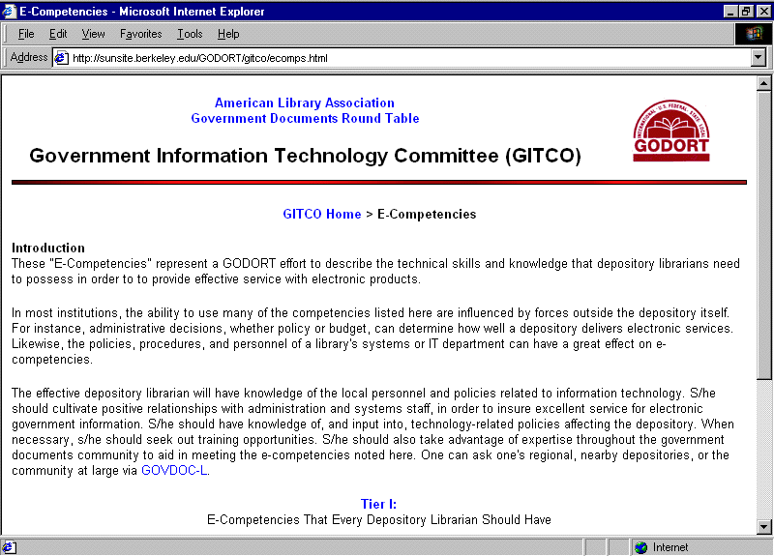

Slide 13
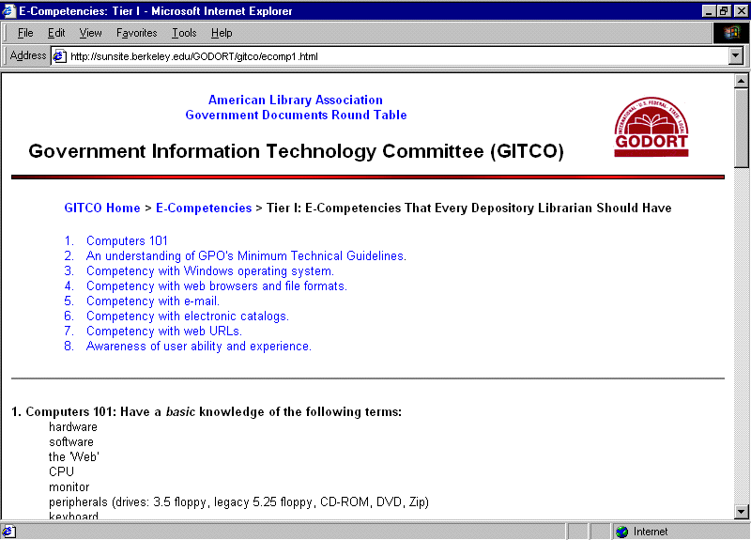

Slide 14
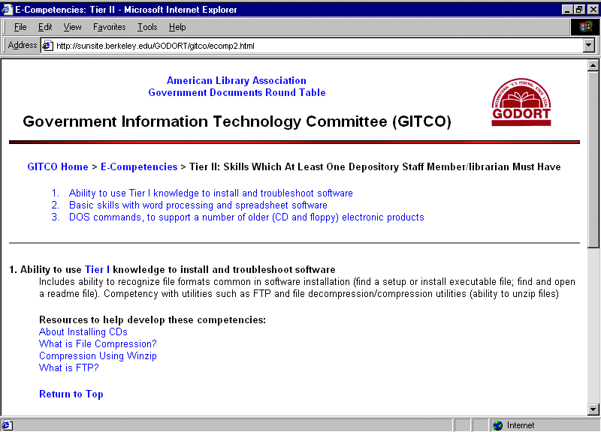

Slide 15
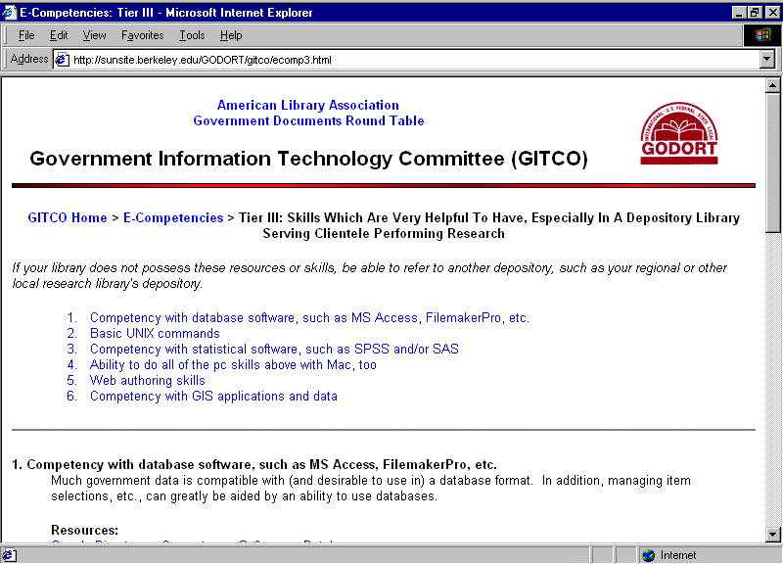

Slide 16
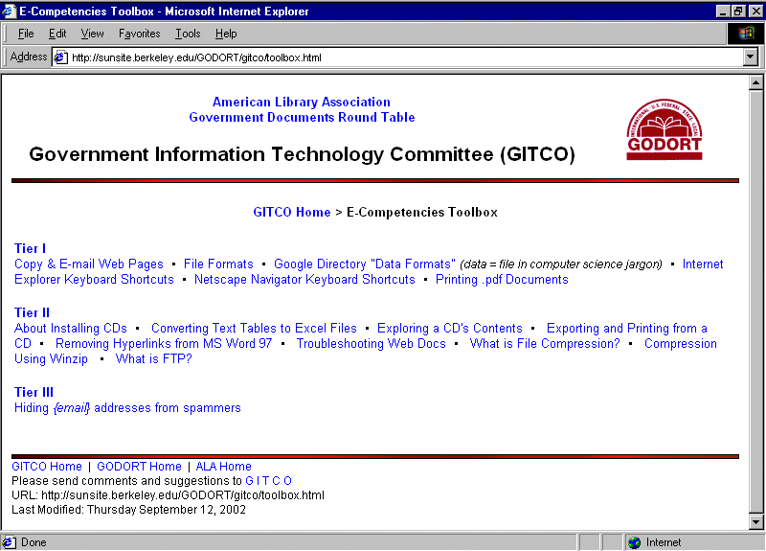

Slide 17
GODORT Created Resources:
How You Can Help
Submit recommendations to:
Amy West: westx045@tc.umn.edu
Megan Dreger:mdreger@mail.sdsu.edu
Co-Chairs, GITCO
Cass Hartnett: cass@u.washington.edu
Coordinator, Federal Documents Task Force

