Slide 1
The Critical Path Initiative: The Division of Therapeutic Proteins’ Perspective
Amy S. Rosenberg, MD
Director, Division of Therapeutic Proteins
ACPS Meeting, October 19, 2004

Slide 2
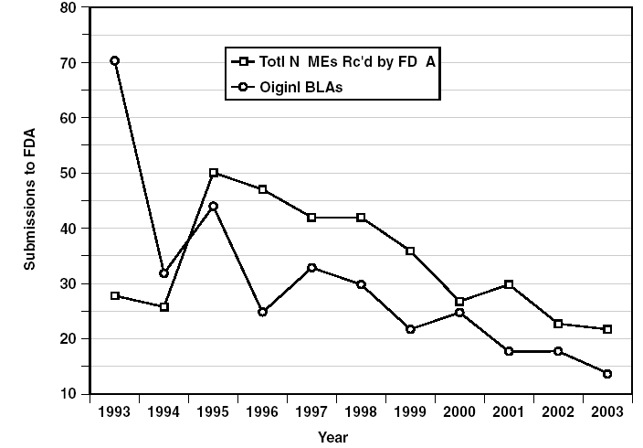
Incentive for Critical Path: the Decrease in Novel Drug and Biological Product License Applications

Slide 3
The Primary Problem: Failure to Develop Therapeutics and Vaccines to Address Difficult Diseases
High candidate drug failure rate
  99.9% of candidate drugs fail;
  <20% of drugs entering human testing get approved;
  a drug entering phase I in 2000 less likely to reach market than one entering Phase I in 1985
  ~50% of phase 3 studies fail due to lack of efficacy
Notes:
Although many articles in the recent literature bemoan the diminution in submission of novel product license applications, the real problem, in my mind, is the failure to develop therapeutics and vaccines to treat difficult diseases. This of course, in spite of the wealth of information arising from novel technologies

Slide 4
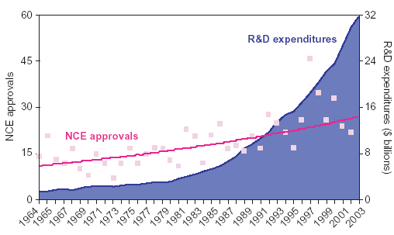
New Chemical Entities Lag Significantly Behind R&D Expenditures
(Science, Drug Discovery 19 March 2004)
Notes:
This isn’t for lack of trying. As shown in this figure, R&D expenditures have risen exponentially but the numer of new chemical entity approvals is essentially flat lined

Slide 5
Factors Contributing to Decline in New Product Applications
(Glassman and Sun. Nature Rev Drug Discovery 2004)
Failure of novel methodologies and treatments to achieve practical applications
  High throughput screening and combinatorial chemistry
  Antisense
  Pharmacogenomics
  Genomics based target identification
  Gene therapy
  Immunotherapy of cancer
  Antiangiogenesis treatments for cancer

Slide 6
Practical Medical Applications of Proteomic and Genomic Data: Industry Perspective
“I think we got too enamored of technology and lost focus of what to do”. The 1990s were really a boon for us in terms of science. We forgot that we needed to link all of that to disease”
    (Lee Babiss, Roche)
“We thought we would very quickly validate targets that were critical to disease and agonize or inhibit them as a way to start to find a drug...What we found in fact is that validating targets takes a lot of time. This is one of the big disappointments of this era”
    (Frank Douglas, Aventis)

Slide 7
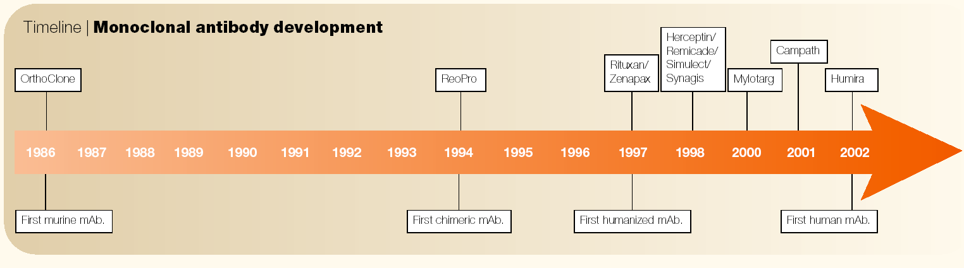
Notes:
1975 Kohler and Millstein Hybridoma technology

Slide 8
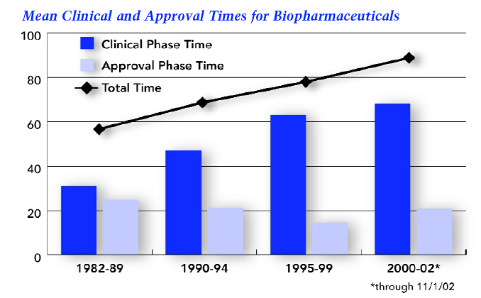
Lengthening Clinical Times Have Increased Total Times for Approval of New Biological Drugs
(Tufts Outlook 2003)

Slide 9
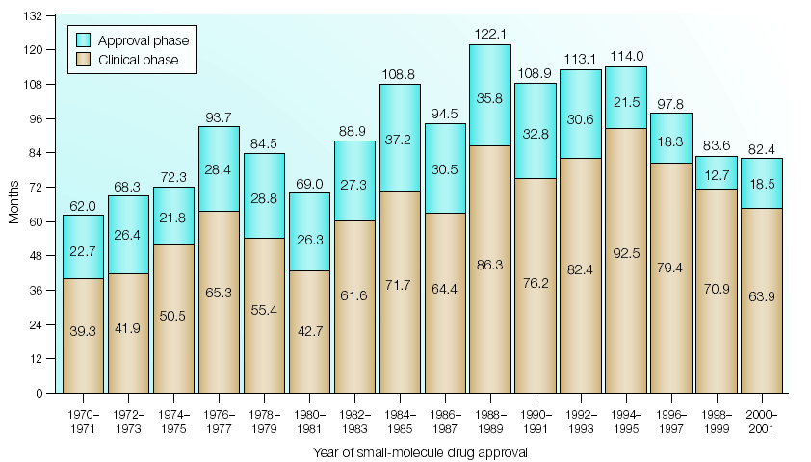
Small Molecular Drugs: Both Clinical Phase and Review Times have Diminished Since the Early 1990s

Slide 10
Factors Contributing to Decline in New Biological Product Applications
Shift in disease indications:
  chronic diseases; longer trials to assess effects and durability of response
Shift to therapeutic products whose mechanism of action and toxicities were less well understood
  Unexpected and difficult toxicities
  Difficulty of developing surrogate endpoints

Slide 11
FDA-Industry Share Common Goals but Make Distinct Contributions
(JM Reichert, Nature Reviews Drug Discovery, 2003)
“ The ultimate goal of both the FDA and industry is to provide patients with access to new, safe and effective treatments. Coordination and cooperation between industry and FDA will be required.”
“The FDA can only assist in the process though. The development of innovative products is actually accomplished by the pharmaceutical and biopharmaceutical industry.”
Notes:
So how can FDA and Industry can work together to improve drug development? First is to acknowledge that we have a common goal. Second, is understanding each others’ roles in achieving that goal

Slide 12
The “NIH Road Map”: Participation by Industry, NIH, and FDA
NIH Initiatives
“New Pathways to Discovery”
“Research Teams of the Future”
“Re-engineering the Clinical Research Enterprise”
FDA needs to work with NIH as well as Industry to address Road Map and Critical Path Initiatives
Notes:
In addition to FDA industry interactions, we also have a third co partner for development of new products to address poorly treated disease and that is the NIH that recently evolved the “ROAD MAP” initiative

Slide 13
Role of FDA
FDA uniquely positioned to identify and overcome challenges to product development:
  Reviewers can identify common themes and systematic weaknesses across similar products
  Based on such knowledge reviewers formulate guidance documents: availability fosters development and innovation; improves chances of an initial success of a marketing application; shortens time to approval

Slide 14
FDA Strategies for Speeding Innovative Therapeutics to Market
2002 Improving Innovation in Medical Technology: Beyond 2002
  Highlighted importance of guidance documents to avoid multi-cycle reviews
2004 Critical Path Initiative
Notes:
FDA efforts to improve efficiency in DD are encapsulated in two initiatives: Critical Path and Improving Innovation

Slide 15
Critical Path Initiative: Support of Research for Product Development
Support research for applied sciences needed for medical product development
Develop new tools to improve predictions regarding safety and effectiveness of new products in faster time frames at lower cost
Notes:
CPI arose from the following set of premises

Slide 16
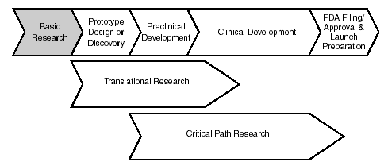
Research Support for Product Devlopment

Slide 17
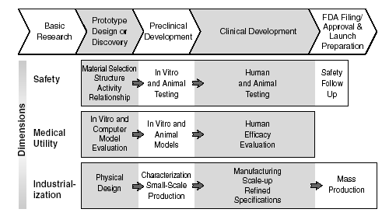
Critical Path: Targeted Areas
Notes:
Neglected areas are safety follow up and mass production. Assessing Safety: show that the product is safe for each stage of development: preclinical: product is safe enough for early human testing; eliminate products with safety problems early Clinical Development: show that product is safee enough for commercial distribution
Demonstrating Medical Utility: Show that the product benefits people. Preclinical: select appropriate biological with high probability of effectiveness. Clinical: show effectiveness in people.
Industrialization: Go from a lab concept or prototype to a manufacturable product. Design a high quality product: physical design, characterization, specifications; Develop mass production capacity: manufacturing scale up; quality control

Slide 18
The Researcher/Reviewer: Ideally Positioned to Advance Critical Path
Regulation
  Product expert: integral to regulatory process at all stages of product development.
  Provides scientific expertise on multiple levels:
    product manufacture (including inspections)
    product characterization including mechanism of action, in vivo bioactivity and toxicities;
    expert in analytical methods;
    expert in animal models
    key role in policy formation; guidances

Slide 19
The Researcher/Reviewer: Ideally Positioned to Advance Critical Path
Basis for regulatory expertise is engagement in high quality research program
  Maintenance of active laboratory research in field relevant to review area
  Publishes findings in peer reviewed, high quality journals
  Undergoes site visit evaluation of program every 4 years and yearly internal evaluation

Slide 20
Report of the Subcommittee to FDA Science Board 1998
“It is the concensus of the Committee that FDA requires a strong laboratory research focus and not a virtual science review process; otherwise we risk the potential to damage not only the health of the population of the US but also the health of our economy…”
Notes:
Strong support for the researcher reviewer was evidenced in the last critical review of research activities at FDA, the Subcommittee to the FDA Science Board in 1998.

Slide 21
Importance of Intramural Research: Researcher Reviewer
(FDA Science Board Subcommittee Report)
Regulators and policy makers require expert knowledge and first hand experience with the latest technology being applied to biological products
An intramural research program is required to assess risks of new therapies, to develop assays and new approaches to increase efficacy and safety, and reduce risks.
A strong well maintained intramural research program provides the basis for a climate of science and scientific communication within FDA that enhances the ability of the Agency to recruit and retain high quality scientific staff

Slide 22
Support for Intramural Research
(FDA Subcommittee Report)
The research program facilitates the ability of FDA to address existing regulatory issues and to anticipate future problems to keep pace with rapidly emerging and complex cutting edge technology.
It facilitates a response in a timely, flexible and competent way to new policy issues that require new “Points to Consider” documents, that suggest approaches to companies preparing IND and BLA applications.
The research program must be primarily staffed with full time, permanent personnel (rather than visiting and post-doctoral scholars) to capture the value of their research experience in regulatory submission reviews.

Slide 23
The Division of Therapeutic Proteins
Amy Rosenberg MD
Director
Barry Chereny Ph.D
Deputy Director
Sandra Chung
Secretary
Elizabeth Shores PhD
Chief, Laboratory of Immunology
Emmanuela Lacana, Ph.D
Emily Shacter, Ph.D
Chief, Laboratory of Biochemistry
Baolin Zhang, Ph.D.
Gibbes Johnson, Ph.D.
Acting Chief, Laboratory of Chemistry
Michael Norcross, MD
Principal Investigator
Jinhai Wang, MD
Full Time Review Staff
Kurt Stromberg, MD
Ingrid Markovic, Ph.D.
Kathy Lee, M.S.
Serge Beaucage, Ph.D
Principal Investigator
Raymond Donnelly, Ph.D
Principal Investigator
Harold DIckensheets, Ph.D
New Laboratory Needed
New Laboratory recruitment
Amy Rosenberg MD
Principal Investigator
Hugh McFarland, Ph.D
Lai Xu, M.D., Ph.D..
Full Time Review Staff
Dov Pluznik, Ph.D.
Daniela Verthelyi, Ph.D., MD
Senior Staff Fellow
Joao Pedras-Vasconcellos, Ph.D.
Full Time Review Staff
Susan Kirshner, Ph.D
Joy Williams, Ph.D..

Slide 24
DTP Licensed Products
Product Diversity:
  30 novel molecular entities/37 total licensed products
  many naturally derived products but mostly recombinants
  minimal “me too” products: IFNs.
  engineered versions of prototype products to enhance PK or other product characteristics: pegylation; site directed mutagenesis for hyperglycosylation, other enhancements
  diverse cell substrates: bacteria, yeast, insect cells, rodent, human, transgenic animals
  manufacturing process unique for each product

Slide 25
DTP Products
Interferons
Interleukins
Thrombolytics
Anti-thrombotics
Therapeutic Enzymes
Hematologic Growth Factors
Neurotrophic Growth Factors
Chemokines
€
Wound healing products
Toxin-fusion molecules
Angiogenesis/Anti-angiogenesis agents
Immunomodulators
Immune Adjuvants
Receptor Antagonists
Lectins

Slide 26
Principal Scientific and Regulatory Challenges in DTP
Comparability/Follow on Biologics
Immunogenicity
Potency Assessments
Product Counterfeit
Novel transgenically produced products: chicken eggs, plants
Infectious Disease Transmission

Slide 27
Keen Knowledge of Pitfalls in Product Development:
Pre-clinical studies:
  optimal drug delivery route not explored: cytokines/growth factors microenvironment considerations: act locally, not globally
  lack of appropriate animal models or failure to develop species specific product: safety and efficacy
Phase I/2:
  immunogenicity: thrombopoietins; CNTF;
  Unexpected adverse events (IL-12)
  animal models poorly reflective of human disease: lack of biological activity in human disease
  MOA not fully evaluated; most appropriate endpoints not sufficiently investigated;

Slide 28
Pitfalls in Product Development
Phase 3: Product Issues
  development of validated potency assay
  changing manufacture during phase III studies
  Lack of adequate process validation

Slide 29
Pitfalls in Product Development: Insight into Clinical Issues
Phase 2/3: Clinical Issues (R. Temple)
  Insufficient dose ranging studies;
  Overoptimism regarding less than adequate phase 2 (“confirm” before you’ve “learned”)
  failure to continue dose finding in phase 3, choosing wrong single dose or regimen based on too little data
  no valid biomarker, so no possible early insight until phase 3
  surprise infrequent adverse effect
  adverse effects showing up with longer exposure

Slide 30
DTP’s CP Focus: Support Ongoing Critical Path Projects
Entry of products with novel mechanisms of action into drug development pipeline:
  Research that investigates mechanism of action of new products
  Research that establishes new animal models for assessment of safety/efficacy
  Research that provides new or improved products to pipeline

Slide 31
DTP’s Focus: Support Ongoing Critical Path Projects
Barriers/hurdles to product development including immunogenicity, potency assessment:
  research that overcomes these barriers to product development
  activities to standardize assays; compare immunogenicity across products in same class
Identification of surrogate endpoints/ biomarkers for safety and efficacy:
  research that identifies novel biomarkers for safety and efficacy
  activities to gain concensus on appropriate surrogate markers

Slide 32
Research on Novel Products:CpG Oligonucleotides
Development as immunomodulators for infectious diseases
Principal Investigator: Daniela Verthelyi, Ph.D., M.D.
  Investigation of immunomodulatory activities of innate immune response: CpGs; other Toll Like Receptor (TLR) agonists
  Identification of surrogate markers of immune protection in primate models of infectious disease
  Development of novel TLR agonists
  Application to bioterrorism situations: “animal rule”

Slide 33
Research on Novel Products: Chemokines
Chemoattractant cytokines -critical for cell migration: inflammation,metastasis, angiogenesis, allergy, atherosclerosis
Principal Investigator: Mike Norcross, MD
  Development of methods to assay potency of chemokine products
  Cellular and molecular regulation of chemokines and chemokine receptors in HIV infection.
  Methods for non-clinical screening of antiviral biological products.
  Development and validation of biomarkers and surrogate endpoints for immune base therapies for HIV infection.
Notes:
Matastasis:SDF-1
Allgraft rejection:
Would healing:
Arthrosclerosis:
Angiogenesis:

Slide 34
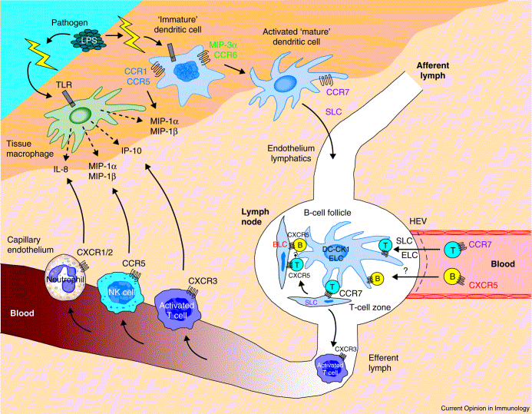
Cell Migration is Controlled by Chemokines
Chemokines

Slide 35
Research on Novel Products: Novel Cytokine Development
Signaling pathways of novel interleukins and interferons:
Principal Investigator: Raymond Donnelly, Ph.D.
  Defining signal transduction pathways and receptors for Interleukins 19,20,22,
  Defining biological properties of IFN-λ

Slide 36
Research that Provides New and Improved Products to Pipelines
Enhance specificity and sensitivity of oligonucleotide microarrays for multiple purposes
Principal Investigator: Serge Beaucage, Ph.D
detection and quantification of bacterial and viral nucleic acid contaminants in biologics including blood products
high-throughput screening of point mutations or single nucleotide polymorphisms in genomic DNA that predispose human to diseases.
gene expression assays to evaluate the safety and efficacy of drugs

Slide 37
Critical Path Projects Promoting
Novel Anti-Cancer Treatments
Principal Investigator: Emily Shacter, Ph.D.
  Modulation of signal transduction pathways to enhance tumor cell death in response to cancer chemotherapy agents
  Investigation of antioxidants as potential chemoprotective agents to limit side-effects from chemotherapy
Principal Investigator: Gibbes Johnson, Ph.D.
  Enzymology of EGFR signaling
  Identification of novel signaling molecules

Slide 38
Immunogenicity Issues Along the Critical Path
All protein therapeutics potentially immunogenic
  IgE antibodies can cause anaphylaxis
  IgG antibodies can neutralize a therapeutic protein, or can block action of endogenous homolog
Immunogenicity
  has killed products in development: TPO, CNTF, GM-CSF-IL-3 fusion molecule
  limits efficacy for many biological therapeutics: therapeutic enzymes, IFNs α,β, asparaginase
  poses ongoing concern for licensed products following changes in manufacture, packaging, and clinical indication: Epo
  lack of standardized assays for comparison across products in same class

Slide 39




The Immunogenicity Barrier

Slide 40
Critical Path Activities: Immunogenicity Concerns
Research to understand the mechanism by which antibody responses to proteins are switched to cause anaphylaxis or to neutralize protein therapeutic (Edward Max, Ph.D., MD)
Research to develop better animal models of immune tolerance and autoimmunity (Wendy Shores, Ph.D.)
Research to dissect immune responses to embryonic stem cells (Amy Rosenberg, MD)
Participation in international efforts to standardize antibody assays for erythropoietin products

Slide 41
DTP Focus: New Critical Path Project Proposals
Immunogenicity-
  Nanotechnology: novel antigen presenting mechanisms could facilitate immunogenicity or tolerogenicity
  Therapeutic enzymes: tolerance induction in CRIM negative patients
  Protein aggregates in therapeutic protein products: risk assessment. Specifications set on manufacturing experience, not on risk: how much, what kinds, how delivered incur risk?
  Development of Guidance Documents where appropriate

Slide 42
DTP Focus: New Critical Path Project Promoting Treatment for Sepsis
(Emily Shacter, Ph.D.)
Development of protein S as an adjunct to activated protein C (XigrisTM) to improve survival from sepsis
  Activated protein C (APC; Xigris) is an approved biologic used to decrease mortality from sepsis.
  Protein S is an anticoagulant plasma glycoprotein required for APC activity.
  Both proteins are depleted during DIC of sepsis, but only APC is given as a therapeutic.
  CDER research suggests that addition of protein S to the treatment protocol will improve efficacy, supporting the idea that recombinant protein S should be developed as a therapeutic protein.
Notes:
However, Critical path is not totally focused on research, a very important component of it also concerns communicating with industry. Both face to face and technology enhanced communications are vital for timely submission and product approval Moreover, the issuance of guidance is critical, as this has been shown to reduce the need for multi cycle reviews

Slide 43
Communication is a Critical Component of Critical Path
(From Industry Survey, Good Review Management Practices. Zezza et al 2003)
Open, honest communication
Informal communication/formal documentation of agreements
Regular status updates
Timely communication of issues as they arise
Clear, concise FDA response with explanation of position
CBER, DODP, DCRDP, DOTC, DPDP, DAVDP, DMEDP
Notes:
Highlights the “climate of science”

Slide 44
Good Communication Facilitates Product Development
Reviewers and Decision Makers
  Direct access to reviewers
  Timely access to decision makers at critical points
  Timely communication of issues as they arise
The final stages:
  Frequent telecons to resolve outstanding issues
  Scheduled labeling meetings and post-approval commitment discussions
  Potential discussion 30 days prior to action date
  Allow sufficient time for management reviews
CBER, DMEDP, DCRDP, DGCDP, OMP, OIM

Slide 45
Other DTP Critical Path Activities
ICH Q5e comparability guidance: led by Barry Cherney, Ph.D., DTP Deputy Director
Standardization of antibody assays for Erythropoietin products: Susan Kirschner, Ph.D.
Support of risk based approach to GMP and inspectional issues: Barry Cherney, Ph.D., and Ralph Bernstein, Ph.D.

Slide 46
Summary
DTP strongly supports Critical Path efforts to facilitate development of new products for poorly treated diseases
DTP research efforts elaborated
Other activities include development of guidance, adoption of risk based approach to GMPs, and maintenance of communication format with industry

