Slide 1
A Profile of the Idle Youth in the U.S.
Ana J. Montalvo
Amy O’Hara
U.S. Census Bureau
Housing and Household Economic Statistics Division
Presented at the Annual Meeting of the Population Association of America, New Orleans, LA on April 17-19, 2008
This poster is released to inform interested parties of ongoing research and to encourage discussion. The views expressed on statistical, methodological, technical, or operational issues are those of the authors and not necessarily those of the U.S. Census Bureau.
Notes:
BANNER ACROSS TOP

Slide 2
Purpose of analysis
To present a snapshot of the idle youth, describing their socioeconomic, demographic, and geographic characteristics.
Idle youth defined
All people 16 to 24 years old not living in group quarters who have not been enrolled in school for three months and are not in the labor force.

Slide 3
Background
The idle youth are people who do not finish school as well as people who finish school but cannot attach to the labor force.
These could be people whose general high school background has not prepared them for the jobs available.
Their ill-preparedness could be:
    job skills-based (points to lack of training programs, apprenticeships, etc.)
    social skills-based (points to lack of family or peers who have steady employment, community problems).

Slide 4
Disconnected youth
Our concept of idle youth is a subset of the disconnected youth concept in the sociology literature.
Disconnected youth:
are often found in disadvantaged communities
often lack adult role models
may still be in school but are disengaged

Slide 5
The National League of Cities defines disconnected youth as those not connected to school, work or caring adults.
Urban Institute researchers limit disconnected youth to those with no post-secondary education who have not worked in a year.
A Kids Count brief by the Annie E. Casey Foundation (2005) reports that:
  Disconnected young men are more likely than other young men to go to prison
  Disconnected young women are more likely than other young women to rely on public assistance

Slide 6
Literature
The transition to full-time work is accompanied by other transitions to adulthood including:
School departure
Moving to separate place of residence
Geographic mobility
Marriage
Childbearing
Weak links between the school and work transition lead young people to become disconnected, resulting in:
  Lower lifetime earnings
  Increased poverty
  Homelessness
  Criminal activity

Slide 7
Specific idle populations
Black and Hispanic youth
(Dervarics, Powers)
Teen mothers
(Bacolod & Hotz, MacDonald & Marsh)
Youth in rural areas
(Snyder & McLaughlin)
Youth involved in the criminal justice system
(Freeman, Harris)
Youth not enrolled in school
(Mare, Winship & Kubitschek, Bridgeland,
Dilulio & Morison)

Slide 8
Data
2006 American Community Survey
Annual survey of approximately 3 million household addresses
Single year estimates of detailed social, housing, economic, and demographic data for geographic areas with populations of 65,000+
Data collection is conducted on a monthly basis
Results are compiled and published annually
Most current source of demographic data on this scale
Limitations
Cannot identify married partners or family relationships among non-reference people
Only collects information on regularly received income from select sources
Notes:
Sample:
2,885,384 initial addresses selected (housing unit)
189,641 initial sample selected (GQ)
TOTAL SAMPLE: 3,075,025 addresses and GQ's
Interviews completed:
1,968,362 housing unit addresses interviews completed (housing unit)
145,311 GQ interviews completed (GQ)
TOTAL: 2,113,673 housing units and GQ interviews completed
reference: http://www.census.gov/acs/www/acs-php/quality_measures_sample_2006.php
Geographic areas with published data: 7,045
(**These areas are large enough to meet the 65,000 population threshold for 1-year period estimates.)
reference: http://www.census.gov/acs/www/Downloads/2006_geography_notes.pdf

Slide 9
Idle youth 16 to 24 years old by sex and type of group quarter status: 2006
 | Adult correctional and juvenile facilities | All other GQ | Total
Total | 353,571 | 74,128 | 427,699
Male | 91.2% | 63.5% | 86.4%
Female | 8.8% | 36.5% | 13.6%
Note: The All other GQ category includes nursing facilities/skilled nursing facilities, other health care facilities, such as psychiatric hospitals and in-patient hospice facilities, and college/university housing, military quarters, and other noninstitutional facilities, including religious group quarters and residential treatment centers.
Of the 3.2 million people 16 to 24 in group quarters (GQ), 13.5 percent (0.4 million) are idle by our definition.
Source: U.S. Census Bureau, 2006 American Community Survey.

Slide 10
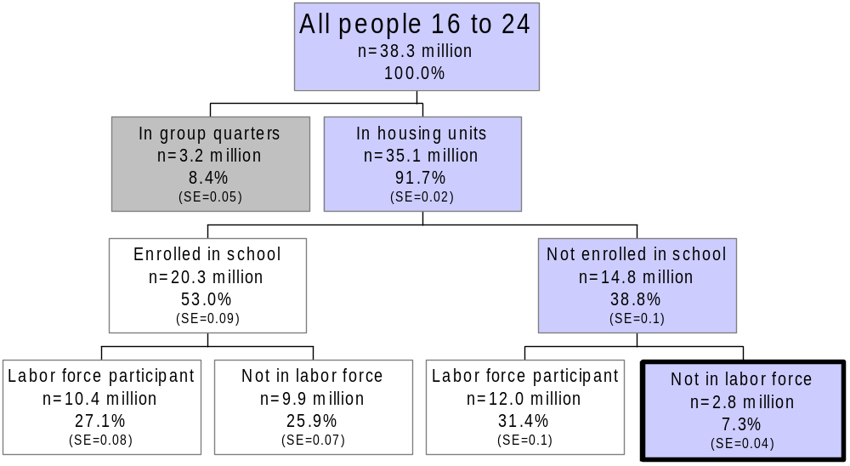
Identifying the idle youth: 2006
(Percentages shown are of the total weighted sample of people 16 to 24 years old)
Source: U.S. Census Bureau, 2006 American Community Survey

Slide 11
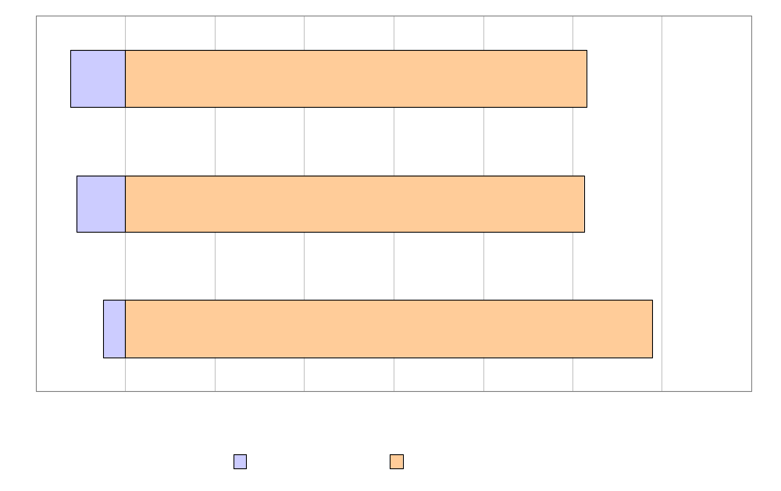
Idle and non-idle youth by age group
2,000
Source: U.S. Census Bureau, 2006 American Community Survey.
Notes:
BANNER ACROSS TOP WILL SAY DEMOGRAPHIC CHARACTERISTICS

Slide 12
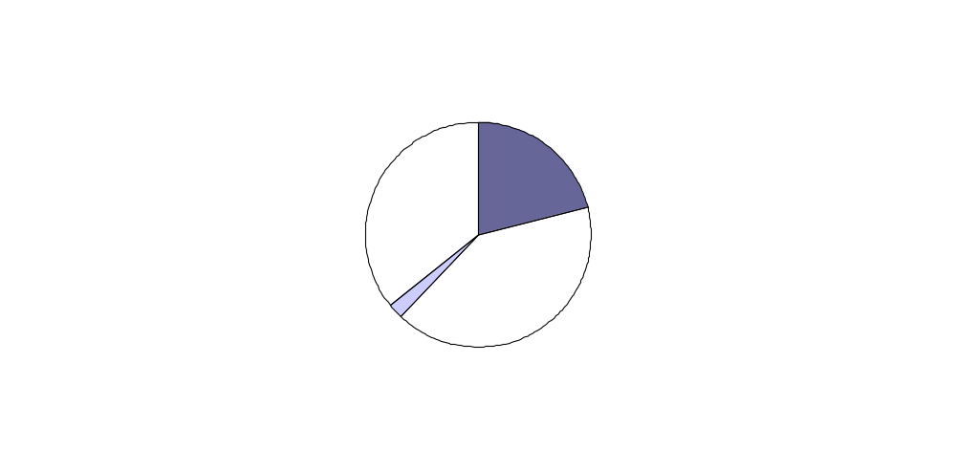
Idle youth by sex and marital status
n = 2.8 million idle youth
Note: Unmarried includes widowed, divorced, separated, and never married.
Source: U.S. Census Bureau, 2006 American Community Survey.

Slide 13
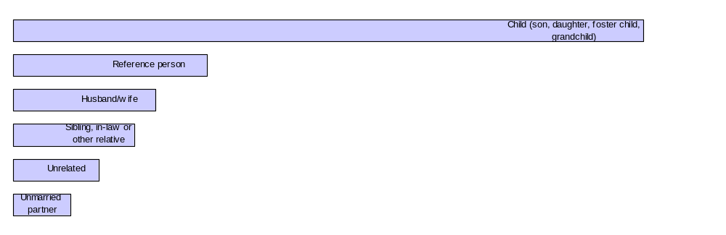
Relationship to reference person among Idle Youth
Note: Unrelated includes roomer, boarder, housemate, roommate, and other non-relative.
Source: U.S. Census Bureau, 2006 American Community Survey.

Slide 14
Idle youth by race and Hispanic or Latino origin
Total idle youth | 2,808,217 | 100.0%
White, not Hispanic or Latino | 1,339,849 | 47.7%
Hispanic or Latino of any race | 772,541 | 27.5%
Black, not Hispanic or Latino | 527,911 | 18.8%
Asian, and Native Hawaiian and Other Pacific Islander, not Hispanic or Latino | 99,790 | 3.6%
American Indian and Alaska native, not Hispanic or Latino | 55,728 | 2.0%
Some other race, not Hispanic or Latino | 12,398 | 0.4%
Source: U.S. Census Bureau, 2006 American Community Survey.
Notes:
62.0%
19.3%
2.2%
3.4%
0.3%
12.8%
100.0%
62.0%
19.3%
2.2%
3.4%
0.3%
12.8%
100.0%
62.0%
19.3%
2.2%
3.4%
0.3%
12.8%
100.0%
62.0%
19.3%
2.2%
3.4%
0.3%
12.8%
100.0%

Slide 15
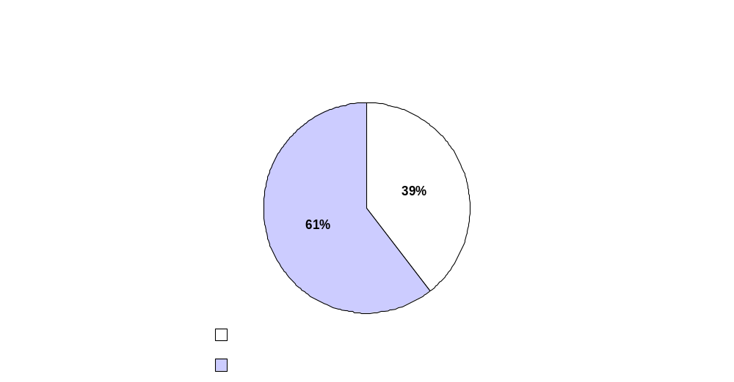
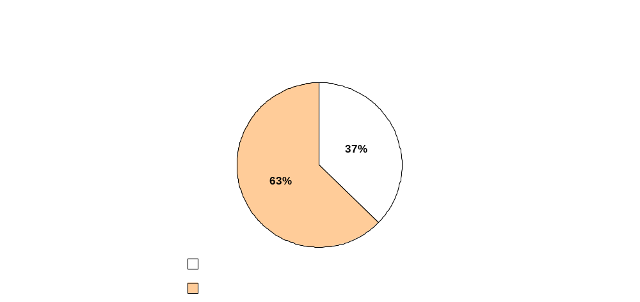
Idle and non-idle youth by education
Source: U.S. Census Bureau, 2006 American Community Survey.

Slide 16
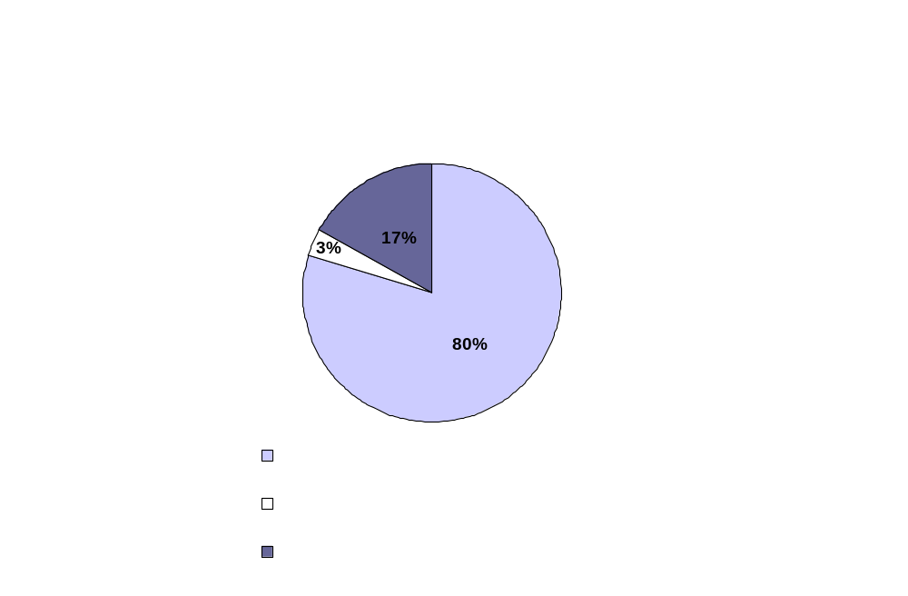
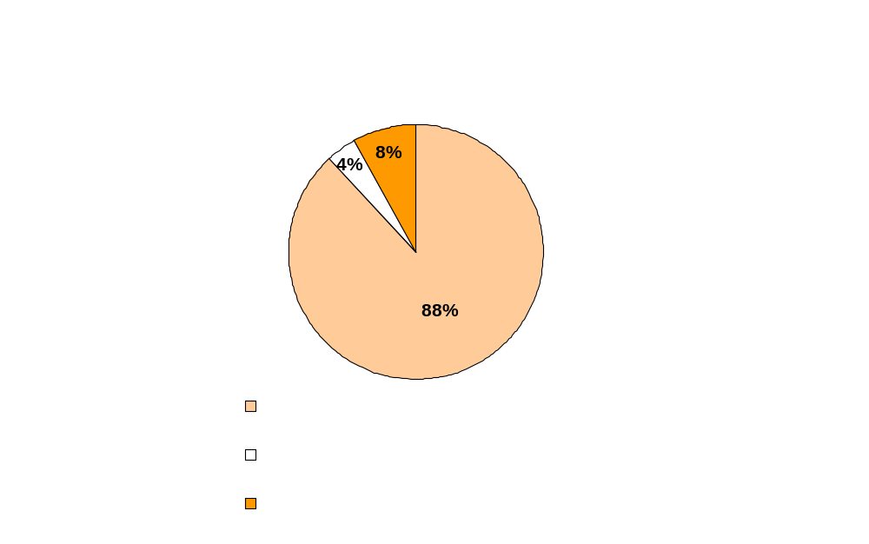
Idle and non-idle youth by citizenship
Source: U.S. Census Bureau, 2006 American Community Survey.

Slide 17
Work history
 | Male | Female | Total
Idle youth | 1.1 million | 1.7 million | 2.8 million
Worked in past year | 32.2% | 28.5% | 29.9%
Non-idle youth | 16.8 million | 15.5 million | 32.3 million
Worked in past year | 74.5% | 73.6% | 74.1%
Source: U.S. Census Bureau, 2006 American Community Survey.

Slide 18
Receipt of public assistance
 | 16 to 18 | 19 to 21 | 22 to 24 | Total
Idle youth | 0.5 million | 1.1 million | 1.2 million | 2.8 million
Receiving public assistance | 2.4% | 5.2% | 6.7% | 5.4%
Non-idle youth | 11.8 million | 10.2 million | 10.3 million | 32.3 million
Receiving public assistance | 0.5% | 0.9% | 1.7% | 0.9%
Note: Public assistance income includes general assistance and Temporary Assistance to Needy Families (TANF). Separate payments received for hospital or other medical care (vendor payments), are excluded. This does not include Supplemental Security Income (SSI) or noncash benefits such as Food Stamps.
Source: U.S. Census Bureau, 2006 American Community Survey.

Slide 19
Ability to work
Idle youth with a disability: 18 percent
The Census Bureau defines disability as a long-lasting sensory, physical, mental, or emotional condition or conditions that make it difficult for a person to do functional or participatory activities such as seeing, hearing, walking, climbing stairs, learning, remembering, concentrating, dressing, bathing, going outside the home, or working at a job
Idle youth with a difficulty working at a job: 13 percent
Respondents were asked if they have a physical, mental, or emotional condition lasting 6 months or more that caused difficulty “working at a job or business.”
Source: U.S. Census Bureau, 2006 American Community Survey.

Slide 20
Poverty status
32.1% live in a household with income below the poverty threshold
Source: U.S. Census Bureau, 2006 American Community Survey.

Slide 21
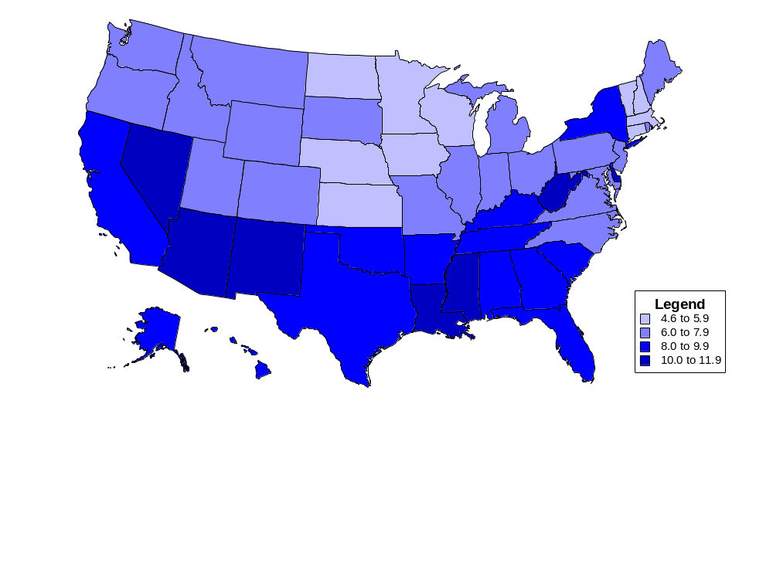
Percent idle by state
Source: U.S. Census Bureau, 2006 American Community Survey.

Slide 22
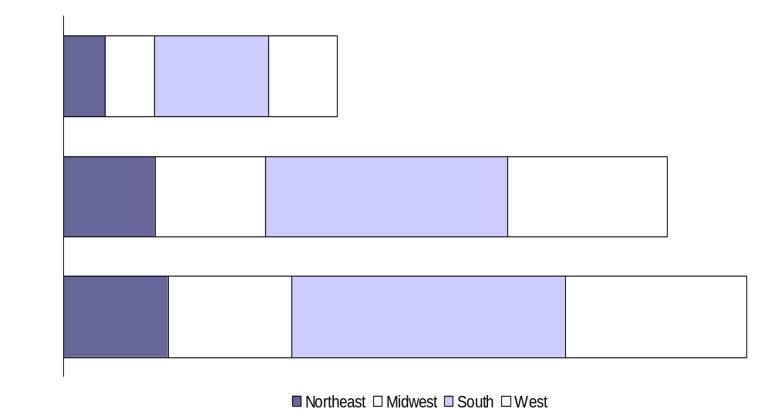
Idle youth by age group and region
Source: U.S. Census Bureau, 2006 American Community Survey.

Slide 23
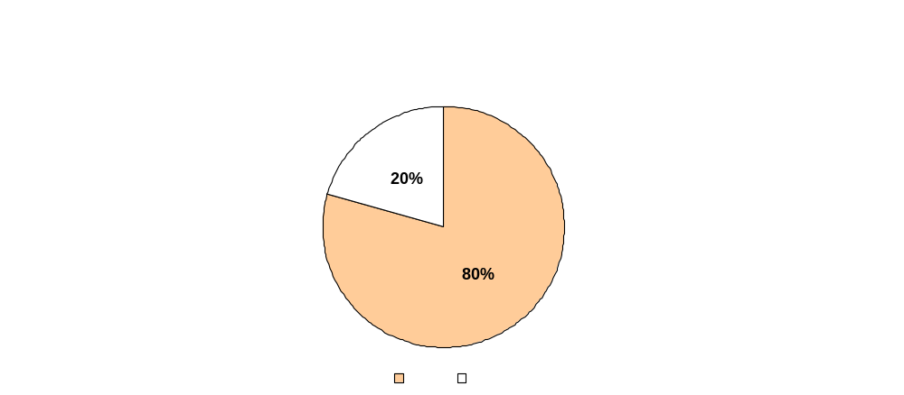
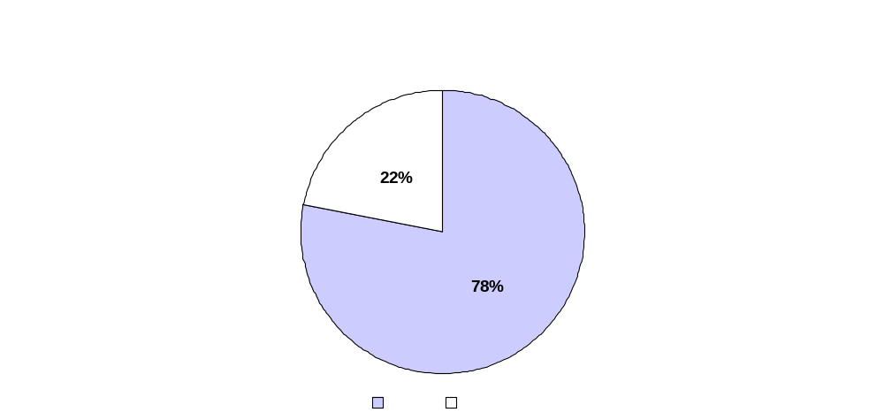
Idle and non-idle youth by rural and urban status: 2006
Source: U.S. Census Bureau, 2006 American Community Survey.

Slide 24
Summary
Transitioning to adulthood, through secondary school to the workforce, is difficult for many young adults.
Most idle youth are related to the householder; the majority are children of the householder.
Female idle youth are more likely to be married compared with male idle youth.
Male idle youth are more likely to be in correctional facilities than female idle youth.

Slide 25
Contact information
Ana J. Montalvo: ana.j.montalvo@census.gov
Tel. 301-763-5977
Amy O’Hara: amy.b.ohara@census.gov
Tel. 301-763-5757
For more detailed information on the American Community Survey (ACS), see the following website: http://www.census.gov/acs/www
To get ACS data, access American FactFinder at: http://factfinder.census.gov/home/saff/main.html?_lang=en
For the ACS Source and Accuracy Statement, access the following website: http://www.census.gov/acs/www/Downloads/ACS/accuracy2006.pdf
Notes:
BANNER ACROSS BOTTOM

