Slide 1
NASA Glenn Lunch & Learn
Applying KM Through Communities of Practice
Amy C. Eugene
Director of Knowledge Management
Cuyahoga Community College

Slide 2
Agenda
Who is Tri-C and Why are we implementing KM?
What is our Process?
  Communities of practice
  Measurements, outcomes and benefits
How important is the People & Culture element?
What are our Lessons Learned?
Conversation

Slide 3
Who is Tri-C?
“At Cuyahoga Community College we are in the knowledge business. The extent to which we are willing to invest ourselves in the knowledge sharing process is up to us. Together we can build an environment where shared knowledge will usher in an exciting, new era of shared success.”
“Knowledge Management democratizes our organization.”
Dr. Jerry Sue Thornton,
  President of Cuyahoga Community College

Slide 4
Tri-C is Recognized as a Leader in KM
"Tri-C is an innovator in the implementation of knowledge management practices in higher education. Their knowledge management program is helping them to identify some of the most pressing needs of the organization by creating a more streamlined process for discussing and implementing improvements to curriculum, fundraising, and overall work management."
Lisa Petrides, PhD., President,
Institute for the Study of Knowledge Management in Education

Slide 5
Tri-C’s Definition of
Knowledge Management:
A discipline and framework designed to help our organization acquire, package and share “what we know” to enable decision-making, creativity, innovation and communication.

Slide 6
Tri-C’s Business Case for KM:
Turnover Challenges
Tomorrow’s Decision-Structure Needs
Expand Capacity to Share Knowledge
Teamwork Culture Builds on Collegiality
Tools to Maintain Competitive Edge
Technology Investment
Notes:
KM is organic

Slide 7
History of KM at Tri-C
CY2000, secured $270K matching grant from local foundation
Implemented change management strategy
  Crafted communications plan
  Filled key strategic KM roles
  Conducted knowledge audit
Created KM framework and model for CoP development
  Adopted knowledge policy
  Developed balanced scorecard for CoP’s
Aligned business processes
Defined knowledge architecture
  Implemented collaboration and DM tool Fall, 2001 (Microsoft’s SharePoint Server)
Notes:
KM is organic

Slide 8

Integrated KM Approach:
Strategy
Technology
People &
Culture
Content
Process
Notes:
Balanced scorecards are based on these dimensions

Slide 9
Goal: Process
To establish structures and processes that put individuals in close contact with those who have the knowledge they need
Process

Slide 10
KM Through CoP’s
Four types of communities; each CoP has portal
Operational/Process
  Curriculum Development
  Grants Management
  Transfer & Articulation
Strategic
  Corporate College
Informational
  Collegewide Technology
Customer (student)-focused
  Student Services

Slide 11
Communities-of-Practice:
Connecting people with common needs/interests on a particular topic to:
  Share ideas, insights, information
  Address challenges & advise each other
  Learn and laugh together
  Create processes, frameworks, templates, etc.
  Own and maintain the content about their topic

Slide 12
Community Activities:
Curriculum Development
  Mapped CD Process
    Implementing CD Software
  Service Learning community
  Articulation & Transfer community
  Prior Learning Credit community
Grants Management
  Conducted Learning Events
  Improved grant proposal process
    Future: Using portal to contribute grant proposals

Slide 13
Community Activities:
(Continued)
Student Affairs
  Developed cross-functional Enrollment Management model
  Conducted student survey regarding “single-point-of-access” to content
Collegewide Technology
  Developed portal that provides collegewide access to status reports and online discussion for technology projects
Notes:
Distance Learning, Corporate College

Slide 14
Community Activities:
(Continued)
Corporate College
  Enabling collaboration and culture shift
    Open access to discussions and planning
  Communications and decision-making infrastructure
  Identifying expertise
Research
  Merging content and expertise from multiple sources
    Institutional Planning, Workforce Development, Professional Improvement Leaves, Library
Notes:
Distance Learning, Corporate College

Slide 15
Goals and Outcomes:
Example: Grants Management
Secure a minimum of 5 proposals/concept papers per campus per semester – for 30 submissions to the Grants Office annually, 10 per campus.
Reduce the number of calls and amount of time spent answering routine grant questions from 8 hours to no more than 1 hour per week.
Increase the grant-seeking notification window given by initiators to the Grants Office from 5 days to 30 days
Increase the final draft submission window given by initiators to the Grants Office from 5 days to 10 days
Attain a minimum 40% acceptance/funding rate for all proposals submitted in a given fiscal year.

Slide 16
Community Knowledge Roles:
Sponsor
Knowledge Coordinator
Subject Matter Expert/Specialist
Community Member
  Primary – Regular Access and Contribution
  Secondary – Less Collaboration but Value the Interaction
Portal Moderator
Notes:
Distance Learning, Corporate College

Slide 17
Phases of Development for
Knowledge Sharing Communities
ENABLING A KNOWLEDGE SHARING CULTURE
1
2
3
4
PREPARE
COMMUNITY
AUDIT KNOW-
LEDGE NEEDS
& ASSETS
ESTABLISH
KNOWLEDGE
ROLES
CREATE KNOW-
LEDGE PROCESS
AND PLAN
5
6
7
8
9
ACQUIRE
CONTENT
DEVELOP
CLASSIFICATION
SCHEME
STORE,
REVIEW &
FILTER
CUSTOMIZE
TECHNOLOGY
MARKET &
COMMUNICATE
10
11
12
13
TRAIN END
USERS
DEPLOY
CONTENT &
TOOLS
ASSESS USAGE,
AWARENESS &
VALUE
MAINTAIN
KNOWLEDGE
FLOWS
FEEDBACK, LEARNING & IMPROVEMENT
Notes:
Measured by phase of development, usage statistics and user surveys

Slide 18
Community Toolkit:
Step 1: Build
Community Creation Form
Guidelines for developing a Manifesto
Definitions of key roles
Template for a Knowledge Plan
Checklist for the Knowledge Audit
Checklist for customizing the Portal
Step 2: Operate
Training Materials
Desktop References
Sample meeting agendas
Suggested topics list for meetings
Sample usage reports
Operations checklists
Content Assessment Worksheets
Schedule of release dates for KM News
Step 3: Evaluate
Guidelines on how to measure community success
Sample Scorecard
Troubleshooting Guide
Methods for connecting Scorecard to a new Knowledge Plan
Template for the Performance Report

Slide 19
Measuring Effectiveness:
Community Scorecards
Tracks goals, outcomes and deliverables
Measures health and vitality of KM communities
Focuses on five areas of College’s integrated KM approach
Ratings structure: green (successfully meeting expectations), yellow (area of improvement), red (needs critical attention)
Used by Community sponsors,knowledge coordinators, and shared with KM Mgmt. Steering Committee

Slide 20
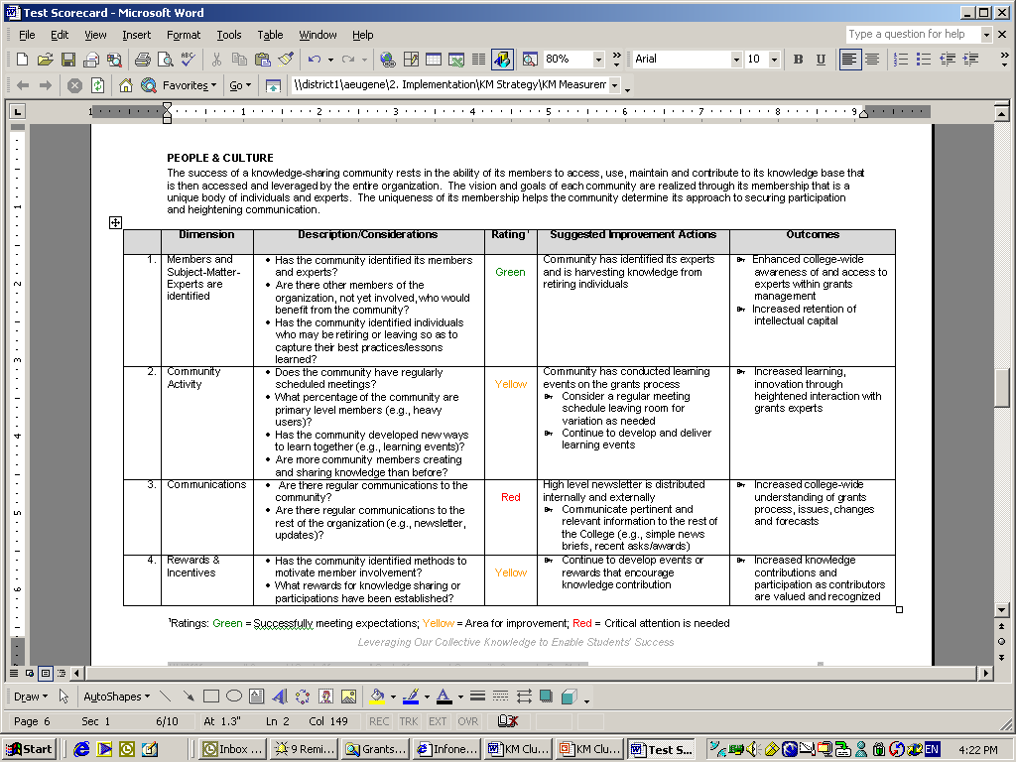

Slide 21
Other Tools for Measuring CoP Effectiveness:
Usage statistics
  Total hits by portal and page
  Number of unique users and their identity
User Surveys
  Measures satisfaction levels

Slide 22
Goal: People & Culture
To foster an institutional climate that rewards knowledge sharing
People &
Culture

Slide 23
Guiding Principles for
Culture Change:
Continually build sponsorship across constituencies and at different levels
Keep the business case, vision and benefits focal for people
Continually raise awareness and involvement through captive communications
  Document and share successes and outcomes
Make KM Tools an integral part of new hire orientation; the “Tri-C Way”
Align performance measures and rewards to promote knowledge sharing

Slide 24
Guiding Principles for Culture Change: (cont.)
Involve users throughout…
  Knowledge audit
  Taxonomy development
  Tool development
  Training/coaching on KM practices
  Feedback and improvement

Slide 25
Commitment from the Top:
In March 2002, the Board approved the policy thus endorsing past, present and future KM initiatives
Appropriate procedures have since followed
Performance objectives were outlined for Campus presidents
Knowledge processes connected with major College initiative (Corporate College)

Slide 26
Tri-C’s Lessons Learned
Don’t call it Knowledge Management
Focus on critical organizational issues
Ensure that people drive the technology
Remember your target audience (Create value propositions)
Recognize importance of roles, responsibilities, and process
Employ the 80/20 rule – iteration is good (Nothing is perfect)
Realize that people look for information using various methods and channels
Expect unexpected benefits

Slide 27
Questions & Comments
Amy C. Eugene
Director of Knowledge Management
Cuyahoga Community College
216-987-4879
amy.eugene@tri-c.edu
Leveraging Our Collective Knowledge
to Enable Student Success

Slide 28
Goal: Technology
To create and maintain a repository of knowledge and best practices available to users throughout the College
Technology

Slide 29
Key Assumptions
Make Technology Fit:
Use familiar technology (Microsoft Outlook, and Sharepoint)
Integrate knowledge sharing technology within everyday work
Enable the community to customize and maintain their portal (People first maxim)
Change functionality as communities discovers what is needed and what is valuable
Create a working relationship and understanding with IT department
Notes:
Speak to their benefits

Slide 30
Technology Components of our KM Solution:
Portals
Websites
Search Engine
Shared Drives
Specialty Knowledge Applications
  People Pages (Expertise Locator)
  Lessons Learned Repository
  Online survey tool
MS NetMeeting
Knowledge and Information Tools Navigator
Notes:
Speak to their benefits

Slide 31
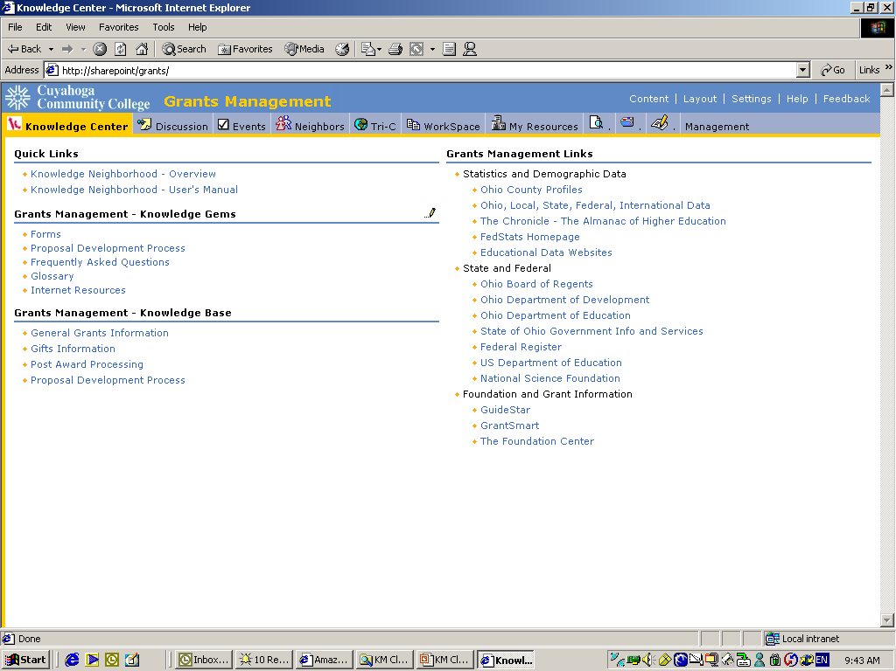
Access pertinent information sources (e.g., shared drives, websites)

Slide 32
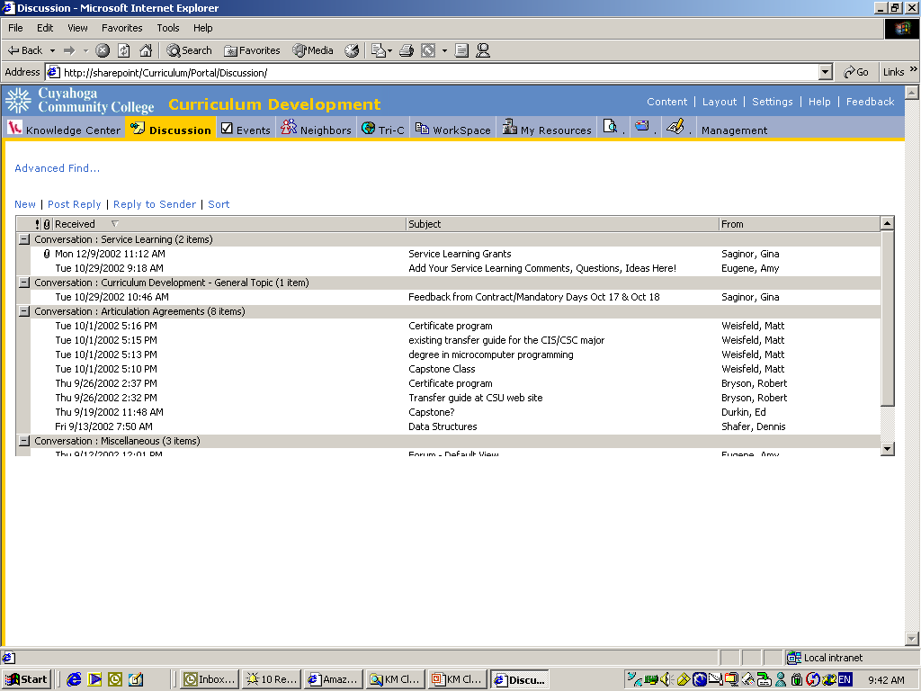
Post questions, ideas, contribute new knowledge and information

Slide 33
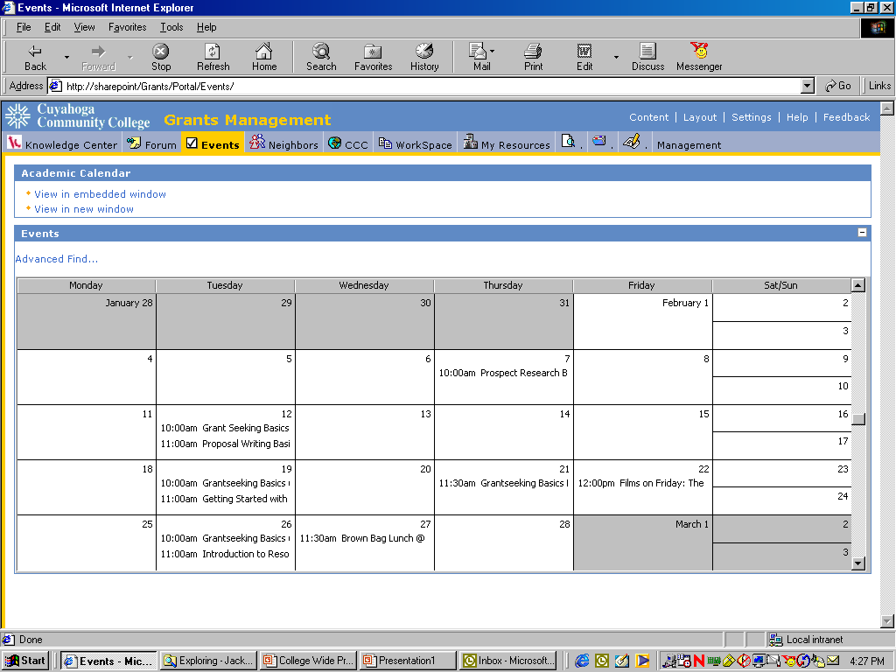
Keep current on the latest events, training, etc.

Slide 34
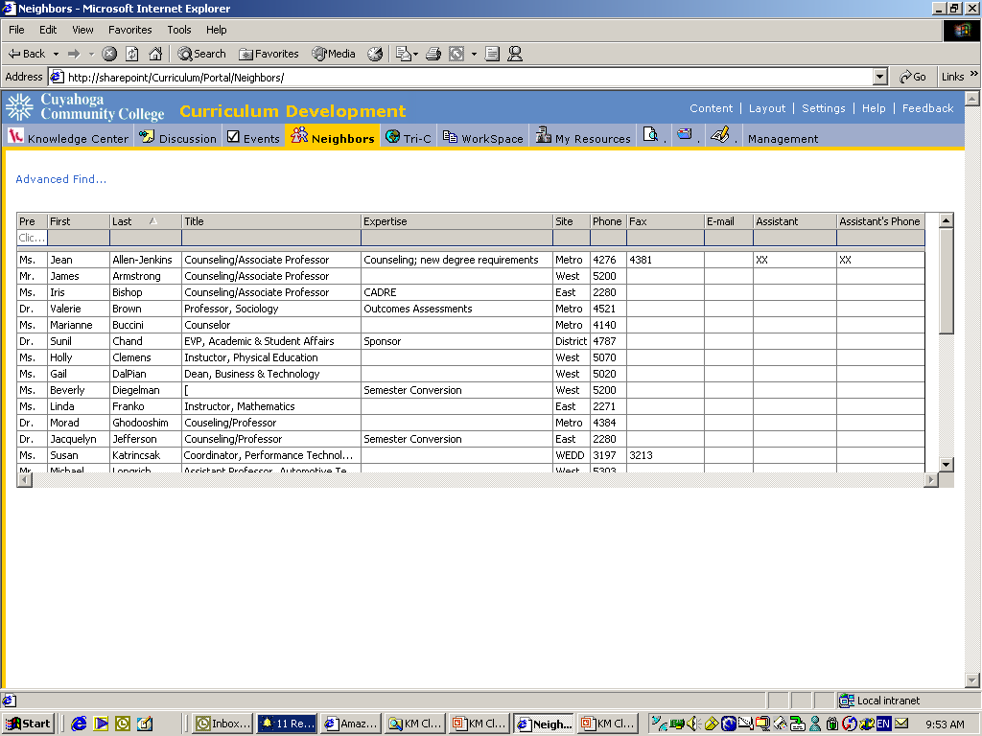
Access subject matter experts

Slide 35
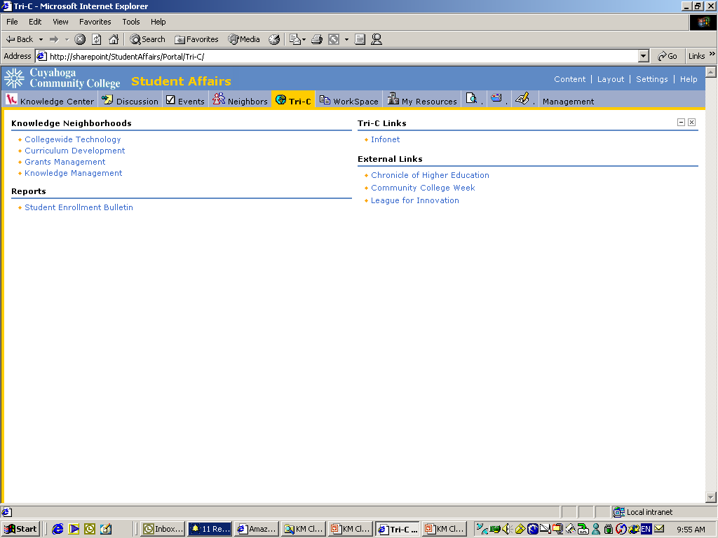
Link to pertinent knowledge and information sources

Slide 36
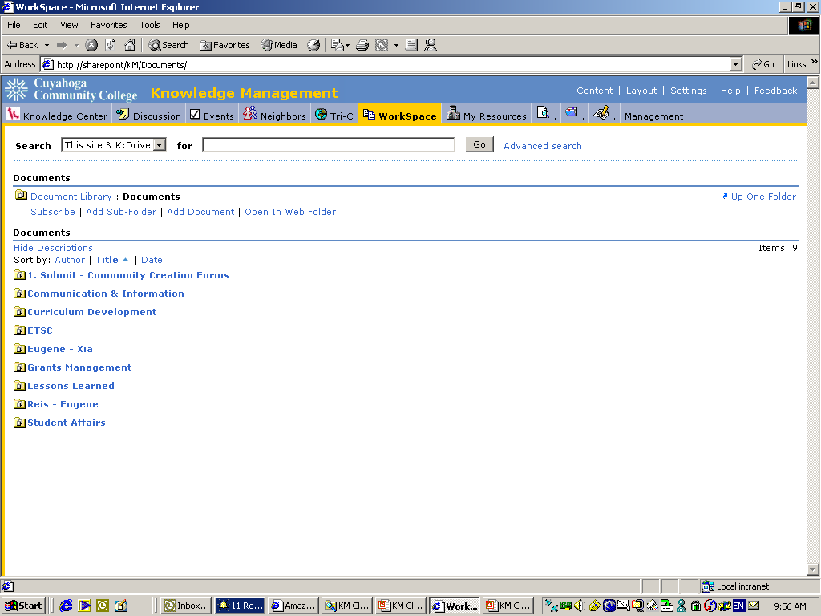
Utilize document management features (e.g., workflow, version control)

Slide 37
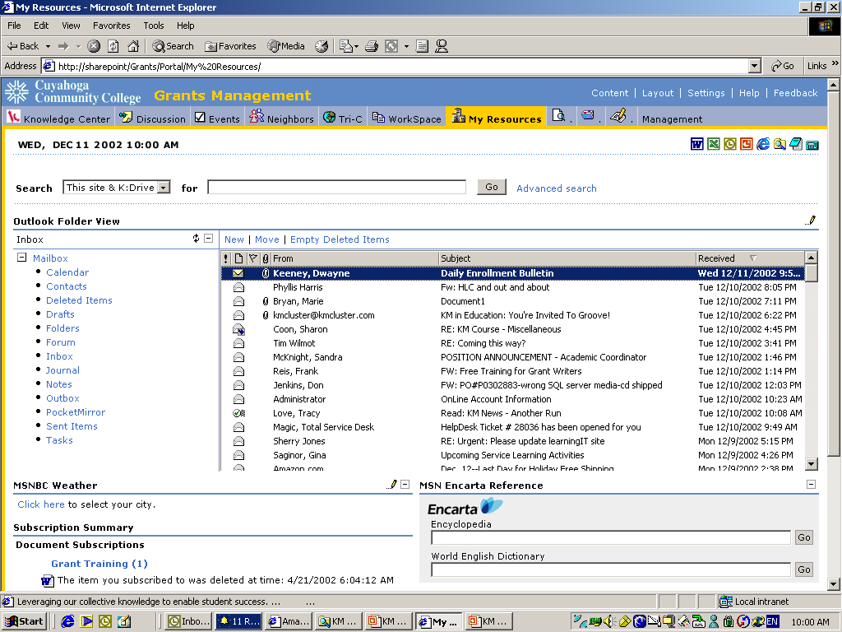
Access email and other sources

Slide 38
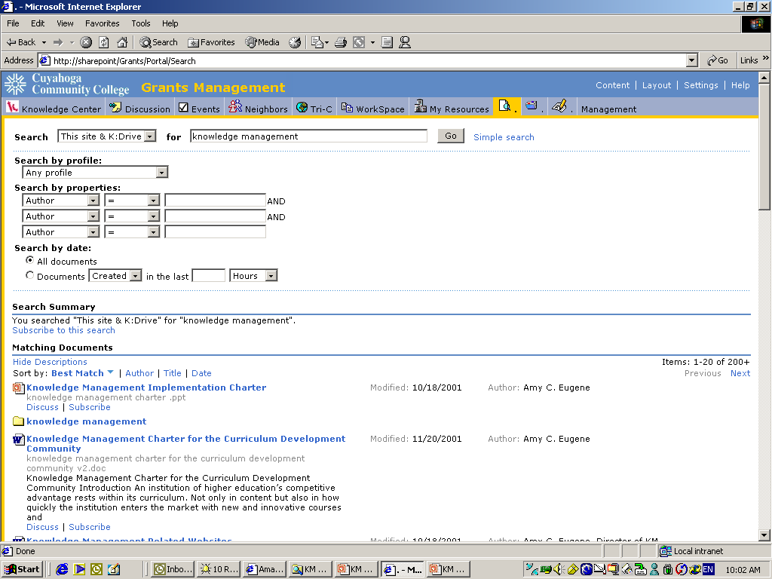
Conduct full-text search of knowledge base

Slide 39
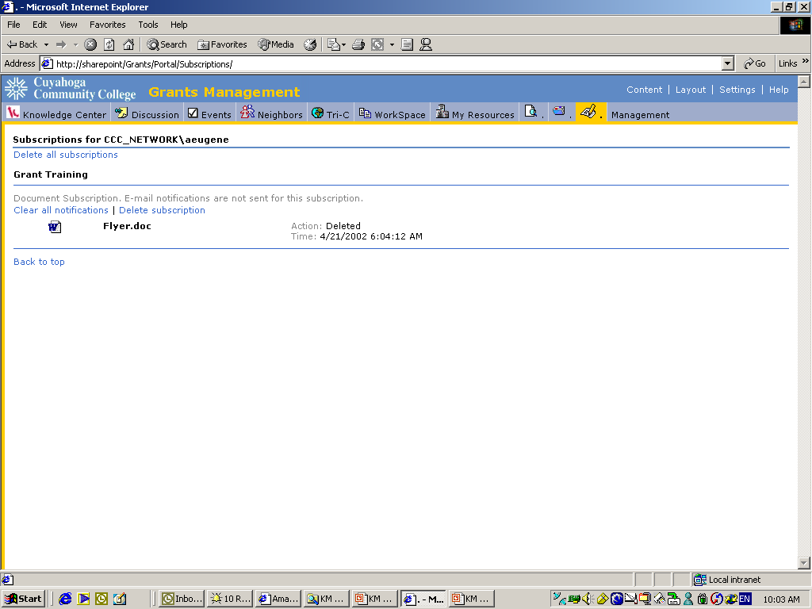
Subscribe to key documents, folders and search results

