Slide 1
Public Access to CD-ROMs Redux
Karen Nordgren, Emporia State University
Coleen Parmer, Bowling Green State University
Amy West, University of Minnesota
October 22, 10:30 a.m. - 12:00 pm.
2002 Fall Depository Library Conference

Slide 2
Number of Titles Installed
University of Minnesota
  31 titles, 99 individual discs
Bowling Green State University
  140 titles, 395 volumes
Emporia State University
  12 titles

Slide 3
Access: Hours and Remote
All - Library Building Hours, no remote access

Slide 4
User Interface
University of Minnesota
  Local Web Site with Executable Links to Start CDs
Bowling Green State University
  Local Web Site with Executable Links to Start CDs
Emporia State University
  Desktop Icons

Slide 5
Delivery of CD-ROMs
University of Minnesota
  Via Virtual CD v. 4, an emulator program that saves virtual versions of the CDs to the workstation
Bowling Green State University
  Via CD-ROM drive and launching software called W3Launch
Emporia State University
  Via CD-ROM drive, with staff mediation

Slide 6
Delivery of Guides
University of Minnesota
  As web pages; link to CD is on the guide page
Bowling Green State University
  As web pages which users connect to from a help button
Emporia State University
  In print and/or online

Slide 7
Institutional Practices
University of Minnesota
  Security
    Fortres Security & public user profile which limits user interaction with hard drives
  Administrative Access
    via administrative profile, available to all department staff
  Back Up
    maintained by IT department

Slide 8
Institutional Practices
Bowling Green State University
  Security
    Public workstations have two desktops: public and restricted use (pass word protected).
  Administrative Access
    limited users with passwords to administrative profile
  Back Up
    Workstation image created with Norton Ghost software with backup copy on office server.

Slide 9
Institutional Practices
Emporia State University
  Security
    limited public user profile
  Administrative Access
    all changes limited to administrator profile, access to profile for Head of Collection Development and Documents Librarian only
  Back Up
    undecided

Slide 10
Workstation Configuration
University of Minnesota
  Operating System & Applications
    Windows NT
    Internet Explorer, Public Web Browser v. 2
    WS_FTP, Winzip,
    Excel 95 and 97 viewers, dBase viewer
  Hardware & Printing
    3.5” floppy and Zip drives
    networked printing for a fee

Slide 11
Workstation Configuration
Bowling Green State University
  Operating System & Applications
    Windows 98
    Mozilla web browser
    Excel viewer
  Hardware & Printing
    3.5” floppy and Zip drives, DVD & CD/R drives
    networked printing

Slide 12
Workstation Configuration
Emporia State University
  Operating System & Applications
    undecided
  Hardware & Printing
    3.5” floppy drive, zip drive, CD-R/DVD drive

Slide 13
Large Titles
University of Minnesota
  Not an issue yet; not decided on Census 2000 disks
Bowling Green State University
  Does not think this will be an issue
Emporia State University
  No decision as yet, although anticipate possible challenges with Census 2000

Slide 14
Maintenance Responsibilities
University of Minnesota
  GPL for any application problems; all other maintenance by IT department
Bowling Green State University
  Documents staff member (20 hours per week)
Emporia State University
  Head of Collection Development and Documents Librarian

Slide 15
Pesky titles and solutions
University of Minnesota
  http://govpubs.lib.umn.edu/cd/pesky.phtml
Bowling Green State University
  http://www.bgsu.edu/colleges/library/services/govdocs/cddoc.html
Emporia State University
  Not sure yet

Slide 16
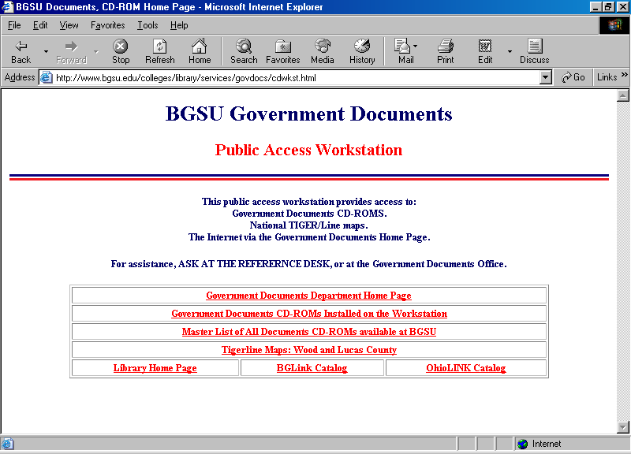
Bowling Green State University Main Menu

Slide 17
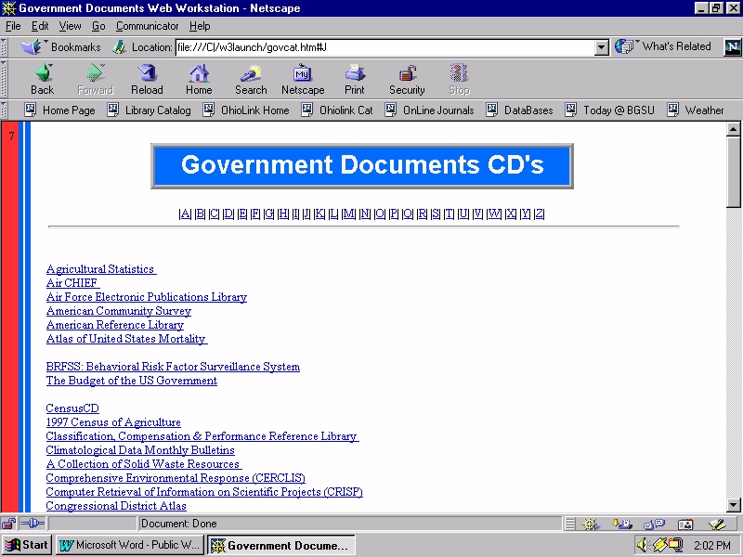
Bowling Green State University Title List

Slide 18
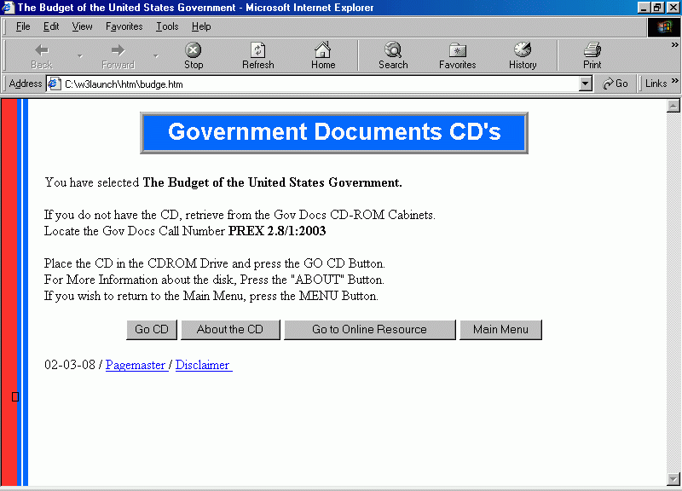
Bowling Green State University Title Screen

Slide 19
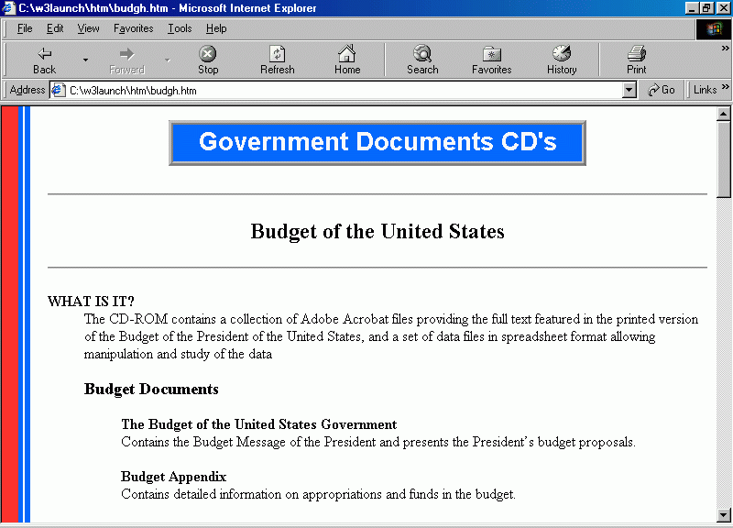
Bowling Green State University User Guide

Slide 20
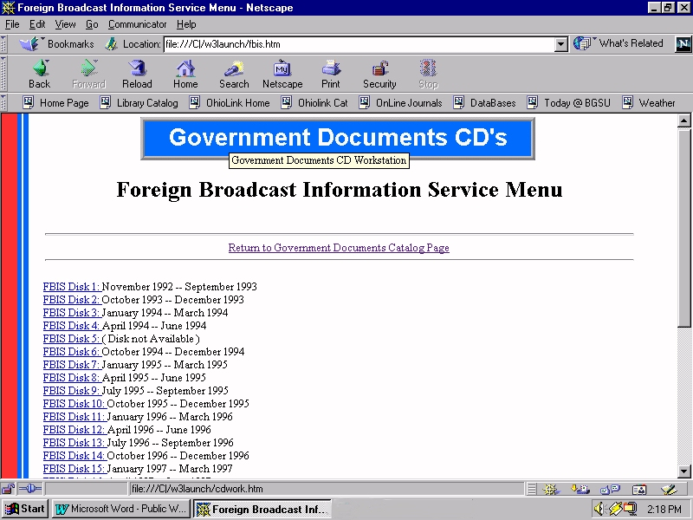
Bowling Green State University - Multi. Volume

Slide 21
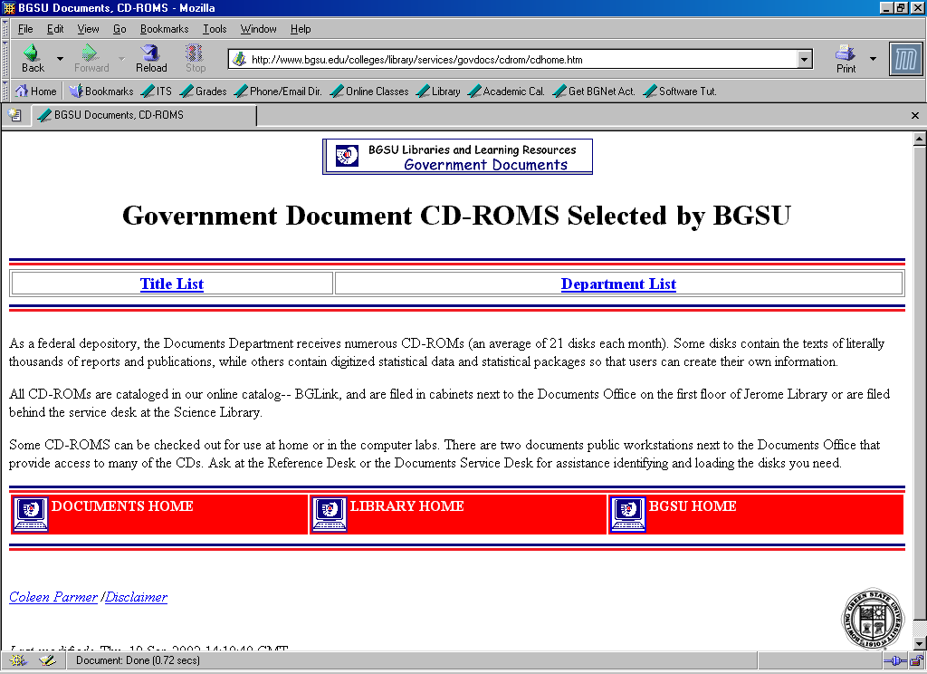
Bowling Green State University - CD Database

Slide 22
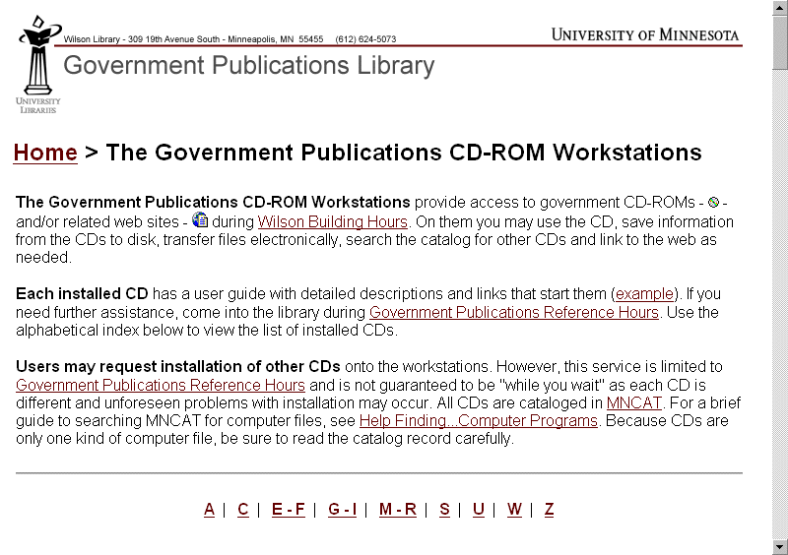
University of Minnesota Main Menu

Slide 23
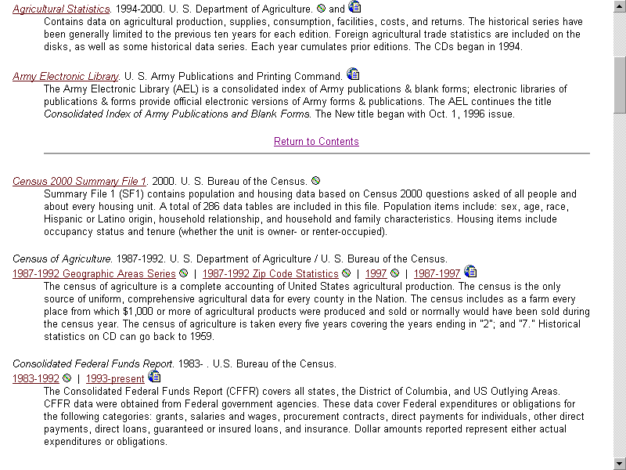
University of Minnesota Title List

Slide 24
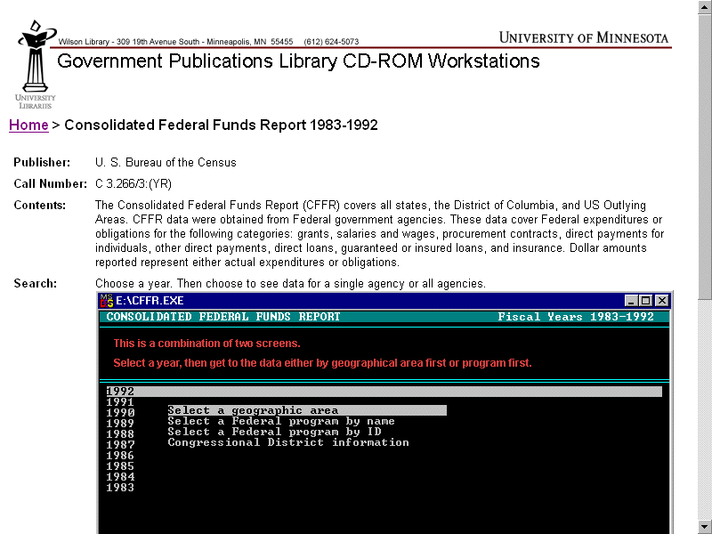
University of Minnesota User Guide pt. 1

Slide 25
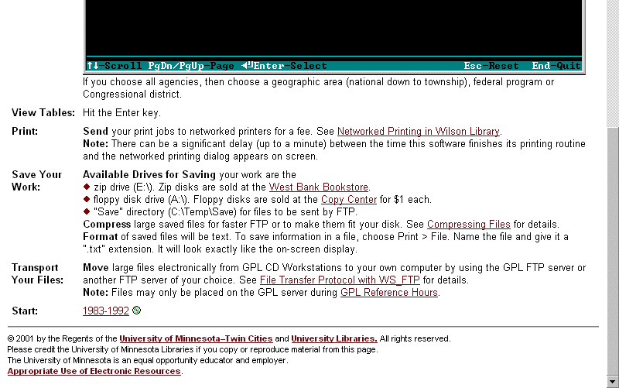
University of Minnesota User Guide pt. 2

Slide 26
For More Information
Karen Nordgren: Nordgrek@esumail.emporia.edu
Coleen Parmer: parmer@bgnet.bgsu.edu
Amy E. West: westx045@tc.umn.edu

Slide 27
Relevant Web Sites
This presentation
  http://govpubs.lib.umn.edu/ppt/cds.ppt
BGSU Documentation
  http://www.bgsu.edu/colleges/library/services/govdocs/cddoc.html
University of Minnesota Documentation
  http://govpubs.lib.umn.edu/cd/summary.phtml

