Slide 1
2007 Heart Disease and Stroke Prevention Training
Amy Carte, RN MS
September 18, 2007

Slide 2

Accessing the Health Care System in
West Virginia
Opportunity for Improvement:
Acute Myocardial Infarction,
Heart Failure, and Stroke
Notes:
Improving Health Care Quality through the Health Care system is certainly an uphill climb. Today, we’ll take a hike through the health care system and try to make things better.

Slide 3
Choosing your path
Don’t we already know the basics for treatment of AMI, CHF, and STROKE?
How well are we applying guidelines in treatment of AMI, CHF and STROKE?
What are the obstructions to further improvement in care of AMI, CHF and STROKE?
How can we achieve “Top 10%” status throughout the state? nation?
Notes:
The hike began with asking ourselves these questions which helped us select the path we would follow.

Slide 4
Identifying the Opportunity
Heart disease is the #1 killer of Americans.
1 in 4 males and females has some form of CVD.
Stroke is the #3 killer of Americans in most states.
About 700,00 Americans will have a stroke this year.
Heart Failure accounts for approximately 1,000,000 hospital admissions each year in US.
Heart failure leading cause of hospitalization in persons over 65
Average US hospital loses $1,288 per HF patient admitted
Sources: American Heart Assn 2005 Update; CMS National 2001 discharge database; MEDPAR, DRG 427;Cardinal Health Clinical Services and Consulting (CHCSC);Heart Disease and Stroke Statistics - 2005 Update; Rich MW, Epidemiology, Pathophysiology and Etiology of Congestive Heart Failure in Older Adults; O'Connell JB, The Economic Burden of Heart Failure
Notes:
Include discussion of HF facts selected

Slide 5
West Virginia Coalition for Quality Health Care
Identify Your Partners
a grant funded, physician-directed organization dedicated to exploring clinical variation,and improving health care in West Virginia for more than 7 years
The Coalition has been funded by the WV Cardiovascular Health Program and the WV Health Care Authority
www.wvheart.org
Notes:
The WV Coalition for Quality Health Care began in 1997 as a 3 yr demonstration project with funding from RWJF, Benedum and the HCA.
Because of our success we have been able to secure grant funding to continue the work of the Coalition from the HCA, and the BPH Cardiovascular Health Program
The entire project, including myself, is funded through grants

Slide 6
Identify Your Partners
State
Quality
Improvement
Initiative

Slide 7
Identify Your Partners
State
Quality
Improvement
Initiative
State
CVH
Program

Slide 8
Identify Your Partners
Third party
Payors and
insurers
State
Quality
Improvement
Initiative
State
CVH
Program

Slide 9
Identify Your Partners
Insurers
and
Payors
State
Quality
Improvement
Initiative
State
Hospital
Association
State
CVH
Program

Slide 10
Identify Your Partners
Third party
Payors and
insurers
Hospital
and
Community
based
pharmacists
State
Quality
Improvement
Initiative
State
Hospital
Association
State
CVH
Program

Slide 11
Identify Your Partners
Third party
Payors and
insurers
Hospital
and
Community
based
pharmacists
State
Hospital
Association
State
Quality
Improvement
Initiative
State
CVH
Program
State QIO

Slide 12
Identify Your Partners
Third party
Payors and
insurers
Hospital
and
Community
based
pharmacists
State
Hospital
Association
State
Quality
Improvement
Initiative
State
CVH
Program
State QIO
Physician
and
Nursing
Specialty
Organizations

Slide 13
Identify Your Partners
Third party
Payors and
insurers
Hospital
and
Community
based
pharmacists
State
Hospital
Association
State
Quality
Improvement
Initiative
Physician
and
Nurse
Leaders
State QIO
State
CVH
Program
Physician
and
Nursing
Specialty
Organizations

Slide 14
Identify Your Partners
Third party
Payors and
insurers
Hospital
and
Community
based
pharmacists
State
Hospital
Association
Other
Partners
unique to
your state
State
Quality
Improvement
Initiative
State QIO
Physician
and Nurse
Leaders
Physician
and
Nursing
Specialty
Organizations
State
CVH
Program

Slide 15
Identify the Process
Study Groups formed by physician interest
Physicians and nurses study care with areas of high variation
Emphasis is placed on identifying what drives variation
Strategies devised to decrease variation and IMPROVE CARE

Slide 16
Study Group Timeline
Formative meeting
Planning retreat
Quarterly Video Conference Meetings
Roll-out (recruiting) meetings
Develop Tool (Resource) Kit
Learning sessions
Site Visits
Ongoing Technical Assistance

Slide 17
AMI Project:
“GAP in the Mountains”
Modeled after the successful American College of Cardiology/American Heart Assn GAP Project in Michigan
31 Hospitals participated on a voluntary basis (59%)
Each participating hospital had a Physician Champion and a Project Leader (RN or QI coordinator)
Notes:
AMI stands for Acute Myocardial Infarction, also commonly known as a heart attack
The AMI Project had 2 arms
- a hospital based project called “GAP in the Mountains” designed to help physicians and hospitals work together to improve AMI/ACS care
and
-a patient education component via commercial messages on the “ABC’s of Heart Health” with web based support for these messages. Geared to get pts to access the health care system earlier, and to partner w/ their caregivers by understanding their condition/meds for better outcomes

Slide 18

GAP TEAM MEMBERS
(For AMI, CHF, and STROKE)
Administrators | Cardiac / Medical Rehabilitation
Physicians | Health Educators
Nurses | Social Services
Quality Improvement Staff | Physical Therapy
Pharmacy | Respiratory Therapy
Utilization Review Staff | Occupational Therapy

Slide 19
ABC’s of Heart Health
A- Aspirin and ACE Inhibitors
B- Beta Blockers
C- Cholesterol screening and medications
Notes:
The Coalition has created and sponsored a series of 3x 30 second commercial messages around this theme
Each message should serve as a “call to action” to get the public more involved and personally invested in their/family’s own care for better outcomes
Aired statewide on NBC and CBS affiliates, and PBS.
Messages direct individuals to the Coalition’s website where we have placed more information on these ABC’s of heart health as well as links to other helpful websites for additional information

Slide 20
Heart Failure Project
Fashioned after our successful AMI GAP in the Mountains Project
Three arms to this project
    Inpatient care
    Physician involvement
    Public Education campaign

Slide 21
HEART FAILURE
QUALITY MEASURES
Discharge instructions
LVF assessment
ACEI for LVSD
Adult Smoking Cessation Counseling

Slide 22
GAP STROKE PROJECT
Began 2005 in West Virginia
No publicly reported data
Need to develop indicators
Will apply GAP AMI and HF Process to Stroke

Slide 23
Who can remember all that?
Clinical guidelines
Quality measures
ER orders
Admission orders
Nursing clinical pathways
Discharge contracts/instructions

Slide 24
STRIKE WHILE THE IRON IS HOT

Slide 25
CMS
Hospital Compare
Physician Specific Data

Slide 26
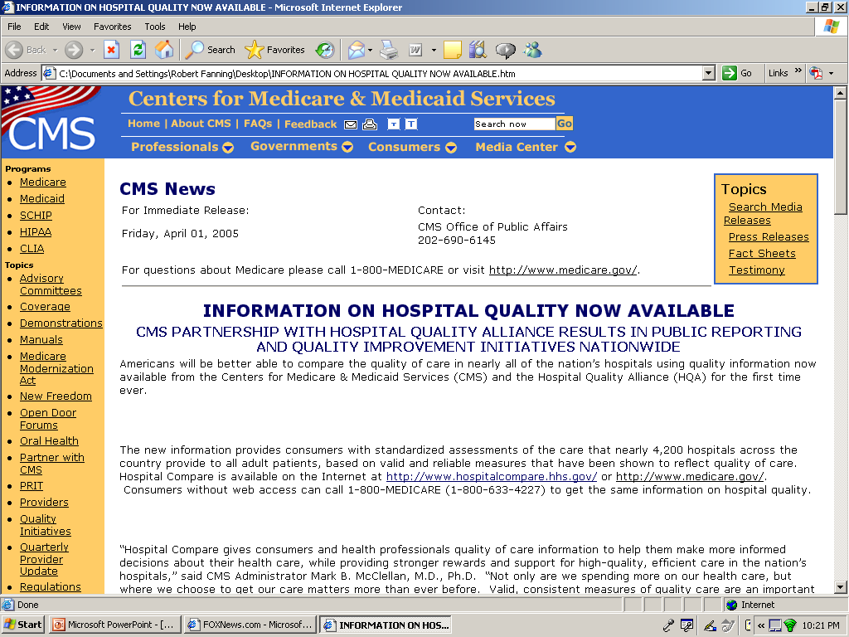

Slide 27
CMS Hospital Compare Data- AMI
MEASURE | TOP 10% | USA | WV
ACEI for LV dysfunction | 100 | 75 | 71
Smoking counseling | 100 | 75 | 75
ASA on arrival | 100 | 91 | 90
ASA on discharge | 100 | 86 | 84
Beta blocker on arrival | 100 | 83 | 86
Beta blocker on discharge | 100 | 84 | 86
PTCA within 90 minutes | 70 | 37 | 39
Lytics within 30 minutes | 100 | 37 | 37

Slide 28
CMS Hospital Compare Data
Heart Failure
 | Top 10% | USA | WV
ACEI in CHF for LV dysfunction | 100 | 74 | 71
Smoking counseling | 100 | 65 | 74
Assess LV function | 98 | 78 | 75
Discharge instructions | 88 | 45 | 49

Slide 29
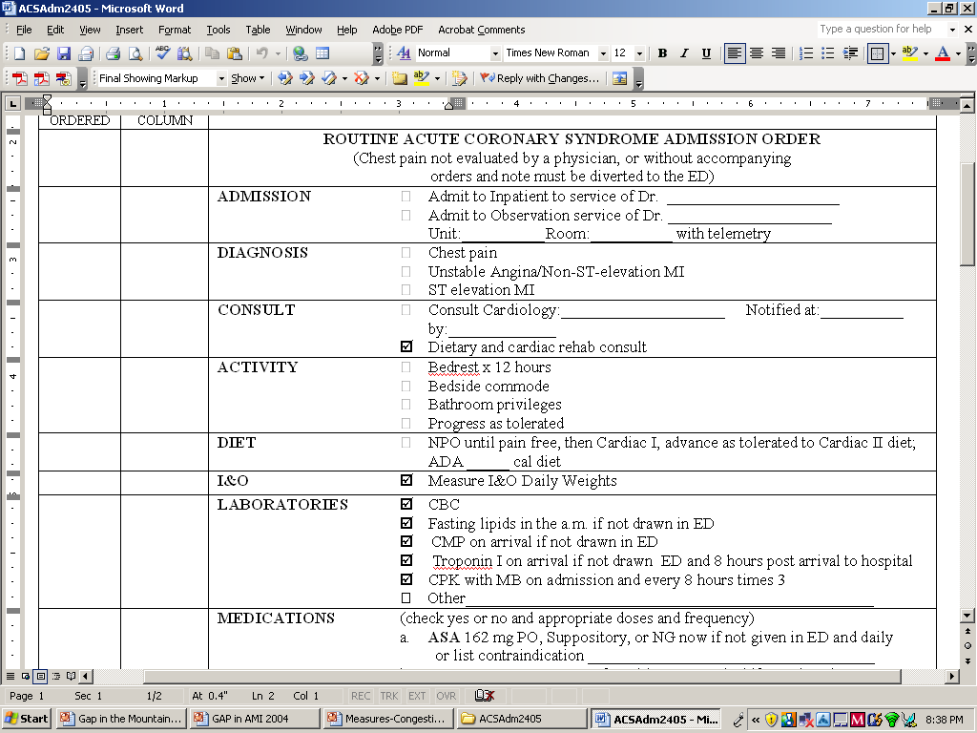
I hate those ACS orders!

Slide 30
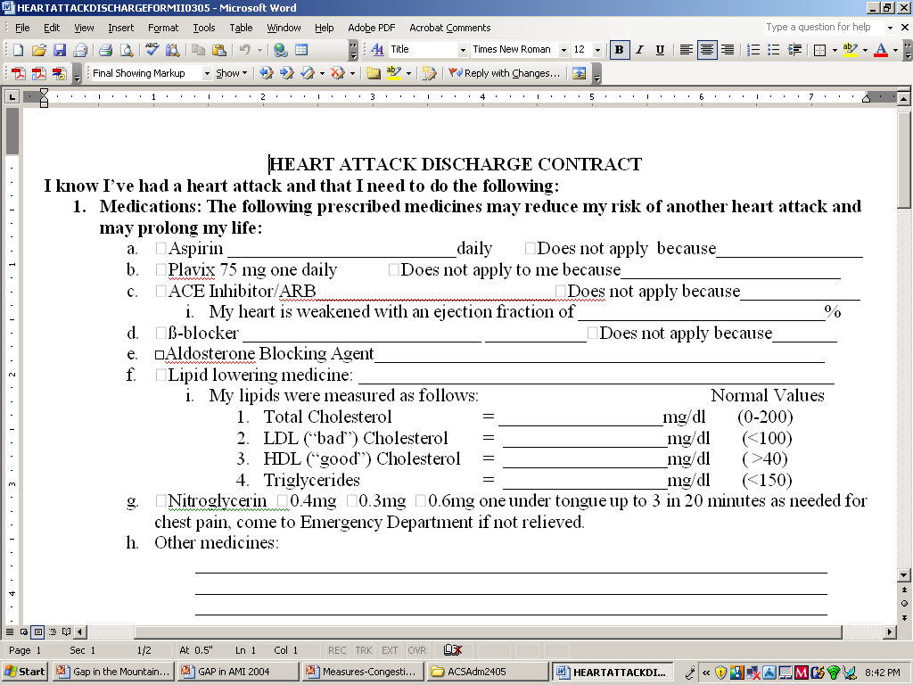

Slide 31
“Patient” Problems”
Patients who sneak into the hospital
  Apply admission orders
Patients who sneak out of hospital
  Code room, secondary diagnoses
Patients with new diagnosis in hospital

Slide 32
“Institutional” Issues
It’s really not the institution, it’s the people who work there.
  Administrators
  Physicians
  Nurses
  QA departments
  Coders, medical records

Slide 33
Physician issues
Resistance to use of admission orders
  How can we streamline them?
    Is there some way to include more automatic items?
Resistance to use of discharge instructions
  Use of computerized systems
  Incentives, through payers?
  Threats, medical records sanctions
  Public reporting of physician specific care

Slide 34
For more information…
Deborah Ruppert, R.N., Project Director
West Virginia Coalition for Quality Health Care
100 Association Drive
Charleston, WV 25311-1571
304 344-9744 ; druppert@wvha.org
Or
Amy Carte, RN-C, Manager
West Virginia Cardiovascular Health Program
350 Capitol Street Room 206
Cha-rleston, WV 25301
304 558-6258 amycarte@wvdhhr.org
www.wvheart.org
Notes:
Highlight web site with patient information
Mention handouts in pkt:
WVSMA article
Current list of participating GAP hospitals

Slide 35

Questions and answers

