Slide 1
AHRQ Annual Meeting
June 9, 2005
3 U’s of Rhode Island’s Health Information Exchange: Useful, Usable and Used
Presented by
Amy Zimmerman, MPH
Rhode Island Department of Health
RI HIT Project Manager

Slide 2
Health Care Landscape in RI
2 State Agencies with major health responsibilities (Health, Human Services)
No local or county health departments
3 major health insurers
2 major hospital systems
15 Hospitals (7 are independent)
3 very large group practices
1 Quality Improvement Organization (QIO)
1 Medical school & Public Health program
1 Quality Institute

Slide 3
Rhode Island Quality Institute (RIQI)
RIQI’s Mission:
A collaboration among hospitals, health care providers, insurers, consumers, business, academe and government for the purpose of improving health care quality, safety and value in Rhode Island.

Slide 4
The Quality Institute’s Strategic Agenda
Technology Infrastructure Safety in Care Delivery Evidence Based Medicine
Statewide Electronic Prescribing
Statewide Coordination and Collaboration of Health Information Technology (HIT)

Slide 5
Goals of Rhode Island HIT Project
Create, implement and evaluate a Master Patient Index as a core component of an interconnected information system putting the right information into the hands of clinicians and their patients when and where it is needed.
Progressive design and implementation to encourage broad acceptance, adoption and use of the HIT system by authorized users.

Slide 6
Initial MPI Data Sharing Partners
RI Department of Health’s KIDSNET (already sharing data with providers)
RI Department of Health’s Clinical laboratory system (beginning to share data with Lifespan)
Lifespan’s Lifelinks (Clinical Lifetime Record)
SureScripts - electronic prescribing pipeline;
Rhode Island Health Center Association’s patient registry/data warehouse (administrative/encounter)
East Side Clinical Laboratory’s web-based reporting system
Medicaid ’s Third party Liability , TPL (evaluation only)

Slide 7
5 Components of MPI Project
Technical Assistance and Coordination and with other Health Information Technology (HIT) efforts within the state (RIQI)
Technical design and development of the MPI (TBD);
Health care provider engagement, training and participation (QPRI);
Consumer education and engagement (Subcontractor TBD);
Well-defined and rigorous evaluation (Brown University)

Slide 8
Stakeholder Input: Initial Activity:
Fall Stakeholder Meetings: To identify needs for a system that will be useful, usable and used
Informational meeting
Needs Identification Workshop (2 meetings: mixed group, and care givers)
Discussion re models for IT principals and architecture

Slide 9
Feedback received:
Ease of Use:
input , viewing, training,
standards based,
adaptable to workflow,
accessible
Security/Privacy/confidentiality:
authentication and access,
multiple mechanisms for access access with different users in mind,
proxy issues,
accountability for accuracy

Slide 10
Feedback received:
Data related needs:
accurate, consistent, reliable,
uniform data definitions,
consistent/standardized presentation and reports but user specific (by medical specialty),
standardized test reports,
very close to real time availability,
robust unique identifier,
provide added value: labs, pharmacy, ER discharge summary and referral, other treating physicians (specialists),
ability to self populate
identify who submitted data, audit trails

Slide 11
Feedback received:
System accessibility and reliability:
variety of access modes,
Flexibility: integrate with existing systems
leverage web,
neutral platform & technology,
minimum access & response time,
access if system goes down,
able to customize defaults etc,
certification of data sources,
? Patient direct access

Slide 12
Feedback received:
Organizational/Practice infrastructure:
not duplicate data entry,
links to billing/administrative systems,
primary care focused,
build on existing workflow and technical systems requirements,
still support legacy systems,
need to access information for print including previous information,
technical support,
affordable,
incentives to use

Slide 13
Revised Project Approach
Phase 1 (18 mos.) | Establish project structure and roles Engage subcontractors and data partners Identify HIT system requirements; Design, build and test operating prototype/1st release
Phase 2 (+18 mos.) | Build/Enhance Community buy-in Refine prototype functionality and features Establish evaluation baseline Iterative deployment of the HIT system
Phase 3 (+24 mos.) | Continue progressive system enhancements Continue active user outreach; build support Perform rigorous evaluation Implement a plan to sustain infrastructure

Slide 14
Initial Proposed Approach
Phase 1- MPI created and could serve as single portal to provide access to each data sharing partner’s data
Phase 2- Common interface developed so patient information presented in a unified,logical manner, add other data sharing partners
Phase 3- include decision support , add other data sharing partners, develop warehouse for population health analysis

Slide 15
Established a Governance Structure
Governing Council: RIQI Board of Directors
Steering Committee: Administered by the RIQI
Management Committee- HEALTH and subcontractors
Working groups (technical, legal and policy, users, communication,education and outreach, data sharing partners, evaluation)
Consumer Advisory Committee of RIQI

Slide 16
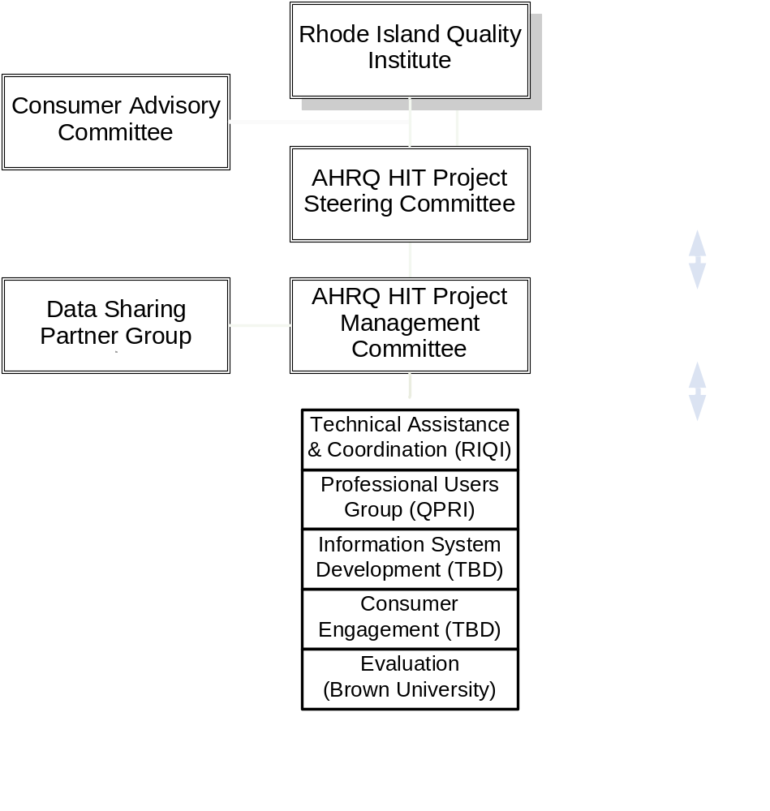
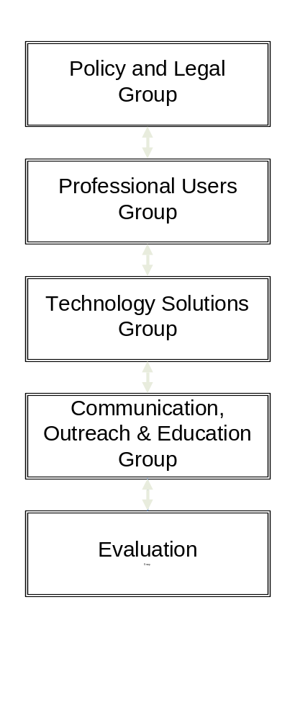
Project Governance & Structure

Slide 17
Stakeholder Themes :
Make system standards based
Design system to be flexible/adaptable to different workflow environments
Value- fast & reliable data
Integrate existing systems with what is in place (includes administrative)
Carefully address authentication, authorization, security and access
Need for uniform data definitions

Slide 18
Stakeholder Themes cont.
Consistent data presentation with some ability to customize (specialty areas)
Need for immediate and tangible results
Most important principals: cost effectiveness, security and confidentiality, accuracy and ease of use, visible benefits and standards
Architecture- combination of information broker and warehouse- seemed initially to be the theme
Governance-Need to clearly recognize partners expertise and roles and play to those strengths – takes Negotiation

Slide 19
Some Critical Challenges:
Working through State Systems – impact on timing
Technical solution that meet’s local needs, in line with national efforts
So..many efforts underway, determining what how to decide what to align with
Managing stakeholders agendas
Identity management
Sustainability and business models
Tight time frames- resulting in parallel workgroups
Defining the scope

Slide 20
More Critical Challanges
Legal: HIPAA, Fraud & Abuse, Anti-Trust, Liability/Malpractice
Physician Adoption
  Few EMRs
  Connect to what?
Unique Patient Identifiers

Slide 21
Contact Information
Amy Zimmerman, MPH
Rhode Island Department of Health
401-222-5942
amyz@doh.state.ri.us

Slide 22
Developing Data Prioritization Plan
Convened data sharing partners group
Developed consensus based criteria to evaluate feasibility of data sharing
Data sharing partners ranked their data elements according to criteria (weighted values)
Analyzed feasibility Data: \
  Labs
  Prescriptions
  Reports (discharge, procedure, operative)
Need to Take to Provider Advisory Panel
Need Approval by Steering Committee I

Slide 23
Developing Technical Solution:
Convened Technical Solution Workgroup
Conducting gap analysis of data sharing partners
Assessing existing infrastructures within state could leverage
Initiated discussion re overall vision, defining scope of this project
Initiated discussion re architecture

