Slide 1
Voluntary Flexible Agreements: An Experiment with Results
Pam Eliadis – Federal Student Aid
Shelia Dunlap – Texas Guaranteed (TG)
Anita Kermes – EDFUND
Amy Kerwin – Great Lakes Higher Education Guaranty Corp.
F. Duane Quinn – American Student Assistance (ASA)

Slide 2
Voluntary Flexible Agreements
What is a VFA?
  Agreement between the Secretary of Education and a FFELP Guaranty Agency
  Waives standard legislative requirements
What is the goal of a VFA?
  Innovation
    Develop best practices in delinquency & default prevention

Slide 3
Voluntary Flexible Agreements
How does a VFA originate?
  A guaranty agency submits a proposal to ED (Federal Student Aid, Financial Partner Services)
  New and existing VFA’s must be “cost neutral”
    No additional cost to the Secretary
    Cost neutrality does not = Fee neutrality

Slide 4
Voluntary Flexible Agreements
How does a VFA originate (cont.)?
  Negotiation Period
    Fee Structure
    Innovative programs and associated waivers
    Performance Measures and Reporting
  Congressional Review
    30 day review by Legislating Committees

Slide 5
Voluntary Flexible Agreements
Existing VFA’s
  Texas Guaranteed Student Loan Corp (TG)
  California Student Aid Commission (CSAC)
  Great Lakes Higher Education Guaranty Corp (GLHEC)
  American Student Assistance (ASA)
  College Access Network (CAN)

Slide 6
Voluntary Flexible Agreements
How does the FFEL program benefit from VFA’s?
  Innovative programs and partnerships
  Work resulting from performance based organization
  ED oversight for demonstrated results

Slide 7
VFA Best Practices
Early Awareness
& Assistance
Student
High Risk
Borrowers
Financial
Literacy
Repayment
Assistance

Slide 8
VFA Best Practices
Student
Financial
Literacy

Slide 9

Where does the money go….
Why Financial Literacy is an important component to higher education.
Shelia Dunlap
Assistant Vice President – Default Prevention

Slide 10
Why Financial Literacy is an important component to higher education
Focus on the Student
Impact to a Campus
Effect on the Overall Economy
Lasting Effects

Slide 11
Focus on the Student
College students and credit cards
  7 out of 10 Undergraduate Students have at least one card.
  43% stated that they received that credit card during their Freshman year
  18% obtained card from vendor on campus
  35% obtained card from direct mail offer
Source: Undergraduate Students and Credit Cards in 2004, Nellie Mae

Slide 12
Focus on the Student
Credit Card Balances
  Average credit card balance for undergraduate students exceeds $2,100.
  1out of 10 students have a balance in excess of $7,000
  The average college graduate exits a campus with a balance of $20,402 in educational debt and credit cards
Source: Undergraduate Students and Credit Cards in 2004, Nellie Mae

Slide 13
Impact to a Campus
“We lose more students to credit card debt than to academic failure.”
      University of Indiana administrator (CFA)
Forget Osama bin Laden-More college students fear going into debt and unemployment.
      Partnership for Public Service, 2005
Notes:
Here are a few quotes

Slide 14
Impact to a Campus
Students will forgo the remainder of their education to address higher debt balances.
  - 3 out of 10 traditional college students work over 20 hours a week.
This in turn effects a campuses retention rates.
This no longer is just a student issue
Source: National Center for Public Policy and Higher Education

Slide 15
Impact to a Campus
Lower retention rates = smaller funds received from federal and state sources
Accountability is a major focus of Reauthorization

Slide 16
Effect on the Overall Economy
Average American utilizes 26.4% of their net income to pay consumer debt.
      Young American Center for Financial Education
There were 2,062,000 personal bankruptcy filings in 2004
  Average age for filers was 38 (Compared to 44 in 2002)
  9.6% of these filings were for people 18-24 years of age.
      Federal Administration Officer of the court, Annual report, Jan 2005

Slide 17
Lasting Effects
Solid Financial Literacy on your campus can help in the following areas:
  Increased retention
    This will lead to a more complete revenue stream for the institution.
  Build successful Students
    This will carry forward to help with creating an active alumni
    This will also allow for strong support and promotion of the institution

Slide 18
Lasting Effects
Solid Financial Literacy on your campus can help in the following areas: (con’t)
  Building a Better Campus
    This will allow a stronger recruiting foundation
    Marketing and promotion will be easier
  Strengthen the Economy
    Every little step can save the U.S. Taxpayers millions.

Slide 19
VFA Best Practices
Early Awareness
& Assistance
Student
Financial
Literacy

Slide 20

Early Awareness
Opportunities In Education
Anita Kermes

Slide 21
College is Possible
Educate early and Encourage often
  Elementary School
  Junior High and High School
  Community Organizations
Get the Parents involved

Slide 22
College is Possible
Focus efforts
  Low income
  First generation students
Student Retention

Slide 23
What’s the Message
Financial aid is available
  Types of aid
  How to apply
Borrow Wisely, Borrow Responsibly
  Investment in your future
  Budget
  Credit cards

Slide 24
What’s the Message
Resources
  Posters and publications
  Presentations
  Web sites

Slide 25
Default Aversion Laboratory
Services for Schools and/or Borrowers
  EDWISE, online financial planning guide
  EDTEST, an online entrance and exit counseling tool
  EDFUND Video Clips: four streaming video presentations focused on financial planning
  Student Loan Debt Summary for students

Slide 26
Default Aversion Laboratory
School Consulting Services
  Research, analysis, and recommendations for enhancing default prevention on campus.
  Developed Cohort Management System (CMS) to help school’s prioritize delinquent borrower counseling efforts
    Currently 416 schools signed up for CMS
    Late stage delinquency assistance
    Focus on current and future cohort years

Slide 27
Early Withdrawal Counseling
Program Background/Overview
  According to EDFUND research, 43.1% of borrowers who dropped out of school, and of those 15% defaulted.
  Encourage borrowers to return to school
  Provides counseling on repayment options during grace period
  Goal: Reduce student loan defaults

Slide 28
Early Withdrawal Counseling
Success Measures for EWC borrowers compared to Control Group
  Return to School
    EWC borrowers were nearly twice as likely to return to school
  Positive Repayment
    EWC borrowers were substantially less like to become delinquent at any time during their first year after leaving school.

Slide 29
Early Withdrawal Counseling
Success Measures for EWC borrowers compared to Control Group
  Delinquency
    EWC borrowers who became delinquent were significantly more likely to be returned to a positive repayment status

Slide 30
Early Withdrawal Counseling
Success Measures for EWC borrowers compared to Control Group (con’t)
  Default
    The percentage of withdrawn borrowers in the control group who defaulted within two years of leaving school was more than 50% higher than among borrowers counseled in the EWC program..

Slide 31
VFA Best Practices
Early Awareness
& Assistance
Student
High Risk
Borrowers
Financial
Literacy

Slide 32

Delinquency Prevention for
High-Risk Borrowers
Amy Kerwin
Chief Guaranty Officer

Slide 33
High-Risk Borrowers
Borrowers who withdraw
  ED data shows that 71% of defaulted borrowers withdrew before completing their program of study
Rehabilitated borrowers
  Past payment problems indicate these borrowers may be more at risk for becoming delinquent again

Slide 34
Support for Withdrawn Borrowers
We identify newly-reported withdrawn borrowers.
  Based on information reported by schools.
  Encourage schools to report withdrawn borrowers as soon as possible.
We make contact before the lender tells the borrower the grace period is ending.

Slide 35

Support for Withdrawn Borrowers
We send a “postcard” to borrowers as soon as they are reported as withdrawn

Slide 36
Support for Withdrawn Borrowers
Tells the borrower who Great Lakes is and why we are contacting them.
Answers the following questions:
  When is my first payment due?
  How much do I owe?
  What if I don’t make my payments on time?
Provides the 800 number to our Early Awareness Unit.

Slide 37
Support for Withdrawn Borrowers
Incoming call results:
  “I didn’t drop out!”
  “I’ve enrolled at a different school.”
  “Who is my lender?”
  “How much will my payments be?”
  “What should I do if I can’t afford my payment?”

Slide 38
Support for Rehabed Borrowers
Our research identified the following as factors contributing to post-rehab delinquency:
  Higher degree of “hand-holding” while in default
  Change in payment due date
  Change in payment method

Slide 39
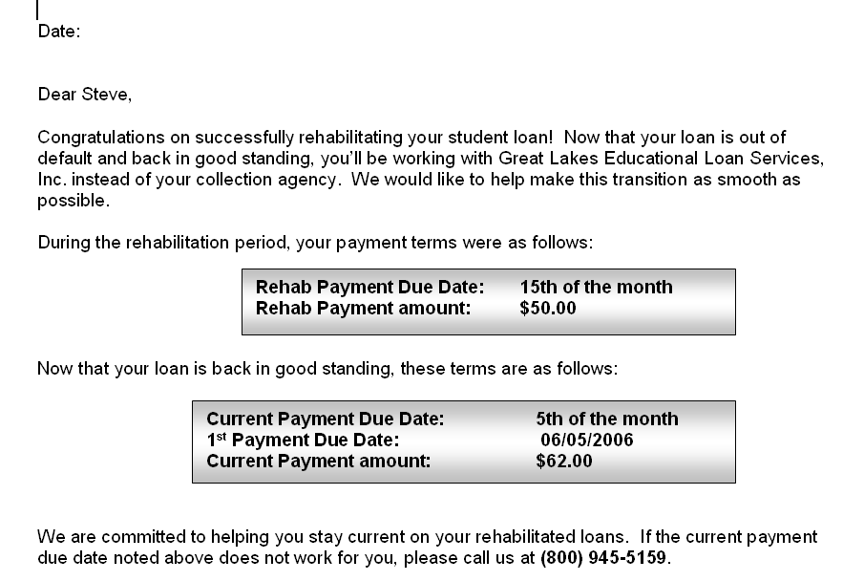
Support for Rehabed Borrowers
We send a “Welcome Back” letter to borrowers as soon as the rehabilitation is funded

Slide 40
Support for Rehabed Borrowers
Provides the borrower the following info:
  Confirmation that the loan is out of default
  Name of the new loan servicer
  Payment amount pre- and post-rehab
  Payment due date pre- and post-rehab
  Options for changing the payment due date or amount
  Benefits of signing up for ACH OR reinforcement of ACH benefits

Slide 41
Support for Rehabed Borrowers
We send a “Payment Reminder” letter for each of the first 6 post-rehab payments due
  Refers to loan as “recently rehabilitated”
  Notes payment amount and payment due date
  Provides ACH or coupon payment instructions
  Benefits of signing up for ACH OR reinforcement of ACH benefits
Letter sent 10 days before due date

Slide 42
Support for Rehabed Borrowers
We use our autodialer to call rehabilitated borrowers who become delinquent
  Calls start at 5 days delinquent
    “Courtesy call” vs. “delinquency call”
  Calls end with a default aversion request
    Once DAR is received, borrower moves from Early Awareness Unit to Repayment Solutions
    “Delinquency call” that reminds borrower of the benefits gained via rehab

Slide 43
Conclusions
Identifying and targeting high-risk borrower segments can have big payoffs!
Before creating a delinquency prevention strategy for these segments, first determine the underlying causes for delinquency.

Slide 44
VFA Best Practices
Early Awareness
& Assistance
Student
High Risk
Borrowers
Financial
Literacy
Repayment
Assistance

Slide 45

Assisting Students During Repayment
F. Duane Quinn
Director of Wellness Outreach

Slide 46
ASA’s Journeys Program
Direct mail to students during grace
  “The right information at the right time”
Continuous quarterly mailings for two years
Opportunity to contact ASA
Option for school to “co brand” school logo – “Branded Journeys”

Slide 47
Journeys 2004: Graduates of 2004
17,009 Borrowers Identified as degree completion; 1962 received no contact from ASA (control); 15,047 mailings; 8 Schools involved in “Branding”.
Journeys 2005: Graduates of 2005
Approximately 25,000 Borrowers have been included. Direct Mail and e-mail. 12 schools “Branded” materials.
Journeys 2006 : Graduates of 2006
Commenced on October 1, 2006. 23 schools involved in Branding

Slide 48
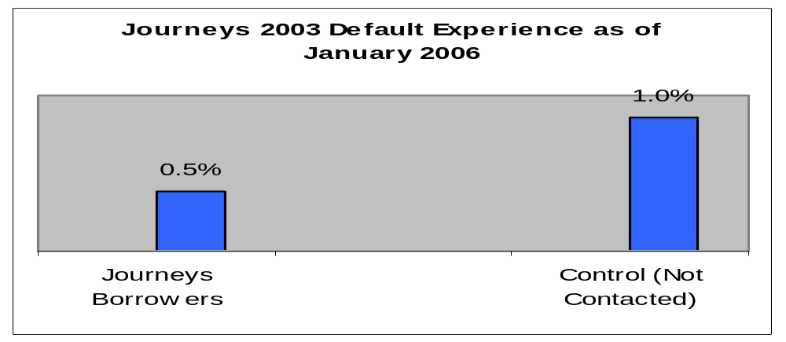
Positive Results Carried Through to Individual Default Experience in 2003
Borrowers who received Journeys 2003 mailings have experienced 50% fewer defaults than borrowers who did not receive Journeys

Slide 49
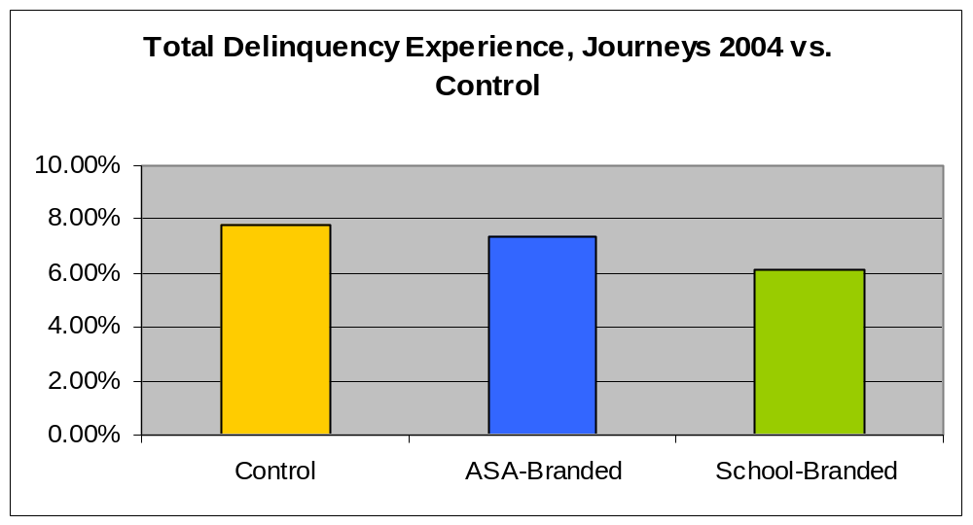
Journeys 2004 School-Branding Has Reduced Delinquency Experience

Slide 50
Journeys 2004 Borrowers Have Fared Better than the General Population
From 2003 to 2004, the default experience of Journeys Borrowers decreased more than for borrowers who received no contact
 | Default Rate Among Control Borrowers | Default Rate Among Journeys Borrowers
2003 | 1.10% | 0.50%
2004 | 0.60% | 0.20%
% Decrease | 46% | 60%

Slide 51
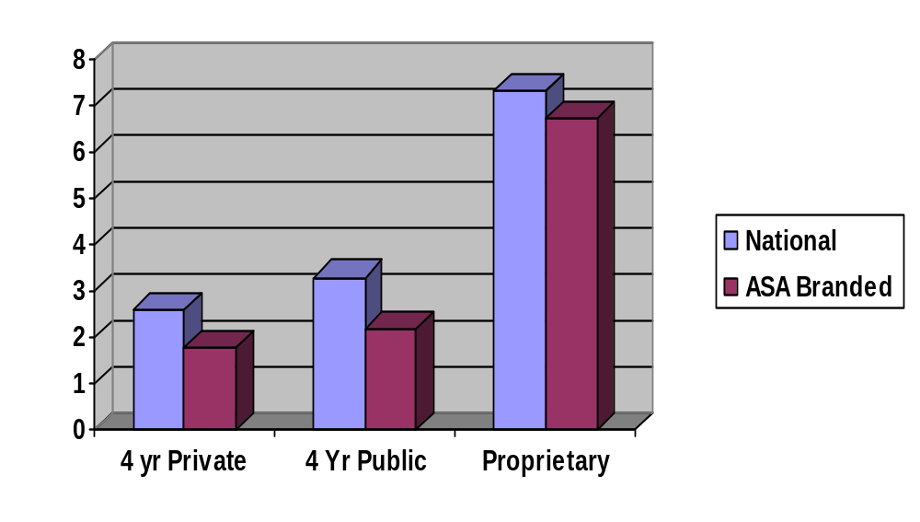
2003 Cohort by Branded School Type

Slide 52
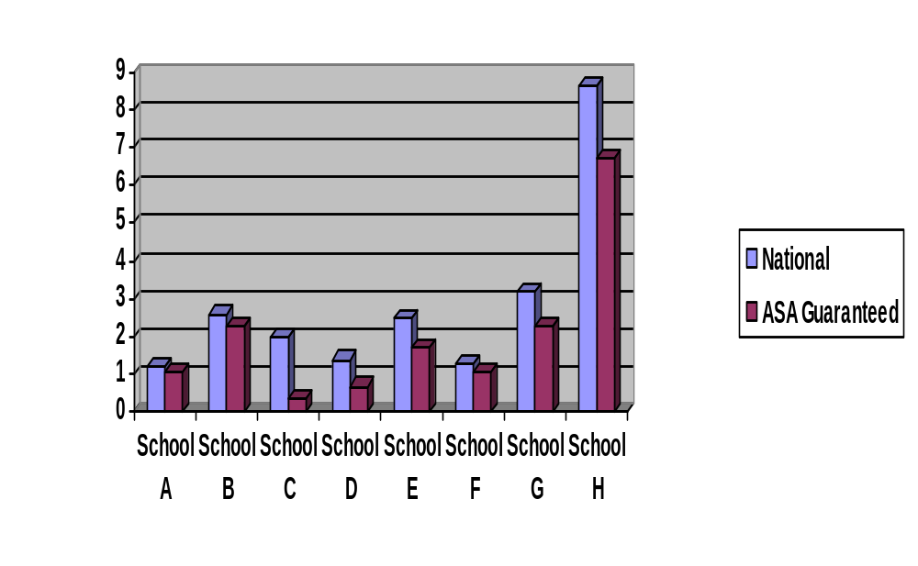
National vs. ASA Cohort for
Branded Schools

Slide 53
E- Newsletter
 | Opened E-mail | Clicked-Through (as % of those who opened)
School-Branded | 30.85% | 25.3%
Servicer-Branded | 51.15% | 6%
ASA-Branded | 17.35% | 9.35%

Slide 54



Slide 55
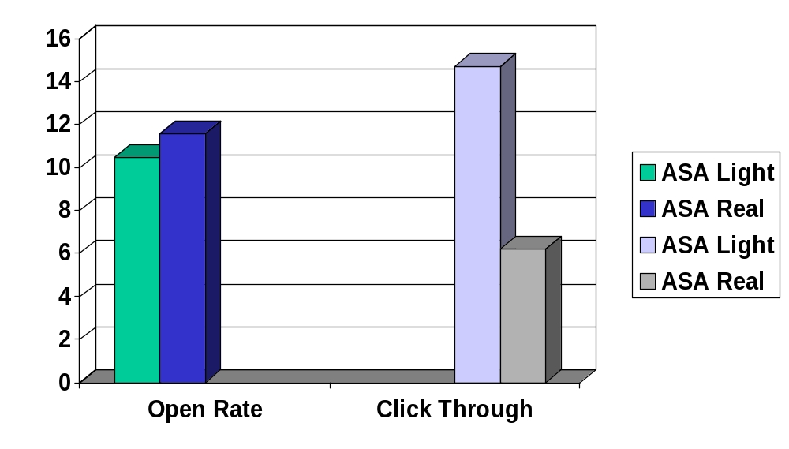
Experiments in e-mail Communication (1/09/06)
Graphics: Real vs. “light”

Slide 56
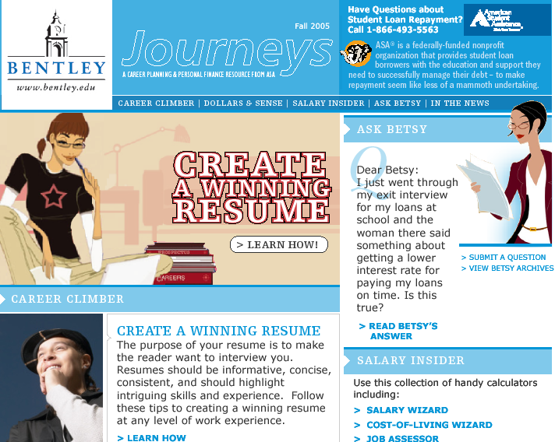

Slide 57

QUESTIONS

Slide 58
Technical Slide
We appreciate your feedback and comments.
We can be reached at:
Email:
  shelia.dunlap@tgslc.org
  anita.kermes@edfund.org
  akerwin@glhec.org
  quinn@amsa.com
  mike.sutphin@ed.gov

