Slide 1


AUDITIONS DAILY AT WWW.USAJOBS.OPM.GOV

Slide 2

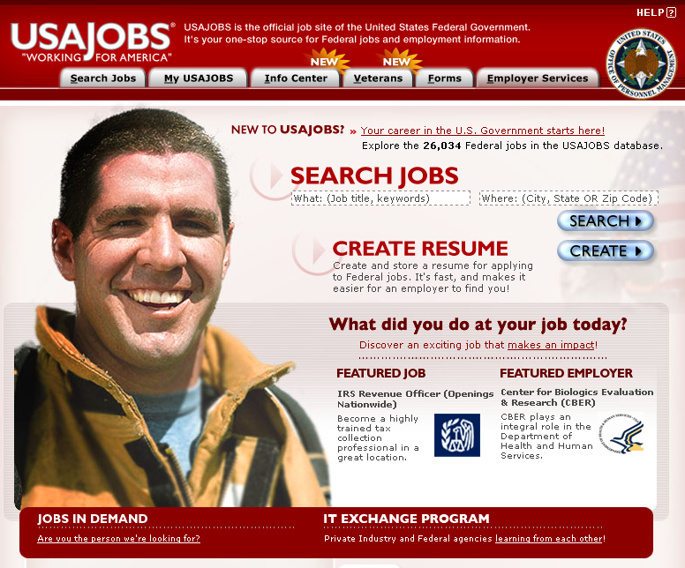

Slide 3
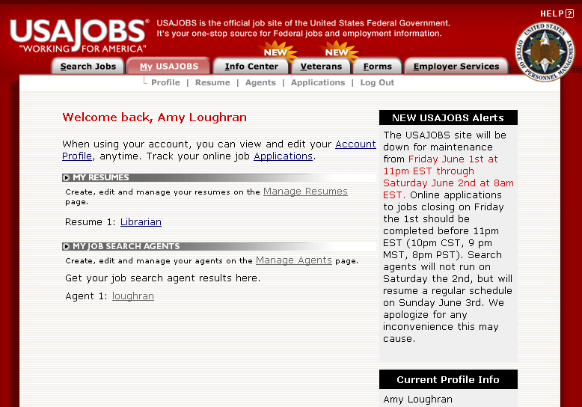

Slide 4
My Search Agent: loughran | View all opportunities | Refine Agent | Disable Agent
 | Forgot your username and password?
Title | Pay Plan/Series/Grade | Salary Range | Agency | Location | Closing Date
Lead Librarian (Reference) | GS-1410-13/13 | $79,397-$103,220 | Department Of State Department Of State | US-DC-Washington | 6/19/07
To see updated results, including all jobs for this agent, or to change your job search agents,
just log into USAJOBS
and click on View next to your search agents.

Slide 5
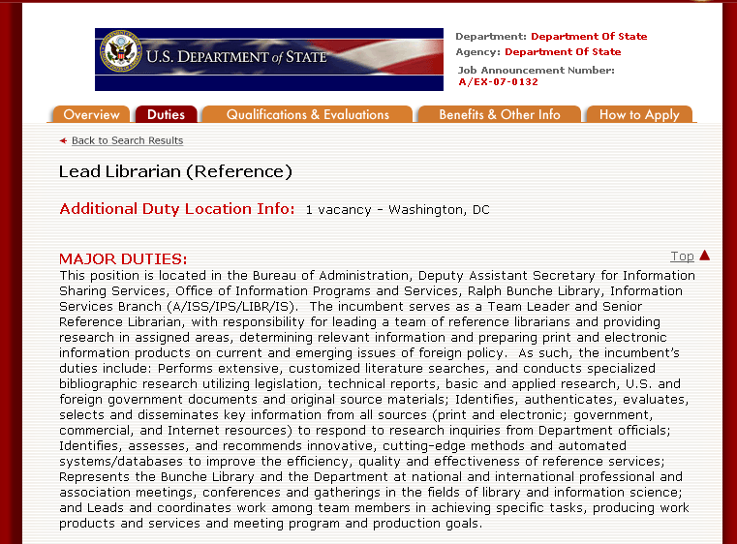

Slide 6
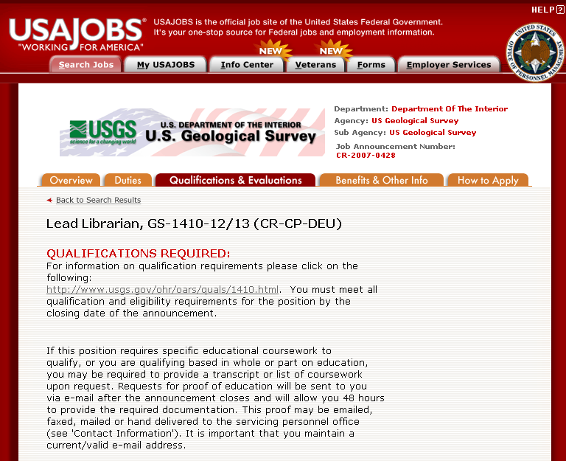

Slide 7
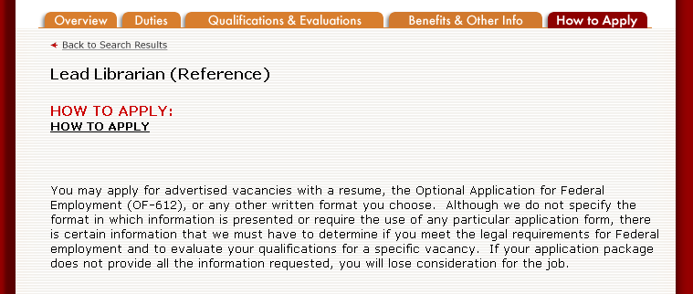
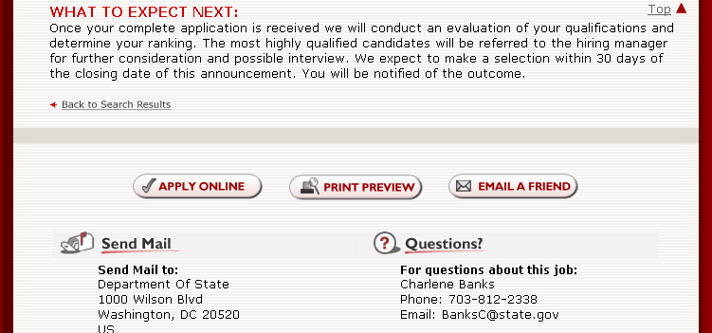
NEED HELP OR
HAVE A QUESTION

Slide 8
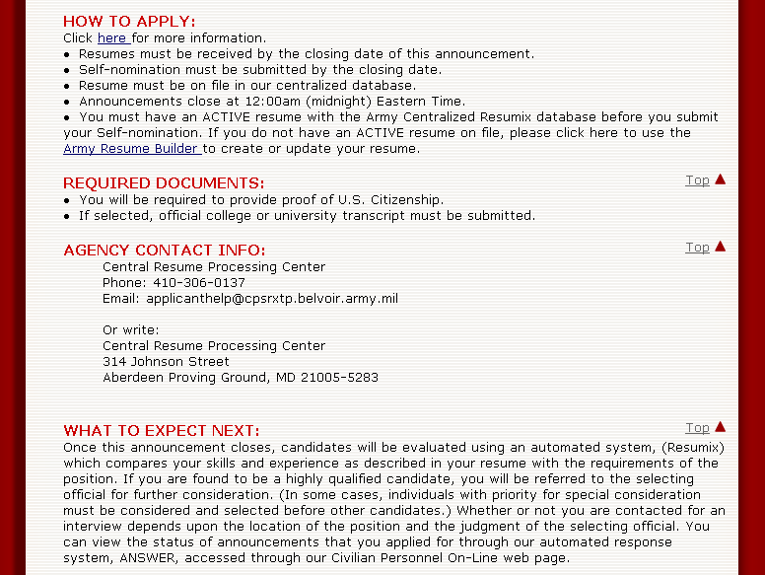

Slide 9
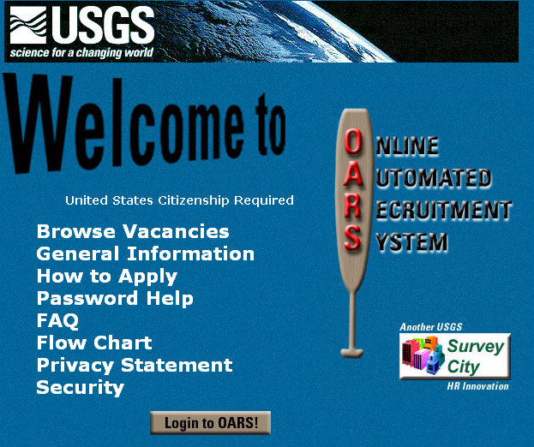

Slide 10
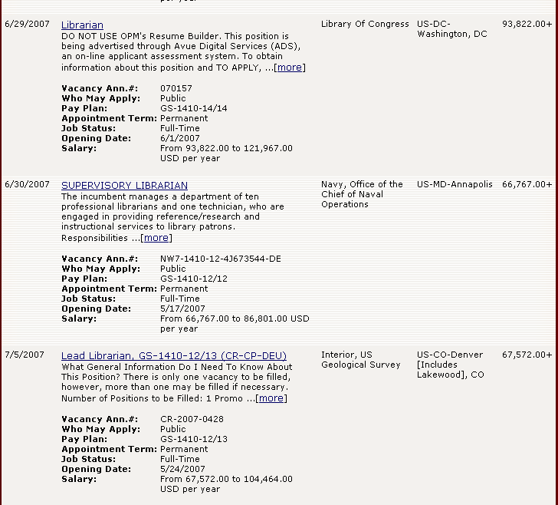
?
Begin as a GS-12,
Promotion Potential GS-13

Slide 11

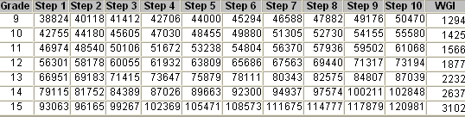

Slide 12
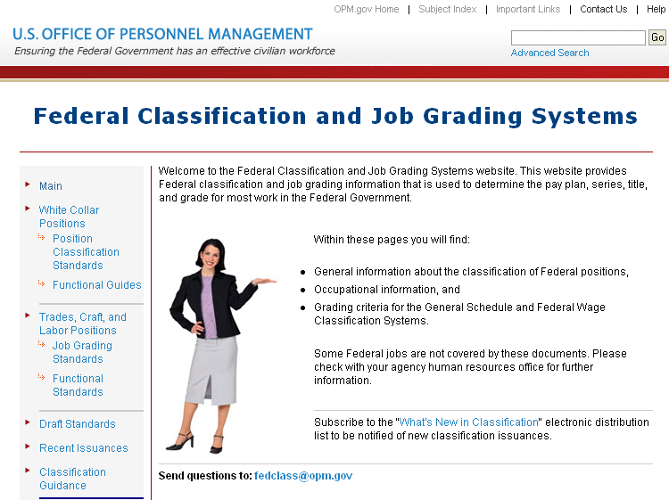

Slide 13
Initial Challenges
Did they get my application?
Key words
Knowledge, Skills & Abilities
Qualified
Veterans preference
Reinstate eligible
52 weeks in time and grade

Slide 14
The Resume Challenge
Action words
White space
Awards, certifications, special skills
Check and print your resume
Special characters, spelling errors
Have a friend read it or another librarian

Slide 15
The Interview Challenge
List of prepared questions
  Ours
  Yours
Phone versus in person
Optimism
Mobility
Three warning words - Can’t * Never * Always

Slide 16
Advice from the Judges
Patience
Follow up
Join a professional association
Join a list serve
Check agency website
Don’t give up – remember auditions are held daily

Slide 17

CONTACT INFORMATION
AMY LOUGHRAN
TRADOC COMMAND LIBRARIAN
AMY.LOUGHRAN@US.ARMY.MIL
757-788-2155

