Slide 1

Enablement and Written Description Issues in Utility Plant Applications
Gary Benzion, Ph.D.
Acting Supervisory Patent Examiner
AU 1638

Slide 2
Art Unit 1638
Paula Hutzell, Ph.D., SPE (detail Biotech Practice )
Gary Benzion, Ph.D., Acting SPE
Amy Nelson, Ph.D., Acting SPE
Beth McElwain, Ph.D.,Primary Examiner
David Fox, M.S., Primary Examiner
Phuong Bui, M.S., Primary Examiner
Ashwin Mehta, Ph.D., Patent Examiner
Medina Ibrahim, M.S., Patent Examiner
Ousama Zaghmout, Ph.D., Patent Examiner
Cynthia Collins, M.S., Patent Examiner
Anne Kubelik, Ph.D., Patent Examiner
Francis Moonan, Ph.D., Patent Examiner
David Kruse, Ph.D., Patent Examiner

Slide 3
Overview
Biological/Technological Factors Affecting Patentability in Plant Biotechnology
Application of the Standards for Enablement & Written Description Rejections.
Practical Examples

Slide 4
Utility Patents for Transgenic Plants
In 1980, Diamond v. Chakrabarty established that microorganisms qualify as patentable subject matter.
To date more than 1600 Utility patents have issued that contain claims to transgenic plants, plant parts and seeds.

Slide 5
Plant Biotechnology Milestones
1983- First plants produced using new biotechnology methods
1994- First food product enhanced through biotechnology (FlavrSavr tomato) hits supermarket shelves
1995- First soybean developed through biotechnology is introduced
1997- U.S. government (APHIS, EPA, FDA) fully approves 18 crop applications of biotechnology
1999- Development of “golden rice” that is rich in beta-carotene to help prevent childhood blindness in developing countries
*From: Biotechnology Good Ideas are Growing, Council for Biotechnology Information,April 2000

Slide 6
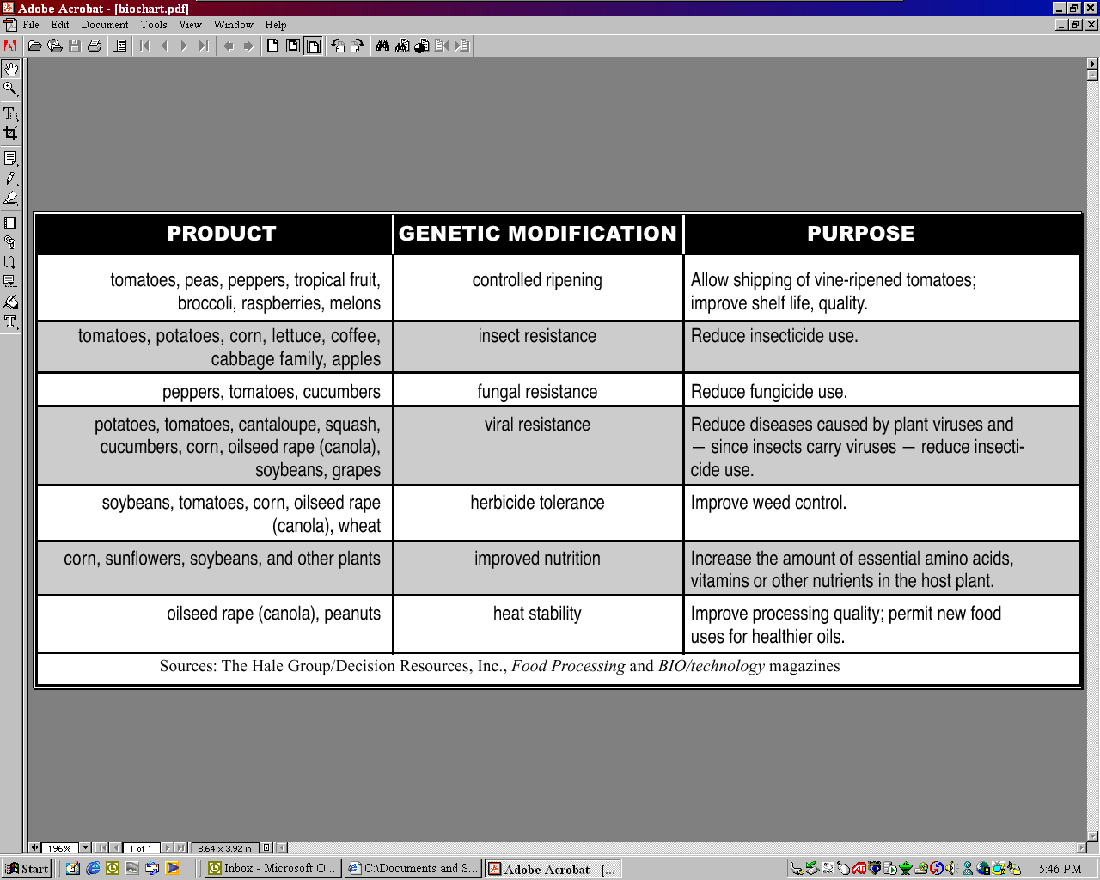
Commercial Agricultural Products Overview

Slide 7
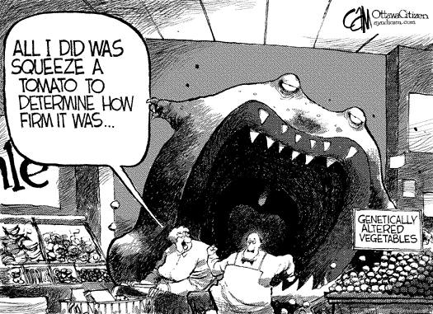
FlavrSavrTM II
Used with permission.

Slide 8
“Wands Factors”
In re Wands, 858 F.2d 731, 8 USPQ 2d 1400, (Fed. Cir. 1988)
Breadth of Claims
Nature of the Invention
State of the Prior Art
Level of Skill in the Art
Level of Predictability
Amount of Direction/guidance
Presence/absence of Working Examples
Quantity of Experimentation

Slide 9
Factors Affecting Enablement and Written Description in Plant Biotechnology
Nature of the Invention
  Plants are not slow-moving animals or large bacteria. They are highly complex biological organisms comprising a high degree of “junk” DNA vs. structural DNA when compared to animals.
Level of Predictability/Quantity of Experimentation
  Affected by the large genotype by environment (g x e) interaction
    Drought, high heat, cold, photoperiods sensitivity- complicate gene expression,-- e.g., Oil quality- affected by temperature

Slide 10
Factors- Cont.
Predictability/Quantity of Experimentation
  Plants are inter specific and inter genus cross tolerant making new and/or unstable genomes
    e.g., Maize (X) Tripsacum- inter species hybrid
    wheat x rye- inter genus Tricale
  Gene expression is affected by the phenomenon of position effect variation.
    Where a gene integrates in a plant genome can be important.
      Large amounts of heterochromatin/methylated DNA regions -can turn off or modify gene expression

Slide 11
Factors- Cont.
Are There Working Examples?
  Plants have a high tolerance to chromosome number variation, chromosome inversion and deletions
    Allohexaploid wheat comprises three distinct genomes
      Knock out a gene to silence it in one genome- will the other genes compensate and/or interfere with DNA expression-- unknown!
    Plants have a high gene copy number- many are pseudo genes
      rDNA in maize varies from 9,000-20,000 copies per line- no correlation to gene copy number and protein expression
      Accordingly, what effect would the insertion of foreign rDNA have on the protein expression in maize?
      Unknown!

Slide 12
Factors- Cont.
Amount of Guidance/Level of Skill in the Art.
  Highly variable in plants
  For example, whole plants can be regenerated from tissue culture. However, tissue culture induces phenotypic variation which can be confounding
    For example, somatic cell variation is not heritable while genetic variation is heritable and both are caused by tissue culture.
    Buffering of genetic abnormalities can be hidden and passed on in later generations due to redundant genetic alleles during chromosome segregation

Slide 13
Factors- Cont.
Developmental Specific Expression Can Delay Detection of Variation
  For example, expression during pollen shed, male specific expression absent during male sterility, delayed or aborted flowering, would not be seen in young plants.
Tissue/Organ Specific Expression
  Expression during pollen or ovule development or during grain fill (many plants have both sexes in one organism)

Slide 14
Factors- Cont.
Breeding or engineering a high level of expression with “always on” promoters may be detrimental.
  Expression of insecticide in absence of insect-- energy drain on plant
  Seed storage proteins- expression only during seed fill
  Oil quality-- changing biochemical pathways only during oil deposition.
  Expression of ripening genes too early can lead to early plant death.

Slide 15
Sample Utility Plant Specification
The specification discloses a method of mutagenesis in maize using transposable elements
One example is provided in which a gene designated (M) is mutated from the recessive allele (m) to a dominant allele (M’) which expresses the recessive phenotype
M is a common gene found throughout the plant kingdom
Analysis of this mutation shows the transposable element integrated into gene M- but the gene structure is not known nor is the change known.
The prior art is completely silent with regard to mutagenesis causing switching of a recessive allele to a dominant phenotype, however, the prior art teaches that transposable elements function by common mechanisms and thus function in most plants and animals
No further information is provided

Slide 16
Sample Claims
1. A method of converting a genetic allele to express a recessive phenotype as a dominant allele, comprising:
(A) introducing a transposable element into a plant
(B) producing progeny seed, and
(C) screening progeny from the seed for recessive mutants which express as a dominant allele
2. A plant comprising a mutant gene M’ which expresses the recessive allele (m) as a dominant

Slide 17
Examiner’s Burden
It is the examiner’s initial burden to clearly establish any prima facie case of lack of enablement and inadequacy of written description in plant biotechnology application by presenting:
  Sound scientific reasoning
  References which buttress the examiner conclusion

Slide 18
Enablement Requirement
35USC § 112, 1st ¶
The specification shall … enable any person skilled in the art to which it [the invention] pertains, or with which it is most nearly connected, to make and use the same, . .

Slide 19
Enablement- Analysis
1. A method of converting a genetic allele to express a recessive phenotype as a dominant allele, comprising:
(A) introducing a transposable element into a plant,
(B) producing progeny seed, and
(C) screening progeny from the seed for recessive mutants which express as a dominant allele.
Analysis- In View of Wands
The invention as claimed is broad, that is, it is directed to any genetic allele and to any plant, and it is not predictable that an allele other than that taught in the specification can be converted by the method steps in the claim.

Slide 20
Enablement- Analysis Cont.
There is no direction in the prior art regarding such allelic conversions or suggestion how to test other transposable element insertions to modify genetic alleles.
Only 1 working example which does not supply guidance on how to apply the method to other genetic alleles.
Experimentation to test other genes via the method would be unduly large as the mechanism of the mutation is not known, although this is not a requirement for enablement, in this instance it is difficult to conceptionalize how this invention works and thus how to enable it.
The method of claim 1 is not enabled as claimed.

Slide 21
Tips
In the absence of other working examples, the specification as filed, should disclose more basic biology concerning M’
  M’could be a point mutation, deletion, truncation, inversion, etc.
  Information on the changes in the gene DNA sequence- if any
  evidence of protein modification/deletion or of changes in the active site of the protein

Slide 22
Enablement- Analysis Cont..
2. A plant comprising a mutant gene M’ which expresses the recessive allele (m) as a dominant
Analysis in view of Wands
The M gene is a common gene in plants
M’ is disclosed in the specification as consisting of the transposable element integrated into gene M of maize
Specification teaches that the gene M can be mutated to M’ by insertion of a transposon. It is not known if this insertion is site specific- although transposons usually insert into specific sequence.

Slide 23
Enablement- Analysis Cont.
Other M genes in other species are known to produce the M protein, therefore it is likely that the mutant M’ from maize will function in other plants in a similar fashion.
Conclusion
Claim 2 is enabled

Slide 24
Written Description
35 USC §112, 1st paragraph
The specification shall contain a written
description of the invention. . .

Slide 25
General Principles- Written Description
Written description is separate and distinct from the enablement requirement
Basic inquiry: can one skilled in the art reasonably conclude that the inventor was in possession of the claimed invention even if every nuance of the claim is not explicitly described in the specification, at the time the application was filed?

Slide 26
Written Description Guidelines
66 Fed. Reg. 1099 (Jan. 5, 2001)
  Level of Skill and Knowledge in the Art
  Complete or Partial Structure
  Physical And/or Chemical Properties
  Functional Characteristics
  Correlation Between Structure and Function
  Method of Making
  Combinations of the Above

Slide 27
Written Description Analysis
Claim1. A method of converting a genetic allele to express a recessive phenotype as a dominant allele, comprising:
(A) introducing a transposable element into a plant
(B) producing progeny seed, and
(C) screening progeny from the seed for recessive mutants which express as a dominant allele
Analysis- in view of the Written Description Guidelines
66 Fed. Reg. 1099 (Jan 5, 2001)
What is the level of skill and knowledge in the art
  The structure of neither the M or M’ DNA or protein is known,
  There is no teaching of how structure affects function- only functional characteristics
  Prior art does not teach other structural changes which have the same functional changes.

Slide 28
Written Description Analysis- Cont.
It is unknown if the dominant phenotype is the absence of an M protein or a change in the protein structure- a representative number of species have not been described
No discussion or knowledge in the art regarding transposons producing this type of mutation
Conclusion
  The inventor was not in possession of the method of claim 1 at the time the application was filed

Slide 29
Conclusion- Written Description
Claim 2. A plant comprising a mutant gene M’ which expresses the recessive allele (m) as a dominant.
Analysis- in view of the Written description Guidelines
66 Fed. Reg. 1099 (Jan 5, 2001)
  The claim is limited to the M’ mutant.
  The limitation to “A Plant” is broader than maize- the level of skill and knowledge in the art concerning the expression of a non-native M’ in a plant evidences that it would be expected to function in plants per se.
  Conclusion
  The inventor was in possession of the claimed invention at the time the application was filed.

Slide 30
Conclusion- Written Description
Tips
  In the specification as filed provide complete or partial DNA structure and protein structure
  Correlate the structural changes to the functional changes
  Determine the physical properties of the gene/protein

Slide 31
Utility?
While the invention of claim 1 may be claimed as a method of mutagenesis, the issue of utility would have to be addressed as the specification would have to teach that the method has utility which is:
  Specific.
  Substantial.
  Credible.

Slide 32
Contacts For Further Information
Paula Hutzell 703-308- 4310
Gary Benzion 703-308-1119
Amy Nelson 703-308-3218
Questions?

Slide 33
Enablement and Written Description Issues in Utility Plant Applications
Gary Benzion, Ph.D.
Acting Supervisory Patent Examiner
AU 1638

