Slide 1
Validating the Patient Safety Indicators (PSIs) in the VA: a Multi-Faceted Approach
Funding: VA Health Services Research
and Development (HSR&D) Service
SDR 07-002 : 10/01/07- 9/30/11
Amy Rosen, Ph.D., Principal Investigator
Notes:
Would also like to thank my MANY collaborators across multiple VA centers: Bedford VA Center of Excellence, Boston VA, and also Boston University, AHRQ, etc.

Slide 2
Project Team
Collaboration among
  VA’s HSR&D Service
  National Center for Patient Safety (NCPS) and
  AHRQ (QI team and individual investigators)
VA and non-VA clinicians, surgical experts, nurse abstractors
National steering committee:
  Representatives from VA Office of Quality Performance, NCPS
  Nursing Services, Surgery, Patient Care Services
  Selected members of the AHRQ QI team
  Selected Patient Safety/QI Managers and other potential end-users
Notes:
Health services researchers, methodologists, clinicians, key stakeholders in VA and outside VA

Slide 3
Overall Project Goal
Develop a validated and reliable set of patient safety measures that broadly reflect the interests of key VA stakeholders, but that are generalizable beyond the VA.
Specific Objectives:
  Develop collaborations with key stakeholders to guide in PSI selection and validation
  Investigate the criterion validity of the PSIs by review of the VA’s EMR
  Identify processes and structures of care associated with individual PSIs
  Revise and improve the PSIs using multiple data sources and settings of care
  Assess the utility validity of the PSIs for QI and performance measurement
Notes:
I presented these goals last year, and thought I’d present them again so you can see what we have done and what we have left to do

Slide 4
Goal 1: Develop Stakeholder Collaboration
Stakeholders’ meeting (Dec, 2007):
  Approved selection of PSIs
  Approved plan to validate AHRQ’s Phase I/Phase II PSIs
  Reviewed field consultation interview questions
    Recommended focus on general questions on patient safety
  Suggested less attention on specific PSIs in field consultations
    Field consultations held to examine the validity of the PSIs, not to judge facilities’ performance
Contact with stakeholders subsequent to meeting
  Approved final interview protocols “TO/THRU” memo to sites asking them to participate
Notes:
FOR NOTES:
Stakeholder role is very important to this project and VA wants research to collaborate actively with key stakeholders who might use PSIs or advise on their use. The group acts as an oversight group. Therefore, our mandate was to meet regularly throughout project (face-to-face annually, by phone as needed). We had our first face to face meeting in Dec- here’s what we did (read bullets). We met with about 8 stakeholders including
Ana Alt-White Nursing, Len Pogach, Peter Almenoff, Carol Bills, Lisa Mezzia, AHRQ QI folks, Vickie Montague, Ralph De Palma.
They approved selection of PSIs, etc. Meeting very successful but also interesting in terms of their guidance related to site visits. Because of their concerns, we decided to call the site visits “field consultations” rather than site visits in order to soften what we were doing- prevent judging.

Slide 5
Goal 2: Identify False Positives
Are Cases Flagged by the AHRQ PSIs
Present in the EMR?
Obtained national access to EMR: “VistaWeb”
Hired and trained two nurse abstractors to conduct chart abstraction
Modified AHRQ Phase I and Phase II chart abstraction tools for VA
  Pilot testing and clinician review
  Five tools “ready for prime time,” five almost ready, five being developed de novo
Completed validation of PE/DVT
Currently abstracting charts for iatrogenic pneumothorax
Currently piloting web-based application (InfoPath) for gathering and entering chart-abstracted data
Notes:
NOTES:
Validating 15 PSIs (except obstetric ones, transfusion reaction)
Modified tools primarily to help abstractors- this was done iteratively thru pilot testing, nurse suggestions, and then clinician review. Most modifications related to the logic of the questions, such as the order, clarification of meanings of terms, etc. Pneumothorax currently being abstracted, so far getting good IRR, also few false positives.
We have created an electronic chart abstraction tool using InfoPath software. In addition to eliminating the use of paper, privacy risks associated with patient data are significantly reduced and also it reduces abstractor error.
-the next slide gives an example. Still working out the kinks but this will allow us to dump data from chart into database.

Slide 6
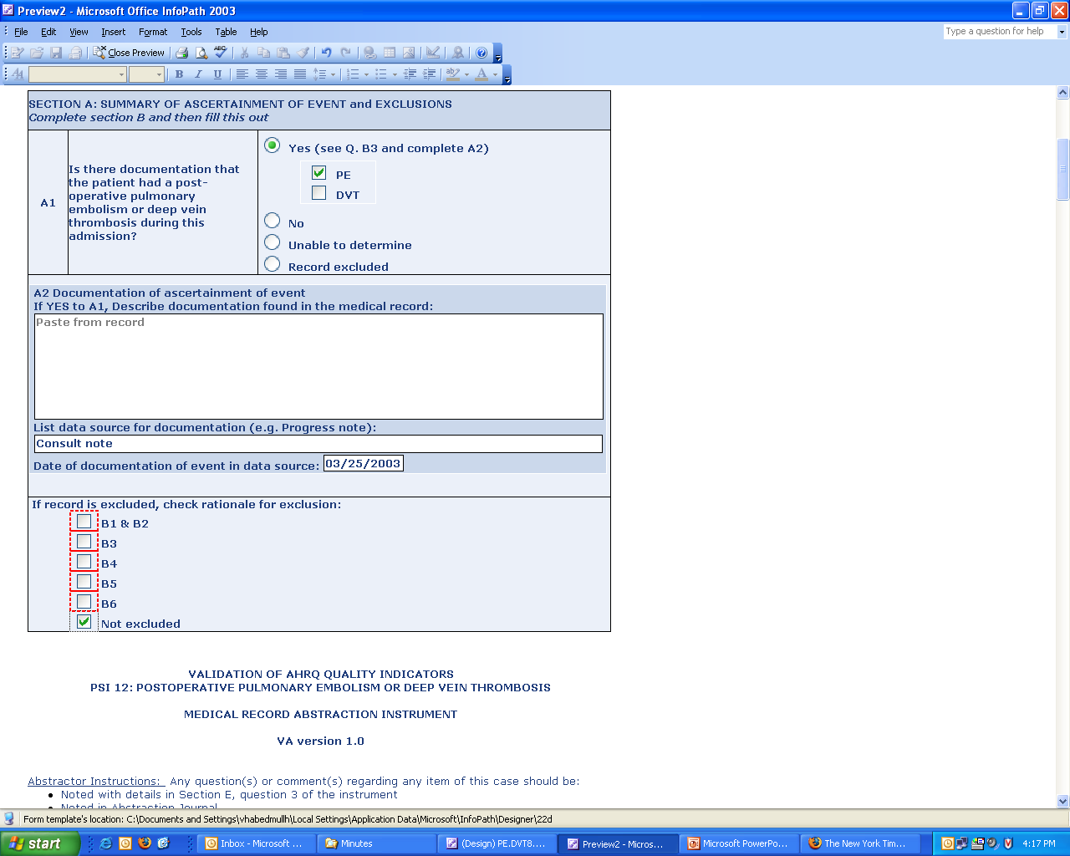
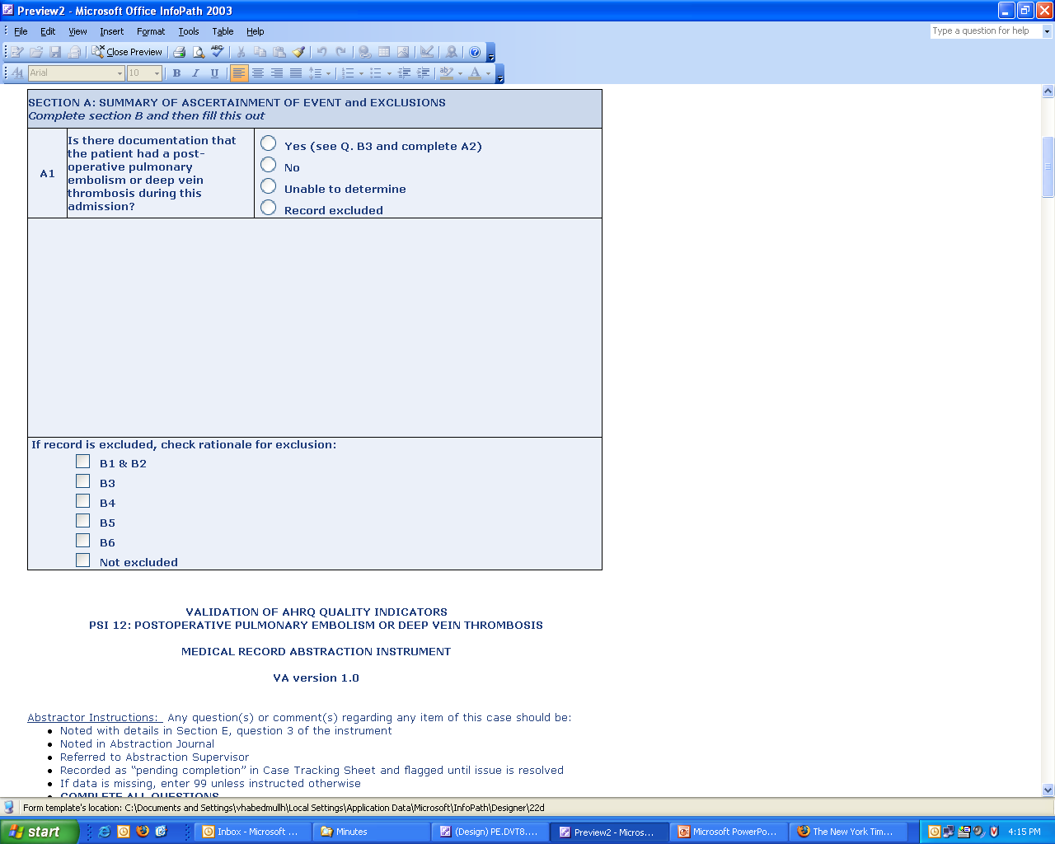
Notes:
This slide shows the conditional formatting features of InfoPath.
CLICK #1
When “yes” is selected, additional fields for data entry appear.
CLICK #2
In the bottom section here, when “not excluded” is checked, none of the other answers (outlined in red) are available.
CLICK #3
These features enable more efficient chart abstraction.

Slide 7
Hospital Selection
Ran PSI software (v. 3.1a) on VA inpatient data (2003-2007)
  Obtained rates of individual PSIs and PSI composites
Used 12 PSIs
  PSIs 1-15
  Excluded PSIs 1, 5, 8
Population:
  158 VA hospitals
Sample for chart abstraction:
  28 hospitals, 112 charts per PSI
Notes:
NOTES:
Ran PSI software on VA data…using only 12 PSIs
Hospitals in sample were somewhat “representative” of all VA hospitals --couldn’t sample all 158 hospitals so we had to select a reasonable # that would provide some representation of VA hospitals, geographic distribution, and also allow for coding variation.
We excluded PSIs that were not frequent and ran software on 12 PSIs

Slide 8
Sample Selection Methodology
Stratified population by observed and expected #s of PSIs
  Group 1: at least 4 observed and 4 expected (n =28)
  Group 2: at least 2 observed and 2 expected (n=33)
  Group 3: at least 1 observed and 1 expected (n=18)
  Total for Groups 1-3: 79 hospitals
Ranked 79 by AHRQ PSI composite (denominator weights)
  Chose top 3 and bottom 3 from each group
  Randomly selected from remaining hospitals within each group: group 1=4, group 2=4, group 3=2 to obtain 28 hospitals (10, 10, and 8, respectively)
  Geographic distribution and ICU severity taken into account
Selected 6 hospitals for field consultations and ranked them based on PSI composite
  Geographic location and size taken into account
Notes:
We calculated observed and expected PSI rates across all VA hospitals and divided hospitals into 3 groups based on specific criteria. Group 2 excludes Group 1
Group 3 excludes Groups 1,2.
(Expected: calculated as overall VA rate * individual facility PSI denominator)
For PSIs 1,5,8, we take wherever we can. We want 4 charts per PSI in each of the 28 facilities (4 * 15* 28= 1680 charts). If facility does not have 4 charts, we borrow from other facilities-no more than 4 extra per facility
For 6 hospitals for field consultations, we used denominator weights from PSI composite from 79 facilities and 2006-2007 data

Slide 9
Chart Abstraction
PE/DVT
Conducted retrospective EMR review of 112 flagged cases
Conducted inter-rater reliability (IRR) throughout EMR review
  28 cases (25% of all charts) reviewed for IRR due to:
    large numbers of exclusions
    IRR > 90%
  89% agreement rate achieved with 1st IRR, 94% with 2nd IRR
Issues
    length of time to complete chart abstraction (1½ hours for full record; 20 minutes for false positives)
    problems with accessing VistaWeb
Notes:
( during pilot –every 5 charts or so, before formal abstracting, and then periodically throughout abstraction until we reached agreement above 90%)
IRR: looked at core questions as well as individual items. Looked at agreement on true positives and false positives. IRR between 2 nurses/nurse did IRR

Slide 10
Technical Specifications of PE/DVT
Numerator:
  Discharges among cases meeting the inclusion and exclusion rules for denominator
    ICD-9-CM codes for PE/DVT in any secondary diagnosis field
Denominator:
  All surgical discharges age 18 and older
    defined by specific DRGs and an ICD-9-CM code for an OR procedure
Exclusion criteria for all cases:
  preexisting (principal diagnosis or secondary diagnosis present on admission, if known) PE/DVT
  procedure for interruption of vena cava the only OR procedure
  procedure for interruption of vena cava occurs before or on the same day as first OR procedure
  MDC 14 (pregnancy, childbirth, and puerperium)
Notes:
Definition:
Cases of deep vein thrombosis (DVT) or pulmonary embolism (PE) per 1,000 surgical discharges with an operating room procedure

Slide 11
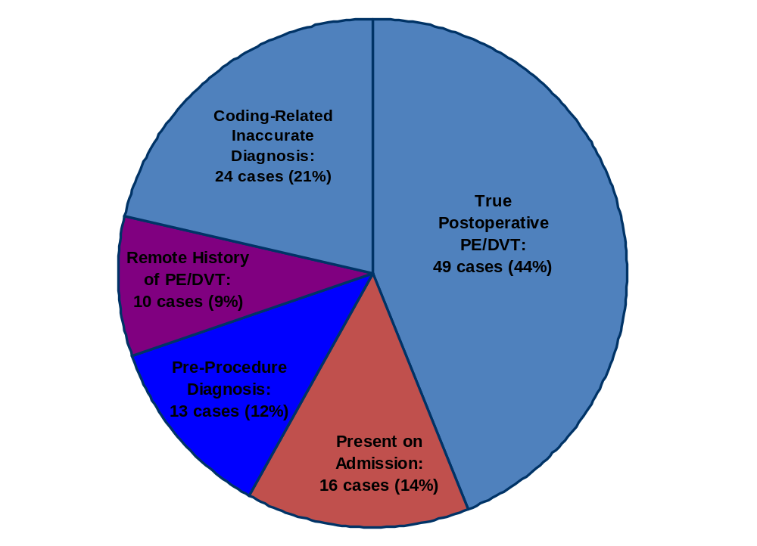
Post-operative PE/DVT Validation Results
Total # of cases: 112
Notes:
A few issues are crucial in these definitions:
1) The differentiation between POA, Pre-Procedure and Old History was based on the diagnosis date not the suspected diagnosis date. A Pre-Procedure label does not mean that the DVT or PE was not present on admission, but it means that the diagnosis of PE or DVT was made after the admission, but before the procedure.
2) Old History was defined as the diagnosis being made > 6 months before admission, irrespective of whether this history of PE/DVT affected the admission management or not.
3) Present on Admission was defined as the diagnosis being made < 6 months before admission, irrespective of whether this history of PE/DVT affected the admission management or not.
4) Any thrombosis at the brachial vein or distal to it was considered part of the superficial not deep venous system
5) The postoperative period was defined as 30 days from the procedure or until the end of the same admission, which ever came later.

Slide 12
False Positives: A Comprehensive Analysis
Classification of False Positives | Number of cases | Percentage
DVT/PE Present on Admission (POA) | 16 | 25.4%
Pre-Procedure Diagnosis of PE/DVT | 13 | 20.6%
Remote History of DVT or PE (> 6 months) | 10 | 15.9%
Arterial (not venous) thrombosis* | 4 | 6.4%
Negative PE/DVT workup * | 4 | 6.4%
“Rule out PE” as cause of death * | 3 | 4.8%
Superficial (not deep) thrombosis or thrombophlebitis * | 3 | 4.8%
Miscellaneous * | 10 | 15.9%
Total | 63 | 100%
* Represents coding-related inaccurate diagnosis

Slide 13
Coding-Related Inaccurate Diagnosis:
Miscellaneous Category
Classification of False Positives | Number of cases
Vein stenosis (no thrombosis) | 1
PE stands for Physical Exam not Pulmonary Embolus | 1
Low dose Coumadin prophylactic not therapeutic | 1
Surgery done at outside hospital | 1
Cerebral embolization of AVM | 1
Prophylactic heparin mistaken for therapeutic heparin | 1
RLE U/S ordered to r/o abscess at surgical site | 1
Unknown | 3
Total | 10

Slide 14
PE/DVT Results:
Comparison of Studies
 | Our study | Zhan study | AHRQ study | NSQIP and PTF study | UHC study
N | 112 | 20,868 | 155 | 55,682 | 1022
PPV | 44% | 29% | 68% | 22% | 61%
Sensitivity | -- | 68% | -- | 66% | --
Notes:
CI for PPV of 30% with 95% CI (Binomial exact is 22%, 40%) Mention that we first got a PPV of 30% when nurses reviewed, then it was 44% after physician review
CI for PPV of 43.8% (95% CI, 34.4-53.4%)

Slide 15
Problems in Coding PE/DVT
PE/DVT PSI designed as initial screen
Accuracy of method to detect true positives using administrative data affected by:
  Standards used to assign codes for “other” or secondary conditions → based on the Uniform Hospital Discharge Data Set (UHDDS)
    “Other” conditions: those that coexist at the time of admission, develop sequentially, affect the treatment received and/or length of stay, or affect patient care
  Definition of PE/DVT relative to
    UHDDS coding standards,
    ICD-9-CM Official Coding Guidelines for Coding and Reporting
    Coding Clinic published by the American Hospital Association (AHA)
Notes:
For “other conditions, affecting patient care can mean
clinical evaluation
therapeutic treatment
diagnostic procedures
extended length of stay
increased nursing care and/or monitoring
Note: according to UHDDS, postoperative PE/DVT is coded with a code from the 997 category, with an additional code to identify the PE/DVT. This method of identifying the Post operative PE/DVT is not part of the PSI algorithm

Slide 16
Problems in Coding PE/DVT, cont’d
False Positive 1: chart review does not document a PE/DVT
  Code was present on admission (POA) and meets UHDDS definition of “other” diagnosis
  Code assigned as a current condition
    Should have been coded as a “history of” with a V code
    It was still a “rule out” condition at the time of discharge
  Coding system issue
    Was miscoded (superficial vein and not deep vein) due to coding invention and ICD-9-CM alphabetic index
    Coder did not identify the correct vein anatomically
    Should not have been coded at all
False Positive 2: chart review documents a PE/DVT, but it is not a postoperative PE/DVT:
  Diagnosis of PE/DVT occurred after admission but before surgery
Notes:
According to the UHDDS conditions that are “rule out” at the time of discharge are coded as if they exist. Note: this is rare.
Miscoding (superficial and not deep vein) can be influenced by the structure of the ICD-9-CM alphabetic index. For example, DVT NOS defaults to DVT of lower extremities

Slide 17
Recommendations for Improving PE/DVT
Modify coding rules:
  Use NSQIP definitions to influence the coding rules
  Specify the circumstances when the PE/DVT should be coded and publish them in Coding Clinic and Official Guidelines
    as “current conditions” or “history of”
Begin using POA in VA
Explore use of “997” complication code as part of the PSI algorithm to capture post-operative PSIs
Explore expansion of POA to include a special character denoting “POA prior to surgery”
Undertake targeted education to help coders, researchers, and healthcare professionals understand the use of coding guidelines for “PE/DVT”

Slide 18
Objective 3
Question: Do High-Performing Facilities Have Higher Rates on Structures and Processes of Care than Lower-Performing Facilities?
Conduct two pilot field consultations locally
  determine feasibility and logistical problems
  test interview questions
  add/delete selected staff
Conduct field consultations at 6 facilities
  Perform structured interviews with selected staff
  Gather data on safety and quality
Assess differences between sites on structures and process using qualitative methods and ratings
Notes:
Problems with EMR
lacks information on structural characteristics of hospitals
documentation on processes of care may be incomplete
Similar to NSQIP process
2 interviewers will go to each site; will interview each staff person/group together. One interviewer will be clinician, one will be researcher.
In process of obtaining IRB approvals from all sites

Slide 19
Selected Staff for Interviews
Individual Interviews
  Executives
  Service Chiefs
  Other Middle Managers
  Other Non-Managers
Group Interviews
  Surgical Service
  Medical Service
  Non-Managers
Notes:
Executives — 30 MIN (max) INDIVIDUAL INTERVIEWS
Quadrad Members
Hospital Director
Associate Director
Chief of Staff
Chief Nursing Officer (Nurse Executive)
Service Chiefs — 30 MIN (max) INDIVIDUAL INTERVIEWS
Chief of Medicine
Chief of Surgery
Chief of Anesthesiology
Other Middle Managers — 1-HOUR INDIVIDUAL INTERVIEWS (except as noted)
Manager of Performance Improvement / Quality Improvement
Patient Safety Manager
Nurse Manager (PCTC)/Associate Director of Nursing/Associate Nurse Executive
Risk Manager — 30 MIN INDIVIDUAL INTERVIEW
Surgical Service — 1-HOUR GROUP INTERVIEW WITH THESE INDIVIDUALS
Staff surgeon
OR nurse manager
SICU nurse manager
Surgical floor nurse manager
PACU nurse manager
Medical Service — 1-HOUR GROUP INTERVIEW WITH THESE INDIVIDUALS
Medical ICU nurse manager
Medical floor nurse manager
Staff internist
Chief pharmacist
Skin care specialist
Non-Managers — 1-HOUR GROUP INTERVIEW WITH THESE INDIVIDUALS
Chief resident, surgical service
Chief resident, medical service
Staff nurse, surgical service (SICU nurse + possibly regular floor nurse)
Staff nurse, medical service (MICU nurse + possibly regular floor nurse)
Respiratory therapist
Other Non-Managers
NSQIP nurse — 1-HOUR INDIVIDUAL INTERVIEW
Infection control nurse — 30 MIN INDIVIDUAL INTERVIEW
Coding department staff member—30 MIN INDIVIDUAL INTERVIEW

Slide 20
Interview Domains
Organization, Structure, and Culture
Coordination of Work and Communication
Interface within Service
Monitoring Quality of Care
Quality Improvement
General Clinical Topics
Coding
Technology and Equipment
Technical Competence of Staff
Leadership
Interface with Other Services
Systems Issues and Human Factors
Staffing
Summary Evaluation of Service Overall
Notes:
NOTES: Domains are based on NSQIP questions, the AHRQ report on "Making Health Care Safer: A Critical Analysis of Patient Safety Practices," and the Safety Attitudes Questionnaire.
Total of 14 questions
Before interview begins, hand out list of PSIs and read definitions of PSIs and patient safety to interviewee.

Slide 21
Domain: Monitoring Quality of Care /
Quality Improvement
In your facility, what are some of the initiatives related to improving patient safety that you know about?
  On what does it focus?
  What facilitated its implementation?
  What were the implementation obstacles?
  How effective do you think it is?
What are some of the most common adverse events that you see in your day-to-day work? Please refer to the list provided.
  What is being done now to reduce the incidence of this complication?
  What do you think would be helpful in further reducing the incidence of this?
  Is there anything not on the list we provided you that you believe is a concern?

Slide 22
Domain: Coding
Who is involved in assigning ICD-9 and procedure codes to adverse events?
  Are physicians involved in reviewing the event codes?
  Do you think there is a concern about the accuracy of coding relating to adverse events?
  If yes: What is the concern?
    How is this addressed?

Slide 23
Domain: Technology and Equipment / Technical Competence of Staff
I am curious to hear about what problems, if any, you or others have had with the technology and/or equipment on the service.
  What problems have you had with the accessibility or availability, or both, of technology and/or equipment?
  What problems you have had with the quality or functioning, or both, of the technology and/or equipment?
  What problems, if any, have you or other staff had being properly trained to use the technology and/or equipment?
  What technology and/or equipment, if any, does not exist at your hospital that would help improve patient safety?
Notes:
By accessibility I mean having equipment “where you need it when you need it” and by availability I mean “equipment existing somewhere in the hospital”
By quality I mean “the age and features of the equipment” and by functioning I mean “how well the equipment works

Slide 24
Capturing Initial Impressions
Immediately after each pilot field consultation, each interviewer summarizes her/his
  Impressions of each domain in a paragraph
  Overall impressions of the site
  →in both cases giving specific examples
Soon afterwards, all interviewers and other members of the PSI validation team meet to discuss the impressions
These discussions will be used to generate a protocol for capturing initial impressions for study’s six field consultations
  We may rate sites, creating examples for an “ideal” site
  We may decide to use only written impressions
Notes:
For the pilot sites, ratings will be used to guide interviewers in capturing specific impressions in writing, but we will not be using these ratings to “rate” sites.

Slide 25
Rating Category Possibilities
Some numeric scale
  NSQIP rating (1 to 9; 1=poor and 9=excellent)
  Other model rating (0 to 4)
Some hierarchy scale:
  Poor, fair, good, very good, excellent
Some recognition scale:
  Bronze, silver, gold
Notes:
We haven’t decided which scale or ratings will we use and how they will be used.

Slide 26
Example of Rating: NSQIP
 | Poor→Fair→Good→Very good→Excellent 1 2 3 4 5 6 7 8 9
Technology and Equipment | ✓
Technical Competence of Staff | ✓
Interface with Other Services | ✓
Relationship with Affiliated Institution | ✓

Slide 27
Initial Impressions of Pilot Sites
Domains | Rating* | Evidence Narrative | Examples
Monitoring Quality of Care Questions 1, 3, 4
Quality Improvement Questions 1, 3
Leadership Questions 2, 4
Systems Issues and Human Factors Question 4
* Our initial rating scale: Excellent, Very good, Good, Fair, Poor
Notes:
This is the form we will use for capturing initial impressions of pilot sites. Discuss evidence narrative and examples

Slide 28
Next Steps (1)
Identify False Negatives
  Use an existing “gold standard” (e.g., VA NSQIP) for 5 surgical PSIs
  Identify risk factors by estimating logistic regression models for each of the PSIs
  Use propensity score stratification to generate propensity class strata for each of the PSIs
  Use AHRQ Composite Tool to review medical records of “high-risk” cases for PSIs
  Screen EMRs of high-risk cases using keyword searches (selected “hits” will have chart review)
  Explore machine language processing as an informatics tool to search for false negatives

Slide 29
Next Steps (2)
Examine association between explicit processes of care and individual PSIs
  Match 1,680 flagged PSI cases with 1,680 controls (unflagged cases matched on demographic and clinical characteristics) to determine whether flagged cases are more likely to experience “process failures”
  Use propensity score methodology to perform matching; chi-square tests used to examine proportion of failure rates among cases and controls
Notes:
NOTES: USE OLD SLIDE

Slide 30
Next Steps (3)
Revise and Improve the PSIs
Add additional data elements to inpatient data:
  Present-on-admission (POA) diagnoses, do-not-resuscitate (DNR) codes, selected clinical, laboratory and pharmacy data elements
Link inpatient data with outpatient/inpatient data 30/60 days preceding index hospitalization (obtain POA diagnoses)
Link inpatient data with outpatient/inpatient data 30/60 days following index hospitalization to evaluate whether additional PSIs are detected
Link VA and Medicare data to examine PSI readmission in private sector
Improve coding by implementing coding changes
Modify PSI numerators and denominators on inclusion/exclusion criteria
Recalculate false positives and negatives

Slide 31
THANK YOU!

Slide 32
CONTACT INFORMATION:
Amy Rosen, Ph.D.
Center for Health Quality, Outcomes & Economic Research
(VA Center of Excellence)
Boston University Schools of Public Health and Medicine, Departments of Health Policy and Management and Family Medicine
Phone #: (781) 687-2960
E-mail: akrosen@bu.edu

