Slide 1
Amy Ritualo,
International Relations Officer, Operations Division
OCFT’s Government Performance and Results Act (GPRA) Performance Measures

Slide 2
What is GPRA?
In 1993, United States Congress passed the Government Performance Results Act (GPRA) to establish strategic planning and performance measurement in the federal government to ensure that tax payers’ dollars were being used efficiently and effectively for the public good.
The act requires federal agencies to develop and submit strategic and annual performance plans that include performance goals and indicators. Achievements are reported to Congress in the annual performance and accountability report.
Congress uses these reports to make informed assessments surrounding program effectiveness for future funding decisions.
Notes:
Government Performance and Results Act, 1993
An act to provide for the establishment of strategic planning and performance measurement in the Federal Government
Initiate program performance reform by setting program goals, measuring program performance against those goals, and reporting publicly on their progress
Improve congressional decision making by providing more objective information on the relative effectiveness and efficiency of Federal programs and spending

Slide 3
The President’s Management Agenda, 2002
Performance-based budgeting would mean that money would be allocated on the basis of what is actually being accomplished
Identify mismanaged, wasteful or duplicative government programs with an eye to cutting their funding, redesigning them, or eliminating them
Rigorous data or evaluations should be a prerequisite to continued funding
Notes:
“Government should be results-oriented – guided not by
process but guided by performance”- Gov. George W.
Bush

Slide 4
USDOL’s Strategic Goal 2:
A Competitive Workforce
Strategic Goal 2 – A Competitive Workforce: Meet the competitive labor demands of the worldwide economy by enhancing the effectiveness and efficiency of the workforce development and regulatory systems that assist workers and employers in meeting the challenges of global competition.
Outcome Goal 2K – Contribute to the Elimination of Child Labor Internationally

Slide 5
OCFT’s GPRA Indicators – 2K
Number of children prevented or withdrawn from exploitive child labor and provided education and/or training opportunities as a result of USDOL-funded child labor elimination projects.
Number of countries with increased capacity to address child labor as a result of USDOL-funded child labor elimination projects.

Slide 6
Children Withdrawn
This refers to those children that were found to be working in exploitive child labor and no longer work under such conditions as a result of a project intervention.
  children completely withdrawn from work, forms (a) – (c) of ILO Convention 182, and
  children that were involved in hazardous work (part (d) of C.182) or work that impedes a child’s education (C. 138) but are no longer working under exploitive conditions because they are now working under improved working conditions (i.e. fewer hours or under safer conditions) or in other acceptable and legal forms of work.
Each child must also be benefiting or have benefited from direct educational or training opportunities/ services

Slide 7
Children Prevented
This refers to children not yet working but who are considered to be at high-risk of engaging in exploitive child labor, for example, siblings of (ex-) working children.
  A “high risk” situation refers to a set of conditions or circumstances (family environment or situation, vicinity of economic activities prone to employ children, etc.) under which the child lives or to which s/he is exposed.
Each child must also be benefiting or have benefited from direct educational or training opportunities

Slide 8
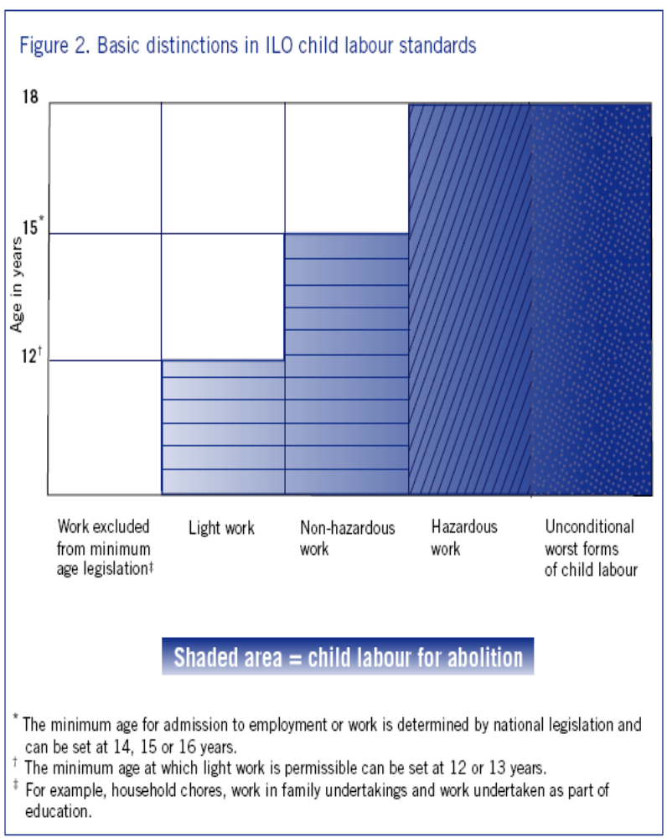
“Exploitive” Child Labor
Light Work (under 12):
Children must be withdrawn from working under the minimum age for work based on national legislation
Unconditional Worst Forms of Child Labor (all children):
Children must be completely withdrawn from work, with no exception.
Non- hazardous work that may interfere with a child’s schooling (under 15*):
Children must be withdrawn from working in a situation that impedes their education.
Hazardous Work (all children):
Children must be withdrawn from working in hazardous conditions.
Source: International Labour Office (2002). A Future Without Child Labour: Global Report under the Follow-up to the ILO Declaration on Fundamental Principles and Rights at Work. Geneva, Switzerland

Slide 9
Countries with Increased Capacity
Increased capacity in a country will be measured by one or
more of the following:
The adaptation of the legal framework to the international standards
The formulation of specific policies and programs at the national, regional, or sectoral level within a country dealing with the worst forms of child labor (WFCL)
The inclusion of child labor concerns in relevant development, social and anti-poverty policies and programs
The establishment of a child labor monitoring mechanism

Slide 10
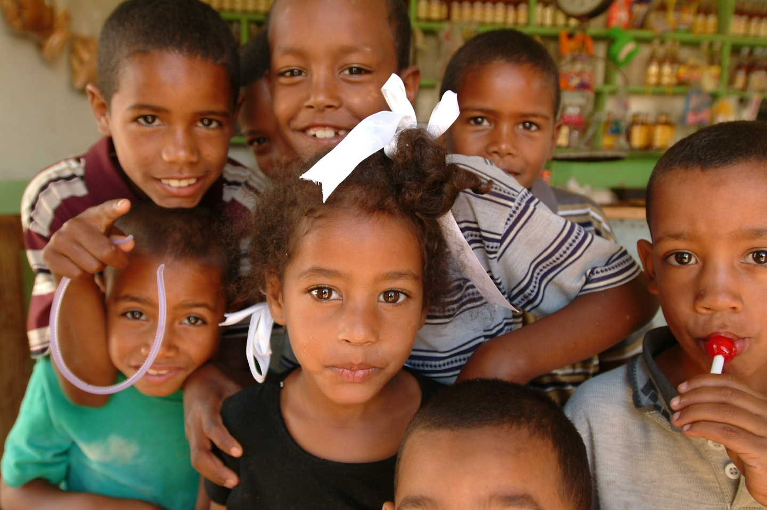
Thank You

