Slide 1
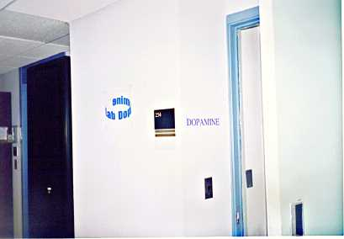
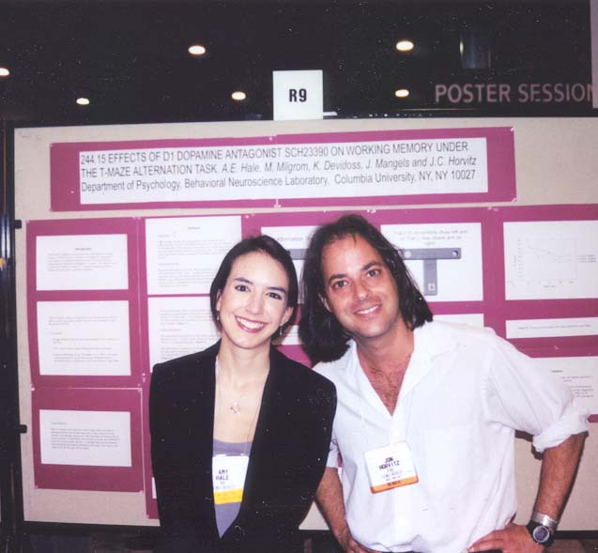
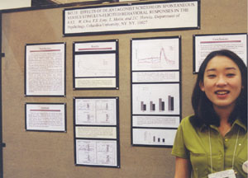
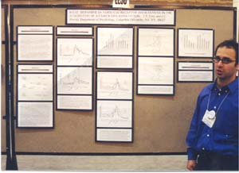
Columbia University
Amy Hale
Won Yung Choi
Yaniv Eyny
Johannes Schwaninger
Princeton University
Barry Jacobs, Ph.D.
Tripp Stewart

Slide 2
Movement of the rat is detected as its infrared body heat crosses compartments of a mounted lens.
A photo-emitter -detector reports each head entry into the food compartment

Slide 3
Pellets drop, on average, every 70 sec.
Each pellet delivery is preceded by a 400 ms, 78 dB sound.
28 trials are presented during each session
Sprague-Dawley rats received 16 days of drug-free training (28 trials/day).
On day 17, rats were pretreated with vehicle, D1 antagonist SCH23390 or D2 antagonist raclopride.

Slide 4

Drug free
Subject 31
Seconds (relative to CS onset)

Slide 5

D1 antagonist
SCH 23390
Subject 31

Slide 6
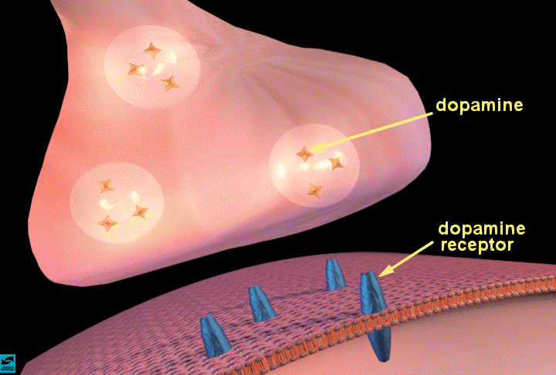
Selective D2 dopamine receptor blockade
Subject 7
VEH, Day 16
28
24
20
16
Trial
12
8
4
10
0
-16
0

Slide 7
Dopamine is needed to execute internally-generated responses, but not for responses to a well-acquired conditioned stimulus

Slide 8
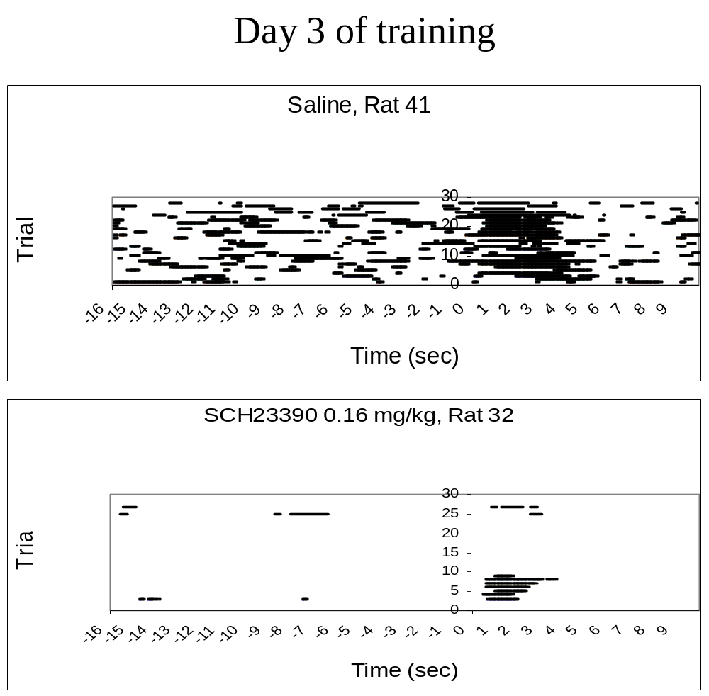

Slide 9
D1 receptor blockade increases the frequency of missed trials early but not late in training
1
0.9
0.8
Missed trials (proportion of total)
0.7
Veh
0.6
0.04 SCH
0.5
0.08 SCH
0.16 SCH
0.4
0.3
0.2
0.1
0
3
17
Days of training

Slide 10
Dopamine is not needed to execute responses to a well-acquired conditioned stimulus
But is necessary to execute responses to a conditioned stimulus during early stages of learning

Slide 11
Test
3-3 group
Test
3-7 group
7-7 group
CS-Food sessions
7
6
5
4
Veh
Latency (sec)
3
2
1
0
3/3
3/7
7/7
Training Sessions/Days

Slide 12
Test
3-3 group
Test
3-7 group
7-7 group
CS-Food sessions
7
6
5
4
Veh
Latency (sec)
3
SCH 0.16
2
1
0
3/3
3/7
7/7
Training Sessions/Days

Slide 13
Motor planning
(anterior frontal lobe)
Motor strip
sensory
CORTEX
Striatum
Thalamus
Gl Pall
DA neurons

Slide 14
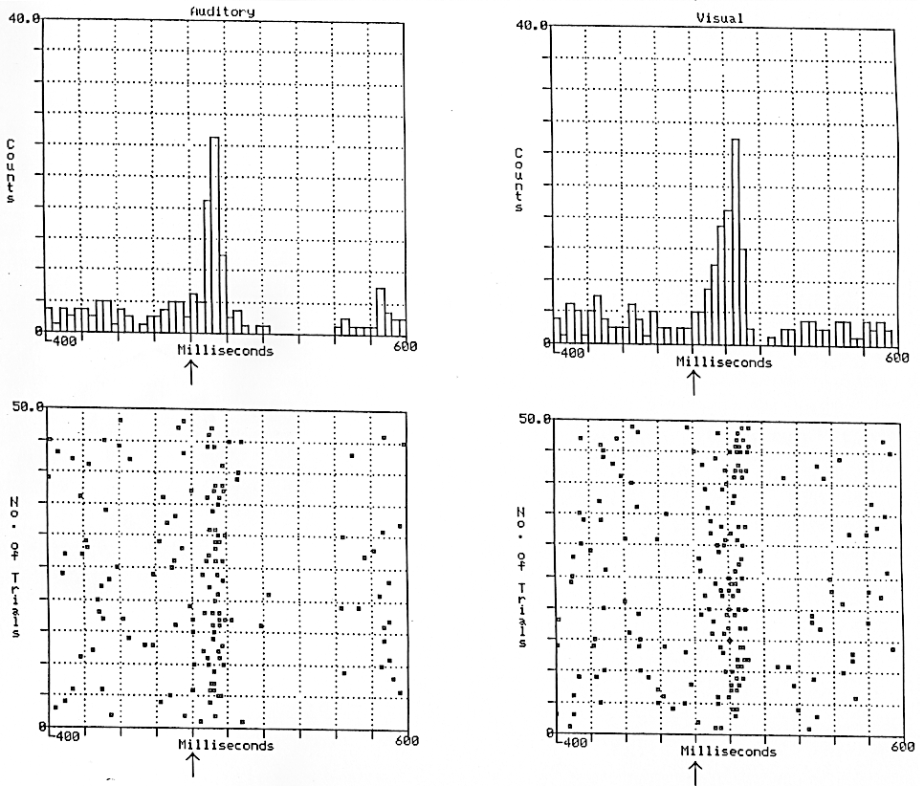
Dopamine neurons respond to salient auditory and visual stimuli

Slide 15
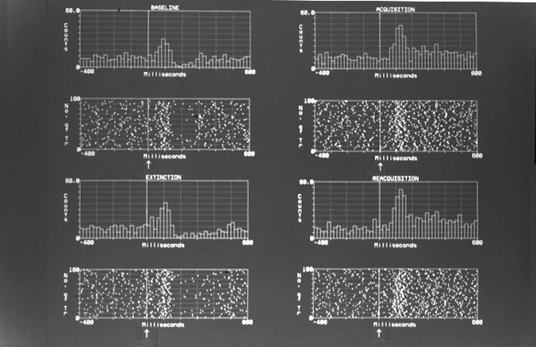
Dopamine neuronal response to a click is enhanced when the click signals reward delivery
1
click
2
click signals reward
3
click
4
click signals reward

Slide 16
D1 receptor blockade disrupts acquisition of head-entry response to food cue
0.6
Unpaired
0.5
Veh
0.4
Head-in (proportion of trials)
0.3
0.2
0.1
0
-10
-9
-8
-7
-6
-5
-4
-3
-2
-1
1
2
3
4
5
7
8
9
10
11
12
13
14
15
TONE ONSET
TONE END

Slide 17
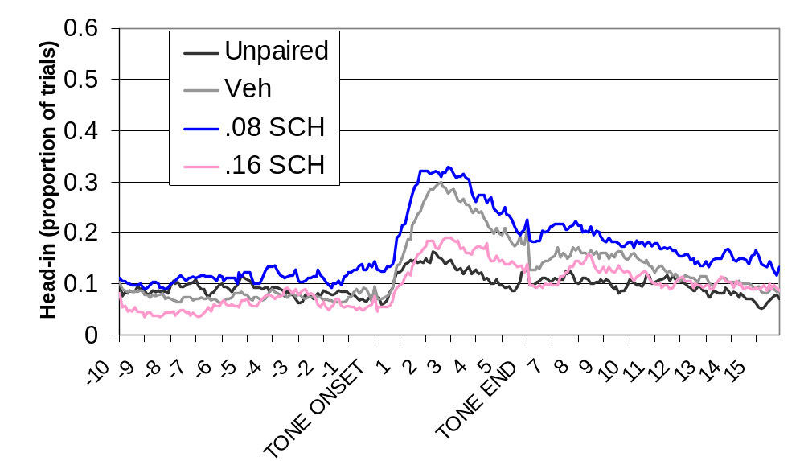
D1 receptor blockade disrupts acquisition of head-entry response to food cue

Slide 18
D2 receptor blockade promotes acquisition of head-entry response to food cue
0.6
Unpaired
0.5
Veh
0.4
.2 Rac
Head-in (proportion of trials)
.4 Rac
0.3
0.2
0.1
0
-10
-9
-8
-7
-6
-5
-4
-3
-2
-1
1
2
3
4
5
7
8
9
10
11
12
13
14
15
TONE ONSET
TONE END

Slide 19
cortex
Striatum
Gl Pall
Thalamus
Dopamine transmission is needed for the execution of internally generated responses, but not for the execution of responses to well-acquired conditioned stimuli
Somehow, learned responses become dopamine-independent with overtraining.
1
Veh
0.9
0.04 SCH
0.8
0.08 SCH
0.7
0.6
0.16 SCH
0.5
0.4
0.3
0.2
0.1
0
3
17
Dopamine plays a critical role in the acquisition of responses to new environmental stimuli, and D1 and D2 receptors appear to play opposing roles in this process.

