Slide 1


Analyzing NCHS Drug Data
Amy B. Bernstein, Sc.D.
Presented at the NCHS Board of Scientific Counselors Meeting
January 28, 2005
U.S. DEPARTMENT OF HEALTH AND HUMAN SERVICES
Centers for Disease Control and Prevention
National Center for Health Statistics

Slide 2
Topics
Health, United States special feature on drugs—overview
Description of drug databases
Issues in drug analyses
Lessons learned
Future analyses using drug data

Slide 3
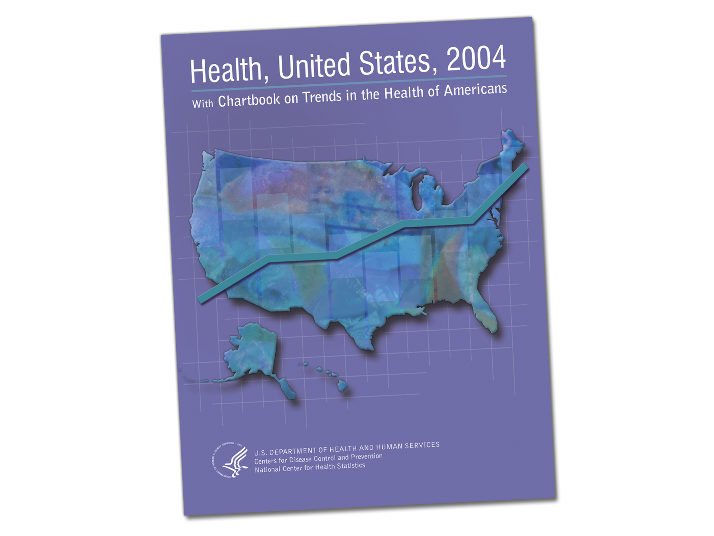
Notes:
You should have received a copy, if not, let me know...

Slide 4
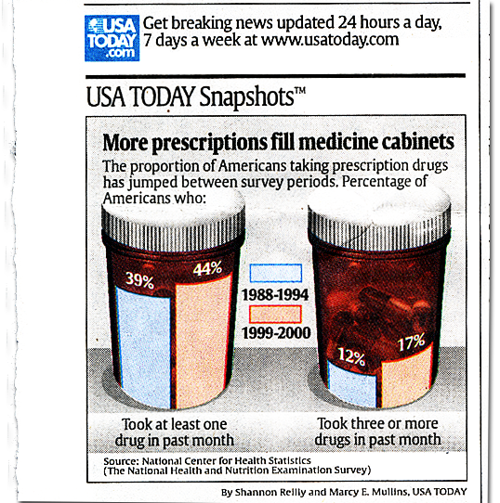
Notes:
This appeared in early January.

Slide 5
Health, United States, 2004
Special Feature
Charts on:
Overall use
Asthma drugs
Antidepressants (and SSRIs in particular) prescribed for adults
Antianxiety and antidepressant drugs prescribed for children
Cholesterol-lowering drugs (and statins in particular)
Nonsteroidal anti-inflammatory drugs (and COX-2 selective inhibitors in particular)

Slide 6
Health, United States, 2004 Chartbook Special Feature on Drugs
Collaboration with FDA’s Center for Drug Evaluation Research (CDER)
Data Sources
    NHANES (prescription drug use in past one month period)
    N/HAMCS data on drugs prescribed, ordered, administered, provided or continued during physician office and hospital outpatient department visits
Notes:
FDA helped us select drug classes to examine...as you can see from the previous slide, they picked ones they were thinking about (NSAIDS such as Celebrex, Bextra, VIoxx; antidepressants for children). THey thought about including antiobesity drugs and accutaine, but thought they might be too controversial!

Slide 7
Definition of “Drug”
  NHANES
  A drug is defined as a unique combination of generic ingredients.
  N/HAMCS
  Recorded on visit record and abstracted verbatim
Notes:
Our drug data come from two major data systems, although the NHIS does collect a little bit of information about whether children take asthma drugs, and we have drug-related poisoning for NHDS and deaths from vital statistics.

Slide 8
NHANES Drug Data
  All drugs used in the past month at time of survey interview
  Only prescription drugs are included, with a few exceptions
  Example:
    --penicillin
    --penicillin, clavulanate potassium
  More closely approximates “prevalence” of use

Slide 9
N/HAMCS Drug Data
Up to six drugs recorded (until 2003)—possible biases for drugs that are not salient to the physician or patient (e.g., PRN drugs)
Both prescription and non-prescription drugs are included
No information is available on compliance or use
Approximates prescribing patterns of drugs associated with medical care visits

Slide 10
Issues in Drug Utilization Analyses
NHANES
Strengths:
Nationally representative and population-based
Examination, laboratory and questionnaire data on conditions, biochemical markers, nutrition, health status, and other items
Respondent-reported sociodemographic data (e.g., race and ethnicity are collected from respondent)

Slide 11
Issues in Drug Utilization Analyses
NHANES
  Possible Limitations:
    Small sample size for less frequently prescribed drugs and small population subgroups
    No trade names that help to determine therapeutic use on public use file
    Respondents may not report use of some drugs
Notes:
e.g., Viagra seems to be underreported relative to industry sales data.

Slide 12
Issues in Drug Utilization Analyses
N/HAMCS
Strengths:
  Nationally representative
  Physician/hospital characteristics
  Conditions (from medical record—but limited number)
  Selected procedures and tests
  Relatively large sample size of visits

Slide 13
Issues in Drug Utilization Analyses
N/HAMCS
Possible Limitations:
  Limited sociodemographic data
  Race/ethnicity data are reported by provider, not patient
  Limited information on episodes or continuity of care
  No data on compliance or actual utilization
  Censoring of both drugs and diagnoses
  Drugs are recorded verbatim from visit records, with possible misspelling

Slide 14
Issues in Drug Utilization Analyses
N/HAMCS
Factors influencing N/HAMCS counts of drugs:
  Person must have visited a physician or OPD
  The more visits made for a specific condition requiring a specific drug, the greater the count of that drug on the N/HAMCS
Notes:
for example there is probably better reporting of hypertension and diabetes medication than of “as needed” medication such as asthma control drugs.

Slide 15
Coding Issues
  Only generic ingredients provided on NHANES public use file, and some N/HAMCS drugs are reported as generic drugs (e.g., “aspirin”)
  “Main reason for use” is collected and coded into ICD-9-CM classification
  Some drugs have the same ingredients but different strengths, or different routes of administration that help determine therapeutic use
  Examples: Asthma drugs
Notes:
Dependent on NHANES codes—cannot recode Beclomethasone is the major ingredient in Beconase@ and Beclovent@, but only Beclovent@ is indicated for asthma
Flunisolide is the ingredient in both Aerobid@ and
Nasalide@, but only Aerobid@ is indicated for asthma

Slide 16
Coding Issues
Changes Over Time
  N/HAMCS 1980-2001: one NCD therapeutic class for each drug recorded
  N/HAMCS 2002-2006: up to three NCD therapeutic classes for each drug recorded
  NHANES 1988-94: three NDC therapeutic classes for each drug reported
  NHANES 1999-2000: six NDC therapeutic classes for each drug reported
Notes:
When analyzing trends, other issues must be considered. N/NAMCS 1980-2001: only “first-listed” NDC therapeutic class used. These slides pertain to the public use files only.

Slide 17
Coding Issues
Changes Over Time
Approved indications for drugs change over time (added or subtracted)
“Major” uses for drugs with multiple therapeutic uses change over time
Drugs may be replaced by other similar drugs
Codes and categories are periodically revised
Codes do not reflect “off-label” use

Slide 18
Coding Issues
Changes Over Time
Because therapeutic indications change over time
  Analysts can merge the most current classifications to drug data from previous years
  Otherwise drugs may be classified differently in different data years
This is less of an issue when analyzing specific drugs
Notes:
This helps with the problem of changing indications over time, as well as the issue that only one therapeutic classification was coded for N/HAMCS drugs in older datasets and now three are coded (as Cathy discussed).

Slide 19

Drugs Prescribed, Administered or Provided During Physician Office or OPD Visits, by Therapeutic Drug Class, 1995-96 and 2001-02
SOURCE: Centers for Disease Control and Prevention, National Center for Health Statistics.
Health, United States, 2004, table 87
Notes:
Example of therapeutic category analysis. Because there are many different antidepressants it is useful to combine them into their therapeutic category. This does not imply that all antidepressants are prescribed for depression, however.

Slide 20


Antidepressant Use by Adults in N/HAMCS and NHANES
Sources: National Health and Nutrition Examination Surveys, National Ambulatory Medical Care Surveys and National Hospital Ambulatory Medical Care Surveys
Notes:
Different data; same trends.

Slide 21
Use of Drugs in Past Month by Race/Ethnicity: United States, 1988-94 and 1999-2000
Persons age 18 and over with a prescription drug in the past month, by race and Hispanic origin, United States, 1988-94 and 1999-2000
 | Crude Percent |  | Age-adjusted Percent
 | 1988-94 | 1999-2000 | 1988-94 | 1999-2000
White, not Hispanic or Latino | 41.4 | 48.2 | 41.1 | 47.4
Black, not Hispanic or Latino | 31.2 | 34.6 | 36.9 | 40.1
Mexican | 24.0 | 24.1 | 31.7 | 32.0
Source: Centers for Disease Control and Prevention, National Center for Health Statistics. Health, United States, 2004, table 86
Notes:
Just a slide to show the effect of age adjustment...Mexican Americans are on average younger than other groups so when comparing age-adjustment makes a large difference (24 versus 32 percent)...

Slide 22
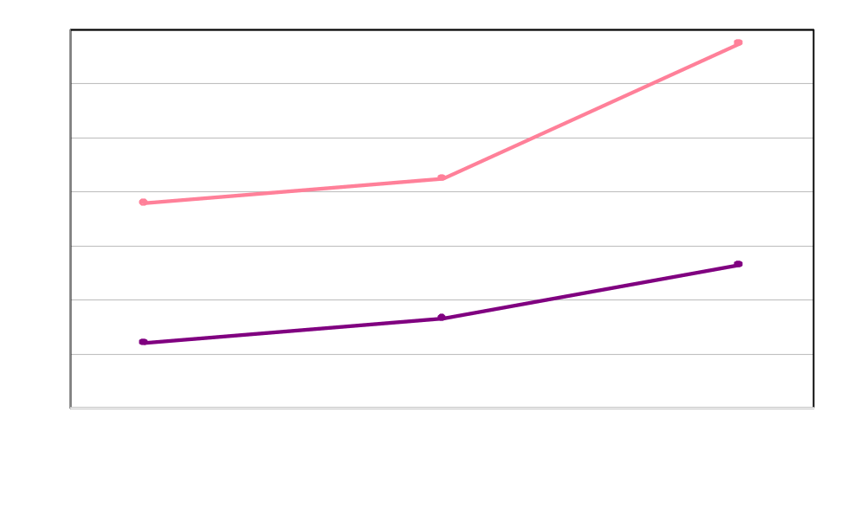
Figure 33. Stimulant drug visits among children 5-17 years of age by sex: United States, 1994-2002
Boys

Girls

Source: Centers for Disease Control and Prevention, National Center for Health Statistics. Health, United States, 2004
Centers for Disease Control and Prevention, National Center for Health Statistics. Health, United States, 2004
Centers for Disease Control and Prevention, National Center for Health Statistics. Health, United States, 2004
Notes:
This is from HUS 2005

Slide 23
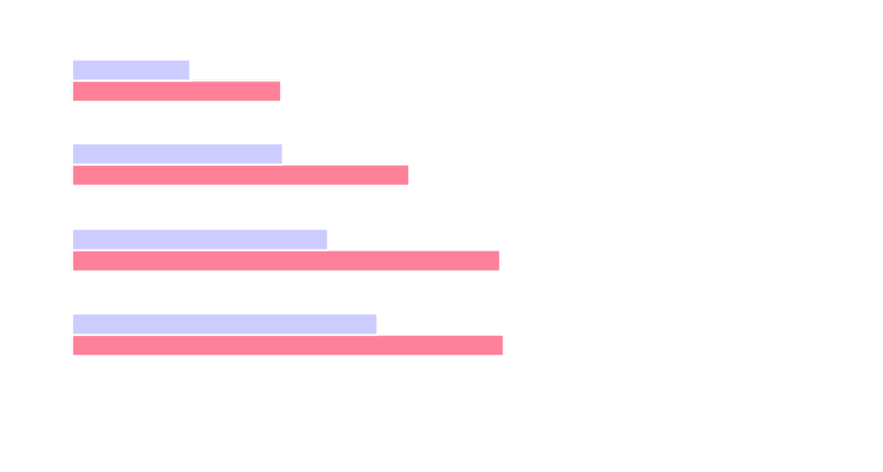
Figure 36. Percent of nonsteroidal anti-inflammatory drug (NSAID) visits with COX-2 NSAIDs prescribed, ordered or provided among adults 18 years of age and over by sex: United States, 1999-2002
18-44 years
1999-2000
2001-2002
45-64 years
65-74 years
75 years and over
Percent of NSAID visits
Centers for Disease Control and Prevention, National Center for Health Statistics. Health, United States, 2004
Notes:
This is not in HUS, but I thought you might be interested given the huge controversy over the COX-2’s. The denominator is any NSAID, including ibuprofin (motrin) and naproxen (Aleve), so this shows the rapid switch in prescribing from the “older” NSAIDS to the ones that have now been pulled off the market..

Slide 24
Lessons Learned From Health, United States, 2004 Drug Analyses
Drug data are extremely complicated to analyze
Each drug analysis is an entire study in and of itself, with different audiences, constituents, and language
Simple statistics are the best received in the press (e.g., 44 percent of Americans taking at least one drug in the past month)
Rates per population can be difficult to present effectively or to explain to reporters
Notes:
There should be a handout showing how popular our drug data are—it contains only a sample of articles using N/HAMCS data, and there are other studies using NHANES. We did have some issues with explaining visit rates/population to some press people, though.

Slide 25
Future Drug Analyses
Trend tables showing percent of population with prescription drug use in past month (NHANES) and common therapeutic classes mentioned during ambulatory care visits (N/HAMCS) will be updated in HUS every year
Several papers underway using both NHANES and N/HAMCS drug data (statins; antihypertensive drugs; antidepressants)
New therapeutic coding systems are being investigated

