Slide 1
The Nation’s Needs in Formal Methods
Amy R. Pritchett
Director, NASA Aviation Safety Program
April 30, 2008

Slide 2
What are Formal Methods?
For·mal -adjective
  17. pertaining to the form, shape, or mode of a thing, esp. as distinguished from the substance: formal writing, bereft of all personality.
  18.being such merely in appearance or name; nominal: a formal head of the government having no actual powers.
  19.Mathematics.
    a.(of a proof) in strict logical form with a justification for every step.
    b.(of a calculation) correct in form; made with strict justification for every step.
    c.(of a calculation, derivation, representation, or the like) of or pertaining to manipulation of symbols without regard to their meaning.
Formal may mean in proper form, or
may imply excessive emphasis on empty form
[i.e.] arbitrary, forced, or meaningless conformance to mere rules or belief in impractical theories.

Slide 3
Trying Again: What are Formal Methods?
Formal methods are mathematically-based techniques for the specification, development and verification of software and hardware systems.
Note: We could argue over the extent to which we are considering meaning ‘versus’ form

Slide 4
What is Software?
Software is
  The description of a human concept or abstraction as based on subjective reality
  Implemented according to some form
    A form relatively unconstrained compared to hardware
  Intended to create some behavior acting on an objective reality
Automation is the software’s manifestation

Slide 5
The Philosophic View of Software
Abstraction
Subjective Reality
Software/Automation
For the software to be valid, these must be correct too
Objective Reality

Slide 6
Trying Again: What are Formal Methods?
Formal methods are mathematically-based techniques for the specification, development and verification of software and hardware systems.
Corollary: This requires examination of more than just software and hardware

Slide 7
Why Formal Methods?
Software cost
Cost of a ‘failure’
Special needs of new systems

Slide 8
Why Formal Methods?
Software cost
Cost of a ‘failure’
Special needs of new systems

Slide 9
Design Assurance Level
Level | Failure condition |  | Objectives | Independence
A | Catastrophic | Failure may cause a crash | 66 | 25
B | Hazardous | Failure has a large negative impact on safety or performance, or reduces the ability of the crew to operate the plane due to physical distress or a higher workload, or causes serious or fatal injuries among the passengers. | 65 | 14
C | Major | Failure is significant, but has a lesser impact than a Hazardous failure (for example, leads to passenger discomfort rather than injuries). | 58 | 2
D | Minor | Failure is noticeable, but has a lesser impact than a Major failure (for example, causing passenger inconvenience or a routine flight plan change) | 28 | 2
E | No effect |  | 0 | 0

Slide 10
SLOC-Cost
Software Development Productivity for Industry Average Projects*
Cost from requirements analysis through software Integration and test
Assuming a full cost rate of $150k/year/person the cost for one line of new embedded flight software is between $735 and $119 per line of source code
* Lum, Karen Et, Handbook for Software Cost Estimation. May 30, 2003, JPL D-26303, Rev 0, Jet Propulsion Laboratory
 
 
Characteristic Software Development Productivity | Source Line of Code/Work Month (SLOC/WM)
Classic rates | 130-195
Evolutionary approaches | 244-325
New embedded flight software | 17-105

Slide 11
… and There’s A Lot of SLOC!
Modern flight management systems run to the millions of SLOC*
All told, software development is often more than 50% of the development cost*
* anecdotally

Slide 12
Reducing Software Cost
Intervening early through a systematic process
  Formal methods for specification
  Auto-coding
  Formal methods for verification
Using automation
  Need it to be fast
  Need it to be interpretable

Slide 13
Review of Formal Methods
Much of the effort has been on verification:
  Automated analysis of an established heuristic or mathematical proof
  Automated theorem proving: system attempts to produce a formal proof from scratch, given a description of the system, a set of logical axioms, and a set of inference rules.
  Model checking: system attempts to produce a formal proof from scratch, given a description of the system, a set of logical axioms, and a set of inference rules.

Slide 14
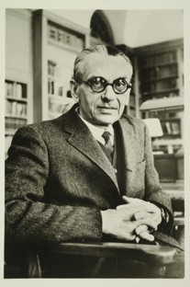
Gödel: Axiomatic Methods Have Limits!
Gödel’s Theorem: for any computable axiomatic system powerful enough to describe the arithmetic of the natural numbers, then:
  If the system is consistent, then it
  can not be complete
  (“Incompleteness theorem”).
  The consistency of the axioms
  cannot be proved within the
  system.

Slide 15
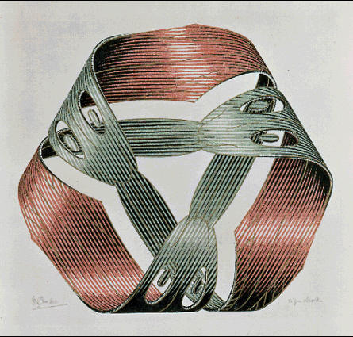
What if the Software is (Essentially) Internally Complete?
Then we are probably missing something!

Slide 16
Should We Follow Gödel Into Illogical Extremes?
“Einstein and Morgenstern coached Gödel for his U.S. citizenship exam, concerned that their friend's unpredictable behavior might jeopardize his chances.
“When the Nazi regime was briefly mentioned, Gödel informed the presiding judge that he had discovered a way in which a dictatorship could be legally installed in the United States, through a logical contradiction in the Constitution.
“Neither judge, nor Einstein or Morgenstern allowed Gödel to finish his line of thought and he was awarded citizenship.”
May we have the same common sense!

Slide 17
Review of Efforts to Establish Cost-Effective Formal Methods
No one silver bullet
  A method will need to ‘buy its way’ into the development process
  Several methods may be needed
To err is human, but to really foul things up you need a computer. by Paul Ehrlich
Program testing can be used to show the presence of bugs, but never to show their absence! Edsger Dijkstra

Slide 18
Why Formal Methods?
Software cost
  Formal methods can help manage complexity
Cost of a ‘failure’
  Will it work in the operating environment?
Special needs of new systems

Slide 19

Let’s Situate Our Limited Picture
We may have created a beautiful picture
…
But does it cover the operating environment?

Slide 20
Describing Automation
Robustness: The range of operating conditions with satisfactory performance
Autonomy:
  (Engineering): The sophistication of the automation’s behaviors when objective and subjective reality overlap – regardless of problems with robustness
  (Management): The ability to go do any task, no matter how simple, and report back when the manager should know anything

Slide 21

An Authoritative Source on Automation…
Maximum Homerdrive:
  Homer Beats Truck Driver in Texas Steak-Eating Contest
  Truck-Driver Keels Over and Dies
  Homer Ends Up Driving Truck

Slide 22


Homer Gets Sleepy...
Automatic Truck Driver Kicks In!

Slide 23


Truck Skids Around Mountain, Drives to Safety
Homer Wakes Up With Truck Sitting at Gas Station

Slide 24


Sometimes Automation Works Well!

Slide 25


The Other Truck Drivers Get Mad

Slide 26


And Try to Run Down Homer

Slide 27
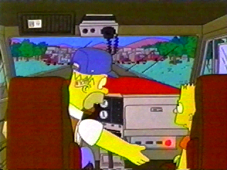
‘Save Me, Automation!’*
*Note operation outside boundary conditions

Slide 28

There Is Much Chaos...
And Homer Saves the Day.

Slide 29
But That’s a Cartoon! It Doesn’t Happen in Real-life…
May 12, 1997
AA Flight 903 descends to 16,000’ as it near Miami
Something ‘upset’ the aircraft
  Flight control oscillations for 34 seconds
  Lost 3000’ altitude
The maneuvering exceeded some internal software check-limit
  The flight instrumentation databus reset itself
  The EFIS showed only black with white diagonal slash marks while the pilots were trying to recover

Slide 30
Another Example: Airbus A320
Built In ‘Stall’ Protection
  Won’t Let Airplane Climb Too Steeply
  When Close to Ground, Helps Pilot Land Airplane
  Pilot Doesn’t Control Airplane Directly -- Instead, ‘Asks’ Computer Through Controls for Changes
Overall, Works Great In Normal Conditions!

Slide 31
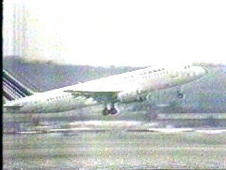
Airshow Flyby
June 26, 1988 – Habsheim, France

Slide 32

Implications for Formal Methods
We check the software
We check the requirements to the software
We check the requirements to reality?
  Including changing circumstances?

Slide 33
Why Formal Methods?
Software cost
  Formal methods can help manage complexity
Cost of a ‘failure’
  Will it work in the operating environment?
  Will it work with the pilot?
Special needs of new systems

Slide 34
‘Human Error’
Can anyone name an accident not caused by ‘human error’?
Formal methods generally used to examine for ‘designer/coder/specifier error’
Formal methods can also be used to identify likely ‘pilot error’ of particular types
  E.g., will the pilot properly understand the Flight Management System?

Slide 35
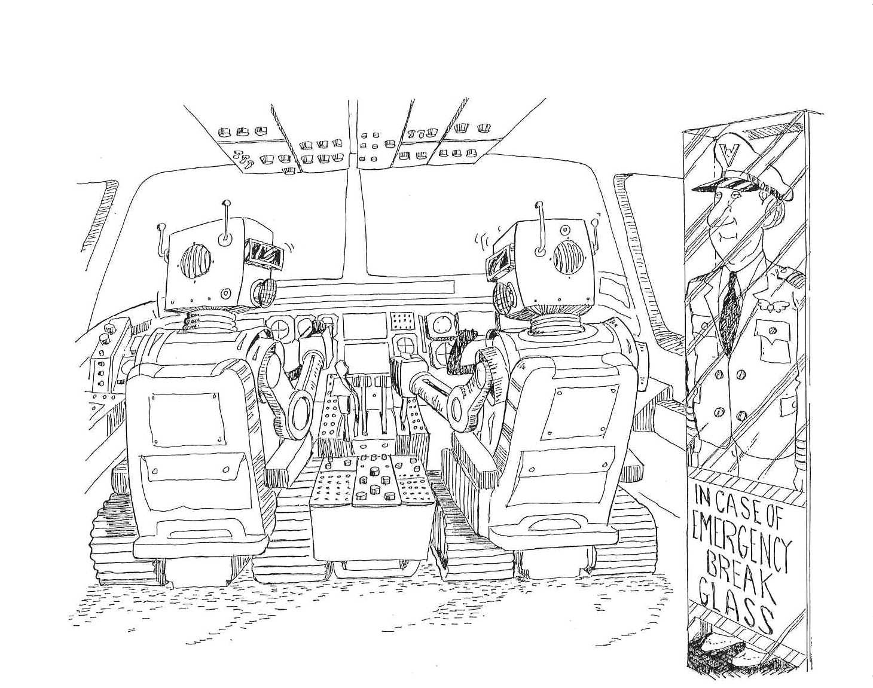
Automated Cockpit?

Slide 36
Human-Automation-Interaction and Complexity
One issue with automation is its complexity
  E.g. 757/767 has 250+ autoflight modes
Pilots normally trained on ‘common’ modes
  Accidents occurring with ‘rare’ modes
Measuring ‘complexity’ is hard
  Has many elements
    Number of modes (simplistic)
    Consistency of behaviors between modes (allowing for inferential reasoning)
    Consistency of behaviors of a mode (dissuading frequential simplification)

Slide 37
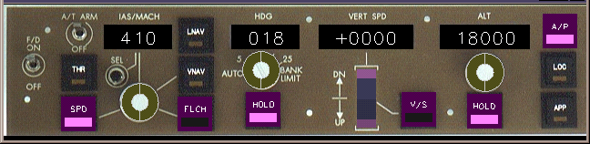
Interaction Mechanism

Slide 38
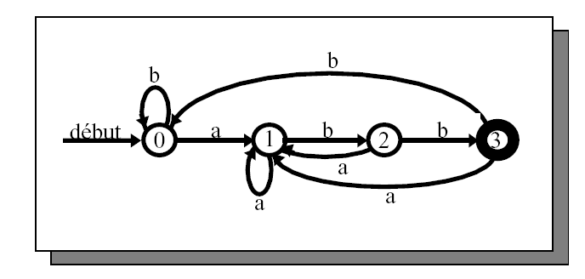
A Finite State Machine...
Taken from the work of Denis Javaux:
To operate this machine, one needs to know...
  What state you’re in
  Under what conditions the state will transition automatically
  What you would need to do to command a transition yourself
    And under what conditions this transition will and won’t happen!

Slide 39
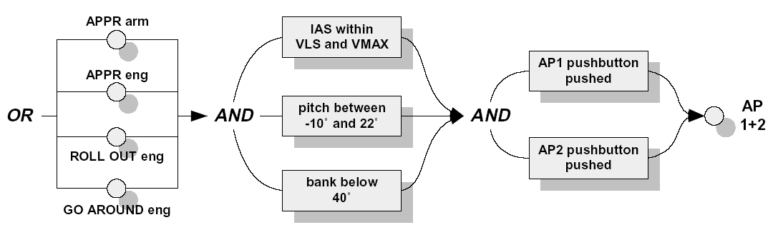
For Example: Will You End Up With Both Autopilots Engaged?
Note: Some of these conditions are ‘tricky’!
Rarely seen (frequential problem)
Not-like other conditions (inferential problem)

Slide 40
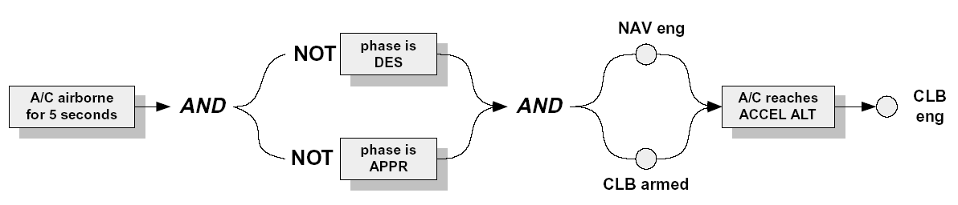
Here’s the Case of an Automatic Transition...
If the pilot setups the aircraft right
  ‘Nav’ mode engaged and ‘Clb’ mode armed
AND once some conditions are later met
THEN the system will go into ‘Clb’ mode

Slide 41
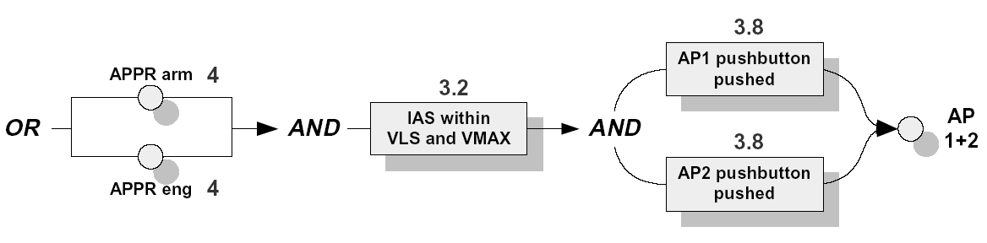
Simplification: A Logical Behavior
Reality:
Believed by the pilot, based on common experience:

Slide 42
Formal Methods in HAI
For finite state machines, structured, verified, demonstrated methods now exist to go through the structure of the finite state machine
  Highlight rare, unusual, un-predictable conditions in which the pilot will:
    Not predict an automatic mode transition
    Not predict correctly the response to a command
Can be used to go through a system design, highlighting problems
  Hopefully, designers will then re-think their designs as much as possible, possibly simplifying them
Note, Denis Javaux’s work is now proprietary to Airbus…

Slide 43
Why Formal Methods?
Software cost
  Formal methods can help manage complexity
Cost of a ‘failure’
  Will it work in the operating environment?
  Will it work with the pilot?
  Will it work with (continuous) flight dynamics?
Special needs of new systems

Slide 44
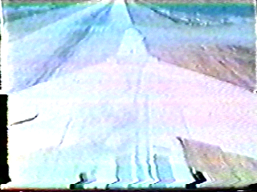
Software Control of (Continuous) Dynamics?
First digital flight control system: F-8

Slide 45
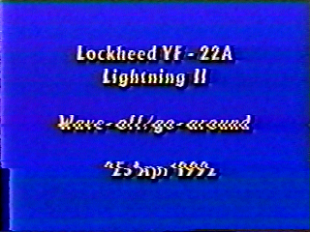
Modern Software Control of Continuous Dynamics?
Flight demonstration of the YF-22

Slide 46
Current ‘Formal Methods’ for Continuous Dynamics?
Heuristics to check for pilot controllability
Specifications (e.g., gain and phase margin) for closed-loop stability
  ‘Tell me what the control gains will be in every flight condition within the operating envelope’
Can they have a closer tie to (discrete formalism-based) formal methods?

Slide 47
Why Formal Methods?
Software cost
  Formal methods can help manage complexity
Cost of a ‘failure’
  Will it work in the operating environment?
  Will it work with the pilot?
  Will it work with (continuous) flight dynamics?
Special needs of new systems
  Adaptive systems

Slide 48
Adaptive Systems
What if we want a system that can adapt to conditions outside the (nominal) flight envelope?
  We can’t describe a priori its behavior
Maybe we would need to ask different questions:
  “Is it possible for the adaptive system to cause harm?”
  “Can the adaptive element recover from a failure in adaptation?”
  “Is there a way to verify the adaptation function (in flight test) without risk to the vehicle?”

Slide 49
Why Formal Methods?
Software cost
  Formal methods can help manage complexity
Cost of a ‘failure’
  Will it work in the operating environment?
  Will it work with the pilot?
  Will it work with (continuous) flight dynamics?
Special needs of new systems
  Adaptive systems
  Emergent behaviors

Slide 50
Emergence
Emergence: Behaviors observed at one level of abstraction which can not be predicted (maybe not explained!) at a different level of abstraction
Example:
  An unstable compression wave in a traffic stream in which each aircraft is individually stable
My hypothesis: Many aspects of complex system safety (and issues) are emergent phenomenon
  How does analysis at one level extrapolate to another?

Slide 51
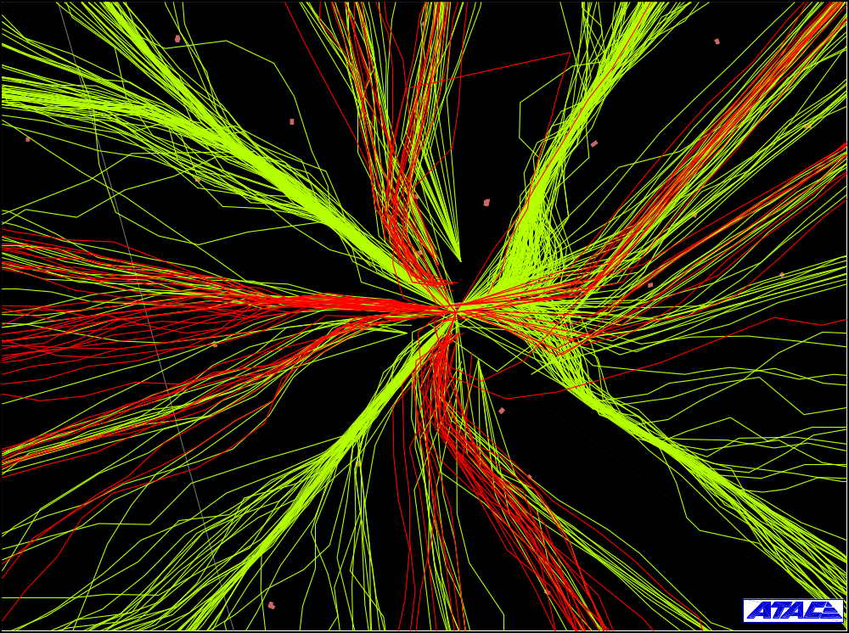

Represent This…
Abstraction is necessary...

Slide 52
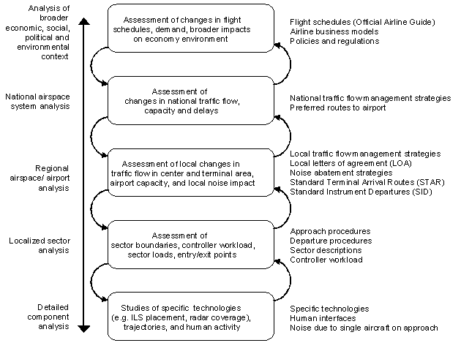
Many Possible Abstractions!

Slide 53
Why Formal Methods?
Software cost
  Formal methods can help manage complexity
Cost of a ‘failure’
  Will it work in the operating environment?
  Will it work with the pilot?
  Will it work with (continuous) flight dynamics?
Special needs of new systems
  Adaptive systems
  Emergent behaviors

Slide 54
Why Formal Methods?
Key Challenges Identified in the Decadal Survey of Civil Aeronautics include:
  Aircraft systems:
    D4: Intelligent and adaptive flight control techniques
    D5: Fault-tolerant and integrated VHM
    D7: Advanced comm, nav and surveillance
    D8: Human-machine integration
    D11: Network-centric avionics architectures
    D12: Smaller, lighter and less expensive avionics
    D13: More efficient certification processes
    D14: Design, development and upgrade processes for complex, software-intensive systems
Formal Methods Can Be Pivotal!

Slide 55
Why Formal Methods?
Key Challenges Identified in the Decadal Survey of Civil Aeronautics include:
  Complex systems (including multi-vehicle / airspace):
    E1: Methodologies, tools and simulation and modeling to design and evaluate complex interactive systems
    E6: Vulnerability analysis as an integral element in architecture design [of the air transportation system].
    E12: Autonomous flight monitoring
    E16: Appropriate metrics [of air transportation systems]
    E19: Provably correct protocols for fault-tolerant aviation communication systems.
    E20: Comprehensive models and standards for designing and certifying aviation networking and comm systems.
Formal Methods Can Be Pivotal!

Slide 56
The Nation’s Needs in FM
Aircraft systems are unbelievably complex
NextGen is the biggest engineering challenge… ever
Safety must be demonstrated to levels hitherto unimaginable
The challenge to the FM community:
  Make the theory consistent and complete
  Make its application cost- and time-effective
  Work with the community to demonstrate the new capability they provide
    Oh, and as a program director let me add,
    do it on-budget and on-time?

Slide 57
Thank You!
Special thanks to:
  Steve Jacobson, DFRC & HQ
  Eric Feron & Eric Johnson, Georgia Tech
  Denis Javaux
  John Wheeler, LM
  Duane McRuer, STI
  ATAC Corp.

