Slide 1
Recruiting and Retaining IDA Participants
by Amy Shir
AFI Resource Center

Slide 2
Purpose of Recruiting Segment
To help you:
identify your target markets,
reach them with the right message, and
enroll them into your IDA program.

Slide 3
Objectives of Recruiting Segment
Define recruitment and explore reasons some AFI Projects have struggled in this area
Explain key relationships among AFI time limits, recruitment and retention
Identify and describe target markets and market segments
Construct benefit-centered messages
Find ways to build trust
Enroll with little “waste”

Slide 4
Marketing
Is the AFI Project accessible?
Is the opportunity cost of participating greater than the perceived benefits?
Is the project’s value communicated compellingly? Or does it sound like a scam??
Is it marketed at the times and places people will hear it?
Is it designed and delivered for the right group(s)?

Slide 5
Recruitment
Why have some AFI Projects had difficulties recruiting participants?
How do we build relationships with our prospective participants? Why would they trust us?

Slide 6
Where to Recruit?
Brainstorm Ideas

Slide 7
Where to find participants?
WITHIN YOUR AGENCY
Graduates of CCCS credit repair
Vita site participants; tax clients
Faith based organizations
Community college students
Habitat for Humanity Wait List
Welfare to Work Clients
Single Parent Groups
Refugee Resettlement Programs
Head Start parents
Small business centers
CAA’s
Affordable Housing Clients
Section 8 Clients
Vocational School Students
Employers (e.g., hotels, restaurants, big box stores, cleaning services, other retail or service employers)

Slide 8
AFI Project Time Limits & Recruitment
  Do people enrolling in years 2 & 3 have enough time to acquire the asset? Can they finish all of the other requirements, e.g., financial education, asset education, credit repair, others?
  What are the implications for your recruitment activities?
  How would communication about your program in year 3 potentially be different from your marketing communications during start-up, years 1 & 2?

Slide 9
Golden Rule of Account Design
Monthly deposits (how do our projects block and tackle for our participants?)
+
Match during the savings period
+
Attendance at required trainings
=
Participants acquiring their selected asset

Slide 10
AFI Eligibility
TANF Eligible in Your State
    OR
Household Adjusted Gross Income of 200% of Poverty or Less; or Qualifying for Earned Income Tax Credit;
    AND
Household Net Worth < $10,000, excluding home and one vehicle
IDA savings deposits must come from earned income.

Slide 11
Measurable Recruitment Goals: An Example
GOAL: 165 account holders
Average 27-30 per quarter for 6 quarters, allowing for attrition and start up time
Generate 25 inquiries per month during each quarter of the first and second project year. (600)
Register 12 people per monthly orientation during each quarter of the first and second project year. (288)
Generate 30 eligible applicants from orientations and referring partners during each quarter of the first and second project year. (240)
Enroll 180 account holders>165 completions with 8% attrition
Actual attrition may be much higher, even more than 50%.

Slide 12
Evaluation
Track your results
  How many queries from what strategy?
  How many applicants from target market members or referral sources?
  How many eligible applicants from target markets/sources?
  How many enrolled from target markets/sources?
  Retention/attrition rate for target markets/sources?
Be prepared to make changes in target markets or recruitment strategies.

Slide 13
Purpose of Retention
Keep those participants you worked so hard to find, recruit and enroll!!
Save time and money!
Ensure that as many participants as possible acquire selected asset.

Slide 14
Objectives of the Retention Segment
Define attrition and retention
List factors that impact attrition and retention rates
Describe accountholder success
Identify facilitators as well as obstacles to successful completion at each step in the AFI Project

Slide 15
Objectives of the Retention Segment (con’t)
Identify and prioritize programmatic strategies to enhance success and mitigate/eliminate obstacles
Develop and implement retention plan
Describe different methodologies and resources that can facilitate problem solving during emergencies

Slide 16
Accountholder Success
What is accountholder success?
Why is identifying and communicating interim success important?

Slide 17


Retention and Recruitment
What is the relationship between recruitment and retention?
Most Programs look like this Best Programs look like this

Slide 18
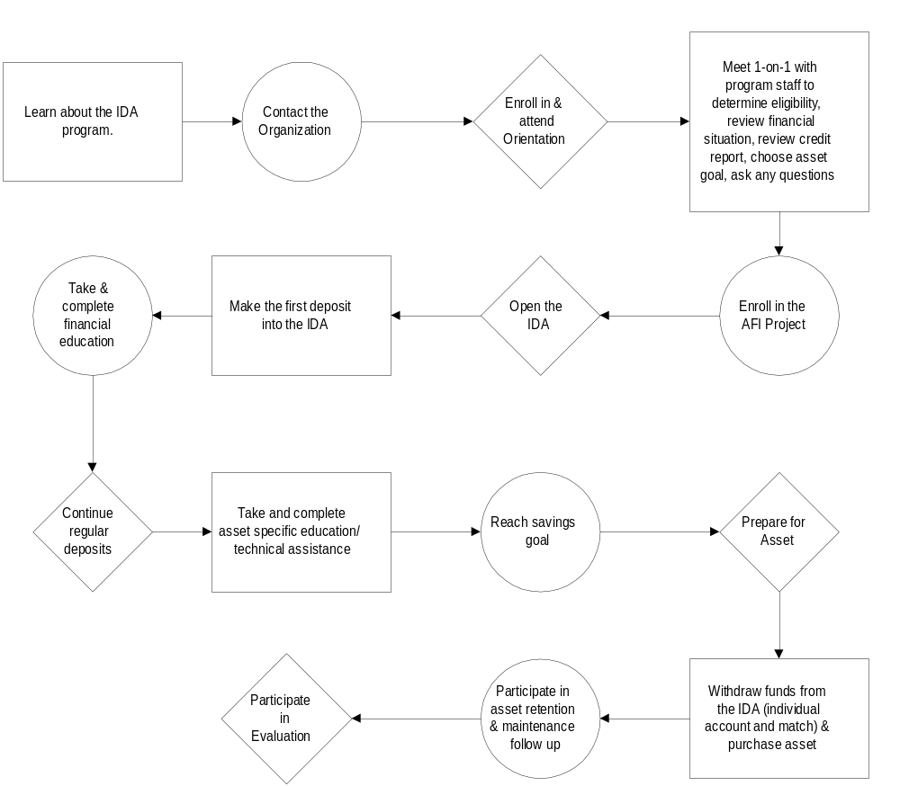

Slide 19
Strategies for Retention:
Group Instructions
Brainstorm all facilitators and barriers for the step your group has been assigned
Select the 2 facilitators and 2 barriers that have the biggest impact on retention at that step
Develop specific strategies that will mitigate/eliminate barriers OR enhance facilitators. Be specific. Answer: HOW

Slide 20
Report Out-Group Instructions
The “step” you examined
A few of the facilitators and obstacles you identified
The 2 facilitators and 2 obstacles that in your opinion have the biggest impact on retention
The 2 best strategies identified for each category

Slide 21
Lessons from the Field
Offer alternatives for making deposits: e.g., direct deposit, mail-in, deposit only ATM
Implement systems of contact and encouragement: Continually monitor progress and Savings Plan. This depends on good data management and organized client files.
Require savings prior to enrollment
Do credit check early in program to assess

Slide 22
Lessons from the Field (con’t)
Require some or all financial education prior to enrollment
Schedule flexible, accessible trainings
Provide support for training attendance: location, transportation, childcare, food, interpreters
Plug into VITA site; encourage lump sum deposit

Slide 23
Allowable Emergencies
Expenses for medical care
Payments necessary to prevent eviction or foreclosure
Living expenses following job loss
Establish parameters for replacing emergency withdrawals within specified timeframe. Provide support network to hasten return to program.

Slide 24
AFI Resource Center
For more information on this topic or other AFI Training Curriculum modules, contact the AFI Resource Center at the Office of Community Services
Phone: (202) 401-4626
Email: AFIProgram@acf.hhs.gov
Web: http://www.acf.hhs.gov/assetbuilding

