Slide 1
Designations for the 2006 PM2.5 Standards: Evaluating the Nine Factors in Setting Nonattainment Area Boundaries
Part 2 – Conceptual Model for Evaluating High PM2.5 Days and its Influencing Emission Sources
Neil Frank
EPA Office of Air Quality Planning and Standards
For Presentation at
EPA State / Local / Tribal Training Workshop: PM 2.5 Final Rule Implementation and 2006 PM 2.5 Designation Process
June 20-21, 2007

Slide 2
The 9 Designation Factors
To Help Determine Nearby Area of Influence for 24-hr NAAQS Violations
Population
and
Urbanization
Emissions
Traffic &
Commuting
Air
Quality
Growth
Non
Attainment
Boundaries
Meteorology
Current
Emission
Controls
Topography
Political
and Other
Boundaries
Air Quality is one of the most Important Designation Factors

Slide 3
Topics to be Covered
Conceptual model for high PM days
Seasons when exceedances occur
Composition of the high days
Analytical tools
  SLICE technique - for evaluating urban contributions to high days
  Residence time analysis – for assessing nearby contributing source regions using back trajectories and emissions data
  Gradient analysis – for identifying days with potential high source-oriented impacts

Slide 4
Conceptual Model for High PM2.5 Days
How to define high PM2.5 days?
What is the typical “daily increment” for high PM days in relation to the annual average?
What is the urban contribution above regional levels?

Slide 5
Conceptual Model for High PM2.5 Days
What high PM2.5 days to consider?
“High PM2.5 Days” Associated with the 98th percentile
  Not just one day per year
  Select all candidate days
  e.g. top 5% or days > 30 - 35ug/m3
  Summarize by season to distinguish varying conditions

Slide 6
Conceptual Model for High PM2.5 Days
High Daily PM2.5 has Urban and Regional Components
40ug/m3
Typical Daily Increment - Example
24
16
Example
+
PM2.5
High Day
Value
Seasonal
Average
Typical
Daily
Increment
The annual average PM2.5 (urban background) is the stuff that is there on a day-to-day basis.
  Comes from nearby and more distant areas
  Can be estimated by seasonal average PM2.5 concentration of non-high days
  Includes contributions from all nearby surrounding counties
  Can be estimated using the traditional urban increment approach
The daily increment (on top of annual average urban background) also has regional and local contributions.
- Key issue: what counties and sources from the urban area contribute to the typical daily increment?

Slide 7
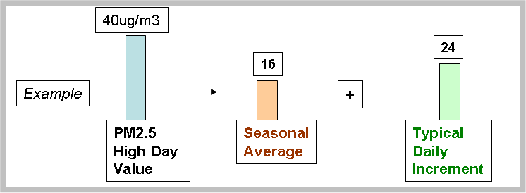
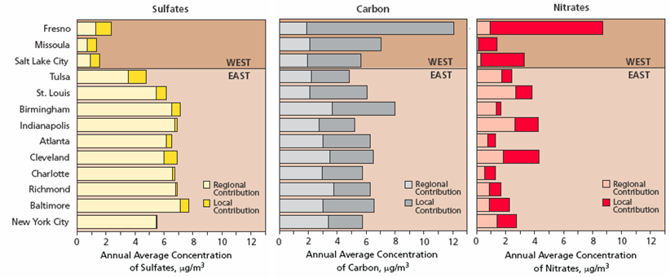
Conceptual Model for High PM2.5 Days
An approach to partition typical levels into urban and regional components
Urban Increment Analyses as used in 2004/2005 PM2.5 Designations
Urban sources in the Eastern US contribute at least 4-6 ug/m3 to annual average PM2.5
  Probably even larger urban contribution in western US cities
Carbon is significant component of average PM2.5 mass, but metro area emissions typically are much less than SO2 and NOx
  Weighted emissions score developed to give additional weight to nearby direct carbon emissions as they contribute to the urban background

Slide 8

Air Quality - Annual Average PM2.5
Conceptual Diagram - Annual Average PM2.5
PM [µg/m³]
40
35
30
Urban areas
~14-20 ug/m3
Countryside
~10-12 ug/m3
25
20
15
urban increment
10
regional contribution
natural background
Western US urban areas may have smaller regional contribution

Slide 9
Air Quality - High Daily PM2.5 Concentrations
Conceptual Diagram - High Daily PM2.5 Concentrations
PM [µg/m³]
Urban areas
~30-40 ug/m3
Countryside
~18-30 ug/m3
40
35
Larger “urban island” on peak days
urban increment
30
25
20
regional contribution
15
10
natural background
Focus of new analyses: understanding what
emissions contribute to urban increment
Western US urban areas may have smaller regional contribution

Slide 10

Conceptual Model for High PM2.5 Days
Source region considerations
Role of Regional vs Urban vs Micro-scale Influences
  On high days particularly in the east, regional emissions often provide a “base” amount of pollution
  Urban-wide and nearby emissions also contribute significantly to high days: “urban island” effect
  In some cases, there may be a micro-scale effect from a single source or small group of sources
    Does not help define NA boundaries, unless it is the only contributing source
  (Note: “urban” can mean large metropolitan area or smaller city)
Air
Quality

Slide 11
Conceptual Model for High PM2.5 Days
Seasons when exceedances occur
Time of Year for Exceedances- varies by Geographic Region
  SE: Mostly summer
  Industrial Midwest (IMW), Mid-Atlantic, So. CA: Winter and summer
  NW, UT, NM, Middle CA: Mostly or exclusively Winter

Slide 12
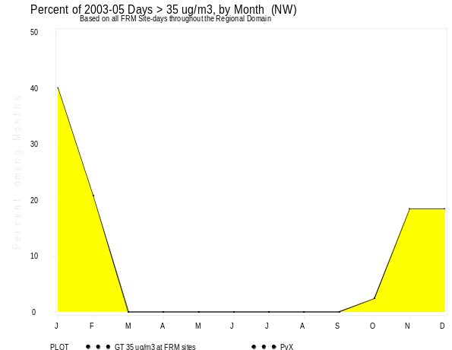
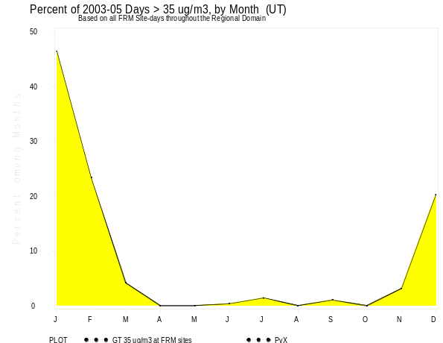
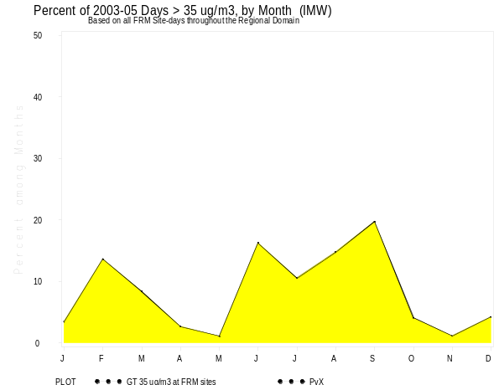
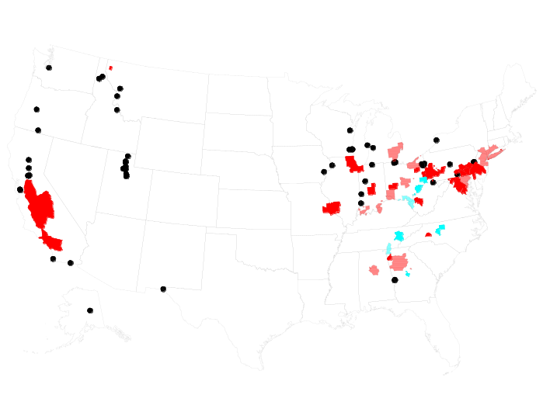
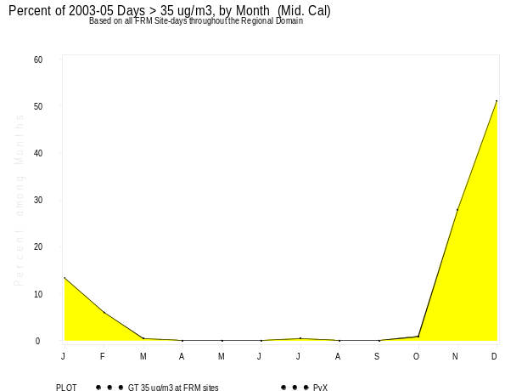
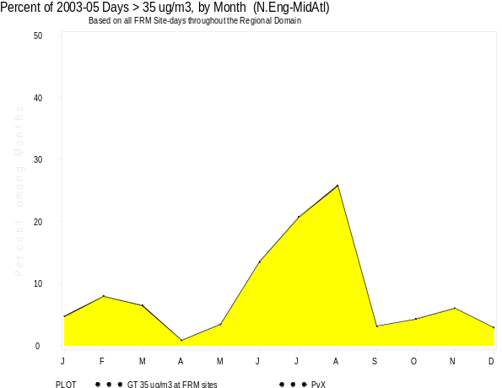
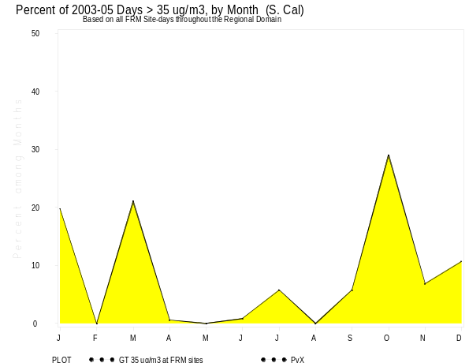
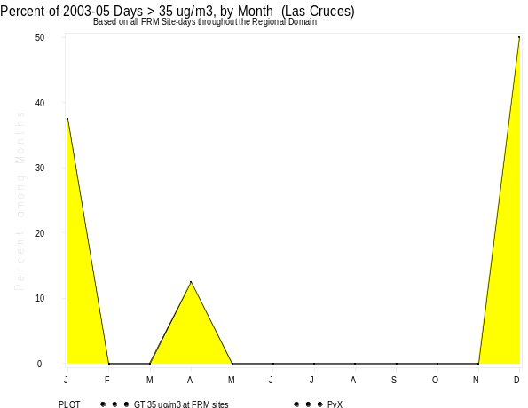
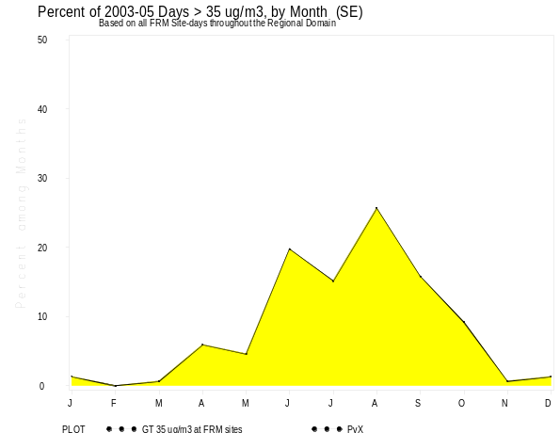
% 50
25
0
NW
UT
IMW
Percent of 2003-05 FRM Days > 35 ug/m3 by Month Based on all sites which violate 24-hr NAAQS
J F M A M J J A S O N D
J F M A M J J A S O N D
Mid CA
MidAtl
J F M A M J J A S O N D
J F M A M J J A S O N D
% 50
25
0
S.CA
La Cruces, NM
SE

Slide 13
Conceptual Model for High PM2.5 Days
Composition data are important
Composition
  Indicate which sources are contributing to average and high PM2.5 values
    Varies across country
  Warm season exceedances: Mostly sulfate + organic carbon
  Cold season exceedances: Nitrate (at higher latitudes and in Western US) + sulfate + carbon; Carbon may dominate in some locations (e.g. MT, ID)
  Gaps in speciation data for certain areas
Air
Quality

Slide 14
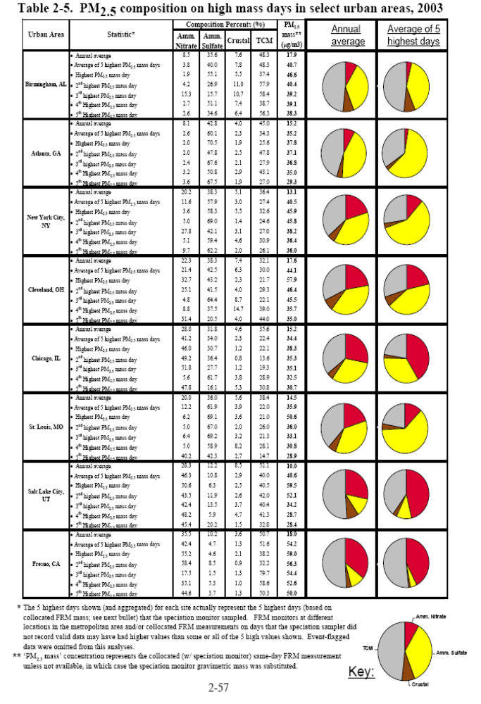
Composition on Annual Average and High PM2.5 Days (From PM Staff Paper)
Some source categories and regional influences may be more important for high concentration days
Air
Quality
High PM2.5 days have:
Birm
Atlanta
NYC
Cleveland
Chicago
St .Louis
SLC
Fresno
S
Comparing average of 5 highest days during 2003, regional sources of sulfates and nitrates are larger contributors to peak day concentrations than to annual average (selected city analysis)
Composition can vary from high day to high day
Carbon can be smaller as % -- but still larger in absolute concentration values -- compared to the average
Note: All the new analyses present “FRM” composition with the peer-reviewed “SANDWICH” Technique
  As used in CAIR and PM2.5 RIA
More Sulfate
NE
MW
More Nitrate
UT
Nitrate
This analysis shows
PM2.5 Composition of the ambient aerosol
(not adjusted to represent FRM mass)
CA
TCM
Sulfate
Crustal
From PM Staff Paper (Rao et al)

Slide 15
% 50
25
0
NW
Cold
UT
Cold
IMW
Cold Warm
Avg High 3 Cold
Avg High 3 Cold
Avg High 3 Warm
or
“Example” Composition for High Days [“Warm” Season (May-Sept) & “Cold”]
But sites can be different within each “domain”
Mid CA
MidAtl
Cold Warm
Cold
or
J F M A M J J A S O N D
J F M A M J J A S O N D
Pies represent average of 3 highest days per year per season, using SANDWICH
% 50
25
0
S.CA
Cold Warm
La Cruces
NM
Cold
SE
Warm
Avg High 3 Cold
Avg High 3 Warm
Avg High 3 Cold
Avg High 3 Warm
El Paso STN

Slide 16
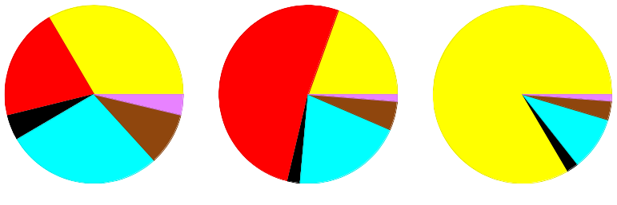
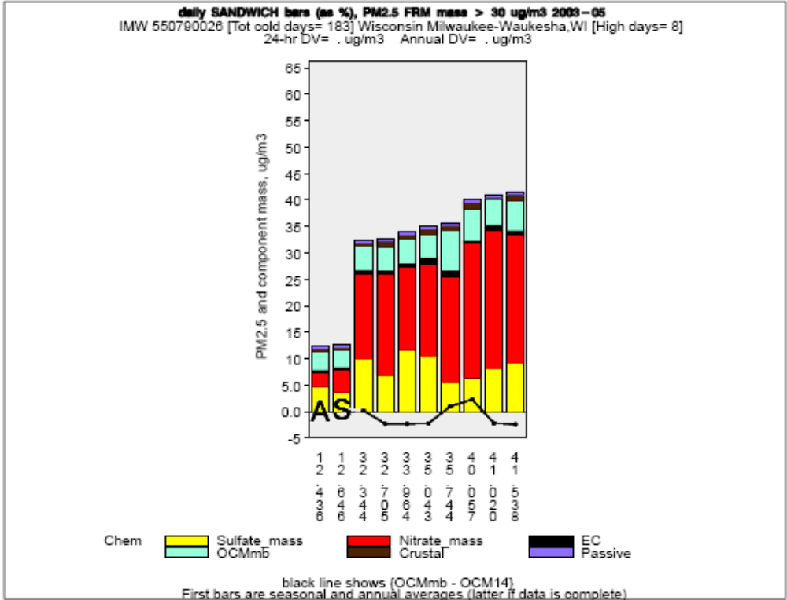
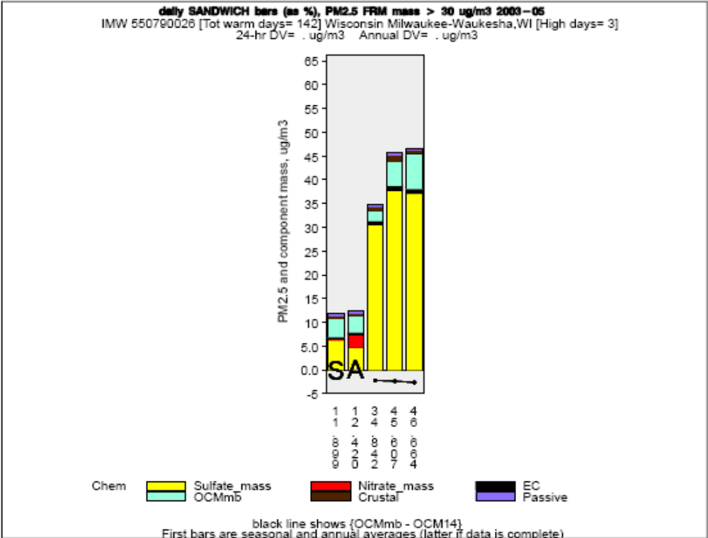
Composition is often similar among the high days
Milwaukee, 2003-05
Average Cool Season Warm Season
3 highest PM2.5 days > 30ug/m3
Per season, Milwaukee, WI (2003-05)
PM2.5 days > 30ug/m3
Measured
PM2.5 mass, ug/m3
Black line is difference between OCMmb and OCM14

Slide 17
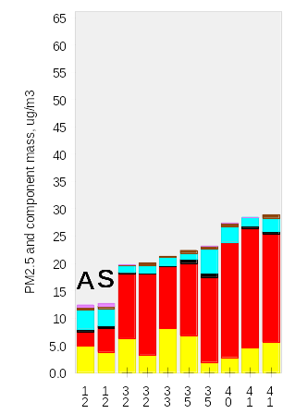
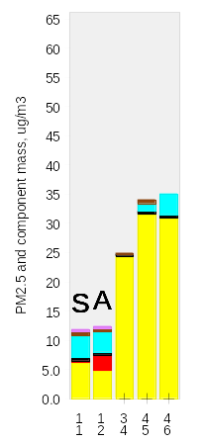
Conceptual Model for High PM2.5 Days
An approach to partition total daily increment into
urban and regional components
Cool Warm
Cool
season
Daily composition
minus Seasonal avg.
Warm
season
Next subtract the daily composition from the seasonal average PM2.5
Use resident time weighted emissions
to partition each component of total daily
Increments into urban &
regional contributions
(% of RTWE in local area)
Measured
PM2.5 mass
The urban background PM2.5 can be estimated using seasonal average PM2.5 concentration of non-high days
PM2.5 days > 30ug/m3
Per season & year, Milwaukee, WI (2003-05)

Slide 18
Analytical Tools to help identify boundaries and develop SIPs
SLICE technique - for evaluating urban contributions to high days
Residence time analysis – for assessing nearby contributing source regions using back trajectories and emissions data
Urban gradient analysis – for identifying whether there are any sites predominantly affected by a single source

Slide 19
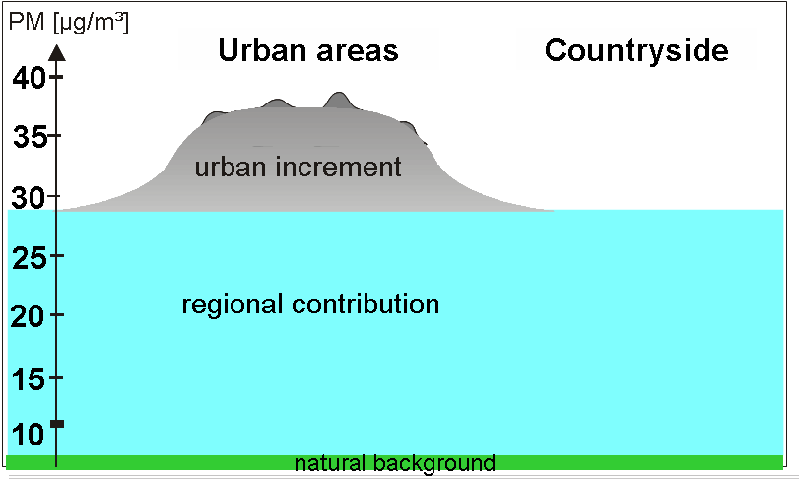
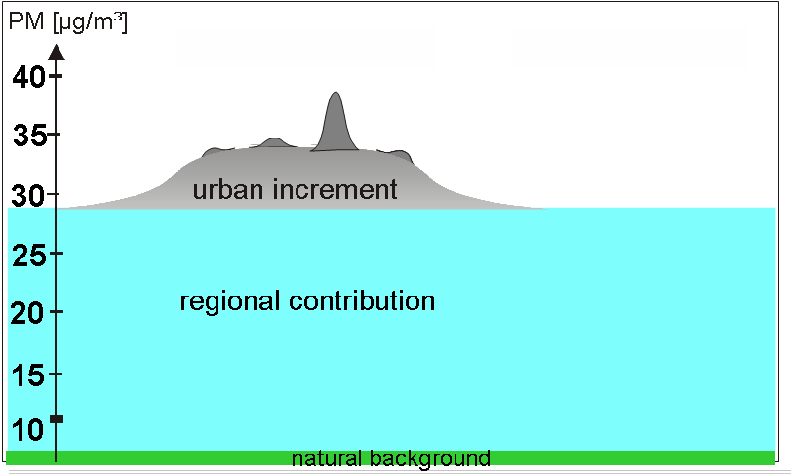
Analytical Tools
Identify urban PM2.5 and gradients
“SLICE” to identify “urban island” days and relative urban amount of PM2.5 mass
  Evidence of urban source contributions
Urban “gradient” technique
  Evidence of predominant strong nearby source influence
Air
Quality
Air
Quality
Emissions
Met
Daily urban portion of PM2.5

Slide 20
Analytical Tools - Residence Time Analysis
Where did the air parcel come from on high concentration days?
Transport patterns producing a potential source region
  Use trajectories and “Residence-Time Analysis” to find upwind probability fields.
  For PM2.5 mass or its components
    Focus on the ensemble of “High PM2.5 days”, by season for subsequent linking to composition pattern.
      Days with identified “urban islands” are more important
  Local pollution roses (annual vs. high days) would also be helpful to identify nearby sources.
Met
Air
Quality
Residence time probability plots with HYSPLIT trajectories have been used by Kinski, Poirot and others to identify potential source regions.

Slide 21
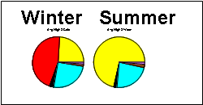
Analytical Tools- Residence time weighted emissions
What are the most likely contributing emissions?
Emissions
Spatial distribution of emissions by season
  Developed from monthly emissions for precursors and direct PM: (SO2, NOx, Carbon, Crustal )
  The importance of each precursor pollutant can be guided by the composition of the high PM2.5 day.
  consider monthly emissions corresponding to the affected PM component according to typical composition by season.
  Some precursors will not be considered or could be down-weighted. e.g. crustal (year-round) and NOX (summer).
Residence time weighted emissions
  Use probability that air parcel passed over an area to weight emissions as potential contributors to the high day concentration impacts
  High probability nearby contributing emissions can be identified for each PM2.5 contributor
Met
Emissions
Air
Quality

Slide 22
Summary
Identifying the area of emission influence considers contributions for
  each “high PM2.5 day” and
  urban average background on top of which are the daily impacts
High concentration days with evidence of urban influence (i.e. with urban islands) are more important
  The magnitude of urban island can help define the daily urban contributions.
In combination with daily and average speciation data, by season of the year
  Emissions with high probability of trajectory residence time are important to assess high day impacts.
  Average emissions and typical wind patterns help understand the sources contributing to the urban “background”
  Both used to understand the relative importance of the various nearby contributing emissions (e.g. direct PM vs SO2 vs NOx).

