Slide 1
168H CAPRI and C&P Templates
Zachary Fain, VHIT
Dr. Steven Brown, CPEP
Shawn Hardenbrook, SDS

Slide 2
Presentation Objectives
CAPRI Background
  Background & Features
  User Groups
  CPWM
CAPRI C&P Templates
  Goals and Objectives
  Dictation vs. Templates
  Template Use
CAPRI Demonstration
  Hands on

Slide 3

CAPRI
Compensation
And
Pension
Record
Interchange

Slide 4
CAPRI Background
The CAPRI application is a joint VHA-VBA IT initiative that acts as a graphical user interface (GUI) interface into the VHA VistA system
First deployed in FY 2001, CAPRI was initially developed as the replacement for the roll-n-scroll VistA AMIE II package used by VBA
  VBA Ratings Specialists struggled using AMIE-II to access VHA Medical Center computers due to hospital system variability
Encompasses a variety of data and functions normally found across several VistA applications
  CAPRI provides one standardized interface to these applications, regardless of differences found across VHA facilities

Slide 5
CAPRI Background
Provides access to CPRS data in read-only format
  Progress notes, orders, consults, lab data, pharmacy data, nutrition reports, problem list, discharge summaries, vitals, imaging reports
Displays patient’s demographic, appointment and admission data
Allows ability to directly access other VHA facilities at which the veteran has presented for care
Includes an interface to the VistaWeb application
Provides access to DoD data, if available
Provides ability to electronically record compensation and pension examination results in place of costly dictation/transcription methods

Slide 6
CAPRI User Groups
CAPRI application is now a valuable tool for numerous user groups:
  Veterans Benefits Administration (VBA)
  Board of Veterans Appeals (BVA)
  VHA Office of Medical Inspector
  VHA Inspector General (IG)
  VHA OI MPI Data Quality Team
  Health Revenue Center (HRC)
  Veteran Service Organization (VSO)
  VHA C&P Departments

Slide 7
CAPRI C&P Templates
CPWM – Compensation and Pension Worksheet Module
  Project Objective
    Create a “Point-n-Click” examination template system that could produce standardized examination results to ensure veterans nationally receive same quality of examination
Spring of 2002
  Work began on a system of C&P examination templates at the request of the CPEP office (Compensation and Pension Examination Program)
Spring of 2004
  Implementation of the CAPRI C&P templates officially began

Slide 8
CAPRI C&P Templates: Goals
Standardization of VHA C&P Exams
  Standardize what information is collected
  Standardize how information is collected
Eliminate errors of omission
Create efficient Veteran-specific “merged” templates based on AMIE Worksheets
  Merge multiple exam types
  Ask all the “right” questions, avoid the rest
Collaboration between CPEP, OI, C&P

Slide 9
AMIE Worksheet
Compensation and Pension Examination
October 3, 2002
SKIN DISEASES (Other Than Scars)
A. Review of Medical Records:
B. Medical History (Subjective Complaints):
Describe onset and course of disease, whether it is intermittent or constant, and whether it is progressive.
Describe current treatment. Specify the medication(s) used and dosage. State whether any is a corticosteroid or other immunosuppressive drug. State whether medications used are systemic or topical. Describe whether intensive light therapy, UVB, PUVA, or electron beam therapy are used.
For each treatment, report the frequency of use and duration of treatment during the past 12-month period.
Describe any side effects of treatment.
Describe local (skin) symptoms and any systemic symptoms, such as fever or weight loss.
For malignant neoplasms of skin, additionally describe all treatment, including date and type of last treatment.
For benign neoplasms of skin, additionally describe any impairment of function.
For urticaria, primary cutaneous vasculitis, and erythema multiforme, additionally describe the number of episodes during the past 12-month period, whether the episodes are debilitating, how they are treated, and whether they respond to treatment.
C. Physical Examination (Objective Findings):
Report extent of disease - specify if any exposed areas (head, face, neck, and hands) are affected and the percent of exposed areas that is affected and specify the percent of the entire body that is affected.
If there is scarring or disfigurement, follow the "Scars" worksheet in addition to this one.
For acne or chloracne, describe whether the acne is superficial (with comedones, papules, pustules, superficial cysts) or deep (with deep inflamed nodules and pus-filled cysts), which areas of the body are affected, and, specifically, the percent of face and neck affected.
For scarring alopecia, describe the percent of the scalp that is affected.
For alopecia areata, describe whether there is loss of all body hair or whether loss of hair is limited to the scalp and face.
For hyperhidrosis, state whether veteran is able to handle paper or tools after therapy, or is unable to handle paper or tools because of moisture and is unresponsive to therapy.
D. Diagnostic and Clinical Tests:
Describe onset and course of disease, whether it is intermittent or constant, and whether it is progressive.
If there is scarring or disfigurement, follow the "Scars" worksheet in addition to this one.
For alopecia areata, describe whether there is loss of all body hair or whether loss of hair is limited to the scalp and face.

Slide 10
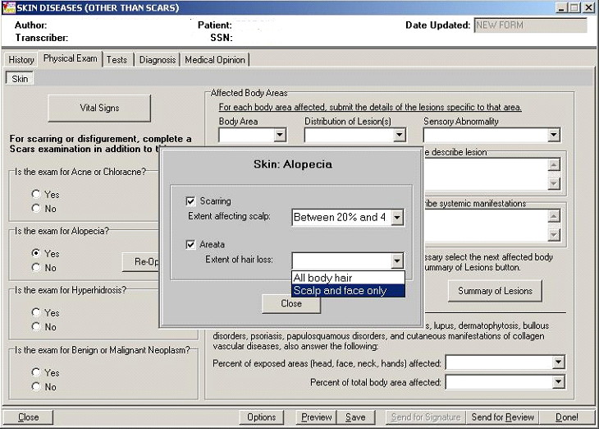
CAPRI Template

Slide 11
Dictation vs. Templates
Time-Motion Study: Data Entry Time
Dictation:
  Average: 3.4 minutes per exam
Templates
  Average: 4.1 minutes per exam

Slide 12
Dictation vs. Templates
Time-Motion Study: Visit Time
Dictation
  Average: 11.26 minutes per exam
Templates
  Average: 14.51 minutes per exam

Slide 13
Dictation vs. Templates
Summary
Templates improve quality
Templates improve exam turnaround time
Templates lengthen encounters by 3.25 minutes on average
Templates lengthen documentation time by 0.7 minutes on average

Slide 14
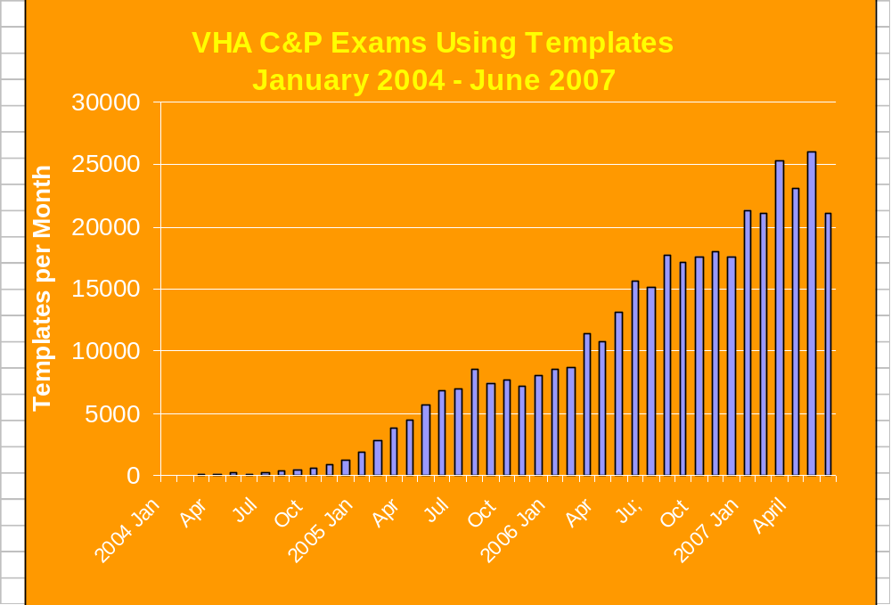
CAPRI Template Usage

Slide 15
CAPRI Template Usage
OMAHA;IOWA CITY;DES MOINES;KNOXVILLE, IOWA; | 32817
TAMPA; | 22519
GAINESVILLE/LAKE CITY;N. FLORIDA/S. GEORGIA VHS; | 15808
ALBUQUERQUE; | 13975
KANSAS CITY;COLUMBIA MO;LEAVENWORTH;TOPEKA;WICHITA; | 13815
SALISBURY; | 12719
NASHVILLE/MURFREESBORO; | 12582
MANILA; | 10871
LEXINGTON; | 10736
HUNTINGTON; | 10341
SAGINAW; | 8828
WEST PALM BEACH; | 8544
BAY PINES VA HCS; | 8485
FAYETTEVILLE AR; | 8299
LOUISVILLE; | 8223
BIRMINGHAM; | 8173
MINNEAPOLIS; | 8142
NEW ORLEANS; | 8139
ALEXANDRIA; | 7765
SAN JUAN; | 7506
Largest Site Usage Jan, 2004
Through
June, 2007

Slide 16
Template Mandate
VA is committed to mandating template use
Key stakeholder feedback and refinements are underway prior to mandate

Slide 17
CAPRI Hands On Demonstration
Sign On
  Access: ##VEHU
  Verify: VEHU##

Slide 18
Where to Get More Information
CPEP Hosted Website
Documentation:
  “http://www.va.gov/vdl/application.asp?appid=133”

Slide 19



Questions?
Not me I got it!
What ?

