Slide 1

National Response Framework
Integrated Emergency Management Course

Slide 2
Course Justification
With the release of the NRF, the Emergency Management Institute (EMI) realizes the opportunity to offer a course that simultaneously:
  Provides students the most current information regarding their role in national preparedness and response
  Enhances the communications links among State emergency personnel and their counterparts in the FEMA Regions and other Federal Agencies such as those described in the Emergency Support Function (ESF) Annexes.

Slide 3
Course Goal
The goal of the NRF IEMC is to provide the knowledge, skills, and abilities necessary for State-level emergency management professionals to effectively conduct all-hazards response by coordinating operations with counterparts from local government, other State governments, Federal agencies, private sector organizations, and nongovernmental agencies.

Slide 4
Course Objectives
At the conclusion of this course, participants will be able to:
Discuss the differences between the NRP and the NRF and apply the five key NRF response doctrine principles
Describe the key roles and responsibilities of the State and of different NRF elements
Describe the roles of each response agency on both the federal and state levels
Describe the role of the Emergency Management Assistance Compact (EMAC)

Slide 5
Course Objectives (cont)
At the conclusion of this course, participants will be able to:
Apply the procedures and protocols for both supplying and acquiring NIMS typed resources
Manage resources effectively
Describe how all levels of government, non-governmental organizations, and the private sector should be linked to provide an integrated approach to all-hazards response and recovery.

Slide 6
Target Audience
State-level emergency management officials who work in the State’s EOC during its activation
Host States are encouraged to use this course to train their staff and build depth in backup personnel that would support 24/7 EOC operations.

Slide 7
Units of Instruction
Day 1 | Day 2 | Day 3 | Day 4
Unit 1 Welcome & Introductions | Unit 6 All-Hazard Emergency Planning 101 | Unit 11 Response Exercise | Unit 12 Recovery Exercise
Unit 2 NRF/NIMS Overview
Unit 3 ESF Roles & Responsibilities | Unit 7 Situational Awareness & Common Operating Picture
Unit 4 NRF Game | Unit 8 Tabletop Exercise
 | Unit 9 Resource Management |  | Exercise Hot Wash
Unit 5 Overview of State Hazards | Unit 10 Exercise Briefing | Exercise Hot Wash

Slide 8
Unit 1: Welcome & Introduction
Opening Comments from host State official
Opening Comments from Federal Regional Official
Self-introduction of Instructors and support staff
Self-introduction of course participants
Orientation to course facilities
Overview of the course schedule

Slide 9
Unit 2: NRF/NIMS Overview
Review history of Federal preparedness documents
Discuss the process of developing the NRF
Examine the contents of the NRF and its annexes
Discuss the role of NIMS in the NRF

Slide 10
Unit 3: Roles & Responsibilities of the Emergency Support Functions
Describe the reasons and roles behind the ESF organizations
Describe the roles of Federal agencies that comprise an ESF and the relationship of the Federal ESFs to the State organization

Slide 11
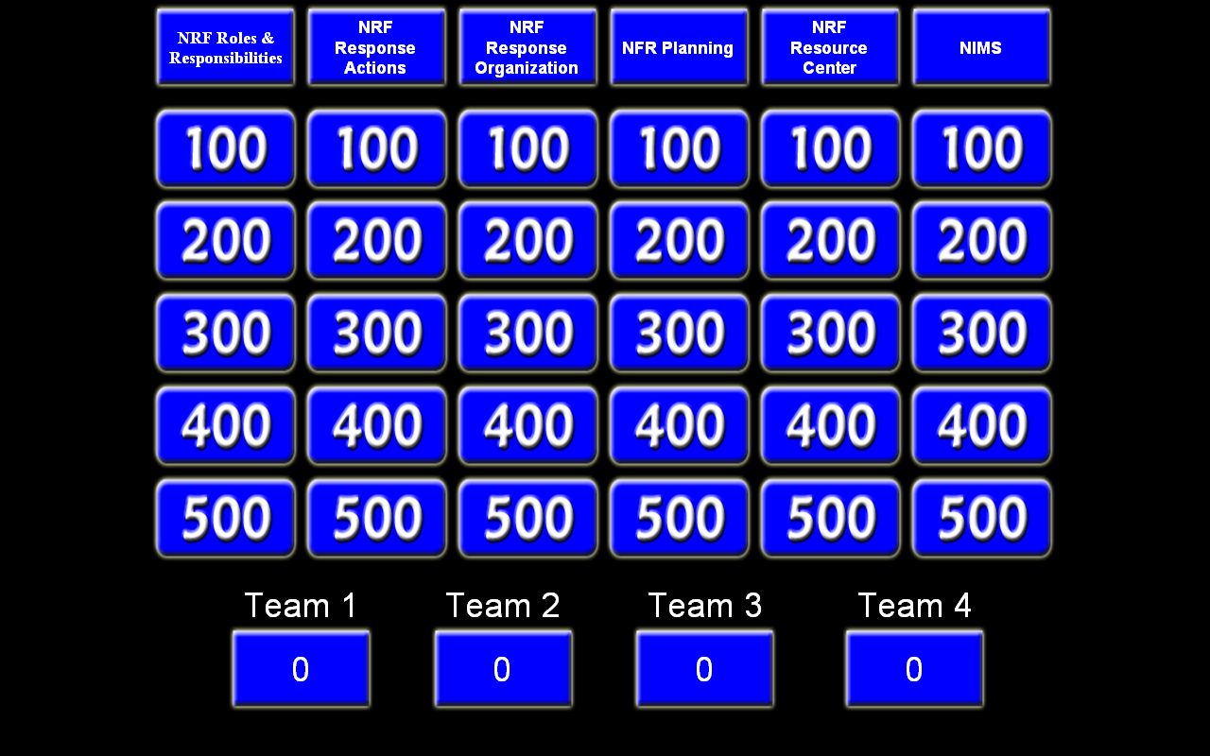
Unit 4: NRF Game
Participants are divided into teams
The rules of the game are explained
The game is played with emphasis on the review of information
Prizes Awarded

Slide 12
Unit 5: Overview of State Hazards
Review a history of disasters in the host State
Review the State’s risk assessment process
Discuss the host State’s method for organizing to mirror ESF functioning
Examine the State’s planned response protocols for the most likely hazards
Other information such as lessons learned or areas needing improvement as deemed appropriate by the State

Slide 13
Unit 6: All-Hazard Emergency Planning
Discuss the emergency planning process
Review CPG-101 – Producing Emergency Plans
Review the contents of Annex 1 to HSPD-8
Describe the host State’s mechanism for mirroring the functioning of Federal ESFs

Slide 14
Unit 7: Situational Awareness & Common Operating Picture
Describe the confusion typical during response operations
Illustrate the errors that can be made without accurate information
Describe methods for maintaining Situational Awareness and a Common Operating Picture

Slide 15
Unit 8: Tabletop Exercise
HSEEP-compliant Tabletop exercise divided into 2-4 modules

Slide 16
Unit 9: Resource Management
Discuss the types of resources needed during response operations
Discuss resource management as described in the NRF
Discuss host State-specific resource management issues

Slide 17
Unit 10: Exercise Briefing
Provide State-specific information relevant to the exercise on Day 3

Slide 18
Unit 11: Functional Response Exercise
This exercise will be a one-day HSEEP-compliant functional exercise.
Exercise participants will perform their emergency duties based upon the existing Emergency Operations Plan (EOP) / Comprehensive Emergency Management Plan (CEMP) procedures and guidelines.
Highlight NRF and NIMS integration opportunities, including response actions, response structures and staffing, use of the incident command system, multi-agency coordination systems, public information systems, communication and information management systems, and resource management systems.

Slide 19
Response Exercise
Core Target Capabilities
COMMON - Communications, Planning
PREVENT - N/A
PROTECT - N/A
RESPOND - Emergency Public Information and Warning, Emergency Operations Center Management, Mass Care, Critical Resource Logistics and Distribution, Citizen Evacuation and Shelter-in-Place, Fatality Management
RECOVERY – N/A

Slide 20
Response Exercise
Optional Target Capabilities
COMMON – Risk Management, Community Preparedness and Participation, Intelligence and Information Sharing and Dissemination
PREVENT - Information Gathering and Recognition of Indicators and Warnings, Intelligence Analysis and Production, Counter-Terror Investigation and Law Enforcement, CBRNE Detection
PROTECT - Critical Infrastructure Protection, Food and Agriculture Safety and Defense, Epidemiological Surveillance and Investigation, Laboratory Testing

Slide 21
Response Exercise
Optional Target Capabilities
RESPONSE - On-Site Incident Management, Volunteer Management and Donations, Responder Safety and Health, Emergency Public Safety and Security Response, Animal Disease Emergency Support, Environmental Health, Explosive Device Response Operations, Fire Incident Response Support, WMD and Hazardous Materials Response and Decontamination, Isolation and Quarantine, Search and Rescue (Land-Based), Emergency Triage and Pre-Hospital Treatment, Medical Surge, Medical Supplies Management and Distribution, Mass Prophylaxis
RECOVERY - Structural Damage Assessment, Restoration of Lifelines, Economic and Community Recovery

Slide 22
Unit 12: Functional Short-Term Recovery Exercise
This exercise will be a half-day HSEEP compliant functional exercise.
Exercise participants will perform their recovery duties based upon the existing Emergency Operations Plan (EOP) / Comprehensive Emergency Management Plan (CEMP) procedures and guidelines.
Highlights NRF and NIMS integration opportunities, including recovery actions, recovery structures and staffing, use of the incident command system, multi-agency coordination systems, public information systems, communication and information management systems, and resource management systems

Slide 23
Recovery Exercise
Core Target Capabilities
COMMON - Communications, Planning
PREVENT - N/A
PROTECT - N/A
RESPOND - Mass Care, Medical Supplies and Distribution, Critical Resource Logistics and Distribution
RECOVERY – Structural Damage Assessment, Restoration of Lifelines, Economic and Community Recovery

Slide 24
Recovery Exercise
Optional Target Capabilities
COMMON – Risk Management, Community Preparedness and Participation, Intelligence and Information Sharing and Dissemination
PREVENT - Information Gathering and Recognition of Indicators and Warnings, Intelligence Analysis and Production, Counter-Terror Investigation and Law Enforcement, CBRNE Detection
PROTECT - Critical Infrastructure Protection, Food and Agriculture Safety and Defense, Epidemiological Surveillance and Investigation, Laboratory Testing

Slide 25
Recovery Exercise
Optional Target Capabilities
RESPONSE – Emergency Triage and Pre-hospital Treatment, On-Site Incident Management, Volunteer Management and Donations, Responder Safety and Health, Emergency Public Safety and Security Response, Animal Disease Emergency Support, Environmental Health, Explosive Device Response Operations, Fire Incident Response Support, WMD and Hazardous Materials Response and Decontamination, Citizen Evacuation and Shelter-in-Place, Isolation and Quarantine, Search and Rescue (Land-Based), Medical Surge, Mass Prophylaxis
RECOVERY – N/A

Slide 26
NRF IEMC Participation
Volunteer Early
  Have EOC and Classroom Access
Prerequisites
  IS-800.B: National Response Framework, An Introduction
  IS-700: National Incident Management System (NIMS), An Introduction
  IS-100: Introduction to the Incident Command System
  IS-200: ICS for Single Resources and Initial Action Incidents

Slide 27
Questions?

