Slide 1
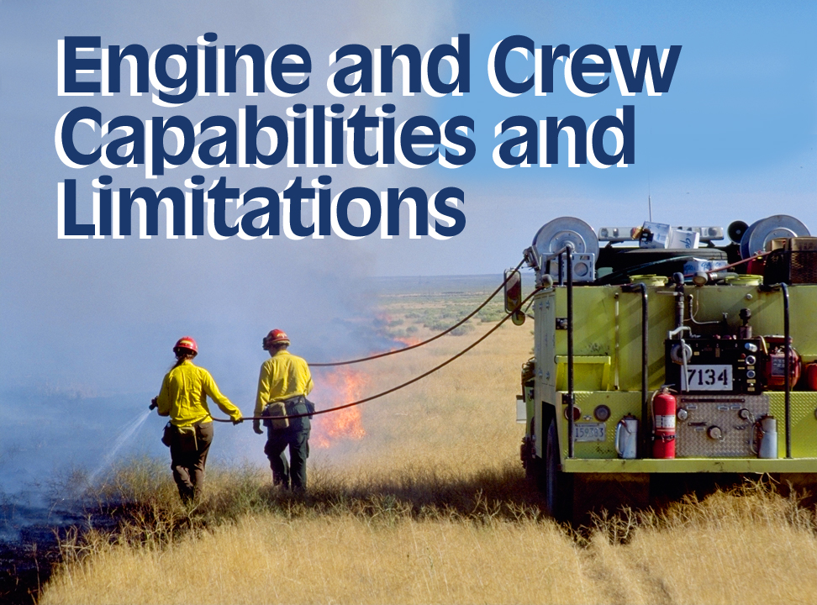
Unit 1
01-<number>-S231-EP

Slide 2
Unit 1 – Objectives
Identify engine capabilities and limitations that the engine boss must consider when deciding to attempt an assignment.
Describe assignments that require specialized training of engine crewmembers.
Describe the observations the engine boss must make of crewmembers to insure safety is not compromised.
Describe the criteria used to maintain the engine inventory.

Slide 3
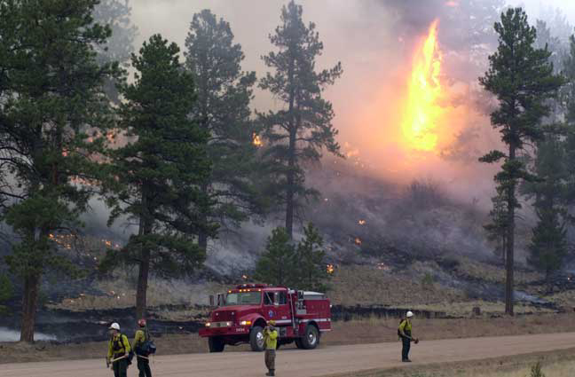
Engine and Crew Capabilities
As an Engine Boss, what is the importance of knowing the capabilities of your:
  Engine?
  Assigned
  personnel?

Slide 4
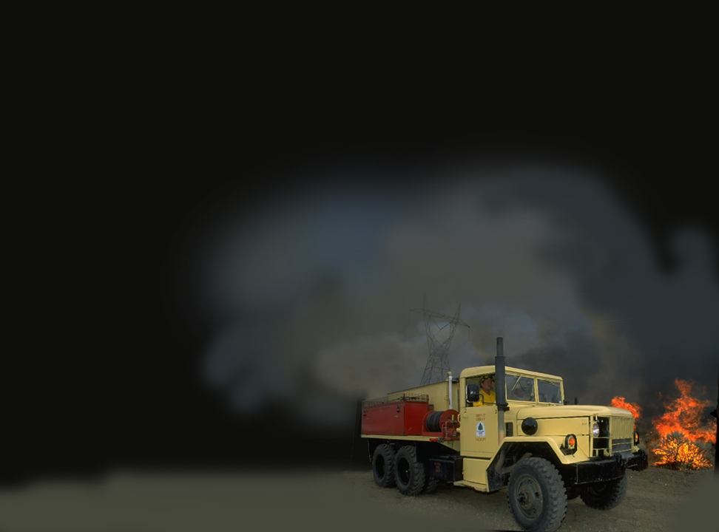
How do the capabilities of your engine and assigned personnel apply to any tactical assignments you may receive?
01-<number>-S231-EP

Slide 5
Tactical Assignments
Be sure to apply these your situation:
Risk Management Process
Standard Fire Orders
Watch Out Situations
LCES Checklist
Downhill Checklist
Wildland/Urban Watch Outs
Others?

Slide 6
Engine Inventory
Pre-incident inventory
Maintaining inventory during incident operations
Utilization of hose and appliances
Demobilization/post-incident inventory re-supply

Slide 7
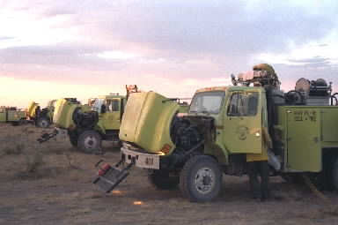
Daily Engine Maintenance
Daily checklist
Preventative maintenance checks
Maintenance schedule and records

Slide 8
Unit 1 – Objectives
Identify engine capabilities and limitations that the engine boss must consider when deciding to attempt an assignment.
Describe assignments that require specialized training of engine crewmembers.
Describe the observations the engine boss must make of crewmembers to insure safety is not compromised.
Describe the criteria used to maintain the engine inventory.

