Slide 1
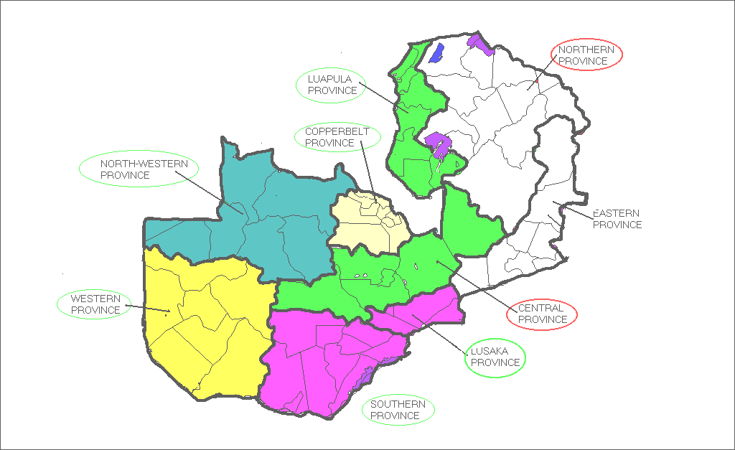



National Laboratory Quality Assurance Training
Workshop Goals and Objectives
A
I
B
Z
A
M
Ndola School of Biomedical Sciences Zambia
August 9-13, 2004

Slide 2
Overall Goal:
Provide accurate and reliable laboratory testing in support of HIV / AIDS Care and Treatment Programs
  Automated Chemistry and Hematology Laboratory
  CD4 testing
  Microscopy

Slide 3
Objectives
Describe factors that may contribute to erroneous results
Validate automated methods prior to use
Define the following terms:
  Calibrators
  Standards
  Controls
  Linearity

Slide 4
Objectives
Implement quality control procedures to determine if patient results are acceptable
Interpret quality control data using Levey-Jenning charts
Maintain appropriate documents and records

Slide 5
Hematology and Chemistry
Describe the principles of hematology and chemistry analyzers used in Zambia
Explain the underlying causes of invalid automated hematology and chemistry results
Recognize the significance of flagging and take appropriate actions
List common substances which commonly interfere with the specific analytes using automated hematology and biochemistry analyzers
Describe methods for resolving problems associated with interfering substances

Slide 6
Maintenance - Basic Lab Equipment
Demonstrate appropriate techniques for use and maintenance of micropipetter
Demonstrate the proper use of weigh balance and pH meter in preparing Giemsa stain reagents
Demonstrate proper technique for preparation of thick and thin blood smears for malaria examinations
Demonstrate proper care and maintenance of the bright field microscope
Establish and implement daily, weekly, and monthly maintenance activities for instruments used in your laboratory

Slide 7
CD4 Testing by BD FACS Counts
Describe and discuss flow cytometry and CD4 immunophenotyping
Understand (explain) how CD4 testing can be performed on FACS count
Demonstrate safe laboratory practices
Demonstrate proper specimen processing and identification techniques

Slide 8
CD4 Testing by BD FACS Counts
Describe and perform immunofluorescent staining, instrument operation, quality control, and data acquisition
Demonstrate the proper maintenance procedure for the FACS count Instrument
Describe and discuss quality assurance for CD4 enumeration
Describe and discuss data reporting

