Slide 1
Module 9 Incident
Resources Management
Subjects covered in this module include:
Principles of resource management
Incident resource management
Establishing resource needs
Resource ordering
Resource check-in process
Utilizing resources - staging areas
Resource demobilization
Resource management considerations
09-01-I300-SL

Slide 2
Module 9 Objectives:
1. Identify and describe the four basic principles of resource management.
2. Identify the basic steps involved in managing incident resources.
3. Know the contents of, and how the Operational Planning Worksheet (ICS 215) is used.
4. Identify the organizational elements at the incident that can order resources.
09-02-I300-SL (1 of 2)

Slide 3
Module 9 Objectives:
(cont.)
5. Describe the differences between single and multipoint resource ordering and the reasons for each.
6. Describe why and how resources are assigned to staging areas, camps, and direct tactical assignments.
7. Describe the purpose and importance of planning for resource demobilization.
8. Identify five key considerations associated with resource management and the reasons for each.
09-02-I300-SL (2 of 2)

Slide 4
Principles of Resource Management
Planning
Organizing
Controlling
Directing
09-03-I300-SL

Slide 5
Resources Direction Involves:
Motivation
Providing leadership
Delegation of authority
09-04-I300-SL

Slide 6
In ICS Direction is Accomplished by Assigning Responsibility and Authority Throughout the Organization:
Uses other people’s knowledge and skills
Completes task without unnecessary delay
Enhances training and personnel development
Provides a more meaningful work environment
09-05-I300-SL

Slide 7
Incident Resource
Management Process:
Establishing resource needs
Resource ordering
Check-in process
Resource use
Resource demobilization
09-06-I300-SL

Slide 8
Planning Meeting Activity Checklist
No.
Activity
Primary Responsibility
1
Give situation and resources briefing
Planning Section Chief
2
State Incident objectives and policy issues
Incident Commander
3
State primary and alternative strategies
Operations Section Chief
4
Designate Branch, Division, Group
boundaries and functions as appropriate
Operations Section Chief
5
Describe tactical operations and tactics
Operations Section Chief
6
Make tactical resource assignments
Operations, with support of Planning,
and Logistics Section Chiefs
7
Determine Operations facilities and
reporting locations
Operations and Logistics Section Chiefs
8
Develop the resources, support and
overhead order
Planning and Logistics Section chiefs
9
Develop Communications, Medical, and
Traffic supporting plans
Planning and Logistics Sections
10
Approve and implement the plan
Incident Commander approves and
General Staff implements
09-07-I300-SL

Slide 9

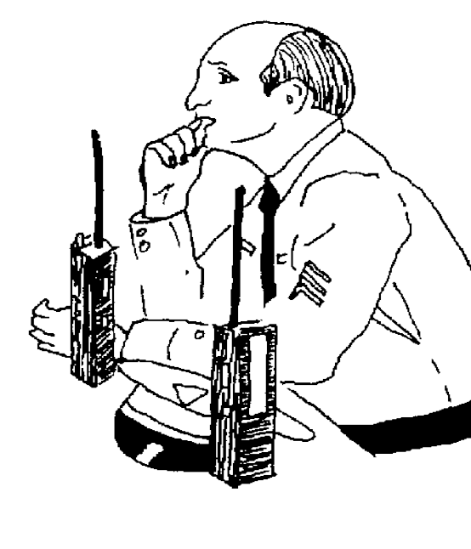
Operational Planning Worksheet
Can be Used as a Display at the Planning meeting
Operational Planning Worksheet ICS 215
09-08-I300-SL

Slide 10
The ICS 215 Form is a Basic Planning Tool
It provides information on:
Incident work location
Work assignments
Kind and type of resources needed
Current availability of incident resources
Reporting location
Requested arrival time for additional resources
09-09-I300-SL

Slide 11
Incident Resources:
Personnel resources
are assigned to functional areas within ICS sections based on experience, training, and past performance.
Equipment resources
consist of both the equipment and the personnel to operate the equipment. This includes aviation resources.
09-10-I300-SL

Slide 12
Placing Resource Orders from the Incident
Incident Commander must
approve all resource orders.
Authorized to Place
Resource Orders
Incident Commander
Logistics Section Chief
Supply Unit
09-11-I300-SL

Slide 13
Essential Elements of Information
for any Resource Order:
Incident Name
Order and/or request number
Date and time of order
Quantity, kind, type of resources
Reporting location
Requested arrival time
Radio frequency
Person/title placing request
Callback Number or Radio designation
for clarification
09-12-I300-SL

Slide 14




Send Resource Orders by:
Terminal
Radio
FAX
Phone
09-13-I300-SL

Slide 15

Single vs. Point Ordering of Resources
from an Incident
Single Point Ordering
Agency Dispatch
Incident
09-14-I300-SL

Slide 16
Be Sure You Understand the Ordering Process!!!
Single Point Ordering
Preferred Method
Multi-Point Ordering
Done When:
Multi-agency involvement requires it
The kind of resource requires special handling
Required by agency policy
Agency overload
Agency policy
Complex order
09-15-I300-SL

Slide 17
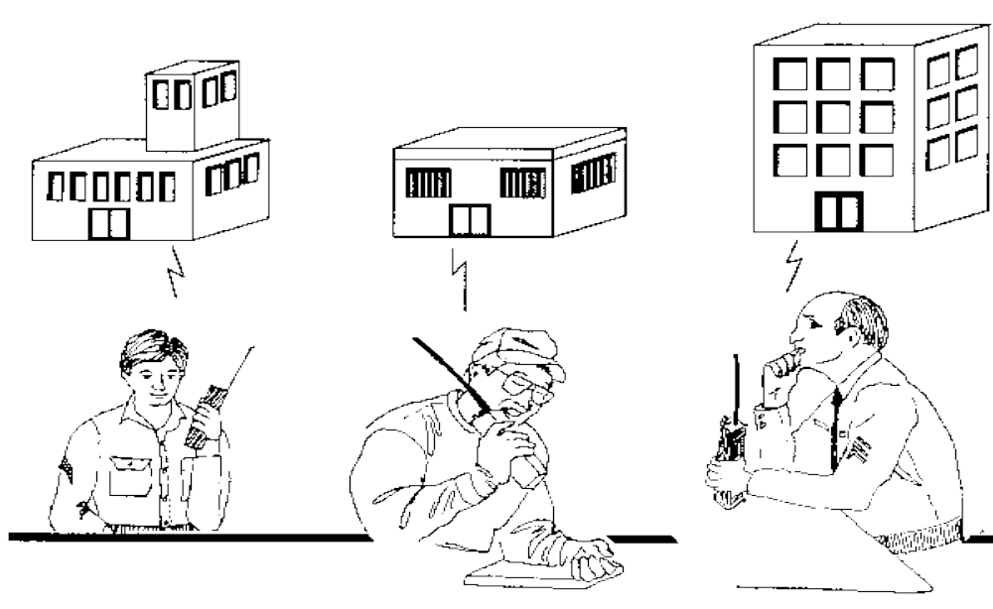
Multipoint Resource Ordering from an Incident
Medical
Police
Fire
09-16-I300-SL

Slide 18
Resource Check-in
Locations at an Incident
Incident Base
Camp
Staging Area
Resource Unit at the Incident Command
Post
Helibase
09-17-I300-SL

Slide 19
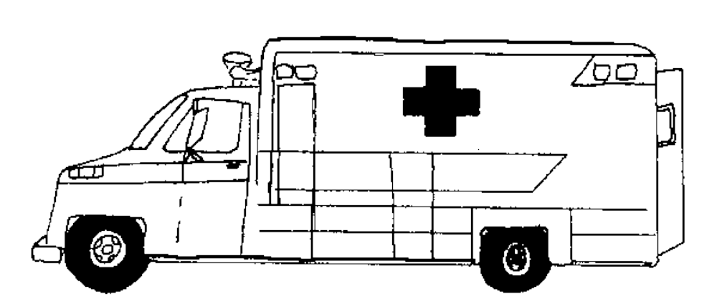
On an Incident Resources are
Initially Assigned to:
Base or
Camps
Divisions
or
Groups
Staging Areas
09-18-I300-SL

Slide 20
Incoming Resources are assigned to Staging Areas Because:
Resources will be assigned during the current operational period.
Resources are needed to provide a reserve force for contingencies.
Resources are to be formed into Task Forces and/or Strike Teams.
09-19-I300-SL

Slide 21
Staging Area Managers
Must be Briefed
Briefing
Number and kind of resources
Communications
Minimum resource levels
How to obtain resources
Expected duration
Logistics support
09-20-I300-SL

Slide 22
Task Forces and Strike Teams:
Can be formed on the incident.
When formed on the incident they must be disassembled prior to release from the incident.
09-21-I300-SL

Slide 23
Demobilization
Planning - begin early!
Set up a Demobilization unit for larger incidents.
Operations Section will set continuing tactical resource needs.
09-22-I300-SL

Slide 24
Demobilization Plan
General information
Responsibilities
Release priorities
Release procedures
Directory
Home
09-23-I300-SL

Slide 25
Key Resource Management Considerations
Safety
Personnel accountability
Managerial control
Adequate reserves
Cost
09-24-I300-SL

