Slide 1
Smallpox Vaccine Logistics: Distribution, Storage, and Security
Department of Health and Human Services
Centers for Disease Control and Prevention
December 2002
Notes:
Presented by Dr. Sue Gorman, CDC

Slide 2
Smallpox Vaccine Logistics: Distribution, Storage, and Security
Learning Objectives:
  Describe how the smallpox vaccine will be ordered and shipped
  Describe the support to be provided by the National Pharmaceutical Stockpile
  Describe the project area distribution and redistribution responsibilities
  Describe the storage and handling requirements for the smallpox vaccine

Slide 3
National Pharmaceutical Stockpile (NPS)
Concept of Operations
Provide rapid delivery of a broad spectrum of support for an ill-defined threat in the early hours of an event
Provide large shipments of specific materiel when a threat is known
Provide technical assistance to receive and distribute NPS materiel during an event
Notes:
Our concept for responding to a large-scale public health emergency or terrorism event involves providing rapid delivery of a broad spectrum of support, including pharmaceuticals and other medical supplies in the early hours of an event to allow local authorities to begin to respond to an ill-defined threat. Additionally, we can provide shipments of large and continuous quantities of specific items once a threat is known. Finally, we can provide technical assistance by sending our Technical Advisory Response Unit (TARU), which is compromised of five to seven individuals from the National Pharmaceutical Stockpile, to help the affected area receive, distribute, dispense and reorder National Pharmaceutical Stockpile assets. The TARU will remain at the affected area for as long as there is a need.

Slide 4
NPS Response Options
Broad Spectrum Support:
  12-Hour Push Packages
Specific Item Support:
  Vendor Managed Inventory (VMI)
  Vaccines
  Buying Power/Surge Capacity
Notes:
The National Pharmaceutical Stockpile program will use the following options to respond to an event. Broad spectrum support is provided by what we refer to as 12-hour push packages. 12 hours, because they will arrive at the affected area in 12 hours or less after the federal decision to deploy the assets, and push package, because specific items do not need to be requested. We will push out over 90 different items in the hope that some portion of these will be useful in the early hours of an ill-defined threat. Our push package weighs more than 50 tons and is packaged in 130 specialized cargo containers. The containers will arrive by either air or ground and fill the body of a wide-body cargo jet or eight semi tractor-trailers. Specific item support may include large quantities of items such as antibiotics that are also in our push packages or other items such as vaccines or ventilators that we store and ship separately as they are needed. Many of the items in the National Pharmaceutical Stockpile are held and maintained by our commercial partners until we direct their shipment. We refer to these items as Vendor Managed Inventory or VMI. In the event an item is needed that is not found on the formulary, we're able to exercise our buying power or surge capacity by working with our acquisition partner, the Department of Veterans Affairs National Acquisition Center to rapidly procure the item from the private sector and deliver it to the affected area. We will also be able to respond with vaccines for pre- event distribution or post-event distribution as needed. Vaccines are not stored as part of the 12-hour push packages.

Slide 5
Distribution
We will begin shipping vaccine based on approval of State Plans
Vaccine will be packaged at NPS Program Repositories for direct shipment to the normal distribution points within the 62 Project Areas
Notes:
We will begin shipping vaccine based on approval of state or project area plans. The vaccines will be packaged at National Pharmaceutical Stockpile program repositories for direct shipment to the normal distribution points within the project areas.

Slide 6
Distribution
Shipments will be made on Monday, Tuesday, and Wednesday
All shipments will be sent by commercial partners for overnight delivery
Shipments will arrive at designated locations by 10:30 the next day
Notes:
Shipments will be made on Monday, Tuesday and Wednesday of each week and all shipments will be sent by National Pharmaceutical Stockpile program commercial partners for overnight delivery. You can expect to receive your shipment of vaccine by 10:30 in the morning on the following day.

Slide 7
Distribution
Stage 1 will take 14 days to complete
All shipments will come in EnduroTherm insulated Styrofoam shipping containers
Vaccine is a licensed product and all ancillary support will be in the kit
Each kit provides the capability to inoculate 100 persons
Notes:
After the project areas plans have been approved, which should take 48 hours for turn-around and any time needed for changes and final sign-off, and the National Pharmaceutical Stockpile program is advised to begin shipping the vaccine, it will take 14 days to complete the shipping process. The shipments will arrive in EnduroTherm insulated Styrofoam shipping containers. The vaccine being shipped out at this time is the licensed Wyeth Dryvax vaccine, and all ancillary supplies, such as bifurcated needles, diluent, and transfer needles, will be found in the vaccine kit. Each kit will be able to provide the capability to inoculate 100 persons.

Slide 8
EnduroTherm
Packed by a validated protocol
  Small=16 x 13 x 14 inches
  Medium= 19 x 13 x 17 inches
  Large= 23 x 23 x 24 inches
Notes:
The EnduroTherm shipping container is packaged by a validated protocol. The small container, which measures 16 by 13 by 14 inches, can hold between one and four vaccine kits. The medium container, measuring 19 by 13 by 17 inches, can hold between 5 and 14 kits. And the large container, measuring 23 by 23 by 24 inches can hold between 15 and 45 kits.

Slide 9
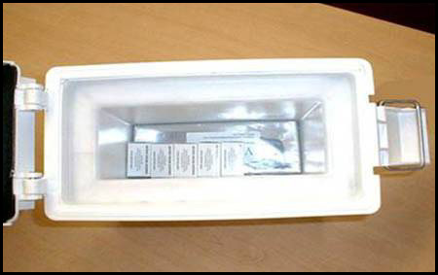
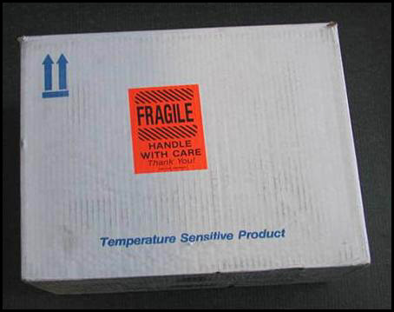
EnduroTherm
interior
EnduroTherm
exterior
Notes:
This slide shows the insulated EnduroTherm shipping containers. The EnduroTherm containers contain gel packs that are either refrigerated or frozen, depending on where the container is being shipped, and what the ambient temperature is depending on the time of year. The container is packed according to a validated blueprint. These blueprints have been tested and validated in controlled environmental chambers. The chambers simulate all sorts of environmental variables that could occur during the initial shipment process. All of the National Pharmaceutical Stockpile protocols on these EnduroTherm shippers must maintain 72 hours of controlled temperature at 2 to 8 degrees Celsius. The containers are reusable, however, they should not be reutilized for redistribution within your state. The containers have a return ship-to address on them in order for you to return them to the National Pharmaceutical Stockpile program.

Slide 10
What Do The Shipments Contain?
Vaccine
Diluents for vaccines that must be reconstituted (1 vial per every vial of vaccine)
Bifurcated Needles
Transfer Needles (1 needle for every vial of diluent)
Notes:
Now I'd like to discuss what you can expect to get in your shipments. The shipments will contain vaccine. Currently we'll be shipping the licensed Wyeth Dryvax vaccine. This vaccine needs to be constituted with diluent. The diluent is provided in the kit, with one vial of diluent for one vial of vaccine. The ratio of dilution will be 1 to 1 for this licensed vaccine. Bifurcated needles are part of the kit with 100 needles in each kit. There is also one transfer needle in each kit so can you put the diluent into the vial of vaccine.

Slide 11
What Do The Shipments Contain?
Package Insert
Lot Number Stickers
Vaccinia Immune Globulin (VIG) will be shipped as need is validated
Notes:
The shipments will also contain the package insert for the vaccine and 100 lot number stickers that can be used to affix to the patient's medical record or chart. VIG, Vaccinia Immune Globulin, which is used for treating certain serious adverse events to the smallpox vaccine will not be shipped out as part of the initial shipment. VIG will be shipped on a case-by-case basis as the need is validated.

Slide 12
What Needs to be Acquired Locally
Non-latex gloves
2x2 gauze pads, plus cloth tape or paper tape
Semi-permeable bandages
Notes:
There are several products that the National Pharmaceutical Stockpile program will not be shipping. States or cities or project areas need to work with local providers and manufacturers to identify the availability of these products. However, they are usually readily available and are used in all manner of care. These include non-latex gloves for those administering the vaccine, gauze pads and cloth or paper tape and semi-permeable transparent bandages for dressing the vaccination site.

Slide 13
What Needs to be Acquired Locally
Zip lock plastic bags (to provide vaccinated persons with a supply of gauze pads, tape and bandages)
Sharps containers
Medical waste bags
Note – Do not procure alcohol or alcohol wipes as alcohol inactivates the vaccine
Notes:
Additional supplies that will need to be located locally and will not be shipped by the National Pharmaceutical Stockpile program include zip-lock type plastic bags to provide vaccinated persons with a supply of gauze pads, tape and bandages; sharps containers for disposal of bifurcated needles and transfer needles; and medical waste bags for the disposal of contaminated bandages or dressings. We will also not be shipping alcohol or alcohol wipes and we do not recommend that you procure these locally.

Slide 14
Project Area Distribution Responsibilities
Provide Points of Contact and Alternate Points of Contact for the shipment to include all telephone numbers and fax numbers
Provide the ship-to-address for the delivery of the vaccine (no P.O. Boxes, must be a street address)
Provide estimated numbers of vaccine doses required
Notes:
Now I'd like to move on to the responsibilities of the project area as far as distribution and redistribution. In order for us to ship the vaccine to you, you must provide us with a point of contact and an alternate point of contact as well as telephone and fax numbers for those people. We will also need a valid ship-to address for the delivery of the vaccine. This must be a street address. Post office box addresses will not be acceptable. We also will need to know the estimated number of vaccine doses that your project area will require.

Slide 15
Redistribution of Vaccine
Redistribution is the responsibility of the Project Area
“Cold Chain” must be constant during redistribution
Temperature logging is required to validate that 2-8 degrees Celsius was maintained during movement
Notes:
Once the National Pharmaceutical Stockpile program has made the initial shipments to your designated normal distribution points within your project area, any redistribution that takes place will be the responsibility of the project area. Cold chain management must be maintained throughout any redistribution that take place. This means that the temperature must be maintained and logged to ensure there are no variations or interruptions in the temperature. The temperature is required to be maintained at 2 to 8 degrees Celsius during storage and movement.

Slide 16
Redistribution of Vaccine
Further guidance on proper “Cold Chain” management and supply practices can be obtained from the NPS Program
Approved commercial systems available to assist in redistribution (Vaxicools and Vaxipacks)
Notes:
The National Pharmaceutical Stockpile program will be able to provide further guidance on proper cold chain management technique and supply practices if the project areas have any questions on these practices. To provide some guidance on redistribution practices, I would like to discuss approved commercial systems that are available to assist in redistribution. These systems are called Vaxicools and Vaxipacs. The National Pharmaceutical Stockpile program will not be providing these containers for the project areas’ redistribution needs. These systems can be ordered commercially by the project areas if they so desire.

Slide 17
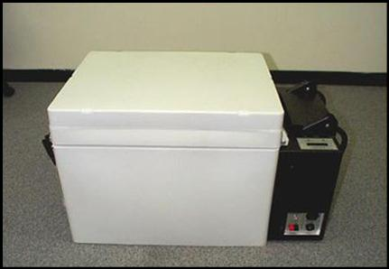
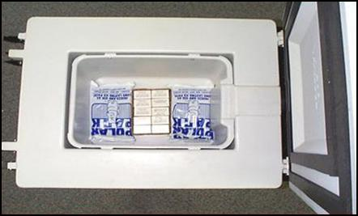
Vaxicool
Notes:
These photos depict the Vaxicool units. The Vaxicool system in basic terminology is a portable refrigeration unit, however, it incorporates state-of-the-art electronics to ensure that proper cold chain standards remain constant. This system has three alert capabilities to warn the user of any deviation from the desired temperature range. These include digital readouts, temperature warning lights and audible alarms. These systems have been field tested and used around the world for distribution of vaccine by the Department of Defense for a number of years.

Slide 18
Systems To Help With Redistribution - Vaxicool
Weighs about 110 lbs.
Dual Temperature Settings
  Holds a temperature range of 2 to 8 degrees Celsius or -17 to -20 degrees Celsius
Uses internal battery or electrical power (115 or 230 volts)
Notes:
All of the Vaxicools in the National Pharmaceutical Stockpile program are dual units. This allows us to store the vaccine at minus 20, and with the flip of a switch, we can bring the product to 2 to 8 degrees Celsius. That is the temperature required at the time of inoculation. These units are able to run on internal battery power for 60 hours, before requiring recharging or they can run on electrical power. In addition to battery and electrical power, it is also possible to hook up a solar panel which will recharge the battery in order to keep the system running. The Vaxicool unit weighs 110 pounds and can hold 1 to 28 vaccine kits.

Slide 19
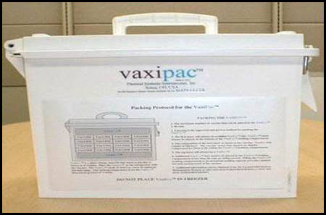
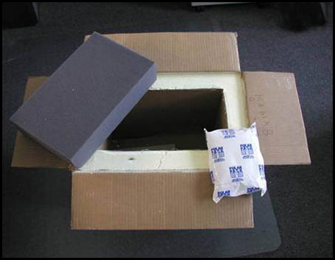
Vaxipac
Notes:
These pictures show a smaller unit called the Vaxipacs. The Vaxipacs are designed to be complimentary to the Vaxicool or another approved refrigeration unit. The basic concept is to take a small number of vials of vaccine from a larger storage area and redistribute them through hospital or regional area for a short period of time. The Vaxipac utilizes chemical and vacuum insulated technology as opposed to the state-of-the-art electronics found in the Vaxicool.

Slide 20
Systems To Help With
Redistribution - Vaxipac
Packed according to their existing protocol and will maintain a temperature range of 2 to 8 degrees Celsius for 24 hours
Depends solely on an inner cooler called Vaxisafe. The Vaxisafe must be chilled (refrigerated) for at least 24 hours before being placed into a Vaxipac
Notes:
A Vaxipac is a small portable carrier that when packaged according to protocol will maintain a temperature range of 2 to 8 degrees Celsius for 24 hours. Inside the Vaxipack is an inner cooler called a Vaxisafe. The Vaxisafe is a unique phase-change material that must be chilled in the refrigerator for at least 24 hours before being placed in a Vaxipac. A Vaxipac can hold up to three prepackaged vaccine kits along with the two required Vaxisafes. These components are reusable. Both of these items are an approved method of moving vaccines by the National Pharmaceutical Stockpile program and the Department of Defense. There may be additional methods of shipping that have been approved by your project area.

Slide 21
Storage
All kits must be maintained at 2-8 degrees Celsius
Proper refrigeration must be in place at point of delivery
A temperature reading log must be maintained on the refrigeration system
Provide details on any redistribution plans to include “cold chain” management throughout
Notes:
All vaccine kits must be maintained at 2 to 8 degrees Celsius. Proper refrigeration must be in place at the point of delivery. A temperature reading log must be maintained on the refrigeration system that you are using. This is to ensure that the vaccine has not been compromised. This will also aid us if the National Pharmaceutical Stockpile ever decides to recover any unused vaccine. We ask that for any redistribution plan you have in place, you will provide the details of how you will maintain cold chain management throughout the process.

Slide 22
Security Issues
Code of Federal Regulations must be followed
Fixed storage facilities
Controlled access to both the facility and the storage system
Surveillance and/or security staff
Notes:
The final topic that I would like to address is that of security. In the Code of Federal Regulations, there are standards that should be adhered to relating to the safeguarding of pharmaceuticals and vaccines. We have provided you with a web page and specific 21 CFR chapters in the planning guidance that has previously been sent out. We recommend using fixed storage facilities as part of your plan in order to reduce risk. These could include hospitals, clinics or other buildings with appropriate refrigeration in place. A mobile storage facility with refrigeration such as a bloodmobile will not provide adequate security. The fixed facility and the storage system must provide controlled access. The facility should also be monitored by either electronic surveillance, such as camera systems or infrared detection or the presence of physical security patrols.

Slide 23
Reminders
Vaccine should NEVER be frozen
Normal storage temperature is 2 to 8 degrees Celsius
After reconstitution, vaccine:
  Must be used within 30 days
  Maintained at 2 to 8 degrees Celsius
Notes:
The vaccine should never be frozen. It should be stored at 2 to 8 degrees Celsius. For the licensed Wyeth Dryvax vaccine that we will be shipping, after reconstitution with the diluent, the vaccine must be used within 30 days. This is different than the package insert. The package insert says the vaccine after reconstitution must be used within 15 days. After the package inserts were printed additional information was provided to the Food and Drug Administration that supported use up to 30 days after reconstitution. A letter stating this change will be included with your shipment.

Slide 24
For More Information
National Pharmaceutical Stockpile
Telephone: 404-639-0459
Email: NPS_PPT@cdc.gov
Notes:
For additional information on cold chain management practices, I invite you to call or e-mail the National Pharmaceutical Stockpile program at the number (404.639.0459) and Email address (nps_ppt@cdc.gov) on the screen.
I have reviewed several important topics today on various logistical issues including storage, security, redistribution and distribution of vaccine. Having adequate processes in place to address these issues will ensure that our shipments and your redistribution process flow smoothly. However, the most important take-home message from my presentation today is to maintain adequate cold chain management practices throughout the process. This will ensure that the vaccine integrity is never compromised. Thank you.

Slide 25
For More Information
CDC Smallpox website
  www.cdc.gov/smallpox
National Immunization Program website
www.cdc.gov/nip

