Slide 1
An XML Schema for NMWG
GGF8 - June 2003
Yee-Ting Li (UCL)
Presented by
Richard Hughes-Jones
(University of Manchester)

Slide 2
Requirements and Goals
Different network monitoring architectures represent their results in different formats
  Unify output to common format to aid consumer interaction
Ability to describe all characteristics and underlying measurement methodologies
  Make it future proof
Does not replace current technologies
  Idea is to cast network data to a suitable format for intercommunication
For use in Web Services and OGSA Technologies
  Fits in with idea of a Web Service front end

Slide 3
‘Features’ – What does XML give us
XML Schemas describe the structure and content of XML document
  Uses meta data to describe virtually anything through document structure
  Extensible and flexible – can use XSLT’s to format the data in any other way (schema conversion)
Can store both historical (lists) and ‘single’ measurements in same document
  Makes it easier for consumers to parse information
Includes all necessary information to repeat a test
  Embodies measurement methodology as a fundamental necessity

Slide 4
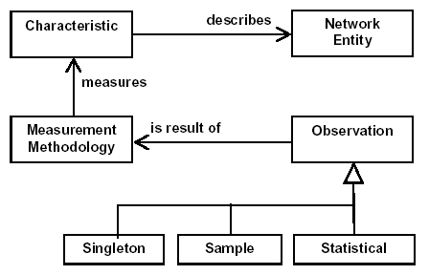
NMWG - Overview
Results gathered into an Observation
Realised by a Measurement Methodology
Which measures a Characteristic
Which describes a Network Entity

Slide 5
NMWG Schema Goal
To be able to fully describe network metrics/characteristics
  In complete and extensible way
  Able to store as much information as required
  Able to have as little information as required
To be used in a real system with real results
  Capable to describing WHAT a tool measures and HOW and WHERE
Focusing actually implementing what the NMWG document says… and doesn’t say…
  With view on actually using it to retrieve results…
  As a results doesn’t always exactly match what NMWG says/suggests ☺

Slide 6
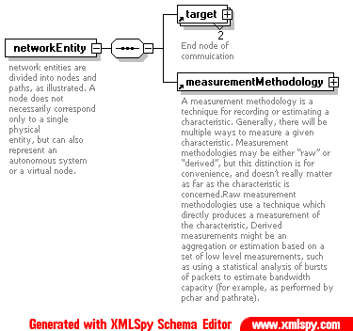
NMWG Schema - Overview
Each box – XML element = chunk of meta data
networkEntity is root document
  Described by:
target
  Describes the source and sink nodes
measurementMethodology
  Used to describe the application used to gather the results
  The network used
  The results (observations) of the characteristics

Slide 7
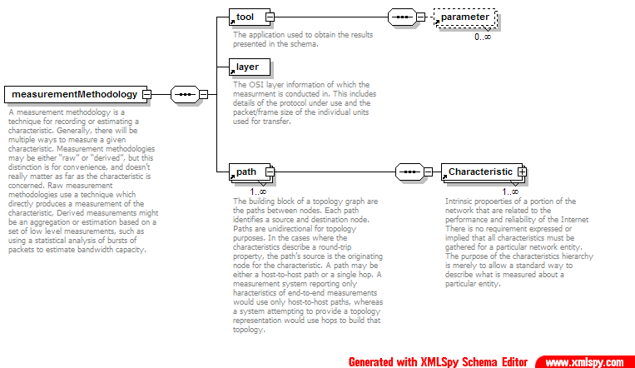
Schema – measurementMethodology
Name / version / cmd …
Key – value pairs
Char – numeric only
hoplist
Notes:
- Whether the methodology is raw of derived is an attribute in <measurementMethodology/>, also a brief desciption of the methodology in attr ‘method’.
The realisation of a measurement methodology is the tool (name, version, accucy), extended with key/value pairs in the parameter element
A layer element used to formally describe the OSI layer and protcol used for test; includes TCP types and packet sizes.
Path: endToEnd (most tools) and hops (traceroute/pipechar etc): endtoend would only have one path entry (black box), hops would have an entry for each hop end to end.
Characteristic describes each path that its nested under. Benefit; can describe many characteristics for each path; eg, ping can give both loss and delay for same path.

Slide 8
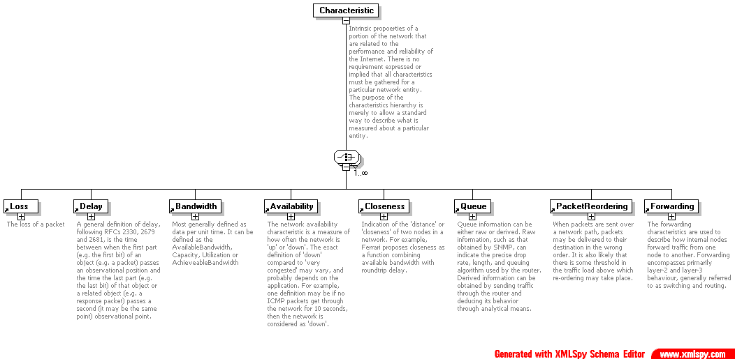
NMWG Schema - Characteristic
Characteristics:
make uniform representation
– all at same level
Missing:
Patterns – in statistical part
Non - numeric
BW type
Use XML attribute
Notes:
- no defintion of sub classes of characteristics – all high level
- idea is to be uniform in the descriptions, so used <observationSample/> (next)

Slide 9
Schema - observationSample
Tried to incorporate method of describing more than one observation at once
  When we retrieve historical information of the bandwidth for the last month
May have singleton values as well as statistical values
  Collate all ping singletons for last year!
  Or just get a the averages for each week..
Some tools may report more than one characteristic
  Eg ping: 2WD and loss, traceroute: rtt and path, pipechar: capacity and path etc.

Slide 10
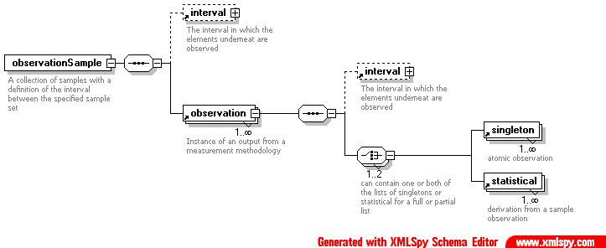
NMWG Schema - observationSample
Aim to represent Singleton or Statistical in the same way.
observation can be: Singleton or Statistical or Singleton(s) and Statistical
observationSample is allows for a series of observations
Notes:
Every Characterstic has an observationSample underneath
Singletons and statisticals have attributes to describe the value, units and error.
Can have singletons and or statisticals. The statisticals in same observation are statistical descriptions of its peered singletons.
Problem is that we have now defined that only charactersitcs that are numerical can exist in schema (can’t have ForwardTable, etc).
Statistical also has ‘type’ attribute; eg average, percentile etc.
Statisticals can also be extended to represent patters; just use eg. LossAverage as type
Interval summarises the time period of when the underlying elements take place: under observation we have the pattern of when the singletons take place, under observationSample, it describes the pattern of observatiosn.
A observationSample can have lots of observations => historical information.

Slide 11
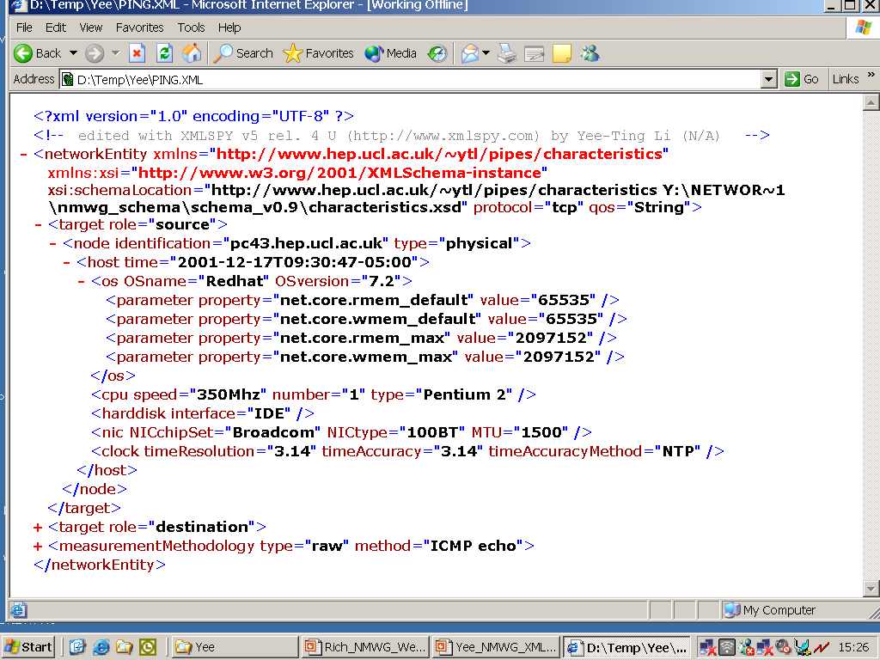
Example Of Ping Schema : target

Slide 12
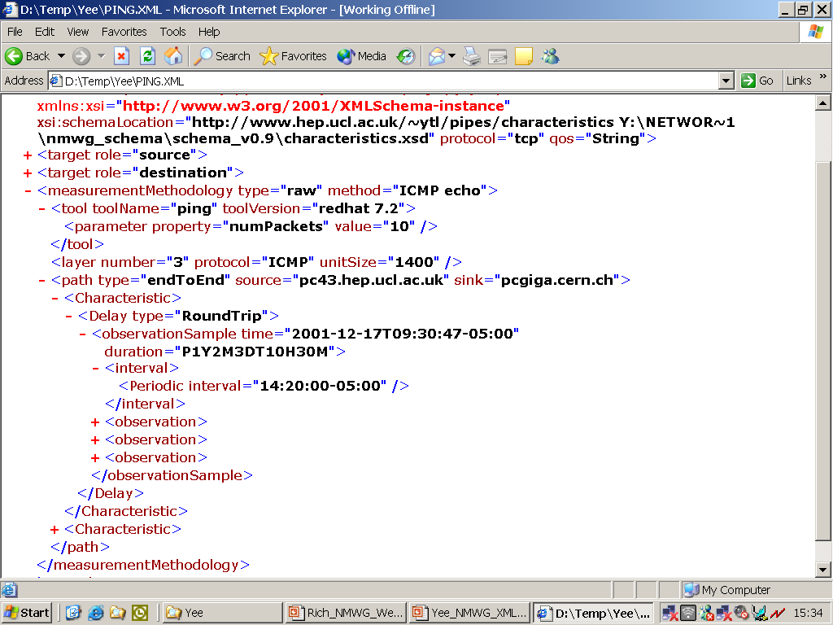
Example Of Ping Schema : measurementMethodology

Slide 13
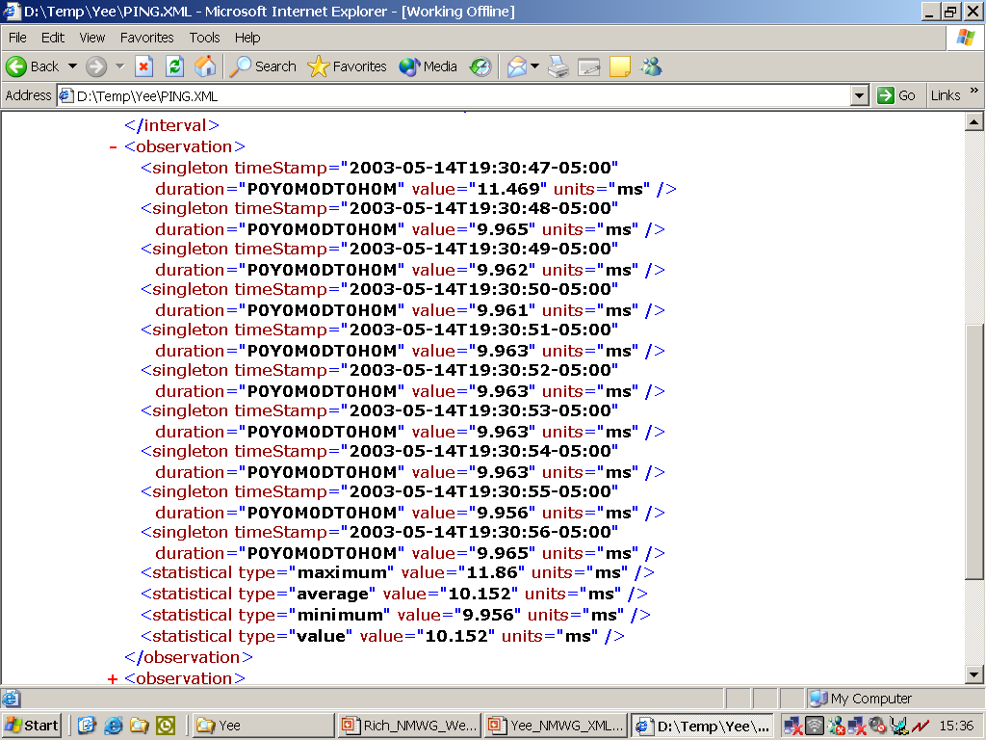
Example Of Ping Schema : observation

Slide 14
Summary
A useable implementation of XML Schema for Network Monitoring
  Can report single observations or a group of observations in a single document
Demonstrated suitability for most common monitoring tools
  Easily extended to most tools
Also includes non-network information that may contribute to poor network performance
  Host configuration, kernel parameters etc.
However doesn’t quite fit into NMWG framework
  Needs further refinement of both the Schema and what NMWG define

