Slide 1



Immunization Information Systems 101
Immunization Information Systems 101:
What Every Program Manager Should Know

Slide 2


Need For This Module
Educate new immunization and IIS staff
Provide an introductory IIS education resource
Educate partners, providers, and stakeholders

Slide 3
Learning Objectives
Describe what immunization information systems (IIS) are
Describe the benefits of IIS
Describe the basic functions of IIS
Describe how IIS can be used to support immunization and other partner program activities

Slide 4
Continuing Education Credit
Continuing education credit is available only through the CDC/ATSDR Training and Continuing Education Online System at www.cdc.gov/TCEOnline/.
You must have a verification code specific to this program to apply for CE credit. The code will be revealed during the course of the program. CE credit for this activity will expire on Change Me, 2007.

Slide 5
Financial Interest Disclosure
CDC, our planners, and our presenters wish to disclose they have no financial interests or other relationships with the manufacturers of commercial products, suppliers of commercial services, or commercial supporters.

Slide 6
Unlabeled/Unlicensed Use Disclosure
Presentations will not include any discussion of the unlabeled use of a product or a product under investigational use.

Slide 7
IIS 101 Topics
What are IIS?
IIS Benefits
Laws, Policies and IIS
History of IIS
Participation in IIS
How IIS Work
Guiding Documents for IIS
IIS Functional Standards
IIS Data Use
IIS Linkages
Future of IIS
Additional Resources

Slide 8
What are IIS?

Slide 9
What are Immunization
Information Systems (IIS)?
IIS are electronic information systems designed to capture and manage data specifically related to immunization. They:
  are population-based systems.
  are computerized, primarily web-based systems.
  ensure confidentiality, privacy, and security of personal data.
  are a collect and consolidate vaccination-related data from multiple healthcare providers.
  generate reminder and recall notices.
  assess vaccination coverage.
  can capture vaccination-related data on children, adolescents and adults.

Slide 10
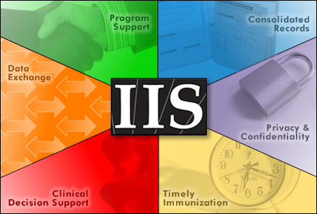

Slide 11
Other IIS Capabilities
Integrate with other electronic health information systems
Vaccine management at the provider and immunization program levels
Forecast next appropriate vaccination(s) due, specific to each patient
Emergency preparedness & pandemic influenza planning

Slide 12
IIS Funding Sources
Section 317
Vaccines for Children (VFC)
Private sources: private foundations, health plans, service clubs
State/local funds: immunization coalitions, state legislature, and State Tobacco Dollars
Centers for Medicare & Medicaid Services

Slide 13
IIS Stakeholders
Public health and government agencies
Healthcare providers
Childcare facilities, schools, & universities
Health plans and insurance companies
Vendors of clinical management or medical billing software
Clinical or medical software vendors
National professional organizations

Slide 14
IIS Benefits

Slide 15
IIS Benefits to Immunization Programs
Retrieve real-time data
track and evaluate trends in data/coverage levels
monitoring outbreaks and disease coverage levels
VFC vaccine usage and provider compliancy
Monitor new vaccine uptake

Slide 16
IIS Benefits to Parents
& Community
Help prevent disease outbreaks in the community.
Keep records kept safe during natural disasters.
Ensure children don't miss any shots or get too many shots.
Remind parents by mail or telephone when their child need shots.
Help determine pockets of need in a community.
Determine where new clinics and provider offices need to be placed.
Maintain records of children in foster care.

Slide 17
IIS Benefits to Providers
Consolidating immunization-related information
Automatically calculating vaccinations needed
Generating reminder and recall notices
Reducing paperwork, save time and money
Connecting clinicians
And many more.

Slide 18
IIS Benefits to Health Plans
Health plans use IIS to measure HEDIS rates to monitor and improve quality of care they deliver
  This saves health plans time and resources to look up and evaluate medical records.

Slide 19
Laws, Policies and IIS

Slide 20
Privacy and Confidentiality in IIS
Information in IIS is private and confidential
Privacy is the legal right of a person to limit access to information about that person
Confidentiality is the treatment in a manner consistent with the understanding made at the time of its disclosure
Privacy and confidentiality are governed by state and federal law and IIS policies

Slide 21
State Laws Affecting IIS
Life long or age specific
Voluntary or mandated reporting for health care providers
Opt-in or Opt-out for individuals/parents
Persons/entities that can disclose information to the IIS
Person/entities that the IIS can allow to access information in the IIS
Privacy and confidentiality of healthcare information
Integration with other public/private information systems
School/daycare entry
Immunizations requirements
Exemptions

Slide 22
Federal Laws Affecting IIS
Health Insurance Portability and Accountability Act (HIPAA)
  HIPAA Privacy Rule governs use and disclosure of “protected health information”
  Health care providers and payers are subject to HIPAA
  IIS are not a “covered entity” subject to HIPAA
    Each IIS should have written confidentiality and security policies that addresses the following issues.
Family Educational Rights and Privacy Act (FERPA)
  FERPA protects the privacy of the educational records held by schools
  Disclosure requires consent

Slide 23
History of IIS

Slide 24
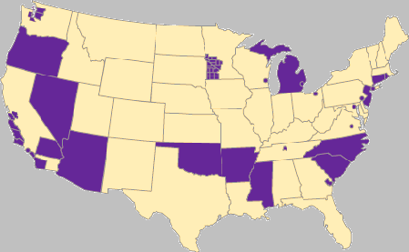
IIS Development
IIS first created in 1990s through Robert Wood Johnson Foundation and All Kids Count
Currently, funding is made available under section 317 (b) of the Public Health Service Act for 50 states, 6 cities and 8 U. S. Territories.

Slide 25
Participation in IIS

Slide 26


Preliminary Data. Percentage of children aged < 6 years participating in a grantee immunization information system -- United States, six cities§, and eight Territories†, 2007
§Chicago, Illinois (34%-66%); District of Columbia (95%–100%); Houston, Texas (67%–94%); New York City, New York (95%–100%); Philadelphia, Pennsylvania (95%–100%); San Antonio, Texas (67%–94%).
†American Somoa (No Report), Marshall Islands (67%-94%), Federated States of Micronesia (95% -100%), Guam (No Report), N. Mariana Islands (No Report), Palau (No Report), Puerto Rico (67%-94%), Virgin Islands (No Report)
No Report
0-33%
34-66%
67-94%
95-100%
National Participation: 71% (excluding Territories)
Source: CY2007 IISAR

Slide 27
Provider Participation:
Key to IIS Success
Ensuring provider participation is critical to complete and accurate electronic immunization records in IIS. Provider barriers and perceptions include:
  Participation requires too much cost/staff time.
  Practices have its own health information systems.
  Perceived non-compatibility of IIS technology and office computers,.
  Confidentiality concerns.
  Lack of support for IIS from the state medical or specialty society.
  Lack of support from the practice's nursing or administrative staff.

Slide 28
How IIS Work

Slide 29
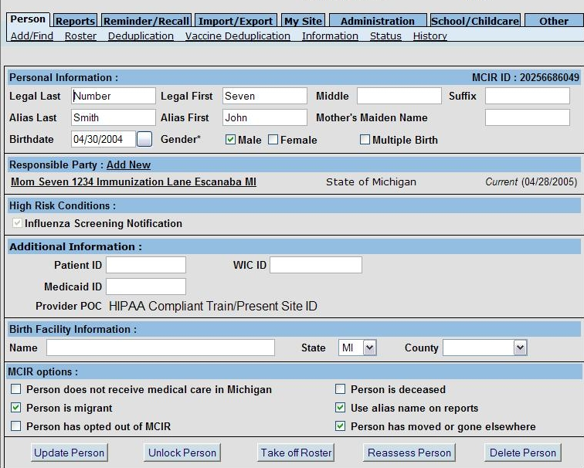

Slide 30
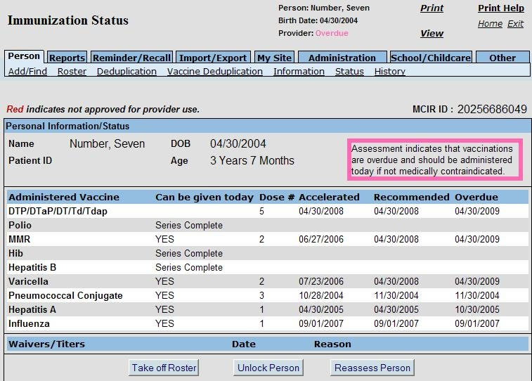

Slide 31
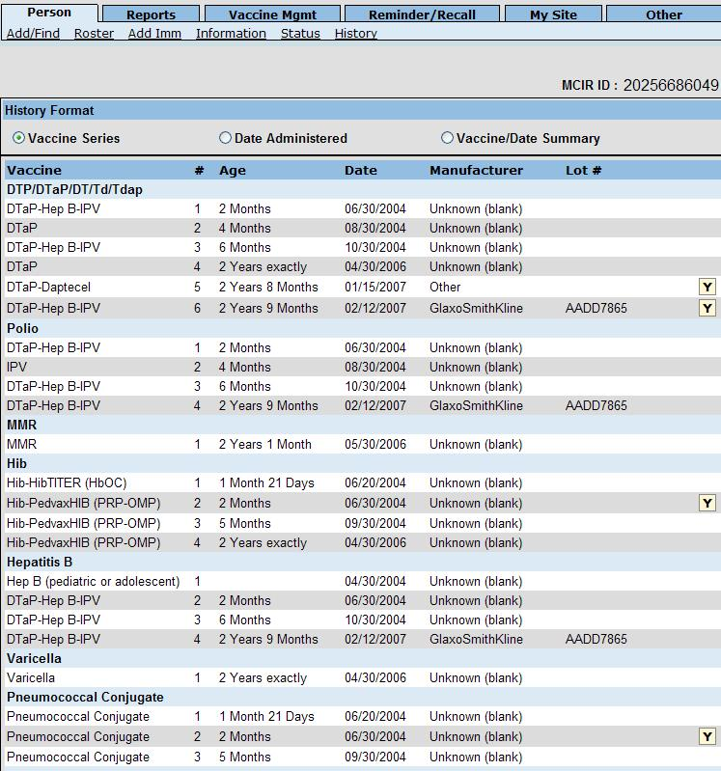

Slide 32
Sources of IIS Data
Birth Records
Direct data entry by providers
Electronic medical records
Medicaid and insurance billing/claims

Slide 33
Information in IIS
NVAC core data elements
  Purpose: a) attributes necessary for identifying individuals; b) facilitate record exchange
  Data are either required or optional
  Examples of required elements: patient first, middle and last names; birth date, birth order, race, ethnicity, vaccine type, date, lot number, address and phone number.

Slide 34
Guiding Documents for IIS

Slide 35
Guiding Documents for IIS
2008-12 Immunization Program Operations Manual (IPOM)- guidance document for developing objectives, activities, and evaluation measures that maximize immunization program effectiveness, including IIS.
IIS Strategic plan provides a roadmap of activities required to reach the 2010 national IIS .objective to increase to 95% the proportion of children (ages 0 - <6 years) participating in a fully operational, population-based IIS

Slide 36
Guiding Documents for IIS
IIS Business Plans- designed to assist grantees in planning, developing, and implementing IIS activities throughout the project lifecycle.
317 Grant- Assures the implementation of effective immunization practices and proper use of vaccines to achieve high immunization coverage, and supports infrastructure for immunization activities.
Public Health Information Network (PHIN) Standards- a national initiative to improve the capacity of public health to use and exchange information electronically by promoting the use of standards and defining technical requirements.

Slide 37
IIS Functional Standards

Slide 38
Functional Standards
12 minimal functional standards, including:
  Electronically store data on all NVAC core data elements
  Establish a IIS record within 6 weeks of birth
  Enable access to and retrieval of immunization information in the IIS at the time of encounter
  Receive and process immunization information within 1 month of vaccine administration
  Protect the confidentiality of health care information
  Ensure security of health care information

Slide 39
Functional Standards continued
Exchange immunization records using HL7 standards
Automatically determine the routine childhood immunization needed, in compliance with current ACIP recommendations,
Automatically identify individuals due/late for immunization to enable the production of reminder/recall notifications
Automatically produce immunization coverage reports by providers, age groups, and geographic areas
Produce official immunization records
Promote accuracy and completeness of IIS data

Slide 40
Forecasting
A core function of most IIS is the forecasting algorithm
Using patients date of birth and shots already received, create an accurate recommendation of what should be given next
Very complex, difficult to design and maintain especially when new vaccines are added or different age ranges are recommended
Currently no federal/national set of code available although this has been expressed as a need by many states

Slide 41
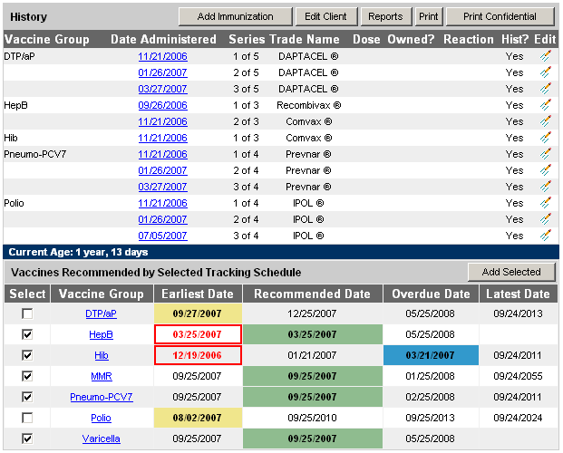

Slide 42
Reminder Recall
Reminders are post cards or autodialers that tell parents when it’s time for the child’s next series of immunizations.
Recalls are sent when a child is overdue for a series of immunizations.
IIS at the state and local level or at the provider level are used to track each patient and to send out reminders and recalls.
    Many IIS can automatically generate reminders/recalls. The format varies by IIS.
      Letters
      Phone calls
      Mailing labels

Slide 43
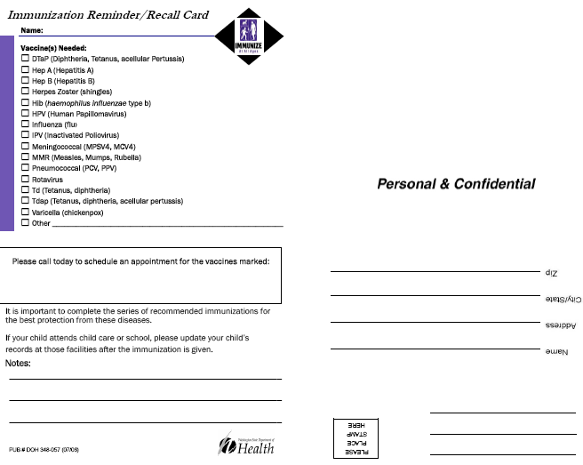

Slide 44
Data Quality
High data quality is: accurate, timely, meaningful, and complete
Data quality focuses on the data coming into IIS and more in-depth vaccine-specific checks
Data quality assurance protocols are used to verifying the reliability and effectiveness of data
Maintaining data quality involves updating, standardizing, and de-duplicating records to create a single view of the data, even if it is stored in multiple disparate systems.

Slide 45
Patient level de-duplication
Important for clinical follow-up and outreach; reminder-recall; and coverage assessments.
The process of identifying possible duplicates and preventing additional duplicates from being added and preventing two records, which truly are unique, from being merged into one.
IIS use mothers maiden name and mothers first name, along with address, gender, race, and others.

Slide 46
Moved or Gone Elsewhere (MOGE)
Important in coverage assessments, reminder-recall, IIS data linkages.
Inappropriate classification of MOGE may result in an inflated or under-inflated coverage measures.
AIRA-MOGE guidelines at: www.immregistries.org

Slide 47
Vaccine Level De-duplication
IIS receive immunization data (vaccination events) from many different sources.
The decisions made during vaccination level de-duplication affect the forecasting of vaccine administration.
Complete and accurate information on the vaccination history of the patient is essential for providers
Resource: www.immregistries.org/

Slide 48
Data Exchange
IIS have developed methods of acquiring immunization data through means other than direct data entry.
Importing and exporting data from another system to and from the IIS can be done through various methods such as:
  encrypted email
  Secure ftp
  https
  HL7- standard required by CDC for all IIS

Slide 49
IIS Data Use

Slide 50
List of most commonly used IIS-generated reports
Reminder/recall
Vaccine usage
Coverage levels
Invalid dose, extra-immunizations, and age-inappropriate vaccination reports
Monthly Doses Administered
Provider Profile Data Report
Profile Reports
Monthly Biologics and Ending Inventory Reports
And many more

Slide 51
IIS data use by Immunization Programs
Assist in implementing immunization program action plans, measurables, and evaluation processes.
Measure immunization coverage levels .
Evaluate vaccine uptake and usage.
Monitor Universal Hep B birth dose.
Comprehensive Clinic Assessment Software Application (CoCASA) tool.

Slide 52
IIS Data use by other Health Programs
  Disease Surveillance:
    Target pockets of need
    Compare incidences of infection
  Disease Outbreak
    Evaluation
    Control measures
  Aid in natural or man-made disaster

Slide 53
IIS Data Use by health-care Providers
IIS can help providers to keep track of the vaccines they provide to their patients
Vaccine forecasting avoids over-and under-immunization
Creates lists of children who need vaccines so providers know who to call in to the office (vaccine reminders)
Marks which children in the office practice need to come back in to the office during a vaccine recall, vaccine shortage, or incorrectly stored vaccine.

Slide 54

Examples of how IIS have been
used in various capacities
Pandemic Flu
Natural Disasters- Katrina

Slide 55
IIS Linkages

Slide 56
Data use through Linkages
Streamline required school immunization reporting
Readily available official immunization record to schools and parents
Track administered vaccines to ensure proper reimbursement for providers
Integrate immunization data with other systems (e.g., newborn and lead screening, WIC, office billing systems and electronic medical records)
Reduce or eliminate the need for health plan staff to conduct manual chart pulls to collect immunization data in physician offices
Increase immunization data quality and completeness
WIC and Immunization Programs share population base

Slide 57
IIS and Vaccine Management
Monitor VFC vaccine usage and ordering
Control inventory/biologics
Track specific vaccine doses
Recall vaccine by lot number, manufacturer, antigen
Analyze doses administered and find children requiring immunization or re-administration of vaccines

Slide 58
Other Types of Health Information Systems
Cancer registries
Early hearing detection
Newborn metabolic screening
Childhood lead poisoning

Slide 59
Future of IIS

Slide 60
Future of IIS
Promote IIS data use
Linkages with other health information systems
Independent objective analysis of IIS operations
IIS accountability and performance measurement
National Vaccine Advisory Committee functional recommendations/standards of operation.
IIS Program evaluation

Slide 61
Additional Resources

Slide 62
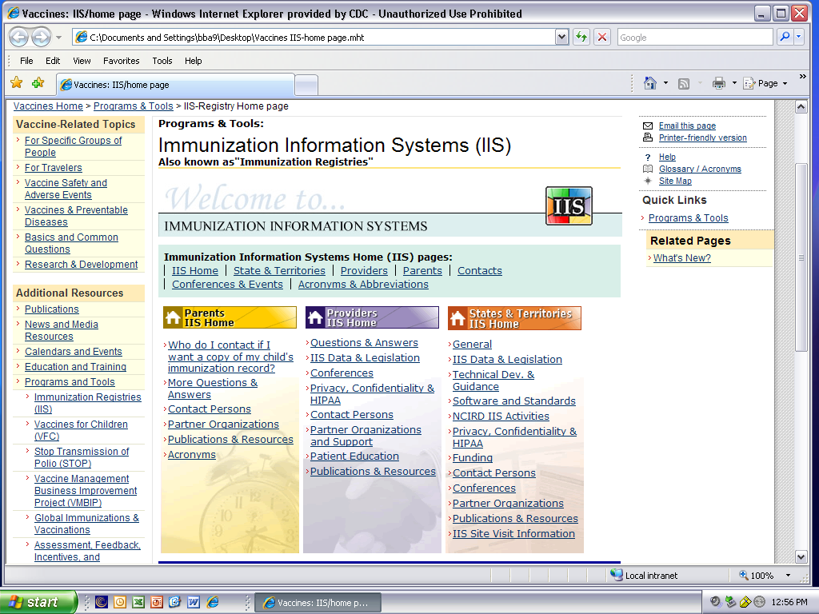
NCIRD’s IIS Website

Slide 63

Subscribe for E-mail Updates to IIS web site pages
  Get Email Updates
Notes:
In addition, on web pages where you see this image and link, click on the link to subscribe to receive e-mail notification of changes made to that page.

Slide 64
Partner Websites
Key partner web sites:
AAP: www.aap.org
AIM: www.immunizationmanagers.org
AIRA: www.immregistries.org
ECBT: www.ecbt.org
PHII: www.phii.org
Expanded list on NCIRD’s IIS website at:
  http://www.cdc.gov/vaccines/programs/iis/default.htm

Slide 65
Acknowledgements
Julie Clark- AIRA/Michigan
Elaine Lowery- Colorado
Emily Peterson- Minnesota
Molly Sander- AIM/North Dakota
Jennifer Zavolinsky- ECBT
Dale Babcock- CDC
Amanda Bryant- CDC
Gayle Daniels- CDC
Susan Farrall- CDC
Lynne McIntyre- CDC
Carl Phillip- CDC
Bobby Rasulnia- CDC

Slide 66
Continuing Education Credit
Continuing education credit is available for this module only through the CDC ATSDR Training and Continuing Education online system at
www2a.cdc.gov/TCEOnline

Slide 67
Continuing Education Credit
Verification Code: NT108F

Slide 68
IIS-related documents
You may also visit the following web page for access to all documents referenced in this module at:
www.cdc.gov/vaccines/programs/iis/iis101docs.htm

