Slide 1









A Conference on Providing Solutions and
Creating Opportunities for U.S. Companies at the
Multilateral Development Banks

Slide 2


EBRD: “not just for Europeans”
Alice Davenport
Senior Commercial Officer US Commercial Service Liaison Office to the EBRD (CS-EBRD)
Washington, DC, April 25, 2005

Slide 3
The EBRD – in brief
Founded in 1991 to help 27 countries of former Soviet bloc – Central Europe to Central Asia
Promotes transition to market economies
Owned by 60 countries and two inter-governmental institutions (EC and EIB)

Slide 4
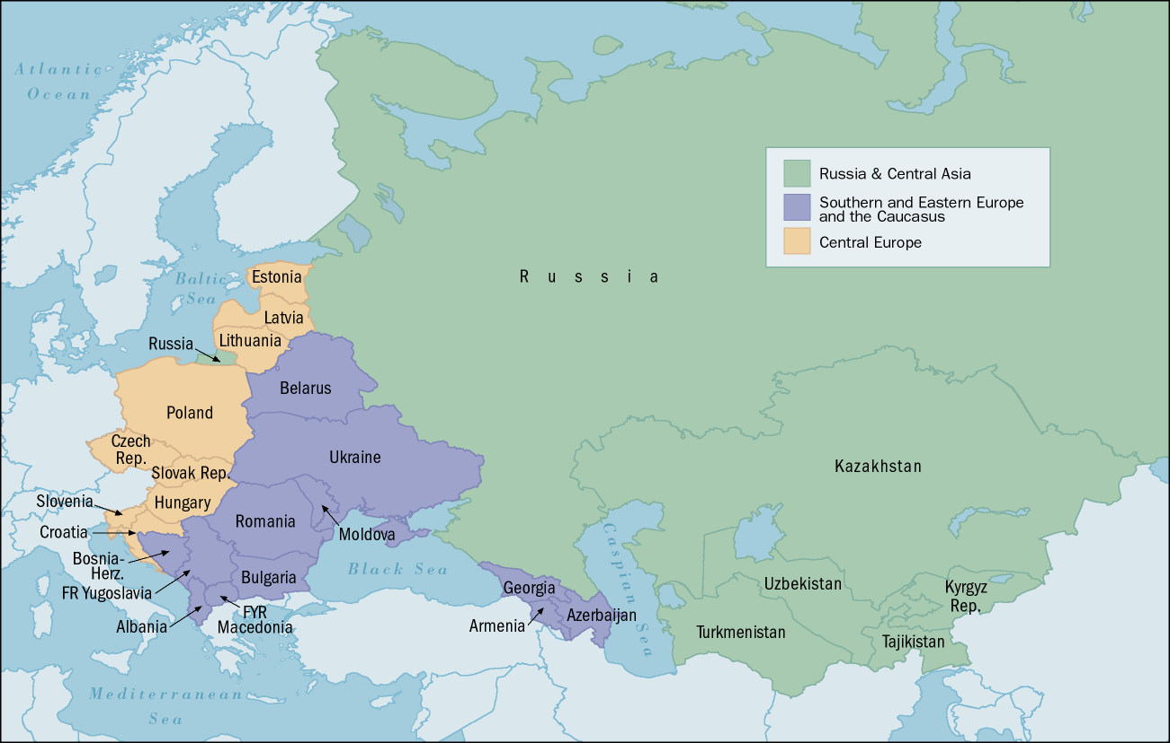
EBRD – 32 offices in 27 countries

Slide 5
The EBRD – Financials
Capital base of €20 billion ($26 billion)
Commitments to date exceed €22 billion ($28.5 billion)

Slide 6
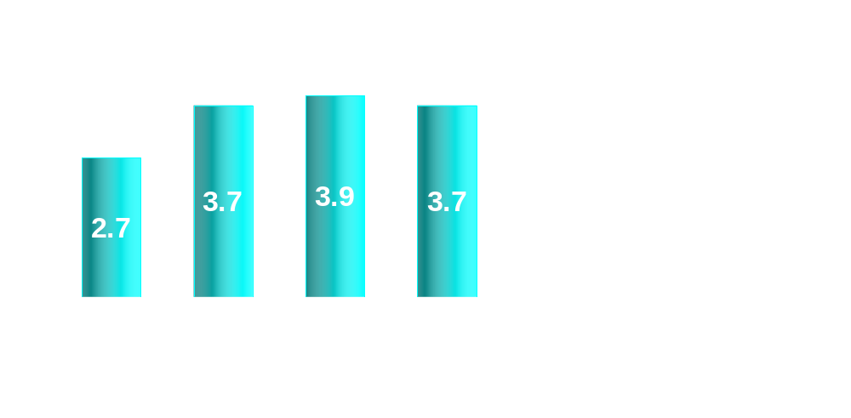
Annual EBRD Investment
EUR billion

Slide 7

MDB comparison of portfolios – Public vs Private Sector
Private sector portfolio (also shown in %)
$ million
Public sector portfolio
$22.4 bln
Private Sec= 17%
$6.8 bln
$6.1 bln
Private Sec= 5%
Private Sec= 15%
$2.6 bln
$4.5 bln
Private Sec= 4%
Private Sec= 79%

Slide 8
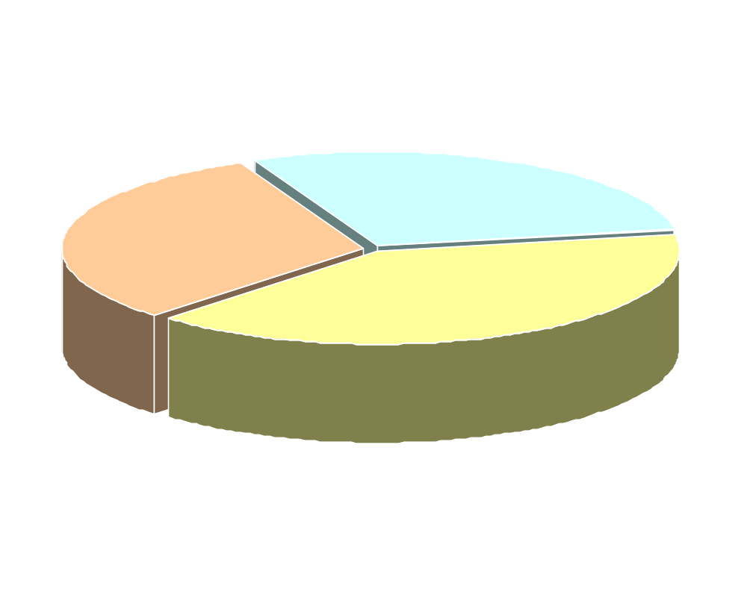
Regional breakdown
Cumulative commitments €22 billion
SE Europe & Caucasus 29%
Russia & Central Asia 31%
Central Europe 40%
[Source: EBRD Annual Report 2003]

Slide 9
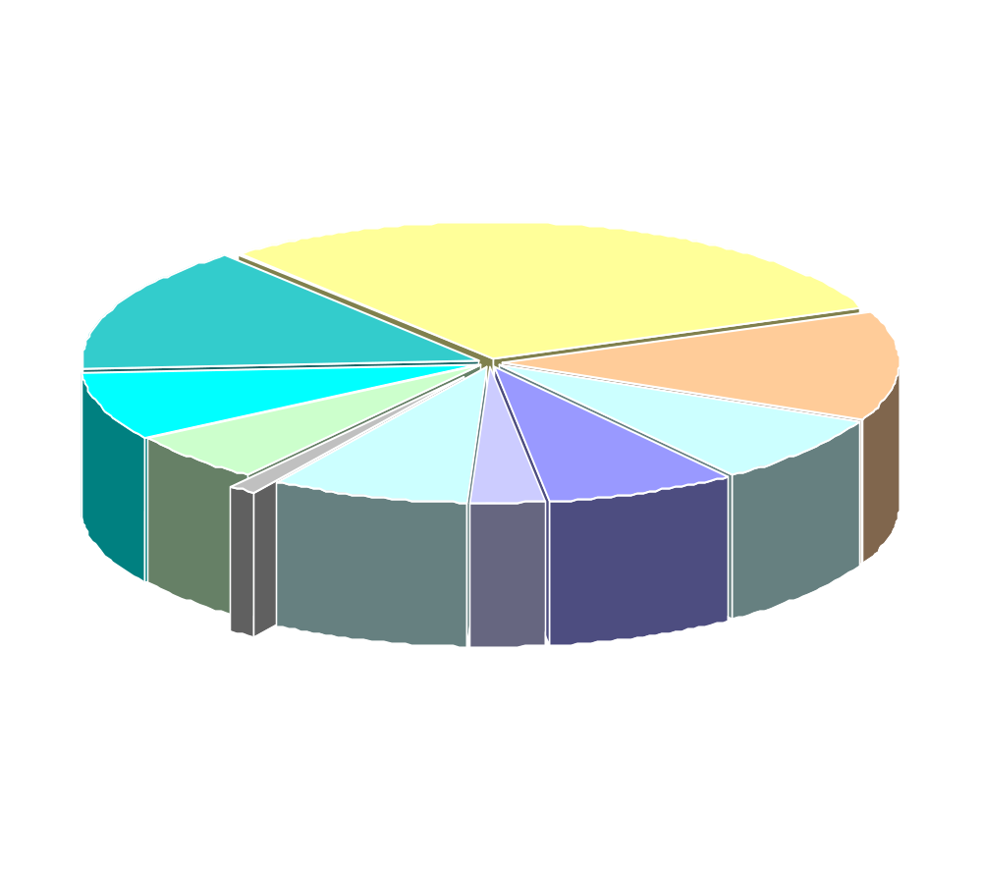
EBRD Portfolio by industry sector
Financial Institutions 30%
Transport 15%
General Industry 13%
Power & Energy 8%
MEI 6%
Agribusiness 8%
Energy Efficiency 1%
Property & Tourism 3%
Natural Resources 8%
Telecoms 8%

Slide 10
EBRD Trends – sector
Financial services
Utilities (water, telecom)
Agribusiness
Transport and urban infrastructure
Energy and environment

Slide 11
EBRD Trends – regional
Moving “south and east”
Special role in EU Accession countries
Emphasis on Russia’s regions

Slide 12
EBRD Initiatives & Programs
Technical Cooperation Funds Program
Trade Facilitation Program
Early Transition Countries (ETC) Initiative
Legal Transition program

Slide 13
The US & the EBRD
The US is the largest single shareholder in the EBRD with a 10% stake
US FDI in the EBRD’s region by the end of 2003 was over $17 billion
One of the largest contributors to EBRD’s Technical Cooperation Fund
USTDA and USAID are strong supporters of EBRD

Slide 14
Opportunities for US Exporters
Procurement - $4.8 billion in project funds
- Public sector
- Private sector
All procurement is carried out by EBRD’s client. EBRD oversees the process, whether public or private
Consultancy opportunities (for EBRD or client)

Slide 15
Public sector procurement
Bank’s client issues tender documents
EBRD publishes details in a Procurement Notice and oversees the whole process
Client evaluates bids and selects winner
Client awards contract
EBRD releases funds

Slide 16
Private sector procurement
EBRD agrees to fund project
Bank’s client is responsible for all aspects of tender process including issuing Procurement Notices
EBRD oversight is more limited
Client evaluates bids, selects and awards contract
Find opportunities by monitoring Project Summaries on EBRD website

Slide 17
Consultancy procurement
For projects over €50K:
EBRD solicits Expressions of Interest (“EOI”)
If between €50K-200K, selection is from shortlist
If over €200K, formal proposals are requested from the shortlist, then EBRD/Client evaluates and selects
EBRD releases funds

Slide 18
Success of US Companies
Of 181 public-sector contracts awarded in 2003, US companies won 4 out of 14 tenders (29% success)
US companies excel in consultancy – 35% of the top-valued EBRD general consultancy contracts were won by US firms in 2003
US law firms do well – ranked 2nd or 3rd in terms of contract value in past 3 years

Slide 19
Finding EBRD Opportunities
CS-EBRD’s Project Pipeline Report helps US companies find opportunities www.buyusa.gov/ebrd
EBRD Project Summaries www.ebrd.com/projects/index.htm
EBRD Procurement Notices www.ebrd.com/oppor/procure/opps/main.htm
Work with partner organizations (EXIM, BISNIS)

Slide 20
CS-EBRD activities
Dissemination of project leads
Counseling on EBRD opportunities and bidding process
Help US companies navigate the Bank’s complex organizational structure
Advocacy & introduction services
Assist in the handling of trade complaints

Slide 21
Conclusions
EBRD is “not just for Europeans”
Continued excellent opportunities for US companies
US bidders are competitive
US companies are strong in key EBRD target sectors (utilities, financial services, energy, telecom, agribusiness, environment)

Slide 22

Main contacts – CS EBRD
Alice Davenport
Senior Commercial Officer
CS-EBRD
+44 207 588 8490
Alice.davenport@mail.doc.gov
http://www.buyusa.gov/ebrd
Louise Hardiman/Ayse Ozcan
Senior Commercial Specialist
CS-EBRD
+44 207 588 8439
Louise.Hardiman@mail.doc.gov
Ayse.Ozcan@mail.doc.gov

Slide 23
A Conference on Providing Solutions and
Creating Opportunities for U.S. Companies at the
Multilateral Development Banks

