Slide 1
Iowa’s Experience with
Two-lane to Three-lane Conversions
Wen Li, Master’s Student
and
Dr. Alicia Carriquiry
Iowa State University Department of Statistics,
Dr. Michael Pawlovich, PE
and
Tom Welch, PE
Iowa DOT Office of Traffic and Safety
for
the Iowa Department of Transportation
Office of Traffic and Safety

Slide 2
Preliminary Results
Density: 12 percent (reduction)
Rate: 34 percent (reduction)
NO control sites – so preliminary results – future effort
Notes:
The arrow points down meaning 12 percent reduction in density and 34 percent reduction in rate

Slide 3
What
Converting an existing 2-lane roadway to a 3-
lane roadway → typically 2-lanes with center
continuous left-turn lane
Important → left-turn lane
Also – sometimes bike lanes and pedestrian accommodations

Slide 4
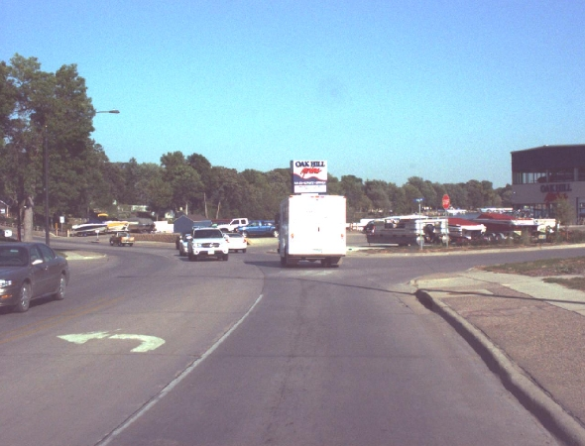
What: 3-lane
Source: Iowa DOT RoadView
Arnold’s Park, IA – US 71 NB
Notes:
Picture: Arnold’s Park, IA-US 71 NB. The photo shows a 3-lane section of Arnold’s Park road in Iowa intersecting with US 71 NB

Slide 5
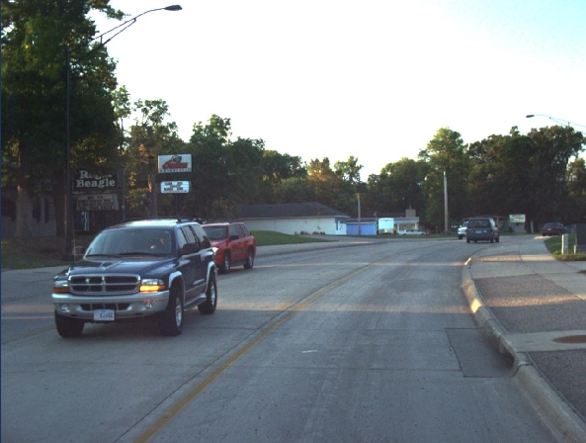
What: 3-lane
Source: Iowa DOT RoadView
Arnold’s Park, IA – US 71 NB
Notes:
Picture: Arnold’s Park, IA-US 71 NB. The photo shows another 3-lane section of Arnold’s Park road in Iowa

Slide 6
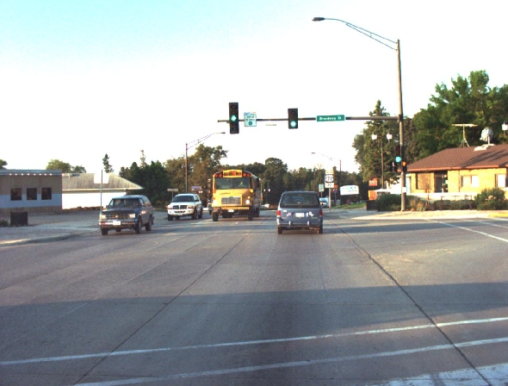
What: 3-lane
Source: Iowa DOT RoadView
Arnold’s Park, IA – US 71 NB
Notes:
Picture: Arnold’s Park, IA-US 71 NB. The photo shows another 3-lane section of Arnold’s Park road in Iowa

Slide 7
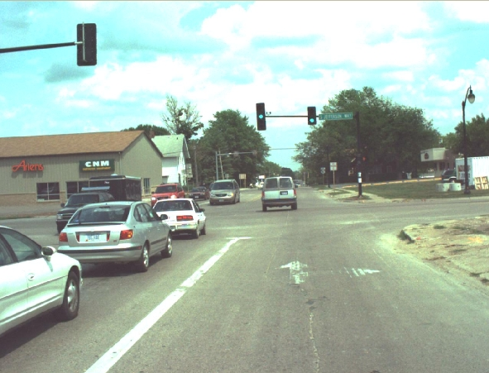
What: 3-lane
Source: Iowa DOT RoadView
Indianola, IA – IA 92 NB
Notes:
Picture: Indianola, IA-US 92 NB. The photo shows a 3-lane section of Indianola road in Iowa intersecting with IA 92 NB

Slide 8
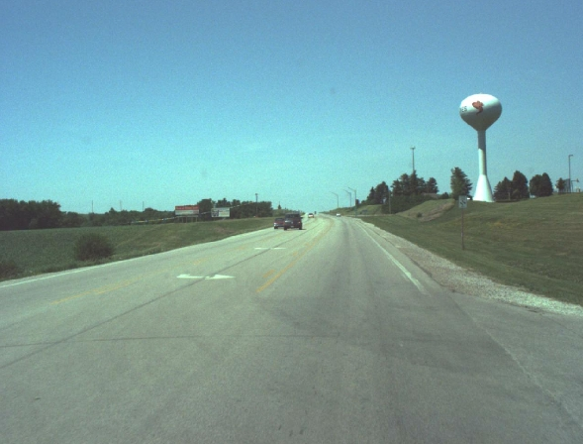
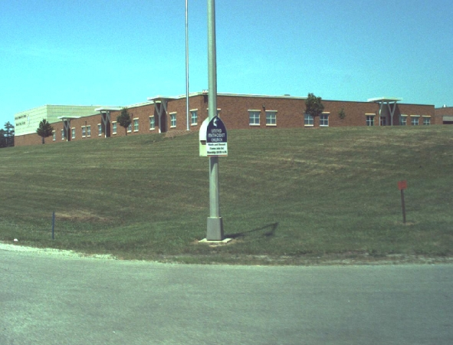
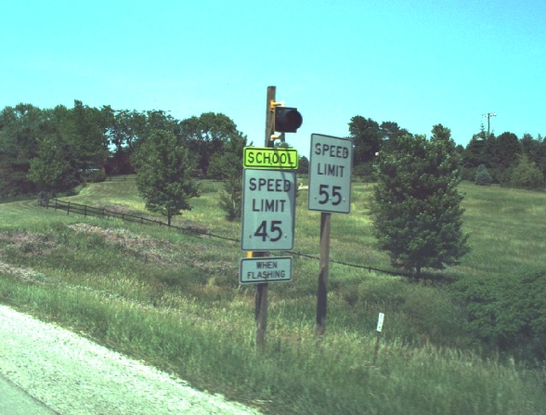
What: 3-lane
Source: Iowa DOT RoadView
Harlan, IA
School
Harlan, IA – US 59 NB
Speed limit
Note: Oncoming van is entering turn lane with vehicle behind it. Speed limit is 45 mph thru the school site.
Notes:
Picture: Harlan, IA-US 59 NB. The photo shows a 3-lane section of Harlan road in Iowa intersecting with US 59 NB
Picture: School. The photo shows the school within the vicinity of the intersection of Harlan road with US 59 NB in Iowa
Picture: Speed limit. The photo shows two (2) speed signs ( 45 mph and 55 mph). There are flashers on the 45 mph sign to indicate reduced speed in the school zone when flashing

Slide 9
History
Treatments in Iowa
  35 from 1981 – 2004
  28 from 1991 – 2004
Studies
  2005 – Florida DOT

Slide 10
Bayesian Before/After
Objective: Assess whether 2-lane to 3-lane
conversions appear to result in crash
reductions on Iowa roads

Slide 11
Bayesian Before/After
Data
  34 treatment – 1 dropped as treatment in 1981
  25 years (1982-2006)
  Volumes: 2,500 to 15,700 (1982-2006)
  Currently NO control sites – future effort

Slide 12
Site Data
Site ID | City | Population 2000 | Volume 2000
1 | Ames | 50,731 | 6,800
2 | Ames | 50,731 | 7,900
3 | Ames | 50,731 | 7,500
4 | Ames | 50,731 | 8,500
5 | Ames | 50,731 | 5,000
6 | Ames | 50,731 | 12,200
7 | Ames | 50,731 | 10,000
8 | Arnolds Park | 1,162 | 15,700
9 | Atlantic | 7,257 | 8,000
10 | Council Bluffs | 58,268 | 8,200
11 | Creston | 7,597 | 5,300
12 | Davenport | 98,359 | 9,500
13 | Davenport | 98,359 | 8,500
14 | Dyersville | 4,035 | 9,000
15 | Eldridge | 4,159 | 7,100
16 | Harlan | 5,282 | 5,300
17 | Hull | 1,960 | 4,400
18 | Indianola | 12,998 | 13,500
Site ID | City | Population 2000 | Volume 2000
19 | Iowa City | 62,220 | 10,000
20 | Iowa City | 62,220 | 7,500
21 | Manchester | 5,257 | 7,900
22 | Manchester | 5,257 | 7,500
23 | Maquoketa | 6,112 | 10,000
24 | Mason City | 29,172 | 3,200
25 | Mason City | 29,172 | 7,400
26 | Nevada | 6,658 | 3,400
27 | Nevada | 6,658 | 5,600
28 | Nevada | 6,658 | 4,000
29 | New London | 1,937 | 2,500
30 | Newton | 15,579 | 11,500
31 | North Liberty | 5,367 | 11,500
32 | Oelwein | 6,692 | 5,000
33 | Orange City | 5,582 | 4,500
34 | Pella | 9,832 | 3,200
35 | Waverly | 8,968 | 6,000
Note: Maquoketa dropped from analysis (1981)
Notes:
The red highlighted cell means site ID 23, Maquoketa city with a population of 6112 and traffic volume of 10000 vehicles per day in the year 2000 was dropped from the analysis

Slide 13
Site Data
Site ID | City | Length (mi) | Completion Year
1 | Ames | 0.50 | 2003
2 | Ames | 0.80 | 2002
3 | Ames | 0.35 | 1998
4 | Ames | 0.45 | 1996
5 | Ames | 0.25 | 2004
6 | Ames | 0.30 | 1998
7 | Ames | 0.50 | 2001
8 | Arnolds Park | 1.80 | 2000
9 | Atlantic | 2.00 | 1994
10 | Council Bluffs | 0.85 | 1995
11 | Creston | 0.32 | 2004
12 | Davenport | 1.00 | 1992
13 | Davenport | 0.90 | 2003
14 | Dyersville | 0.50 | 1987
15 | Eldridge | 0.60 | 2001
16 | Harlan | 2.17 | 2001
17 | Hull | 0.25 | 1997
18 | Indianola | 1.60 | 1983
Site ID | City | Length (mi) | Completion Year
19 | Iowa City | 0.45 | 1997
20 | Iowa City | 0.75 | 2001
21 | Manchester | 0.20 | 2000
22 | Manchester | 0.50 | 2000
23 | Maquoketa | 0.80 | 1981
24 | Mason City | 1.00 | 2003
25 | Mason City | 1.00 | 1998
26 | Nevada | 0.25 | 2002
27 | Nevada | 0.25 | 2002
28 | Nevada | 1.00 | 1999
29 | New London | 0.25 | 1985
30 | Newton | 0.90 | 1982
31 | North Liberty | 0.50 | 2000
32 | Oelwein | 1.00 | 1984
33 | Orange City | 1.00 | 1991
34 | Pella | 1.20 | 1985
35 | Waverly | 1.85 | 1997
Note: Maquoketa dropped from analysis (1981)
Notes:
The red highlighted cell means site ID 23, Maquoketa city with a population of 6112 and traffic volume of 10000 vehicles per day in the year 2000 was dropped from the analysis

Slide 14
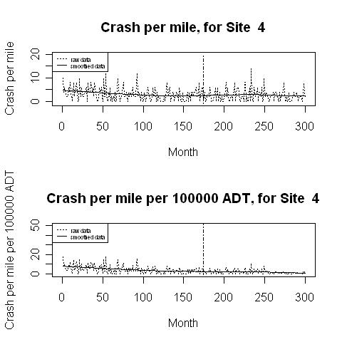
Monthly Crash Densities and Rates
Density
Site 4
Intervention
Rate
Notes:
Graph. Site 4. Site 4 has two(2) graphs: The graph above shows monthly crash densities. The dots indicate the raw data and the smooth line indicate the smoothed data. The x-axis is the month axis ranging from 0 to 300. The y-axis is the density axis ranging from 0 to 10. The red vertical line between months 150 and 200 shows the period of intervention. The smooth line a slight decrease in crash density over time
The graph below shows monthly crash rates. The dots indicate the raw data and the smooth line indicate the smoothed data. The red vertical line between months 150 and 200 show the period of intervention. The x-axis is the month axis ranging from 0 to 300. The y-axis is the density axis ranging from 0 to 50. The red vertical line between months 150 and 200 shows the period of intervention. The smooth line a slight decrease in crash density over time

Slide 15
Modeling/Statistics
Crashes: random, rare count events
Model: Poisson with/ log mean expressed as a piece-wise linear function of:
- time period (months)
- seasonal effects
- random effect for each site
Adopted a Bayesian statistical framework for
estimation of model parameters
Model essentially the same as for prior 4-lane to 3-
lane analysis

Slide 16
Preliminary Results/Discussion
12% (reduction) in crashes/mile
34% (reduction) in crash rate
Recall NO control sites – so preliminary results

Slide 17
Results/Discussion
Prior Florida DOT study:
  32 percent decline in crashes
  not “significant” at 95 percent confidence level
Need to include control sites - future

Slide 18
Questions?
&
Discussion

