Slide 1

How to Identify World Bank Opportunities for SME’s
Presented by:
WILL CENTER
Senior Commercial Officer
US Commercial Service Liaison Office to the World Bank

Slide 2
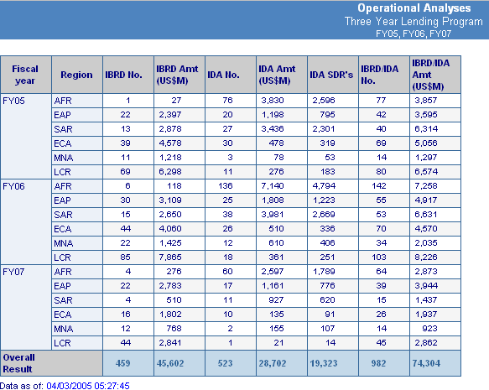

Slide 3
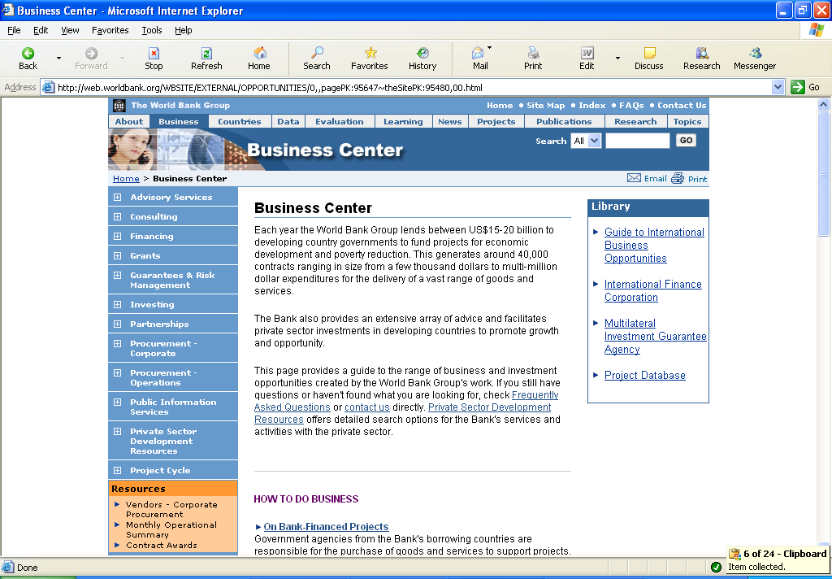

Slide 4
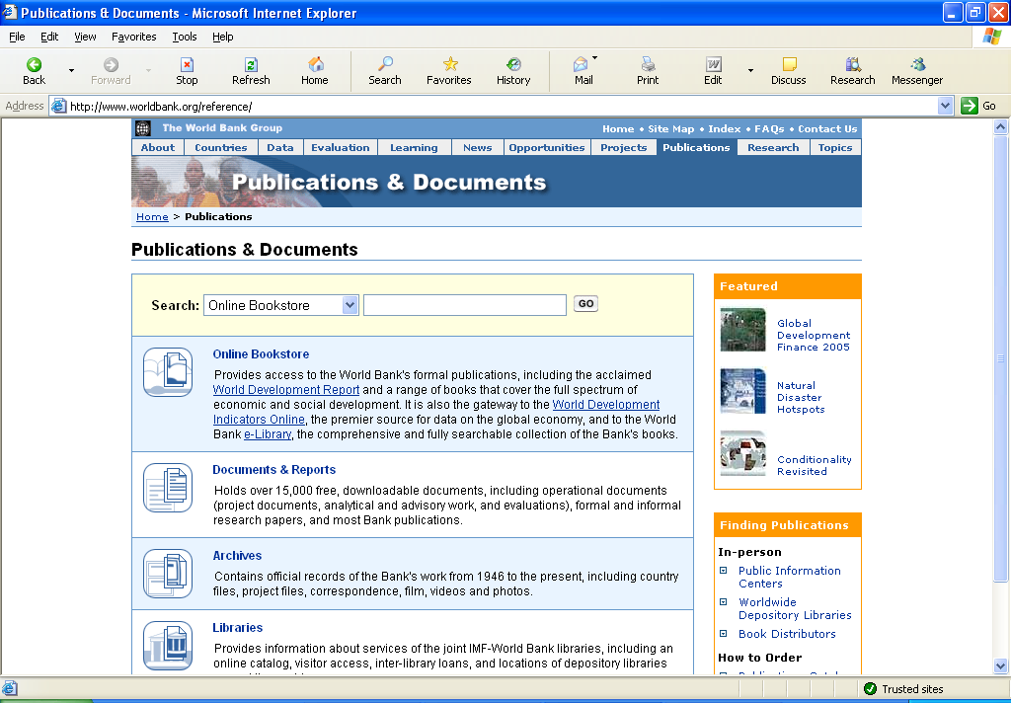

Slide 5
Key Documents & Web Sites
  Country Assistance Strategy
  Business Center/Project Database/Contract Awards
  Project Information Document/Project Appraisal Document

Slide 6
KEY POINTS (IBRD)
  Start with the CAS
  Learn to Speak the Language of Development
  Find the TTL and the Procurement Plan
  Understand the Bank’s Guidelines
  Express Concerns before Bid Evaluations
Notes:
The Borrower prepares RFP and:
Shortlist.
Terms of Reference.
Budget.
Letter of Invitation.
Information to Consultants.
Draft standard form of Contract.
The Borrower also:
Invites proposals.
Evaluates proposals.
Negotiates and awards contract.
Supervises Implementation.
-

Slide 7

World Bank
William Center
Senior Commercial Officer
e-mail: WCenter@worldbank.org
Tel: (202) 458-0120/0118
Fax: (202) 477-2967
Asian Development Bank
Frank Foster
Senior Commercial Officer
e-mail: Frank.Foster@mail.doc.gov
Tel: (011) (632) 887-1345
Fax: (011) (632) 887-1164
Inter-American Development Bank
Brian McCleary
Senior Commercial Officer
e-mail: Brian.McCleary@mail.doc.gov Tel: (202) 623-3821, 3822, 3842
Fax: (202) 623-2039
European Bank for Reconstruction and Development
Alice Davenport
Senior Commercial Officer
e-mail: Alice.Davenport@mail.doc.gov
Tel: (011) (44) 20 7588-8490
Fax: (011) (44) 20 7588-8443
African Development Bank
Ron Soriano
Senior Commercial Officer
e-mail: Ronald.Soriano@mail.doc.gov
Tel: 216-71-10-34-65
Fax: 216-71-10-37-62

