Slide 1
Potential impacts on availability of the draft plateletpheresis guidance on collection facilities
Blood Products Advisory Committee
Gaithersburg, MD
March 9-10, 2006
Louis M. Katz MD
Executive Vice President, Medical Affairs
Mississippi Valley Regional Blood Center
Davenport, IA

Slide 2
(Some) issues with the draft guidance
Longer deferral for ASA and formal deferral for NSAID use
Physician on site within 15 minutes
500 consecutive bacterial cultures allowing a single positive to “validate” 100% QC testing of platelets
Maximum of 24 components annually with specified intervals between single, double and triple collections

Slide 3
ASA and bleeding time (minutes)
The source of the AABB 36º standard 5.4.1A
 | Fresh platelets (n=6) | ASA 600 mg 1º+12º (n=8) | ASA 600 mg 36º (n=5)
1º after transfusion | 9.1±.74 | 15.3±2.5 2 >20 minutes | 8.1±1.3
4º after transfusion | 7.0±.71 | 13.7±5.0 2 >20 minutes | 9.0±.05
Thrombocytopenic (<20,000) children with leukemia or aplastic anemia transfused with fresh platelets or platelets from donors receiving ASA. Template bleeding time. p=NS for 36º v. fresh.
Stuart, MJ et al. NEJM. 1972

Slide 4
Hemostatic effect of “aspirinated” platelets
“We gave donors 0.6 g (10gr) of aspirin 18-24 hours before phlebotomy and transfused their pooled platelets into leukemic patients…. The transfusions resulted in…a striking decrease in the bleeding time.
(W)e suggest that potential donors need not be rejected because of recent aspirin ingestion.”
Benjamin, S and Hoffman, G. NEJM. (Letter) 1972.

Slide 5
ASA and bleeding time
Template bleeding time after transfusion of stored or unstored platelets from 6 aspirin treated (1.2 g BID x 3 days and AM of collection) and untreated donors into thrombocytopenic (<10,000) recipients. Aspirinated platelets correct bleeding time like non-aspirinated but with 4-18º lag.
  “These data suggest that ASA-induced platelet dysfunction is reversible in vivo…. Since the impairment is transient, screening of donors for ASA ingestion is probably unnecessary.”
Slichter and Harker. B.J. Haem. 1976

Slide 6
Considerations re: non-ASA NSAIDs
Effects are reversible
  T_{1/2} varies for individual agents so donor impact variable
  Regardless of T_{1/2}, the relevance of hemostasis data from NSAID treated patients to infusion of “treated platelets” into untreated recipients is not obvious
  Dose effects
  Relevance of in vitro studies in vivo function

Slide 7
In vitro platelet function and NSAIDs
 | Before | 3º | 6º | 24º
ASA | 100 | 56 | 38 | 29
Piroxicam | 100 | 46 | 27 | 44
Naproxen | 100 | 59 | 54 | 59
Indomethacin | 100 | 41 | 59 | 105
Diclofenac | 100 | 67 | 45 | 107
Ibuprofen | 100 | 45 | 59 | 109
Diflunisal | 100 | 47 | 29 | 132
Acetaminophen | 100 | 108 | 87 | ND
Epinephrine induced aggregation before and after ingestion of NSAIDs. Percent of baseline in 5 volunteers. Cronberg, S et al. Scand. J. Hem. 1984.

Slide 8
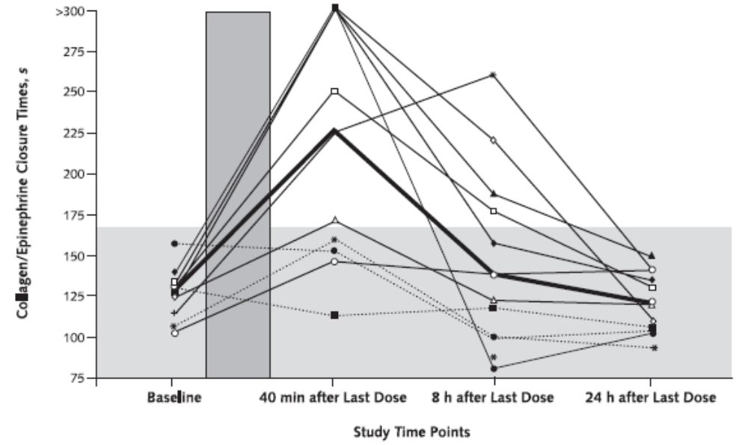
Defect gone 24º after 7d. 600 Q8º ibuprofen [PFA (platelet function analyzer)-100]
Goldenberg et al.
Ann. Int. Med. 2005

Slide 9
NSAIDs except ASA
112 consecutive donors given written questionnaire re: cessation of NSAIDs 3 days before plateletpheresis at MVRBC
  2 would stop donating
  21 use occasionally to regularly and would need a reminder
  41 use at least occasionally but would remember to stop
  48 do not use

Slide 10
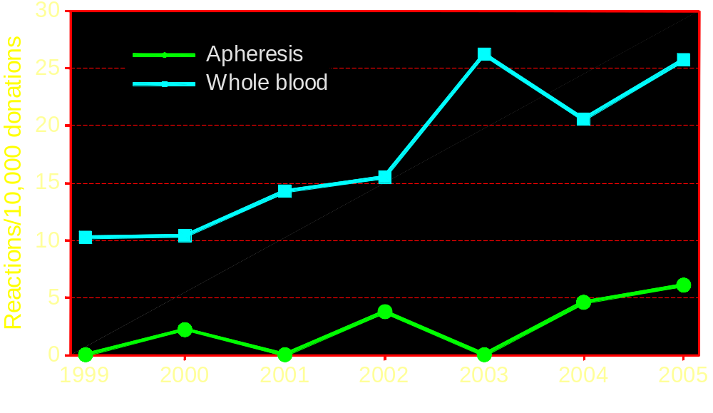
Type 3* reactions (apheresis v. whole blood)
Data from Hoxworth
provided by AABB
*Vagal signs and/or hyperventilation, neuromuscular, excitability, variable color (pale to cyanotic), incontinence, fainting, convulsive movements, true convulsions

Slide 11
499/500 negative bacterial cultures
>90% of apheresis platelets (9-10/2004) are tested with a culture based method in AABB survey (submitted for publication)
Positives (successes) are discarded
Collection facilities have strong economic incentive to minimize false positives
False negatives are the more important remaining issue and this requirement has no impact on false negative rates

Slide 12
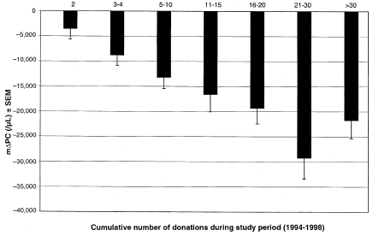
939 donors, 11,464 collections at NIH
(1994-98)
“Regular plateletpheresis donors develop sustained decreases in platelet count. However, clinically significant thrombocytopenia is unusual.…”
Lazarus et al. Transfusion. 2001

Slide 13
MVRBC
43 hospitals in IA, IL, WI
102,622 RBCs
11,232 apheresis platelets distributed
  4 fixed-site plateletpheresis centers
    3.5 hours from main center to furthest
    1 doc
  Fenwal Amicus®
  Gambro Trima®
  1.47 products/apheresis session 2005
24 karat donors (24K)

Slide 14
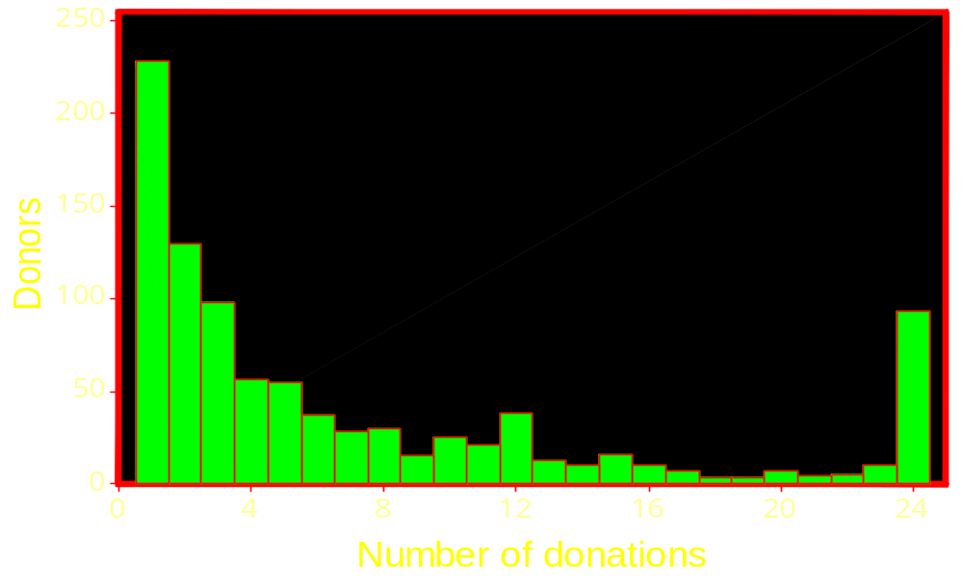
Frequency of plateletpheresis 2004: MVRBC
A restriction to 24 components/yr
would have reduced collections
by 12.5% (minimally) based on
1.47 products/procedure
(1404 products)

Slide 15
MVRBC 24K* (n=60) donors: 2005
Davenport, IA fixed site
Total platelets | 2439
 | (20% of total collections)
Platelets/donation | 1.7
Platelets per donor in 2005 | 40.7
Platelets lost per donor with 24 limit | 16.7
Platelets lost with 24 limit | 41% or 1000 platelets
*24 apheresis donations in calendar 2005

Slide 16
Approx. replacement donors needed at MVRBC with 24 product limitation
(modeled from 2004 and 2005 data)
Freq. in 2004 | N | Ave. don/yr | Prod/ donation | Total prod | Prod lost @ 24/year
<16 | 797 | 4.4 | 1.47 | 5153 | 0
>16 | 142 | 22.4 | 1.7 | 5407 | 1999
To replace 1999 products from >16 time donors with products from <16 time donors requires approximately 1999 products÷1.47 products/donation÷4.4 donations/year or 309 new donors. Assumes no increase frequency among current donors. This is ~33% of the current donor base

Slide 17
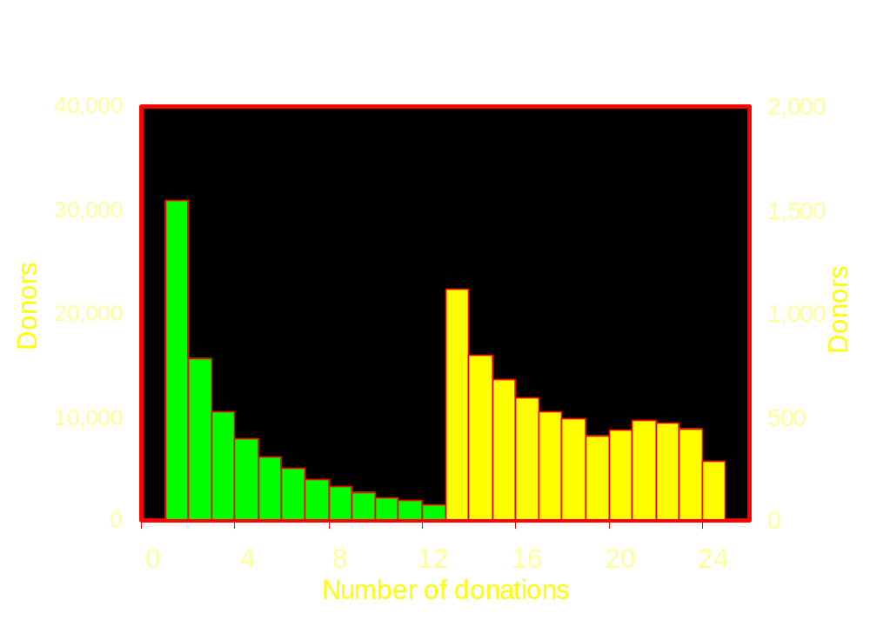
Frequency of plateletpheresis 2004
American Red Cross
5.9% of components lost (CY2004 data.)

Slide 18
>24 component donors (n=3,896): ARC 2004 (6 regions)
Total products | 129,290
Products per donation | 1.8
Products per donor | 33.2
Products per donor lost with 24 component limit | 9.2
Products lost with 24 product limit | 28% or 35,786 units
Data from ARC

Slide 19
Impact on supply and donor base
Donors of >24 prod. | 102 (6.6% of all donors)
Prod. donated | 3902 (36% of all prod.)
Prod. lost with 24 limit | 1454 (13.7% of all prod.)
Additional donors required based on distribution of donation frequencies in current donor base | 863 (56% of donor base)
Data from Dumont, L. Gambro BCT

Slide 20
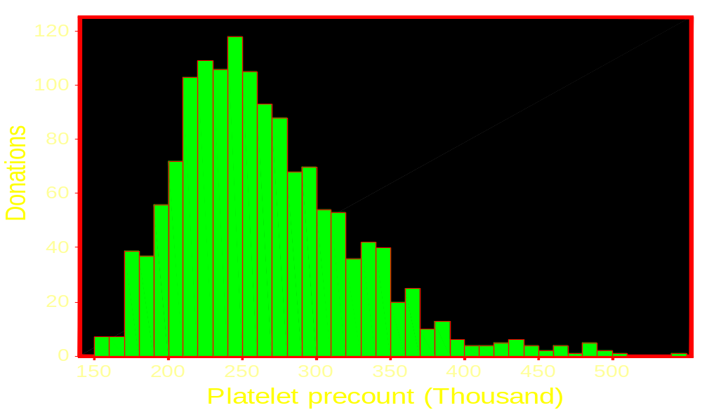
2005 precounts in 60 MVRBC 24K donors
MVRBC 24K Donors
  Male 254 ± 48
  Female 289 ± 73
Community (healthy*)
  Male 226 ± 49
  Female 260 ± 60
J. Consamus MD,
QC Metro Labs
*Used to establish normal range of new instrument in commercial lab

Slide 21
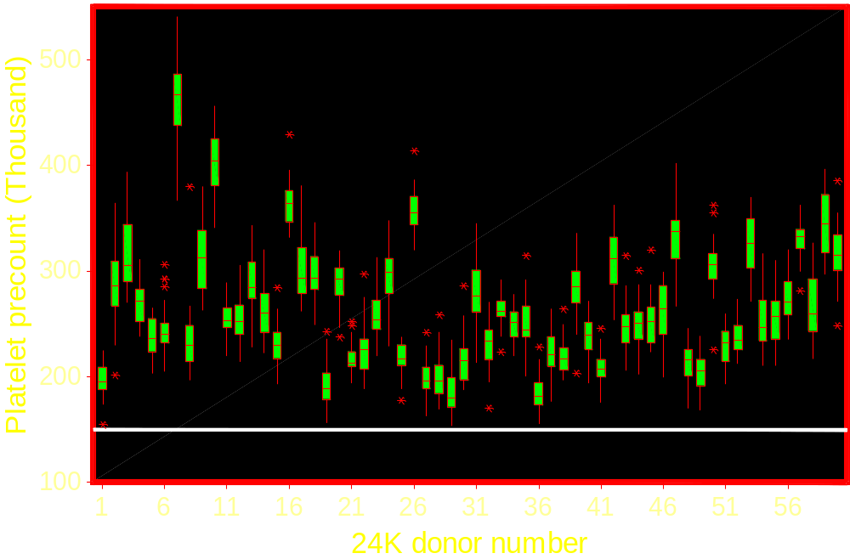
2005 precounts in 60 MVRBC 24K donors
None of these donors were deferred (even
once) during 2005 for precount <150K.

Slide 22
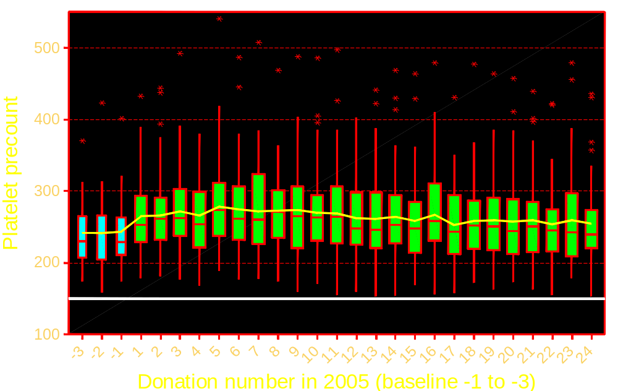
Precounts for 2005 and 1st 3 (ever) donations
(1997-2003, n=31) in 60 MVRBC 24K donors
R²=.1% p=.141

Slide 23
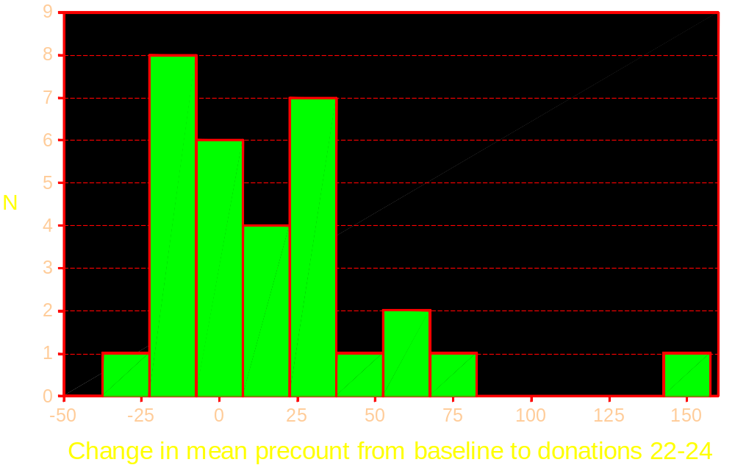
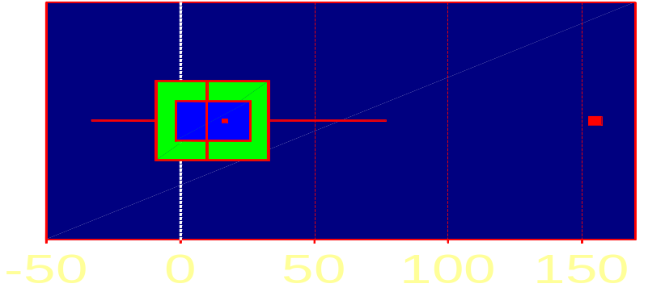
Impact of frequent apheresis on precounts 2005 MVRBC 24K donors
Mean= +16.7 ± 37.0
Median= +10.00 (p>.05)

Slide 24
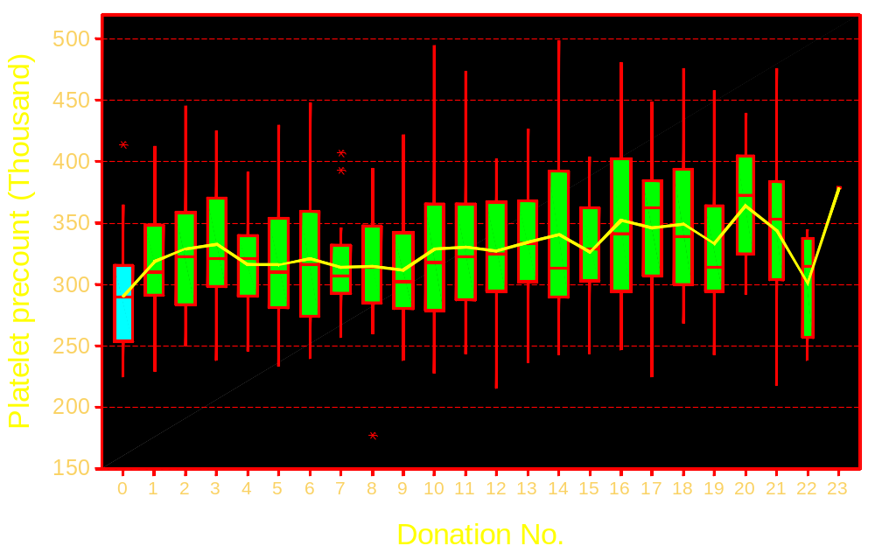
Precounts in 20 frequent FBS donors from 2005 (donation “0” 4/97-1/05 baseline)
Data provided by G. Leparc MD

Slide 25
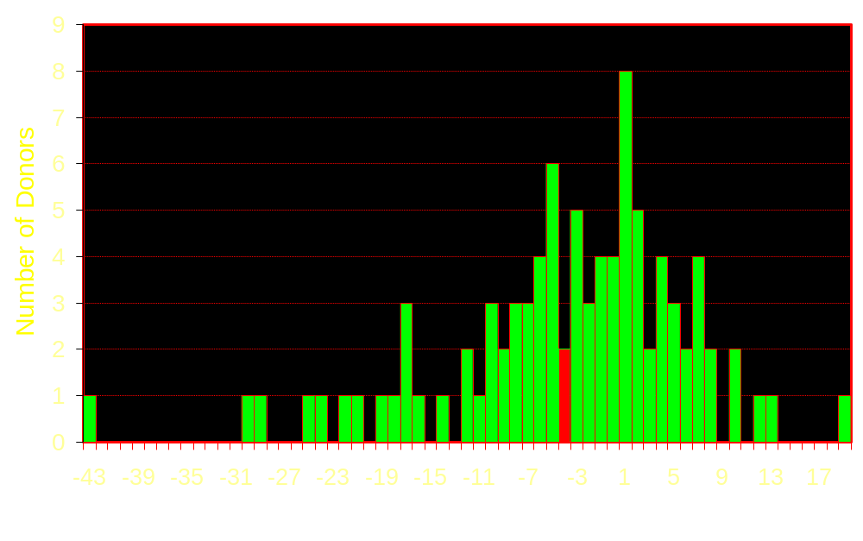
Platelet count: yearly rate of change
Mean: -3900
Decrease: 54
Increase: 37
        Source: ARC
Change In Platelet Count Per Year (Thousand)
91 donors (~5% sample from calendar 2002) followed forward with >14 average
donations per year from 1/02-10/05 in 6 ARC regions.

Slide 26
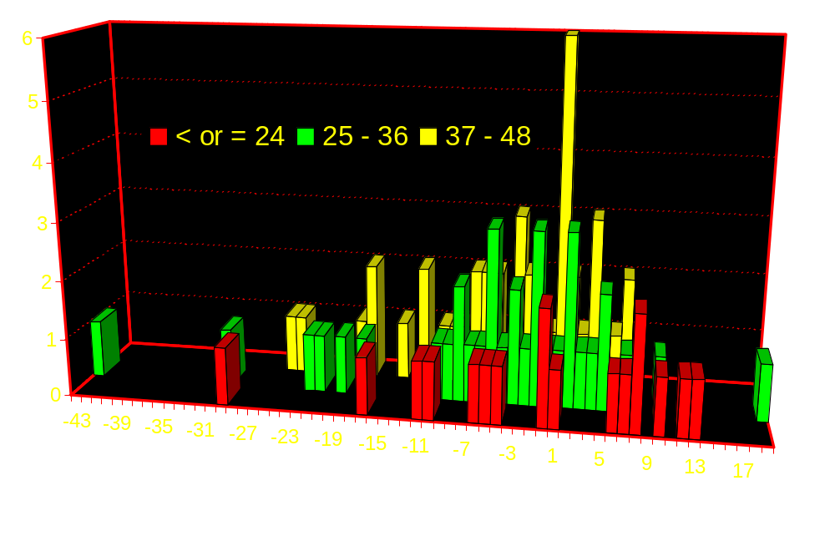
Yearly platelet count change @ 3 levels of average annual product production
91 frequent donors 1-02 to 10-05
Number of donors
Data from ARC
Change in donor platelet count (x10⁹/L)

Slide 27
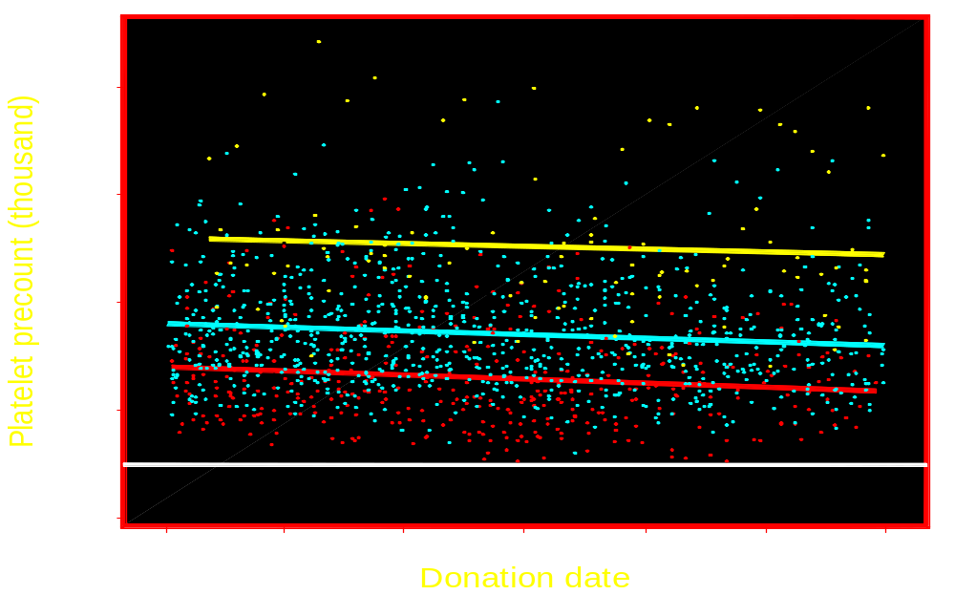
Precount v. products made
60 24K MVRBC donors in 2005
3 n= 99
2 n=864
1 n=414

Slide 28
Single blood center reported to Gambro
12/5/2004 – 12/5/2005
Donors | 1,535
Donation sessions | 6,371
Triple sessions | 992 (15.6%)
Double sessions | 2,743 (43.1%)
Single sessions | 2,199 (33.9%)
< single | 477 (7.5%)
Therapeutic doses (3 – 5.9 x10¹¹ plt) | 10,621
Donors ≥ 8 donation sessions | 285 (18.6%)
Platelet counts by donation frequency and number of products
entered in mixed linear model. Dumont, L. Gambro BCT
Notes:
In this 12 month period, 1535 donors sat for 6371 donation sessions resulting in 10,621 therapeutic doses of apheresis platelets; therapeutic dose being defined as Trima predicted final yield 3.0-5.9x10¹¹ platelets. The number of donation sessions resulting in various quantities of therapeutic doses were: triple platelet products 992 (15.6%), double platelet products 2743 (43.1%), single platelet product 2199 (33.9%) and less than 3x10¹¹ platelets in 477 sessions (7.5%). Maximum donation sessions per year was 24 for any given donor. We further examined donors with ≥ 8 donations sessions in the period (NB: 8 x 3 = 24).

Slide 29
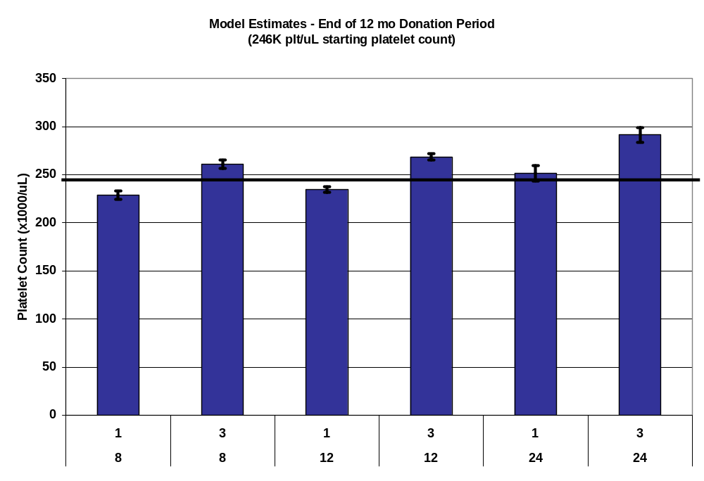
Higher frequency of donation and number of components do not decrease platelet counts
Increasing number of platelets donated from more frequent donation and/or more doses per donation result in increasing platelet counts after a 12 mos. In all donors in model there was no significant decrease (p=0.539).
Data from Dumont, L. Gambro BCT
Notes:
Model estimates (mean +/- SE) for 1 or 3 therapeutic doses per donation: 8, 12, or 24 donations in the period. Average beginning of period platelet count 246K. Increasing number of platelets donated in the period either from more frequent donation and/or more doses per donation result in increasing platelet counts after a 12 month period.

Slide 30
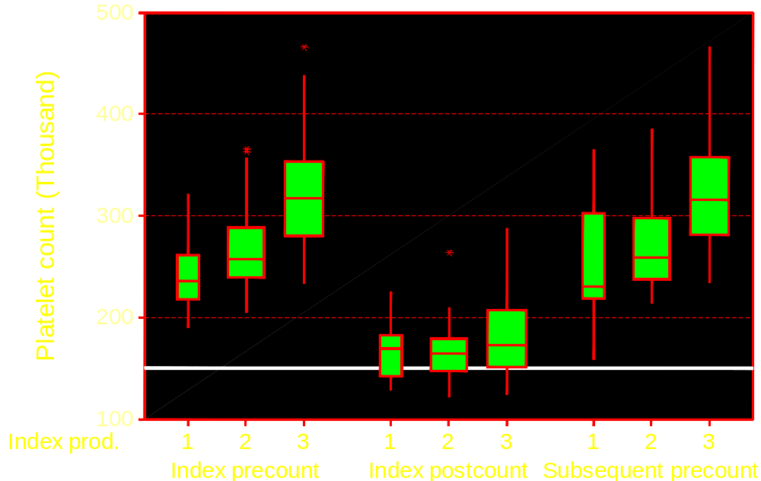
Platelets before/after multiple products
Are postcounts useful??
105 index don. 11/29-12/08/05
87 F/U don. 12/13-12/28/05
Source: G. McPherson.
Hemacare Inc.

Slide 31
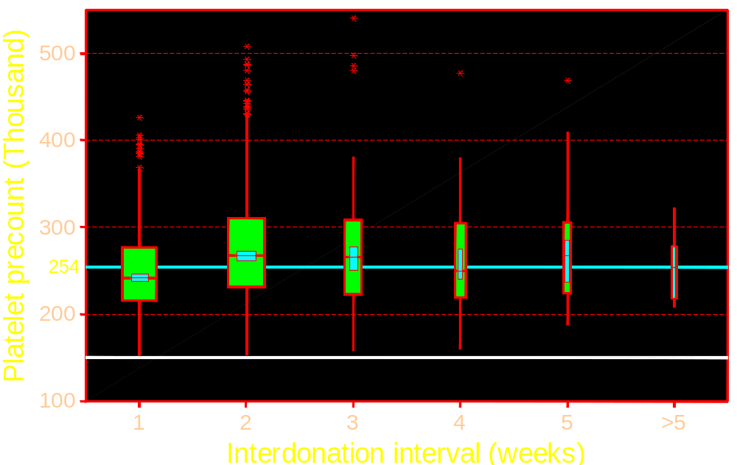
Precount vs. interdonation interval
MVRBC 24K donors 2005

Slide 32
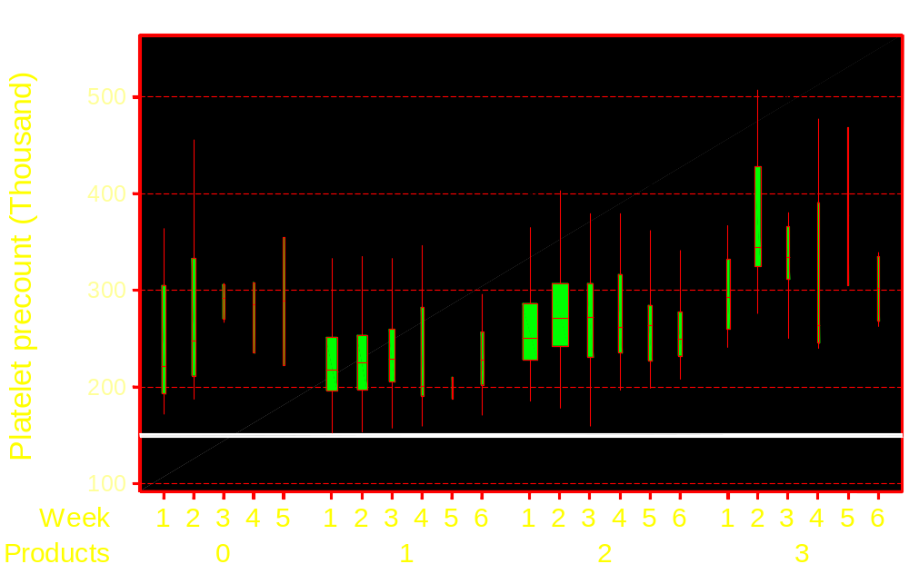
There is no reason to specify interdonation intervals according to components produced
60 MVRBC 24K donors 2005

Slide 33
Plasma volume losses
“…(V)olume (excluding anticoagulant) collected from a donor during a 12-month period should not exceed:
  12 liters (12,000 mL) for donors weighing 110-175 lbs
  14.4 liters (14,400 mL) for donors weighing more than 175 lbs”
There is concern about the impact of high volume plasma removal on plasma protein concentrations
Collection facilities will commit to provide FDA data on total protein and albumin levels in frequent donors if this is requested

Slide 34
Guidance as published
Increased deferrals for ASA and NSAIDs problematic and evidence base is not compelling
Close 3/4 MVRBC plateletpheresis sites
  No Dr. available in 15 minutes
  >67% loss of components
499/500 negative cultures to validate 100% QC
  True bacteremic donors in that interval are success! False negatives remain of concern
>12.5% loss from restriction on products v. procedures
  All 60 24K donors had all pre-counts >150,000
  Platelet counts stable with frequent donation

Slide 35
Recommendations
Amend changes for ASA and NSAIDs
  36º for ASA is supported by limited data,
  none needed for short T_{1/2} NSAIDs, longer for piroxicam et al (prolonged T_{1/2}) also not established
Drop physician attendance requirement
Drop “validation” requirements for bacterial culture.
  Centers with higher rates of positivity will investigate and remediate processes that contribute to false positives
Drop limit on components collected
  Further data on both platelet counts (and platelet mass?) in frequent donors can be collected and provided to the agency to confirm those presented
No need for post-platelet counts

Slide 36
Acknowledgment
Kim Palmer MVRBC
Kay Gregory AABB
Anne Eder ARC
Ed Notari ARC
German LeParc Florida Blood Services
Susan Wilkinson Hoxworth Blood Center
Celso Bianco ABC
Larry Dumont Gambro BCT
Susan Leitman NIH

