Slide 1

Knowledge Management (Knowledge Sharing): A Quick Tutorial and A Look at KM Activities at GSFC
Jay Liebowitz
Knowledge Management
Officer, NASA Goddard

Slide 2
Reversing the Paradigm
OLD:Knowledge is power
NEW: Sharing K is power
80% of the Fortune 500 companies have KM teams and 25% have CKOs (Chief Knowledge Officers)
Dr. Remez, first CKO in the US gov’t (GSA)(now CKO at AARP)/CIO Council Subcom. on KM
SSA, FCC, HCFA, GAO, NASA, military, NSA, GSA, etc. (km.gov)

Slide 3

How Can It Be Done?
Motivate and Reward/Incentives
Build a supportive culture
Actively involve the CEO and senior management
Brute Force (?)--Annual Review

Slide 4

KM Efforts Could Miss the Strike Due to:
Lack of integration of KM strategy with strategic and business goals of the organization
Lack of commitment and active involvement of senior mgt
Poor KM plan

Slide 5

Communications: Formal VS Informal
Tacit to explicit
Formal knowledge repository
70-80% of learning may be informal (Prusak, IBM/Davenport, Accenture)
Knowledge fairs
Need a combo

Slide 6

Knowledge Management
The process of creating value from an organization’s intangible assets
Human capital
Structural capital
Customer capital
brint.com
eknowledgecenter. com

Slide 7

Knowledge Organization
Best leverage knowledge internally and externally
Creating, capturing, securing, combining, transferring, distributing, managing knowledge

Slide 8

Knowledge
Data--dispersed elements
Information--patterned data
Knowledge--capability to act (Hubert St.Onge)
Expertise/Wisdom?

Slide 9

Types of Knowledge
Procedural
Declarative
Episodic/case-based
Meta-knowledge
Anecdotes, war stories, heuristics, best practices, insights, lessons learned, cases, etc.

Slide 10

Potential Pitfalls
Family gems--security
Unwieldy K repositories--maintenance
Integrate within mission/vision
Validity/measure-ment of knowledge

Slide 11

Fact or Fiction?
Knowledge Management is NEW

Slide 12

Fact or Fiction?
Knowledge management is the next buzz word after Y2K

Slide 13

Fact or Fiction?
Knowledge management=Information management

Slide 14

Fact or Fiction?
Knowledge management=Mostly technology

Slide 15

Fact or Fiction?
Knowledge management=Human capital+Structural capital+Customer capital

Slide 16

Fact or Fiction?
Knowledge management=Lotus Notes

Slide 17

Fact or Fiction?
Knowledge management=“Sharing knowledge is power” versus “Knowledge is power”

Slide 18


Fact or Fiction?
Knowledge management=Codification and Personalization strategies

Slide 19

Fact or Fiction?
Knowledge management has rigorous, comprehensive methodologies, techniques, and tools in place

Slide 20

Fact or Fiction?
Almost every IT vendor is now calling its product a “knowledge management” tool

Slide 21
You know you are in trouble when...
The average age of your employees is fairly senior
You haven’t done a good job of documenting processes and capturing knowledge
Your competitors seem to have an edge on you and may also be engaged in KM efforts

Slide 22
You know you are in trouble when...
There doesn’t seem to be a mentoring program to help share and transfer K between the experts and novices (newcomers) in the organization
Little funding has been put into employee training and development
One part of the organization doesn’t know what the other part is doing--even if working in a similar domain

Slide 23
You know when you are in trouble when...
You spend a good part of the day looking for information that has been misplaced
You don’t feel you have the time to chat with your colleagues in the organization in an informal way
Many of your knowledgeable employees are leaving the firm either through early buy-outs, better job offers, or other reasons

Slide 24
The Need for KM in the Government
“The government is experiencing a ‘human capital’ crisis. Half of its workers will be eligible to retire in the next few years, the average employee age is 46, and many agencies suffer from imbalances of available talent and and needed skills.” The Washington Post, Cover Story, Aug. 26, 2001

Slide 25
KM Approach at GSFC
Formalized and Systematized Knowledge Capture
--Goddard KM Working Group (http://pbma.hq.nasa.gov)
--knowledge preservation project http://fpd.gsfc.nasa.gov/cd/video.html#Madden
--case studies of successful & unsuccessful projects/best practices—http://appl.nasa.gov
--lessons learned (LLIS/NGLLIS)—http://llis.nasa.gov
--exit interviews (involving GRAA)
--Systems Review Checklists
--tutorials/mini-courses/colloquia
--codification of explicit knowledge (Library) http://ISandTcolloq.gsfc.nasa.gov/pastspeakers.htm

Slide 26
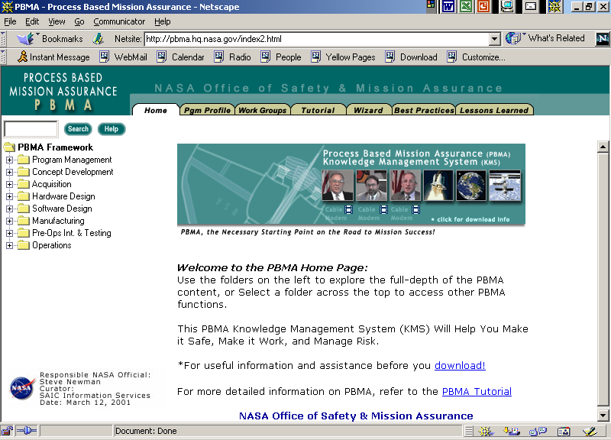
PBMA KMS (http://pbma.hq.nasa.gov)

Slide 27
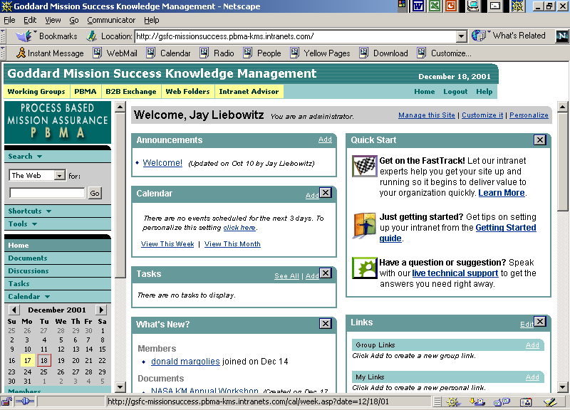
Online Community via PBMA

Slide 28
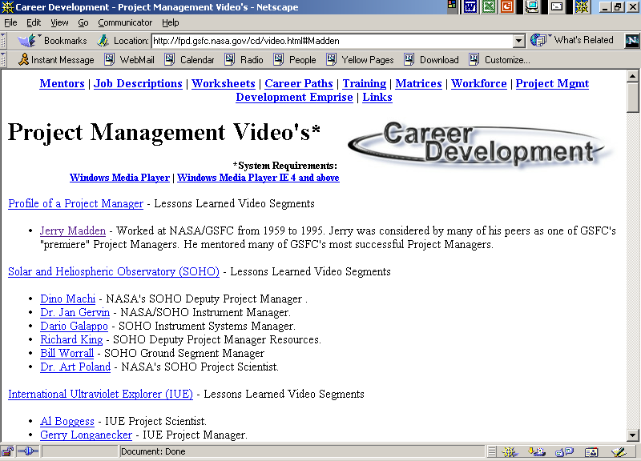
Capturing and Disseminating GSFC Knowledge

Slide 29
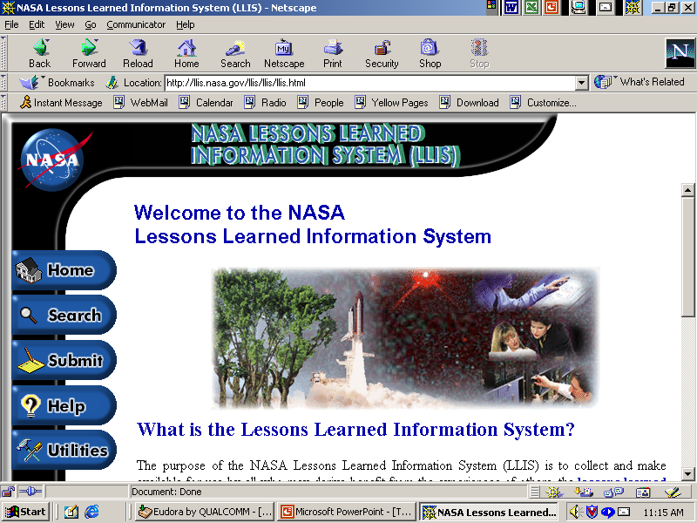
LLIS Welcome Page
(“Push” Feature)

Slide 30
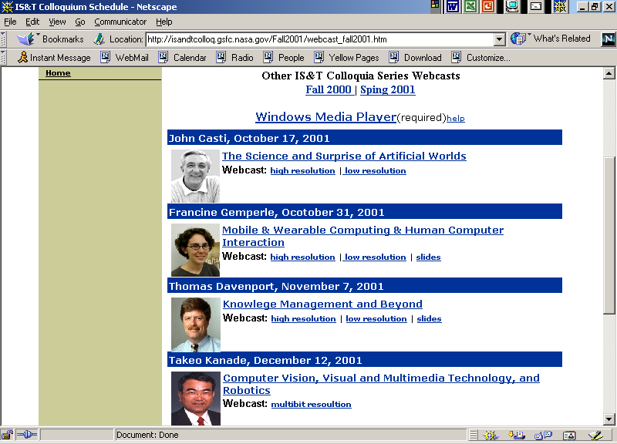
Webcasts of Colloquia

Slide 31
KM Approach at GSFC
Creation of a more unified knowledge network
myGoddard Knowledge Sharing Portal (myGoddard.gsfc.nasa.gov)
--People Connections
--MyExperts (Know-Who Directory)
--Communities of Practice/PBMA-KMS (http://pbma.hq.nasa.gov)
--Mentoring
--OHR
-- Knowledge Base
--Goddard Directory of Projects (Library)
--Webcasts of Colloquia (Library)
--Knowledge Preservation Project (Video Nuggets)/PBMA
--Goddard Mini-Courses (e.g., Code 500)
--Links to Goddard Library, FPPD Web-Based Library, PMWG, etc.
--Lessons Learned
--Case Studies (MAP, WIRE, VCL, etc.)
--NASA LLIS
--Links to APPL, etc.

Slide 32
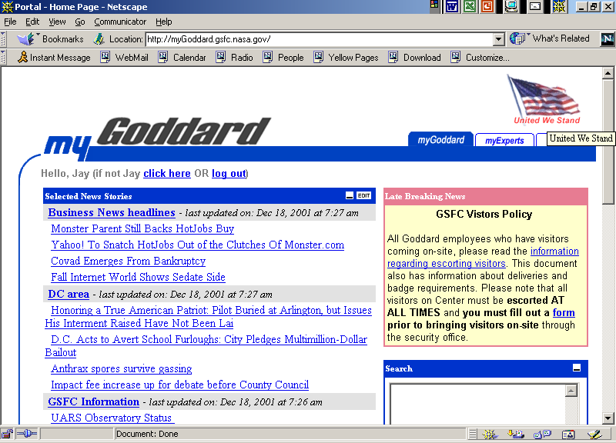
myGoddard (http://myGoddard.gsfc.nasa.gov)

Slide 33
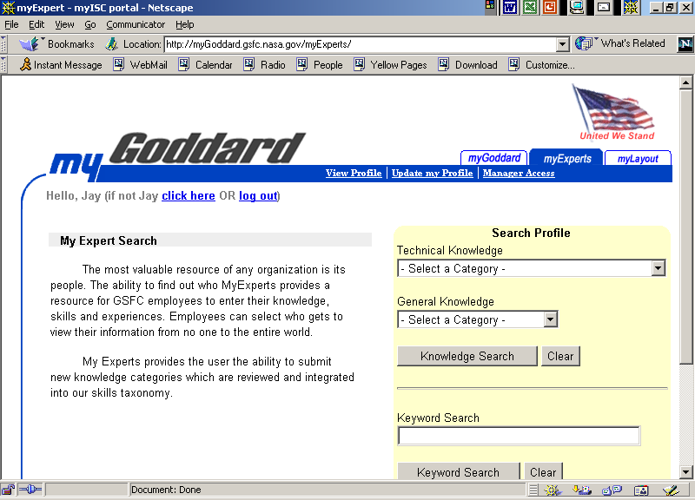
myExperts

Slide 34
KM Approach at GSFC
Strengthen Incentives to Reuse Knowledge
--knowledge sharing forums (APPL—Nov. 13 at Goddard; knowledge swaps; tea & poster sessions; brown bag lunches)
--Knowledge Sharing Day at Goddard (possibly?)
--learning and knowledge sharing proficiencies (HQ study—started Jan. 02)
--building and nurturing a knowledge sharing culture (mentoring program, online comm.)
--KM education/awareness (Tom Davenport, Nov. 7, IS&T Coll.; Goddard KMWG)

Slide 35
KM Research Issues
--Develop “active” analysis and dissemination techniques for knowledge sharing and searching via “intelligent” agent technology (i.e., where “learning” takes place)
--Apply knowledge discovery techniques (e.g., data/text mining, neural networks, etc.) for mining knowledge bases/repositories
--Improve query capabilities through natural language understanding techniques
--Develop metrics for measuring value-added benefits of knowledge management
--Develop standardized methodologies for knowledge management development and knowledge audits
--Provide improved techniques for performing knowledge mapping and building knowledge taxonomies/ontologies

Slide 36
KM Research Issues
--Develop techniques for building collaborative knowledge bases
--Develop improved tools for capturing knowledge from various media (look at multimedia mining to induce relationships among images, videos, graphics, text, etc.)
--Develop techniques for integrating databases to avoid stovepiping, functional silos
--Build improved software tools for developing and nurturing communities of practice
--Develop techniques for categorizing, synthesizing, and summarizing lessons learned (look at text summarization techniques)
--Explore ways to improve human-agent collaboration
--Explore human language technologies for KM (input analysis, extraction, question-answer, translation, etc.—see S. Staab, Nov/Dec 2001, Intelligent Systems)

Slide 37

Summary
KM is one of the hottest topics in industry & govt today
Need to have methodologies, processes, techniques, and tools for KM
90% is building the culture
Need to apply concepts from AI and other disciplines to advance KM

Slide 38
References to Get Started
Liebowitz, J. and T. Beckman (1998), Knowledge Organizations: What Every Manager Should Know, CRC Press, Boca Raton, FL.
Liebowitz, J. (ed.)(1999), The Knowledge Management Handbook, CRC Press.
Liebowitz, J. (2000), Building Organizational Intelligence: A Knowledge Management Primer, CRC Press.

Slide 39
Other References
Davenport, T. and L. Prusak (1998), Working Knowledge, Harvard Business School Press
Cortado, J. and J. Woods (1999), Knowledge Management Yearbook 1999-2000.
Journal of Knowledge Management/Journal of Int. Capital (MCB University Press)
Journal of Knowledge and Process Management (John Wiley)
Knowledge Management Magazine
KMWorld
THANKS!!

