Slide 1
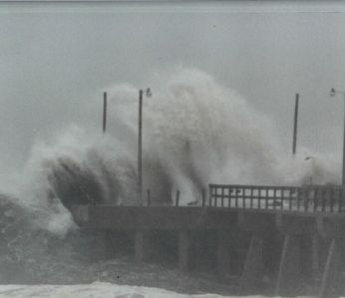


Visualizing Hurricane Rita Inland Storm Surge
Prepared by Ben McGee, Brian McCallum, Charles Berenbrock, Dean Gesch, Marge Davenport, and Robert R. Mason, Jr.
U.S. Geological Survey

