Slide 1


Plans for the
National and Central Region
Climate Services Web Pages
Ray Wolf
Science and Operations Officer
NOAA/National Weather Service
Davenport, Iowa

Slide 2
National Climate Web Team chartered in May 2003
Members from all NWS regions
Members from all NWS structure levels
NWS CIO rep
NCDC rep

Slide 3
Team Charter
Consistent design
Consistent content
Applies to NWSH – Regions - WFOs
Phase 1 – focus on current products

Slide 4
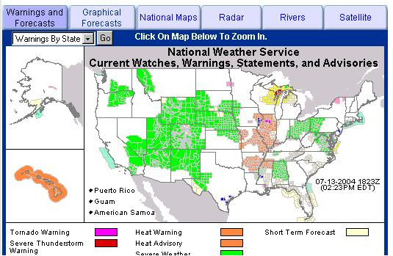
National Climate Page
Add new “Climate” tab

Slide 5
National Climate Page
Left menu bar links to
  Past weather (national climate page)
  NCDC
  CPC
  Glossary
Dynamic max/min temp/precip maps
Maps clickable down to the WFO level
NCDC disclaimer > certified data
Glossary of Terms in development

Slide 6
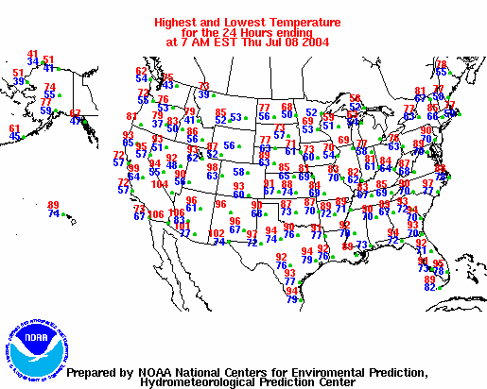
National Climate Page
Toggle Max/Min Temp or Precip

Slide 7
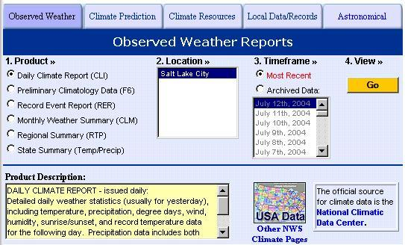
WFO Climate Page
Western Region prototype page similar to Phase 1 implementation

Slide 8
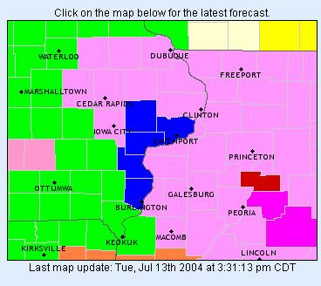

WFO Climate Page
Similar to National Page plus more
Entry map with LCD and other climate sites

Slide 9
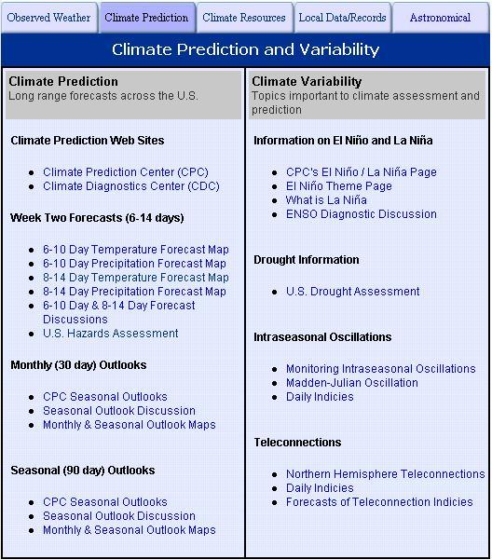
WFO Climate Page

Slide 10
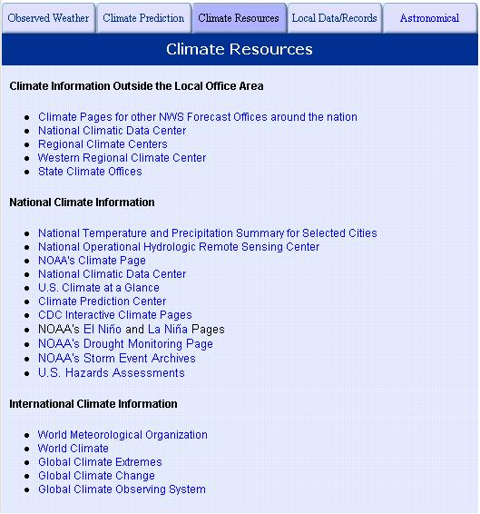
WFO Climate Page

Slide 11
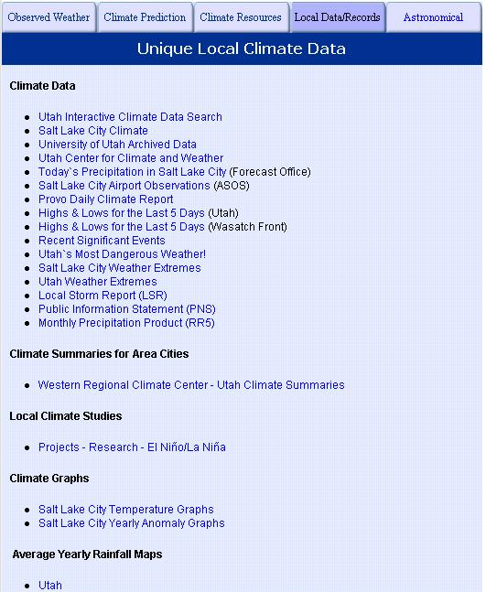
WFO Climate Page

Slide 12
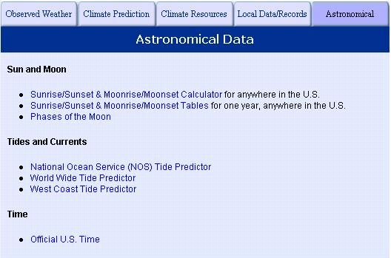
WFO Climate Page

Slide 13
Central Region
Climate Web Team
Purpose – value add to national template
11 members from various offices/backgrounds
Provide input for future national page updates
Support other regional climate teams
Work with existing/future partners/customers

Slide 14
Timelines
National Design team established 5/2003
Regional team established 5/2004
National team submits requirements 6/2004
National Implementation team established 7/2004
Templates submitted for use 1/2005
Feedback period
Regional team enhancements – continuous
  Inventory of CR climate web pages

